Slide 1
Plastic Auto Part Development
December 24, 2018
Anbo CAO, Feng CUI, Chendi JIANG
Notes:
此页可以删除

Slide 2
Contents
1
Introduction
2
Topo-optimization
3
Reconstruction of the model
4
Result & Conclusion

Slide 3
Contents
1
Introduction
2
Topo-optimization
3
Reconstruction of the model
4
Result & Conclusion

Slide 4
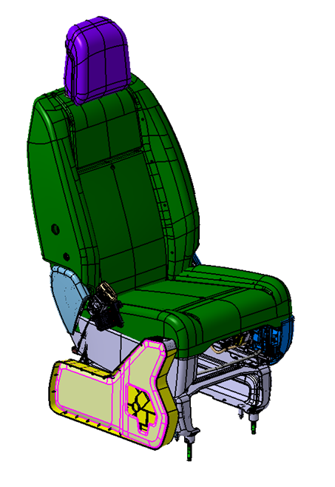
Problem discription
A plastic bracket to mount “Electrical Park Brake” switch button

Slide 5
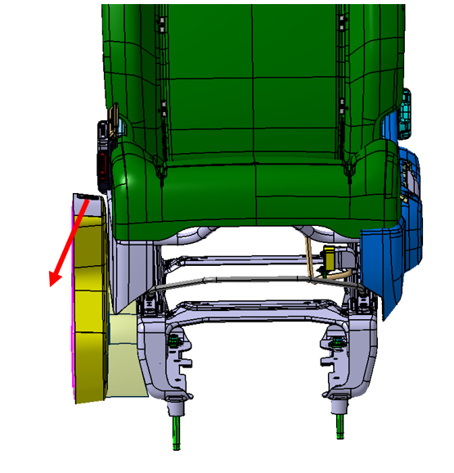
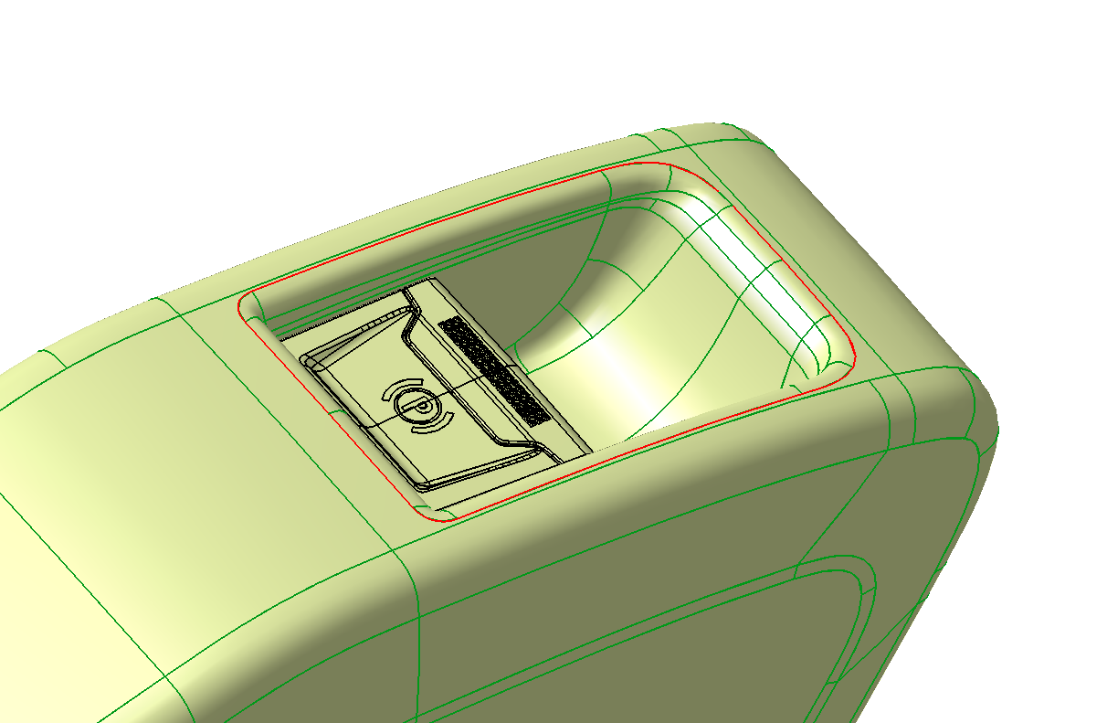
Load definition
F=750N
33º

Slide 6
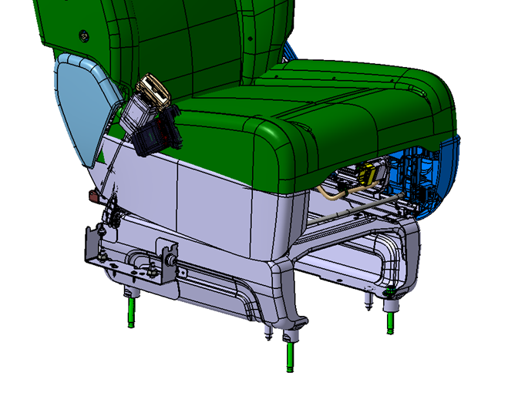
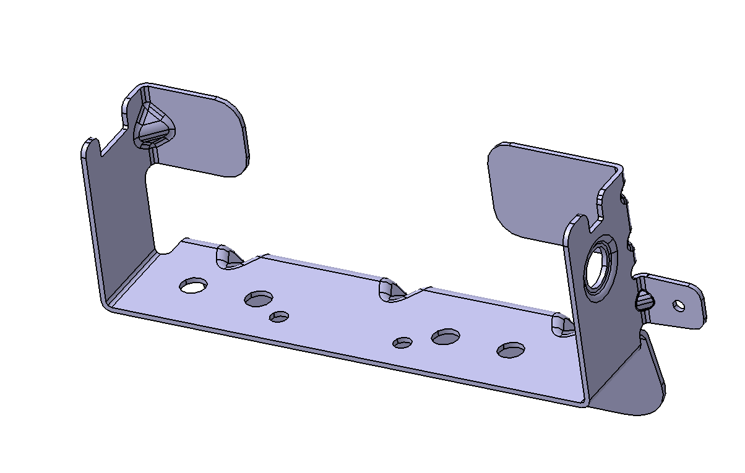
Constraint definition
Rigid

Slide 7
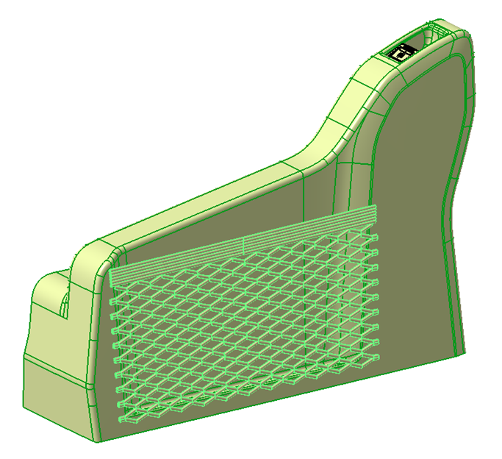
Main needs
Displacement: < 2mm
Bracket to deco box inner surface distance ≥ 5mm
Deco box wall thickness = 2.5mm

Slide 8
Contents
1
Introduction
2
Topo-optimization
3
Reconstruction of the model
4
Result & Conclusion

Slide 9
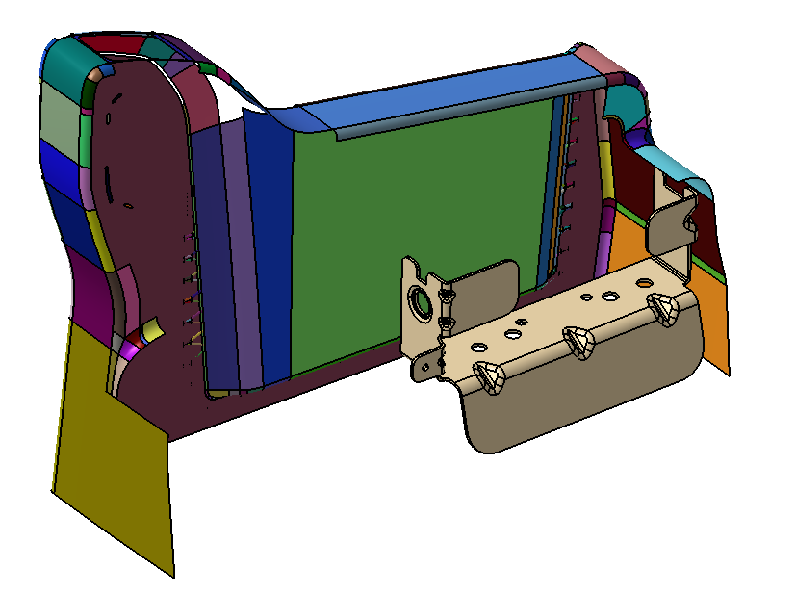
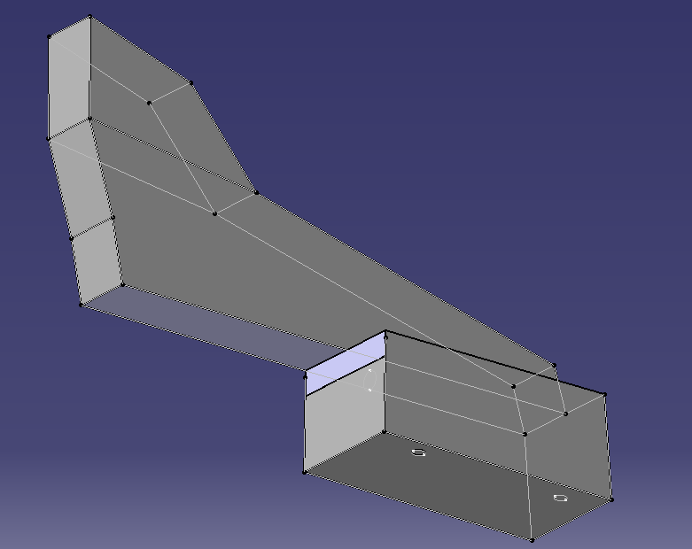
Original model
Console model
Original model

Slide 10
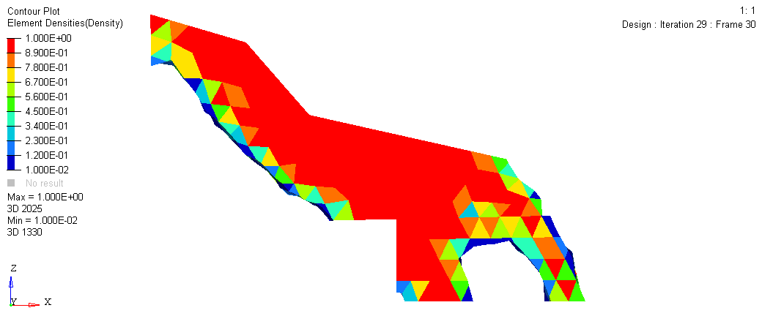
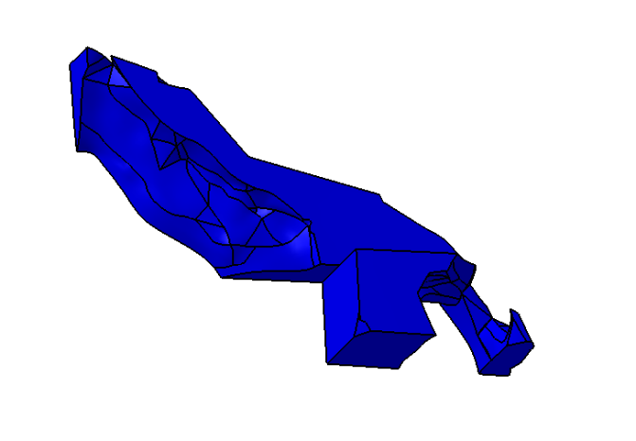
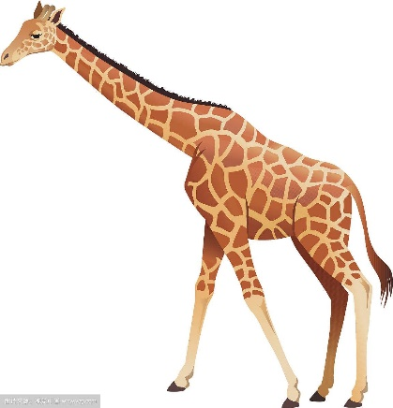
Topo-optimized model

Slide 11
Contents
1
Introduction
2
Topo-optimization
3
Reconstruction of the model
4
Result & Conclusion

Slide 12
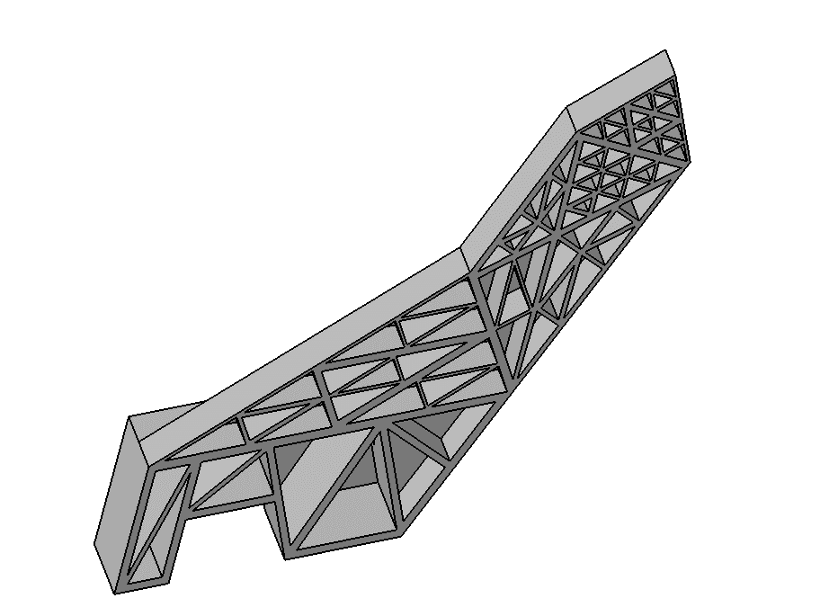
Design based on the optimized result
Shape the model to fit the console
Hollow out
Reinforcement by bars
Repeat the steps before to meet the needs

Slide 13
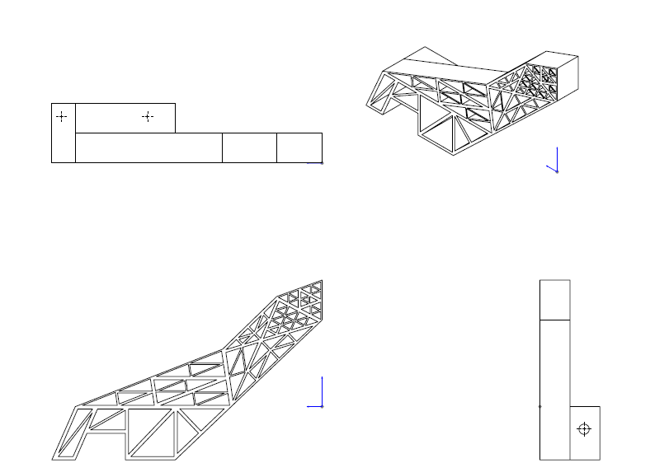
View of the model in 4 directions

Slide 14
Selection of material
Name | Tensile Modulus(Gpa) | Density(g/cc) | Source
Eurostar Starpylen MX06050 PP, 30% Glass Filled, Injection Molded | 5.7 | 1.12 | http://matweb.com/search/DataSheet.aspx?MatGUID=249d6a3ff64348e099ee2d9be629434e
PolyOne OnForce™ LFT PP-30 LGF/000 Natural PP Homopolymer with 30% Long Glass Fiber | 5.52 | 1.12 | http://matweb.com/search/DataSheet.aspx?MatGUID=588405dc61de489e953e23dfeebf4490
Celanese Celstran® +PP-GF30-04CN02/10 PP, 30% Glass Reinforced | 6.8 | 1.13 | http://matweb.com/search/DataSheet.aspx?MatGUID=d55780122e1946fe83536252e4ff63a5
Celanese COMPEL PP-GF30-04 PP, Glass Reinforced | 7.2 | 1.12 | http://matweb.com/search/DataSheet.aspx?MatGUID=d63691b9b8064590b23886de21c2beb3
RTP Company RTP 199 X 135006 A Polypropylene (PP) Glass Fiber - Flame Retardant - Non-PBB/PBDE | 6.89 | 1.51 | http://matweb.com/search/DataSheet.aspx?MatGUID=02cf7c08c06148bea347505aa29d0d81
RTP Company RTP 199 X 129987 B Polypropylene (PP) Glass Fiber - Chemically Coupled - Flame Retardant - Non PBB/PBDE | 7.58 | 1.54 | http://matweb.com/search/DataSheet.aspx?MatGUID=5e0a6f83e65a41dd8bf96504c6775f8d
RTP Company RTP 103 CC FR UV Polypropylene (PP), Glass Fiber Reinforced - Flame Retardant - UV Stabilized | 6.21 | 1.43 | http://matweb.com/search/DataSheet.aspx?MatGUID=21ff3d34204c4c36a1baed6ad2e6f46c
Plastcom SLOVALEN PH 69 GF 40 TS PP reinforced with 40% glass fibre, with modification of mechanical properties and thermal stabilization | 9.5 | 1.15 | http://matweb.com/search/DataSheet.aspx?MatGUID=ad4e5b0fb04b4d63b5cf12816fe48b6d
Plastcom SLOVALEN PH 49 GF 60 PP reinforced with 60% glass fibre | 12.8 | 1.44 | http://matweb.com/search/DataSheet.aspx?MatGUID=4407502b1ac0444e973cf836bbc6aeeb
RTP Company ESD 187 HF Polypropylene (PP) Carbon Fiber - High Flow - Electrically Conductive | 21.4 | 1.15 | http://matweb.com/search/DataSheet.aspx?MatGUID=c818439aedc241138d9ce5f0f086e947
RTP Company ESD 182 Polypropylene (PP), Carbon Fiber - Electrically Conductive | 8.27 | 0.97 | http://matweb.com/search/DataSheet.aspx?MatGUID=bac007a4be2e416da91f69e97cc18df3
RTP Company RTP 183 HI Polypropylene (PP), Carbon Fiber | 8.27 | 0.99 | http://matweb.com/search/DataSheet.aspx?MatGUID=30fa952597844370a894d50a1edd6a73
RTP Company ESD C 180 Polypropylene (PP), Carbon Fiber - ESD Protection - Electrically Conductive | 5.52 | 0.96 | http://matweb.com/search/DataSheet.aspx?MatGUID=85d2ad56a66345369fddcdba8e031bc4
RTP Company RTP 183 TFE 15 Polypropylene (PP), Carbon Fiber - PTFE Lubricated | 11.4 | 1.1 | http://matweb.com/search/DataSheet.aspx?MatGUID=96dde220e262486caebe3c1044d93718
The material we select | Tensile modulus (Gpa) | Density (g/cc) | Poisson ratio
PP | 12.8 | 1.44 | 0.4

Slide 15
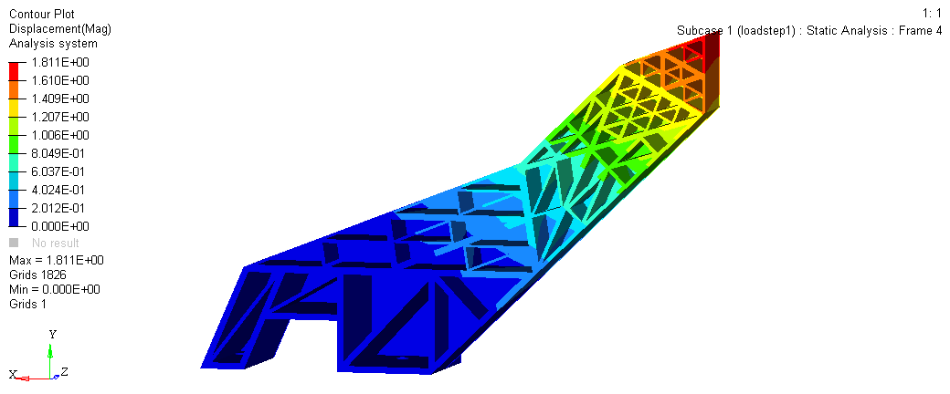
Verification of the design
Max displacement ≈ 1.8mm

Slide 16
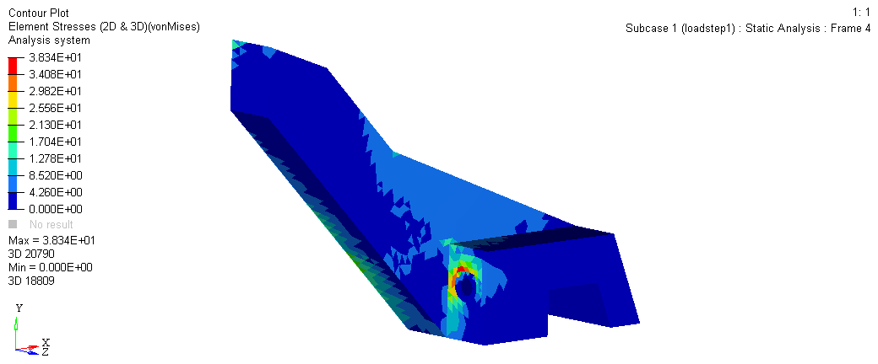
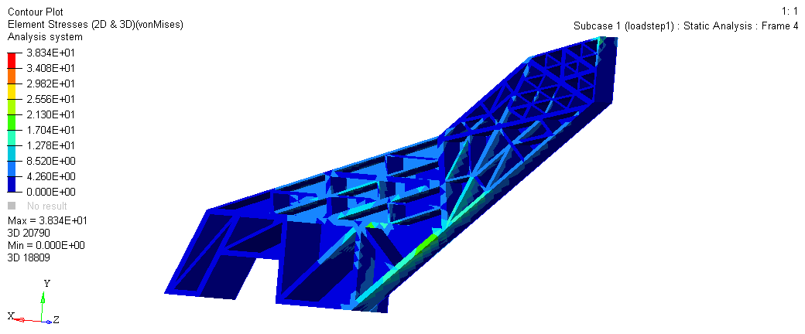
Verification of the design
Max stress ≈ 38.34MPa

Slide 17
Contents
1
Introduction
2
Topo-optimization
3
Reconstruction of the model
4
Result & Conclusion

Slide 18
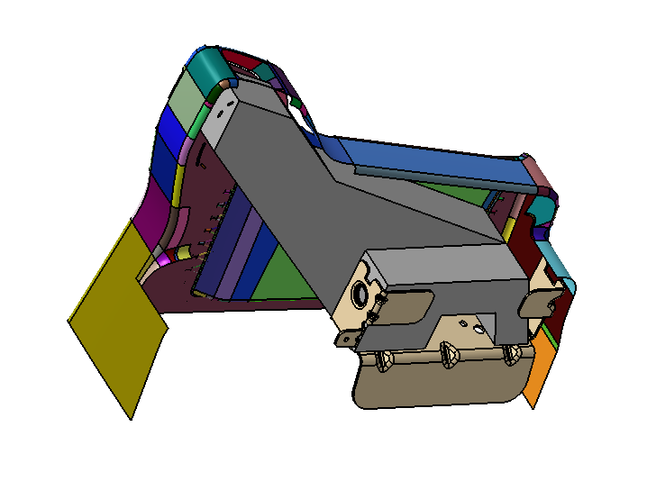

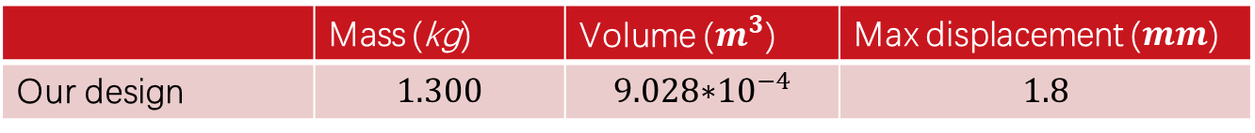
Result
 | Mass (kg) | Volume ($m^{3}$) | Max displacement ($mm$)
Our design | $$1.300$$ | $${\text{9.028∗}10}^{−4}$$ | $$1.8$$

Slide 19
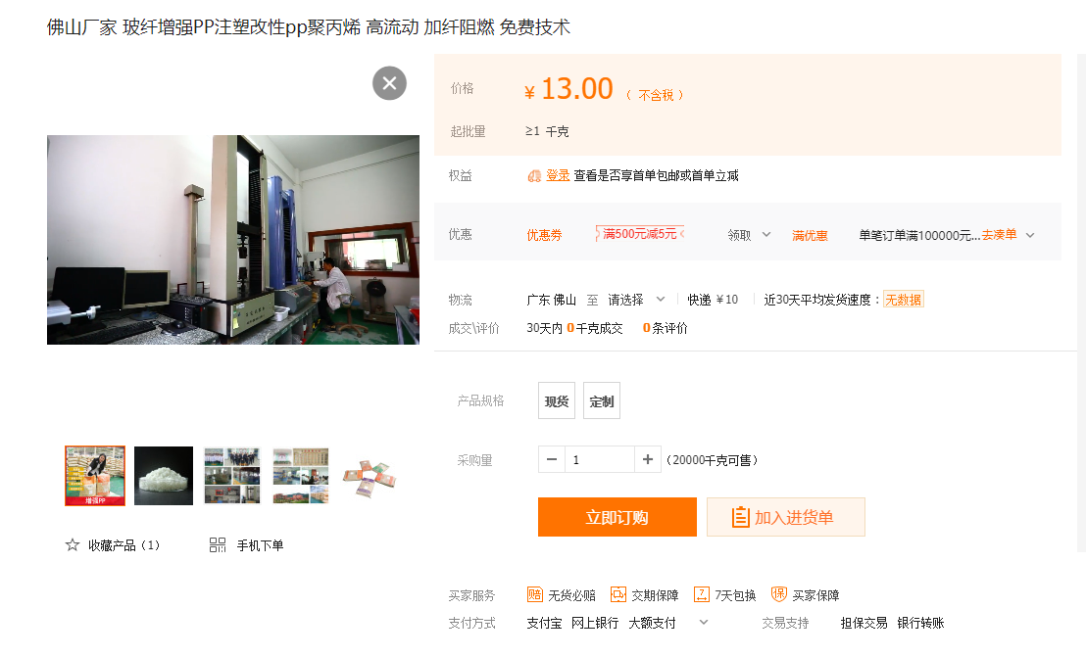
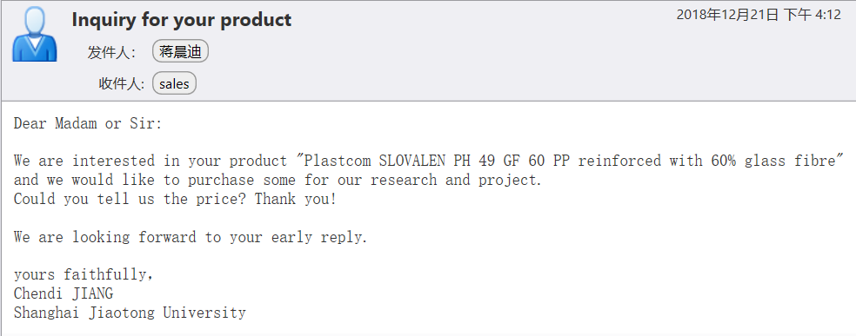
Price of the material
Still waiting for their response …

Slide 20
Conclusion
The reinforcement with bars is efficient in increasing the stiffness of the model.
Triangle structure is quite stable.
The specific stiffness of the material is an important factor. A more appropriate material may be chosen to replace the present one.

Slide 21
Thank you !

