Slide 1

ANDL
Sagar, Atilla, Manu, and Neel

Slide 2

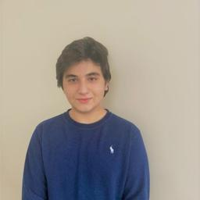


Meet ANDL
Sagar
Atilla
Manu
Neel

Slide 3
“Artificial Intelligence is not a substitute for human intelligence. It is a tool to enhance human creativity and ingenuity.”
Dr. Fei Fei Li - Professor and Co-Director Of Human-Centered Artificial Intelligence @Stanford University

Slide 4
The current issue with AI
The use of AI has become increasingly popular within education.

Slide 5
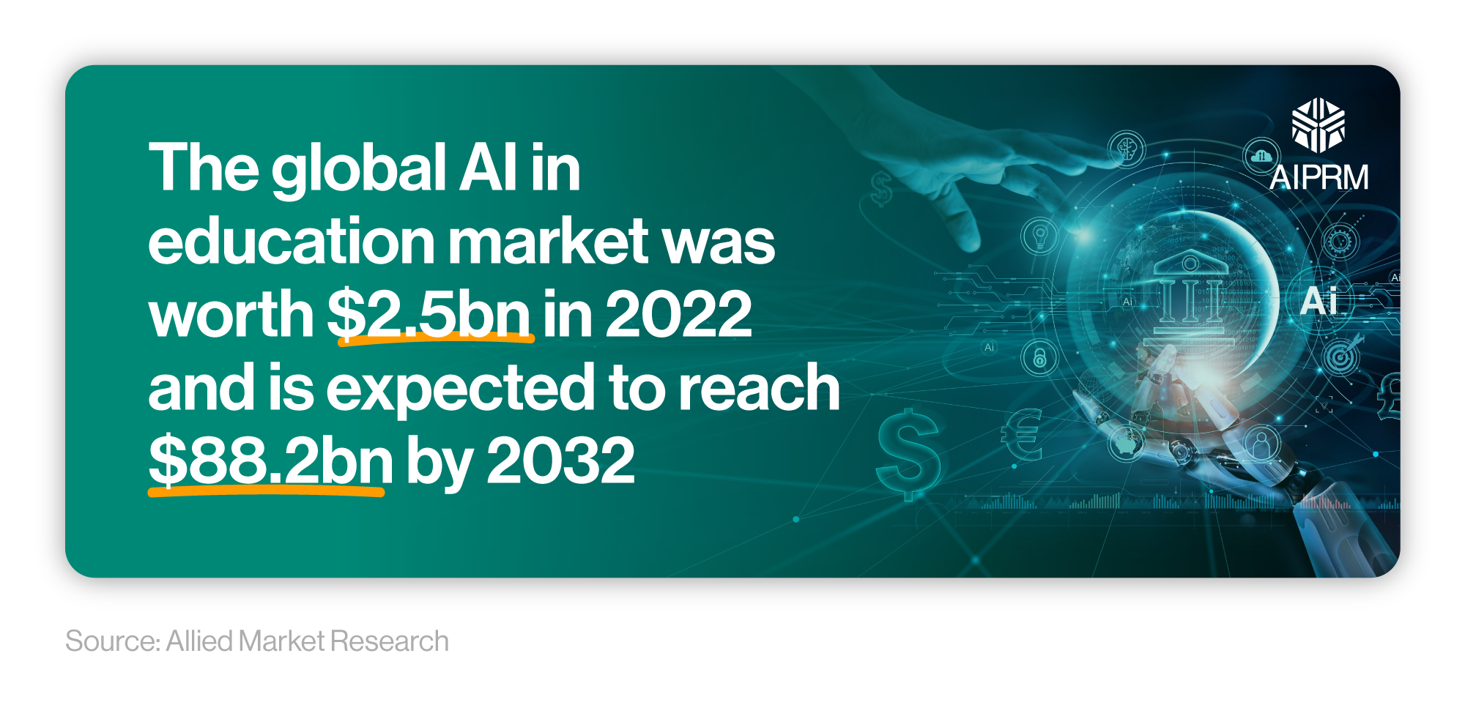

Slide 6
The current issue with AI
The use of AI has become increasingly popular within education.
But so has its misuse.

Slide 7
~35%
~70%
Student decline in critical thinking and decision-making.
AI tools exhibit biases affecting education quality.
Source: Zhai, C., Wibowo, S. & Li, L.D. The effects of over-reliance on AI dialogue systems on students' cognitive abilities: a systematic review. Smart Learn. Environ. 11, 28 (2024). https://doi.org/10.1186/s40561-024-00316-7

Slide 8
The current issue with AI
The use of AI has become increasingly popular within education.
But so has its misuse.
How can educators and students navigate AI appropriately?

Slide 9
Meet ANDL

Slide 10
Hybrid human-AI Decision Making
Responsible & Explainable AI
for Education
Peer-to-Peer Collaboration

Slide 11



ANDL’s Components
Conversational Interface
Community Forum
Analytics Dashboard

Slide 12
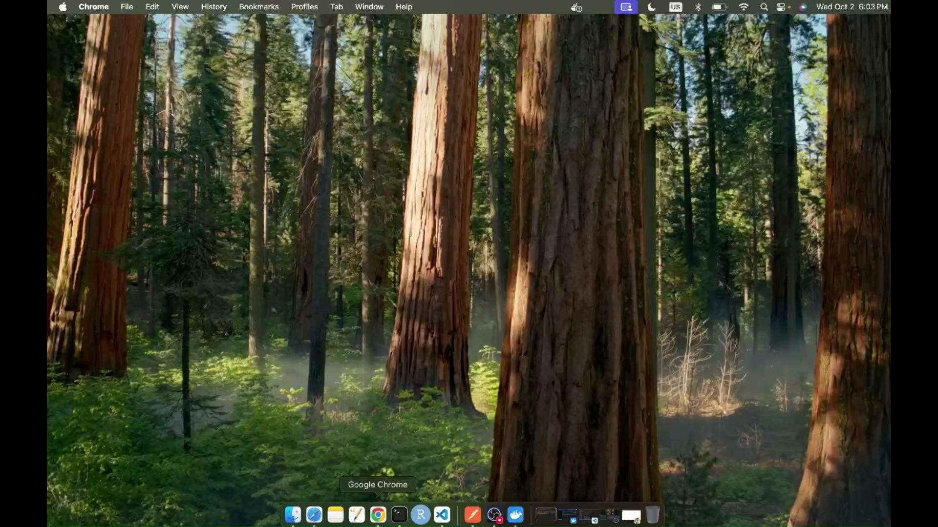
Demo
https://drive.google.com/file/d/14ousLn6Au-s1bwzqORwqhtqN9PTVNvUx/view?usp=sharing

Slide 13
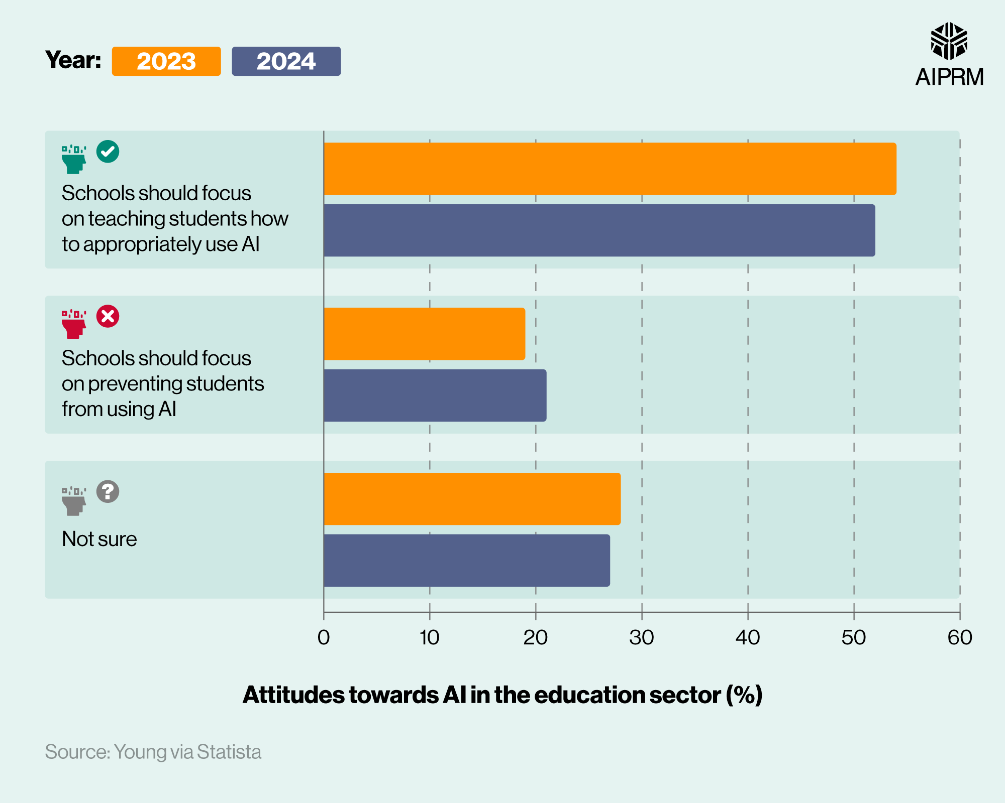
Educators need this.

Slide 14



✓ | ✓ | ✓
✗ | ✗ | ✓
✓ | ✓ | ✓
✓ | ✗ | ✓
✓ | ✗ | ✗
Model Fine Tuning
AI Clarity Modules
Learning Platform
AI regulation
Homework Helper AI

Slide 15
Roadmap
Initiative | Objective | Sep | Oct | Nov | Dec | Jan | Feb
Market Research | Problem analysis, market-fit, value-proposition.
User Discovery | Talk to potential users (students and professors) to understand problem better.
Develop a MVP | MVP for alpha testing.
Usability Testing | Conduct user tests for the product and iterate.
Investor Search | Pitch ANDL to investors and institutions.

Slide 16



The Future with ANDL
Structured Inputs
Curricula-specific Models
Reinforcement Learning

Slide 17
Join Us Towards
Responsible & Explainable AI
for Education
andl.io

Slide 18
Contact Us!
Sagar
Atilla
Manu
Neel
sagar@andl.io
atilla@andl.io
manu@andl.io
neel@andl.io
https://www.linkedin.com/company/andl-ai/

