Slide 1
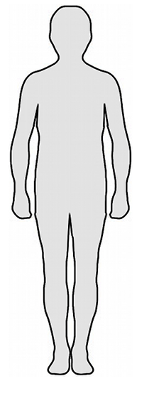
Sensation Mapping Task
Welcome to the sensation mapping task
You will make responses that show where your bodily sensations occur during different scenarios within a typical university setting.
The task requires you to identify any perceived changes in physical sensation in response to the presented scenario.
Physical sensation means where you feel things in your body. For example, if you have a headache you would feel that in your forehead. If you have a lot of nerves and your heart is racing you would feel that in your chest. If you are really cold and your fingers are going numb you would feel that in your hands.

Slide 2
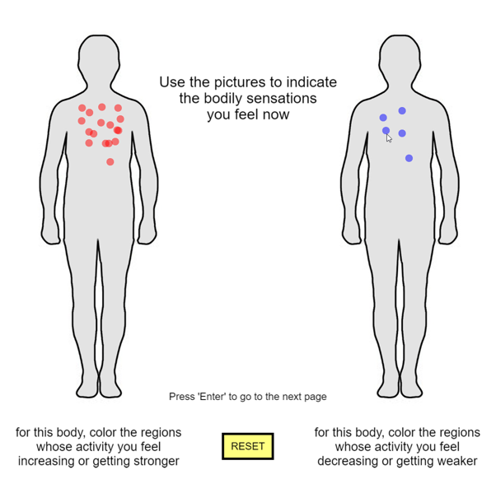
Sensation Mapping Task
You can mark the change of your bodily sensation by mouse click on the body picture
In the left body, you can check the regions whose activity you feel increasing or getting stronger. It will be marked as a red circle.
In the right body, you can check the regions whose activity you feel decreasing or getting weaker. It will be marked as a blue circle.
If you click RESET button, all marks will be removed from the figure, and you can restart marking
When you finish marking, press the ENTER key
Mark using
mouse click!!
Press ENTER to finish!
Press ‘Space bar’ to continue
Previous page
Next page

Slide 3
Sensation Mapping Task
Please respond to each scenario, based upon what is truly felt.
Try to put yourself in each scenario and imagine what your response is within your body.
There are no right or wrong answers – This is your subjective personal experience and anything you feel is ok.
Take your time with each scenario. Please ensure your marking are an accurate reflection of how your body feels when you imagine experiencing this scenario.
This exercise is not just about the most intense feelings but about all changes noticed in your body’s sensations, whether subtle or strong.

