Slide 1

Note: The data and information in this document is reflective of a hypothetical situation and client. This document is to be used for KPMG Virtual Internship purposes only.
Sprocket Central Pty Ltd
Data analytics approach
Melvin Alex Mathew Andoor

Slide 2
Note: The data and information in this document is reflective of a hypothetical situation and client. This document is to be used for KPMG Virtual Internship purposes only.
Agenda
Introduction
Data Exploration
Model Development
Interpretation

Slide 3
Identify the top customers to be targeted from the given Dataset
Note: The data and information in this document is reflective of a hypothetical situation and client. This document is to be used for KPMG Virtual Internship purposes only.
Introduction
Problem Definition:
Sprocket Central Pty Ltd is a specialist in a high-quality bikes and cycling accessories for the riders.
Their Marketing team is trying to boost the business by identifying the customer behavior and trends from the existing dataset.
With the given dataset the top customers to be targeted is to be recommended so as to drive higher value for the organization
Data Analysis:
Age Distribution of Old and New Customers
Past 3 years bike related purchases of Old and New Customers
Job Industry Distribution amongst the old and new customers
Cars owned and not owned in each state
Wealth segmentation by Age category of Old and New Customers
RFM Analysis and Customer Segmentation

Slide 4
Note: The data and information in this document is reflective of a hypothetical situation and client. This document is to be used for KPMG Virtual Internship purposes only.
Data Exploration
Data Quality Assessment
Summary Table
 | Transactions | Customer Address | Customer Demographic | New Customer List
Accuracy |  |  | Date of Birth: Not Accurate
Completeness | 1.Online Order Column:Blanks 2.Brand Column:Blanks |  | 1.Date of Birth: Blanks 2.Job Title: Blanks | 1.Date of Birth: Blanks 2.Job Title: Blanks
Consistency |  | States: Not Consistent | Gender: Not Consistent
Currency
Relevancy
Validity | Product first Sold Date:Format |  |  | 1.Past 3 year purchase column: Data in text format and not in Numeric format. 2.Postcode: Data in text format and not in Numeric format 3.Property valuation: Data in text format and not in Numeric format
Uniqueness |  |  |  | Rank Column: Duplicated

Slide 5
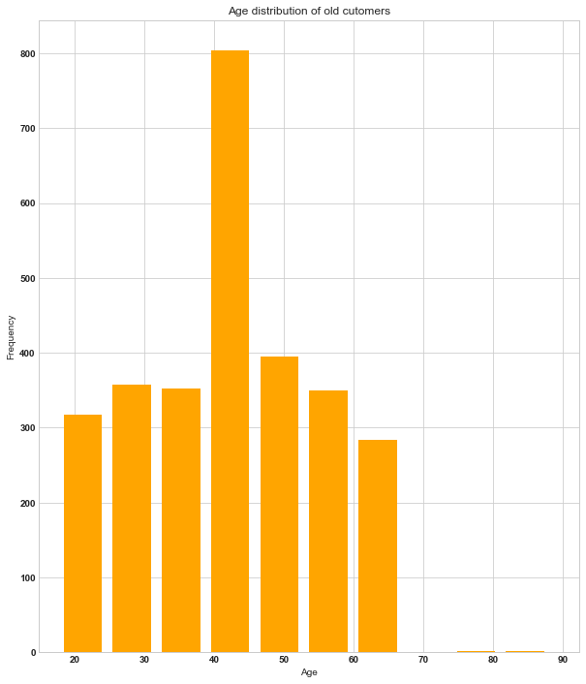
Note: The data and information in this document is reflective of a hypothetical situation and client. This document is to be used for KPMG Virtual Internship purposes only.
Data Exploration
Age Distribution of Old and New Customers
Old customers Age Distribution.
Most of the Old customers belong to the Age group of 40 – 60
The Least customers are aged below 20 and above 80
So what we can conclude is that the Majority of the Old Customers of Sprocket Central are Young and Middle Aged people

Slide 6
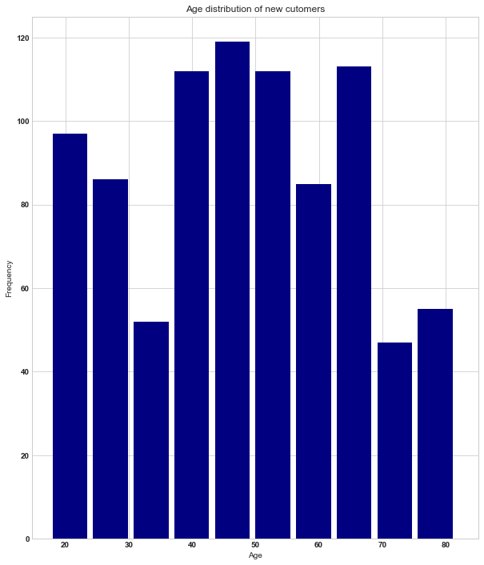
Note: The data and information in this document is reflective of a hypothetical situation and client. This document is to be used for KPMG Virtual Internship purposes only.
Data Exploration
Age Distribution of Old and New Customers
New customers Age Distribution.
Most of the New customers belong to the Age group of 40 – 60
The Least number of customers are aged between 30-40 and above 80
So what we can conclude is that the Majority of the Old Customers of Sprocket Central are Young and Middle Aged people
Between 30 – 40 age group we can see steep drop in the customers

Slide 7
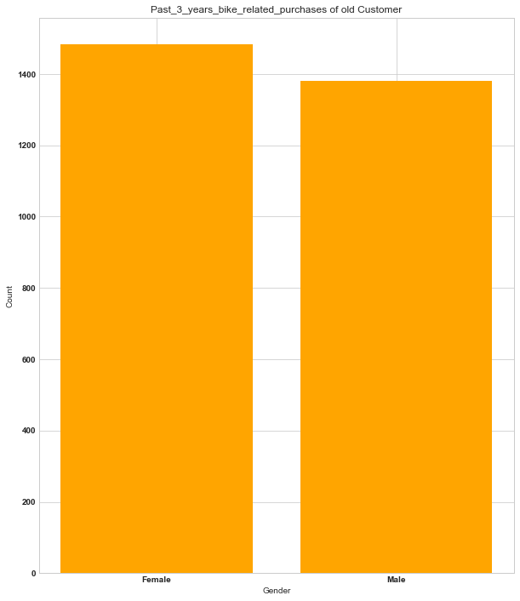
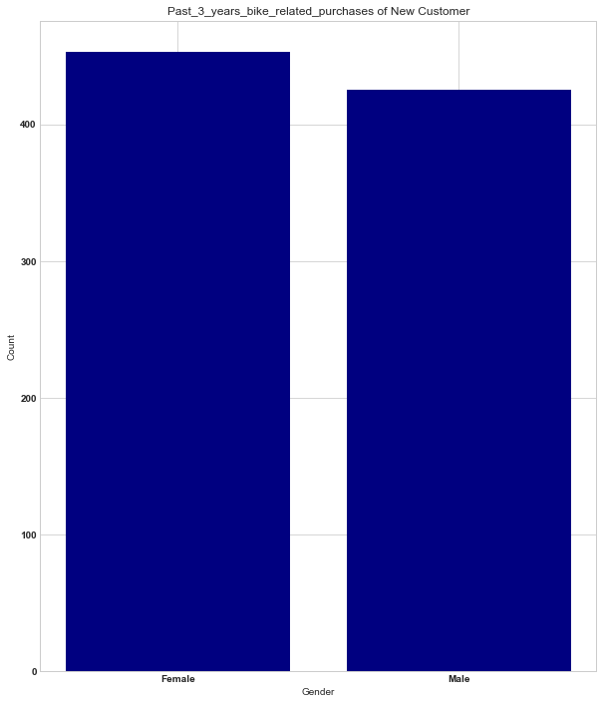
From the last 3 years purchase history we can conclude be it the New or the Old Customers Females have purchased the bikes more than the males So Females dominate the males in bike related purchases
Note: The data and information in this document is reflective of a hypothetical situation and client. This document is to be used for KPMG Virtual Internship purposes only.
Data Exploration
Past 3 years bike related purchases of Old and New Customers

Slide 8
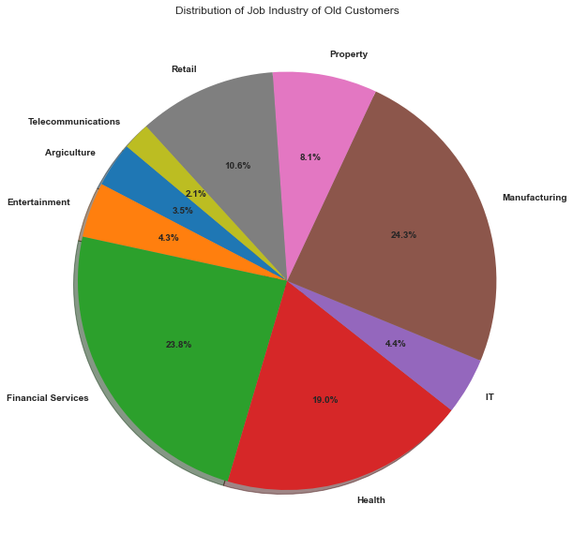
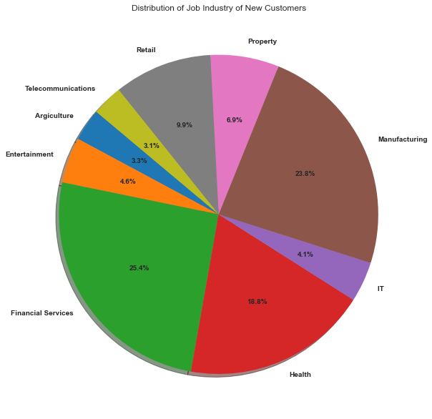
1. Majority of the old customers are from the Manufacturing Industry whereas it is from the Financial Services Industry that majority of the New Customers belong to. 2. Around 50% of the old and new customers are from the Manufacturing and Financial Services industry. 3. The Agriculture and Entertainment industry has the least old and new customers
Note: The data and information in this document is reflective of a hypothetical situation and client. This document is to be used for KPMG Virtual Internship purposes only.
Data Exploration
Job Industry Distribution amongst the old and new customers

Slide 9
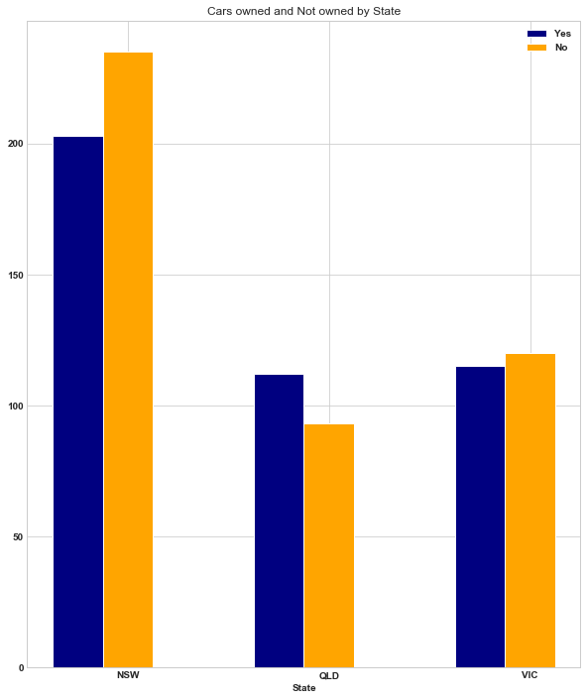
1. Majority of the Customers seems to be from the New South Wales state. 2. NSW has the greatest number of customers that don’t own a car. 3. Victoria State has almost the same number of cars owned and not owned. 4. QLD is the only state with high number of customers that own a car.
Note: The data and information in this document is reflective of a hypothetical situation and client. This document is to be used for KPMG Virtual Internship purposes only.
Data Exploration
Cars owned and not owned in each state

Slide 10
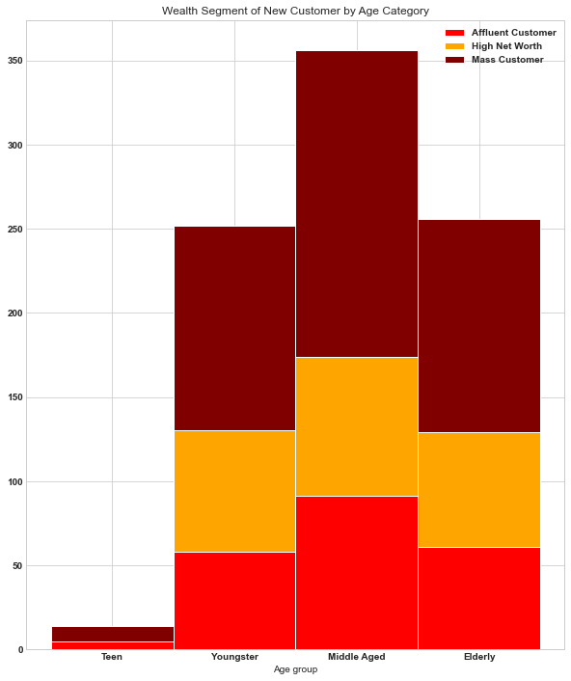
1.Amongst the New Customers in all the age groups the maximum customers are classified as Mass Customer 2. The next Largest category is the High Net Worth Customers 3.Only in the Middle age category the Affluent Customers are more than the High Net Worth Customers
Note: The data and information in this document is reflective of a hypothetical situation and client. This document is to be used for KPMG Virtual Internship purposes only.
Data Exploration
Wealth segmentation by Age category of Old and New Customers

Slide 11
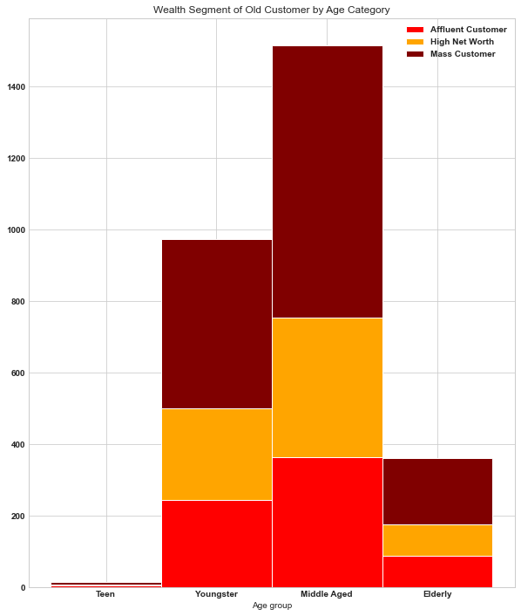
1.Amongst the Old Customers in all the age groups the maximum customers are classified as Mass Customer. 2. The next Largest category is the High Net Worth Customers 3.Only in the Elderly age category the Affluent Customers are more than the High Net Worth Customers
Note: The data and information in this document is reflective of a hypothetical situation and client. This document is to be used for KPMG Virtual Internship purposes only.
Data Exploration
Wealth segmentation by Age category of Old and New Customers

Slide 12
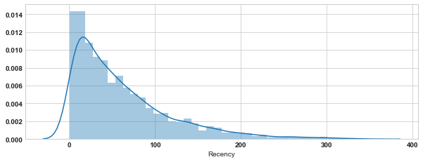
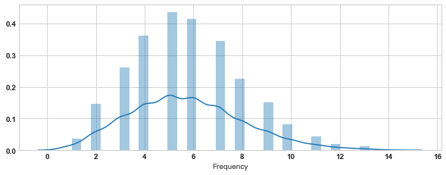
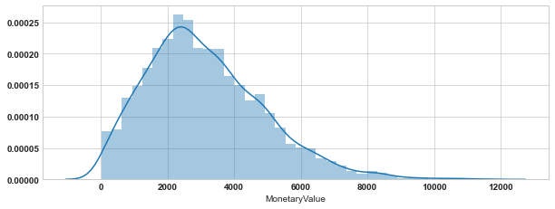
Note: The data and information in this document is reflective of a hypothetical situation and client. This document is to be used for KPMG Virtual Internship purposes only.
Model Development
RFM Analysis and Customer Segmentation
RFM analysis helps to find out those customers whom a business organization should target to maximise their revenue.
RFM Analysis(Recency, Frequency, Monetary Value) displays the customers having high level of engagement with a business for the mentioned categories.
The below given 3 graphs displays the Recency, Frequency, Monetary value distribution of the Transaction dataset. From the graphs we can find how skewed the data is.

Slide 13
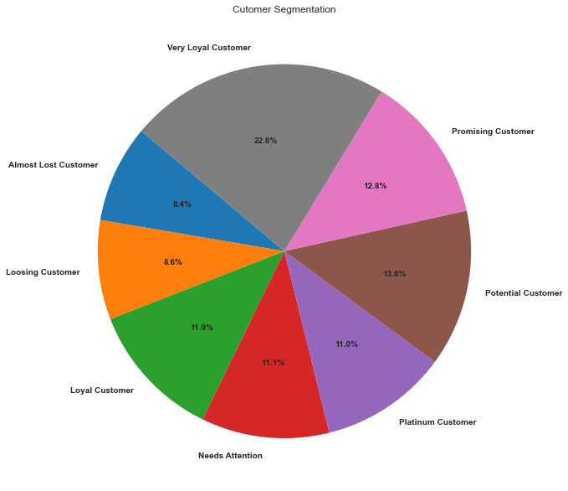
Note: The data and information in this document is reflective of a hypothetical situation and client. This document is to be used for KPMG Virtual Internship purposes only.
Model Development
RFM Analysis and Customer Segmentation
Customer Segmentation Distribution.
So, the customers are segmented as:
Platinum Customer
Loyal Customer
Needs Attention
Almost Lost Customer
Loosing Customer
Very Loyal Customer
Promising Customer
Potential Customer

Slide 14
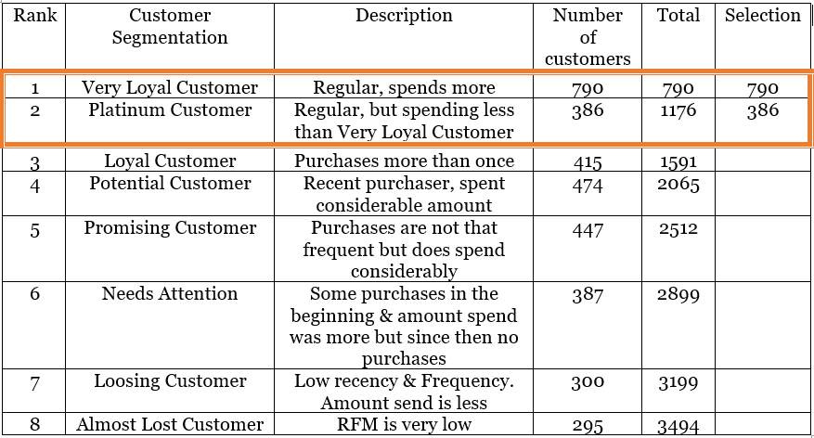
Note: The data and information in this document is reflective of a hypothetical situation and client. This document is to be used for KPMG Virtual Internship purposes only.
Interpretation
Summarized table with the top 1000 customers to be targeted

Slide 15
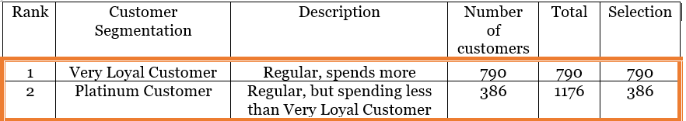
Note: The data and information in this document is reflective of a hypothetical situation and client. This document is to be used for KPMG Virtual Internship purposes only.
Interpretation
Target Customer
So, the customers from these two selected segmentation tends to spend more and also buys frequently than the customers from the other segments.
Hence the customers from these segments has to be targeted by the Marketing team of Sprocket Central

Slide 16
Note: The data and information in this document is reflective of a hypothetical situation and client. This document is to be used for KPMG Virtual Internship purposes only.
Appendix

