Slide 1
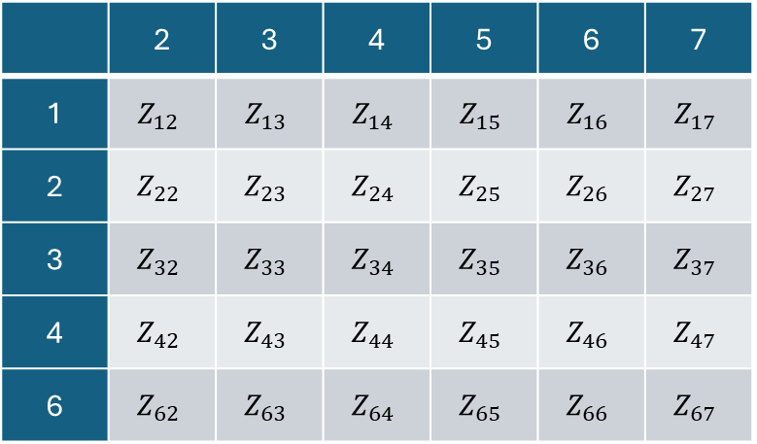
7
Matriz Origen-Destino: Z
Destinos
3
 | 2 | 3 | 4 | 5 | 6 | 7
1 | $$Z_{12}$$ | $$Z_{13}$$ | $$Z_{14}$$ | $$Z_{15}$$ | $$Z_{16}$$ | $$Z_{17}$$
2 | $$Z_{22}$$ | $$Z_{23}$$ | $$Z_{24}$$ | $$Z_{25}$$ | $$Z_{26}$$ | $$Z_{27}$$
3 | $$Z_{32}$$ | $$Z_{33}$$ | $$Z_{34}$$ | $$Z_{35}$$ | $$Z_{36}$$ | $$Z_{37}$$
4 | $$Z_{42}$$ | $$Z_{43}$$ | $$Z_{44}$$ | $$Z_{45}$$ | $$Z_{46}$$ | $$Z_{47}$$
6 | $$Z_{62}$$ | $$Z_{63}$$ | $$Z_{64}$$ | $$Z_{65}$$ | $$Z_{66}$$ | $$Z_{67}$$
1
6
Orígenes
4
2
5

Slide 2
7
3
1
6
4
2
5

Slide 3
