Slide 1
Nailing Search Relevance
Team #3: Josh Paulson, Sathvik Chatta, Ryder Fuscellaro, Andrew Kutsch, Katie Shapiro
10.16.26
Notes:
JOSH
Good afternoon, thanks for coming to our presentation. We are team 3 and our project is called Nailing Search Relevance.

Slide 2
Fine-tuning Home Depot product listings by department can improve search algorithm relevance by 19.3%.
Notes:
JOSH
Our core discovery was that…
BLUF
…How, you might ask?

Slide 3





Meet the Team
Josh
Paulson
Sathvik
Chatta
Ryder
Fuscellaro
Andrew
Kutsch
Katie
Shapiro
Notes:
JOSH
Our team will break that down for you. First, allow us to introduce ourselves. I’m Josh Paulson….thanks team!

Slide 4
Agenda
01
02
03
04
Overview
Analysis
Recommendations
Conclusion
Notes:
JOSH
To give you an idea of where we’re headed today:
We’ll start with a quick OVERVIEW of the issue we’re trying to address.
Then we’ll dive into the ANALYSIS, where we’ll discuss our methodology.
Then we’ll talk business RECOMMENDATIONS.
And finally we’ll wrap up with our final CONCLUSIONS.

Slide 5
01
Overview
Notes:
JOSH
I’ll get started with the problem we’re looking at…

Slide 6
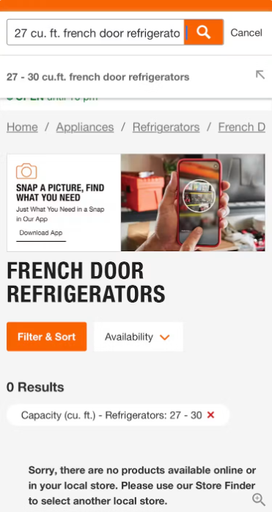
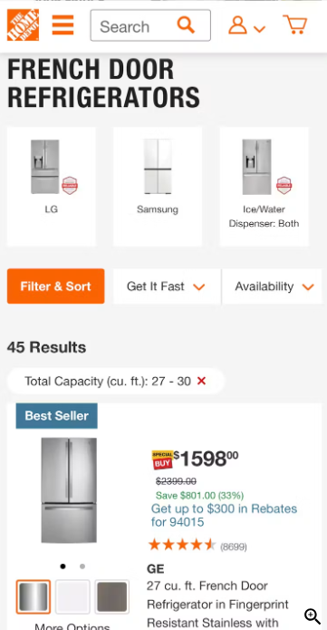

Overview | Analysis | Recommendations | Conclusion
Notes:
JOSH
In a 2024 e-commerce UX study, a Home Depot customer searched for a *CLICK* 27 cubic foot french door refrigerator, exactly what they were looking for.
The search unfortunately returned *CLICK* 0 results. However, researchers found that by filtering and sorting manually, a staggering *CLICK* 45 matching results were returned.
This example highlights a key problem: sometimes, the site is unable to connect the customer to the product they want via the search feature.

Slide 7
Problem Statement
39% of home improvement store customers agreed that it was easy to find what they wanted.
56% of e-commerce sites failed to adequately support users' search needs.
Overview | Analysis | Recommendations | Conclusion
Notes:
JOSH
Furthermore…
A 2023 survey revealed that ONLY…
And in a 2026 study, it was found that *CLICK*…
So this a problem across the whole home improvement industry and e-commerce in general. But we have some targeted improvements that Home Depot can make. *CLICK*

Slide 8
02
Analysis
Notes:
JOSH/SATHVIK
So I’ll pass it off to Sathvik to talk about how we did that.

Slide 9
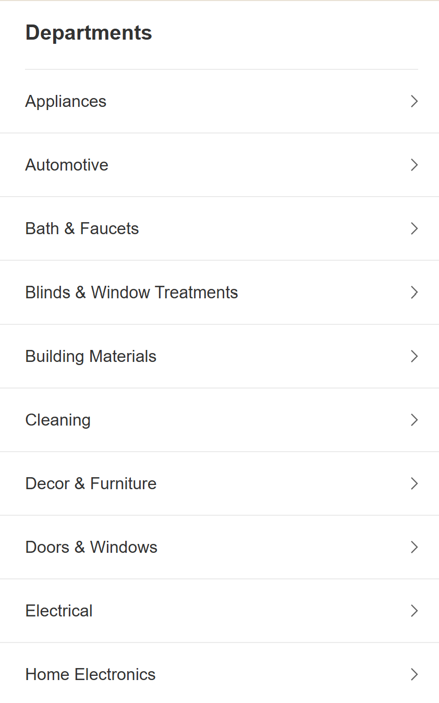
Analysis
Used the predefined categories found on the Home Depot website
25 original categories
Defined using keywords in product description
“Garage” and “Smart Home” combined into an “Other” category
Overview | Analysis | Recommendations | Conclusion

Slide 10
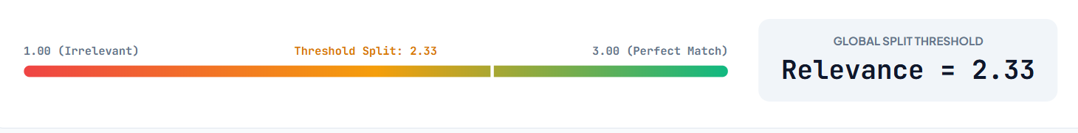
Analysis
Separated each category into high and low relevancy scores
  Low ≤ 2.33
  High > 2.33
Overview | Analysis | Recommendations | Conclusion

Slide 11
Analysis
Tested 25 created features
For search terms, product titles, and descriptions, we examined:
  Word frequency
  Punctuation and digit count
  Length of text field
  Similarity between terms
  Sentiment of product features
Overview | Analysis | Recommendations | Conclusion

Slide 12
03
Recommendations

Slide 13
Emotion in Descriptions
MORE emotion in “Appliances” and “Automotive” leads to HIGHER relevancy score.
LESS emotion in “Home Electronics” leads to HIGHER relevancy score.
Overview | Analysis | Recommendations | Conclusion

Slide 14
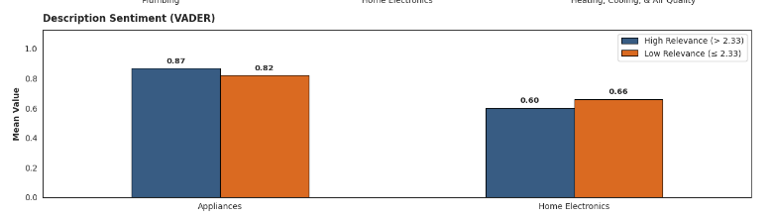
Emotion in Descriptions
More emotion →HIGHER Search Relevance
Less emotion →HIGHER Search Relevance
Overview | Analysis | Recommendations | Conclusion

Slide 15
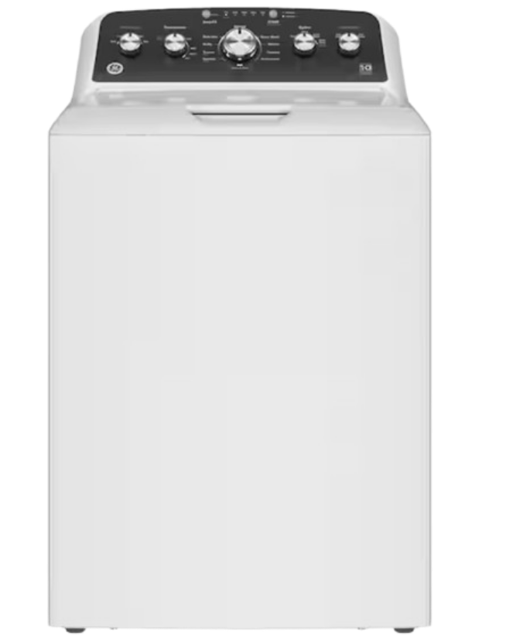
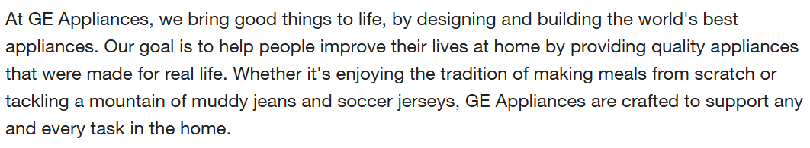
More Emotion in Descriptions (Appliances)
Overview | Analysis | Recommendations | Conclusion

Slide 16
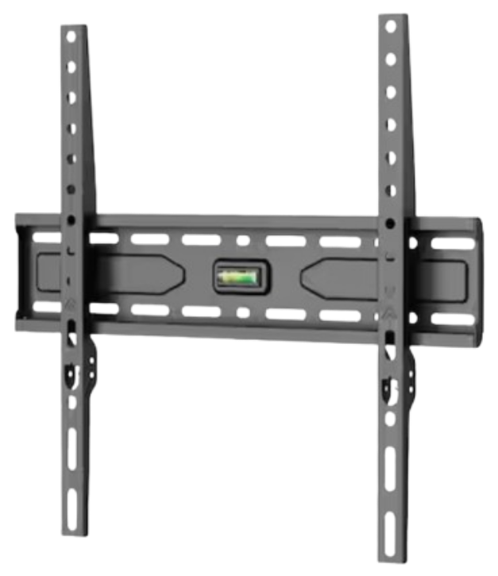
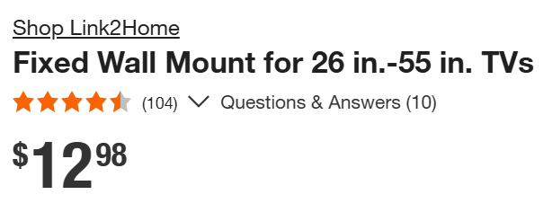
Less Emotion in Descriptions (Home Electronics)
Overview | Analysis | Recommendations | Conclusion

Slide 17
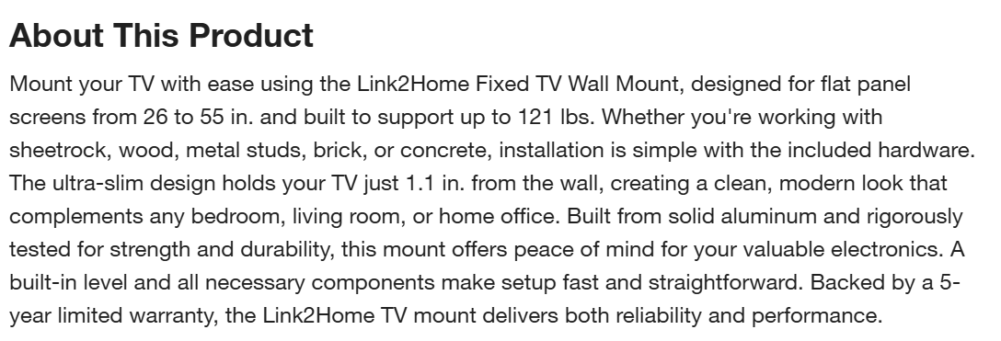
Less Emotion in Descriptions
Overview | Analysis | Recommendations | Conclusion

Slide 18
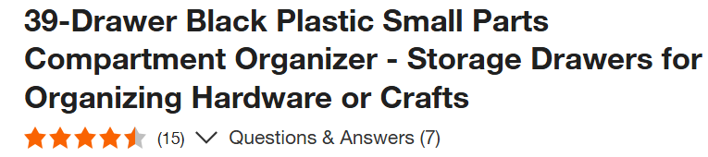
Punctuation in Titles
MORE punctuation in “Storage and Organization” and “Windows and Blinds” leads to a HIGHER relevancy score.
Overview | Analysis | Recommendations | Conclusion
Notes:
another area of opportunity for improving the search algo is the amount of punctuation in the title.
This noise amount was found to again affect the search relevance differently, depending on the department
so this example product is low relevance AND PROBABLY BECAUSE it is not specific enough about dimension,
And that makes sense because when you search for something like a window or storage bin here, you are more likely to use dimensions and therefore more punctuation to find something that fits into a specific space

Slide 19
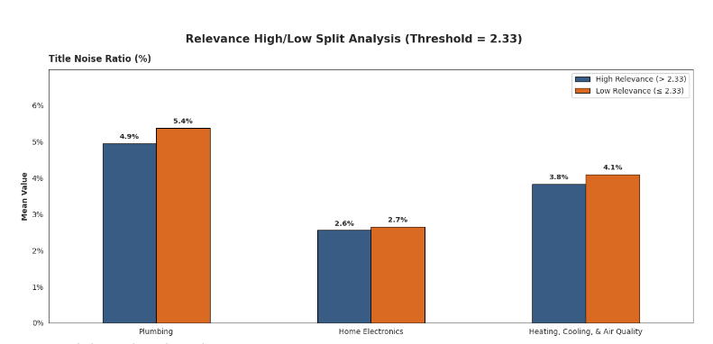
Punctuation in Titles
More title noise in these departments→LOWER Search Relevance
Overview | Analysis | Recommendations | Conclusion
Notes:
On the FLIP SIDE, the low relevant searches in these specific departments ALL HAVE higher noise, as you can see with the Yaxis here showing the mean title noise percentage

Slide 20
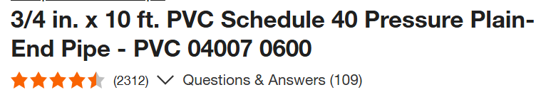
Punctuation in Titles
LESS punctuation in “Plumbing”, “Home Electronics,” and “Heating, Cooling, & Air Quality” leads to a HIGHER relevancy score.
Overview | Analysis | Recommendations | Conclusion
Notes:
so……….READ THE SLIDE!!
Therefore, this example plumbing product with a very punctuated title could use less noise.
This doesnt mean the more or less punctuation you just throw in will magically lead to better searches, we believe it means that these departments have products that are easier to search for depending on how specific you are with things like dimensions
Its not easy, but that is the essence of our findings, solving this problem requires a multifaceted approach rather than an easy fix

Slide 21
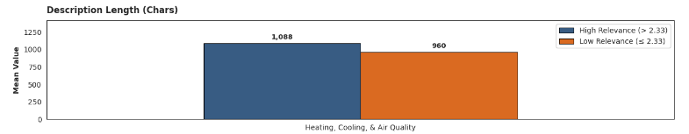
Description Length
Longer Description→HIGHER Search Relevance
Overview | Analysis | Recommendations | Conclusion

Slide 22
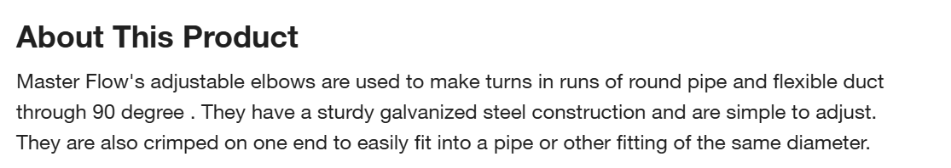
Description Length
INCREASING description length, especially in “Heating, Cooling, & Air Quality”, generally leads to HIGHER relevancy score.
Overview | Analysis | Recommendations | Conclusion

Slide 23
04
Conclusion

Slide 24
Conclusion
 | More | Less
Emotion | “Appliances” “Automotive” | “Home Electronics”
Punctuation | “Storage and Organization” “Windows and Blinds” | “Plumbing” “Home Electronics” “Heating, Cooling, & Air Quality”
Description Length | “Heating, Cooling, & Air Quality” All departments | N/A
Overview | Analysis | Recommendations | Conclusion

Slide 25
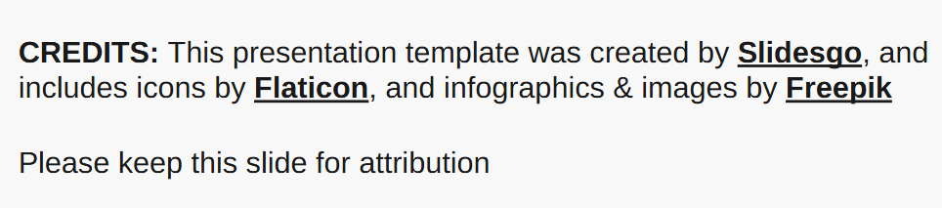

Thank you!
Do you have any questions?
Please keep this slide for attribution

Slide 26
Appendix
Scott, E. (2026, April 29). Ecommerce search UX 2026: 8 search “query types” UX best practices (56% of sites have issues). Baymard Institute. https://baymard.com/research-articles/ecommerce-search-query-types
Nawalaniec, N., Sauro, J., & Lewis, J. (2023, August 15). UX and NPS benchmarks of home improvement websites (2023). MeasuringU. https://measuringu.com/home-improvement-benchmark-2023/

Slide 27
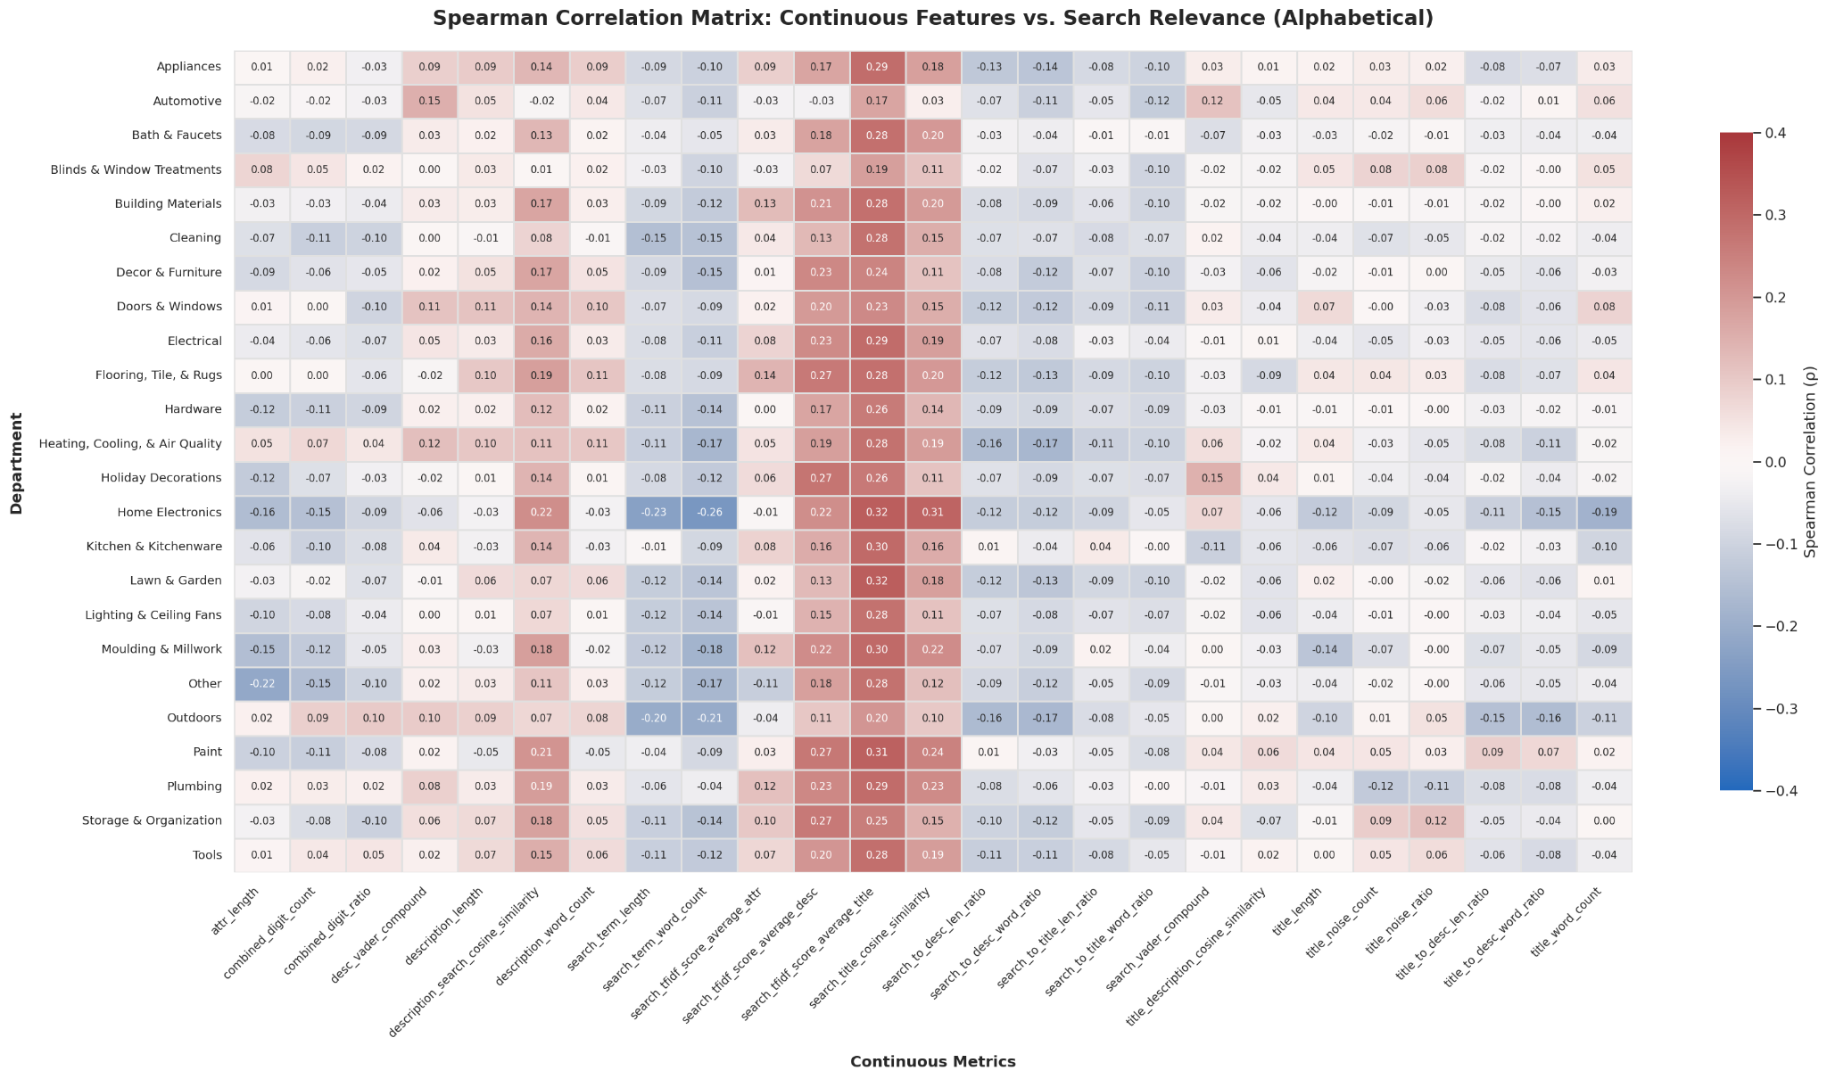
Notes:
Red = increase metric
Blue = decrease metric

Slide 28
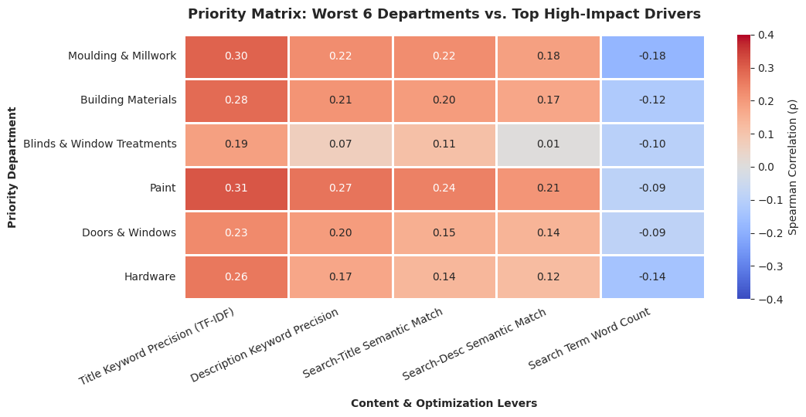

Slide 29
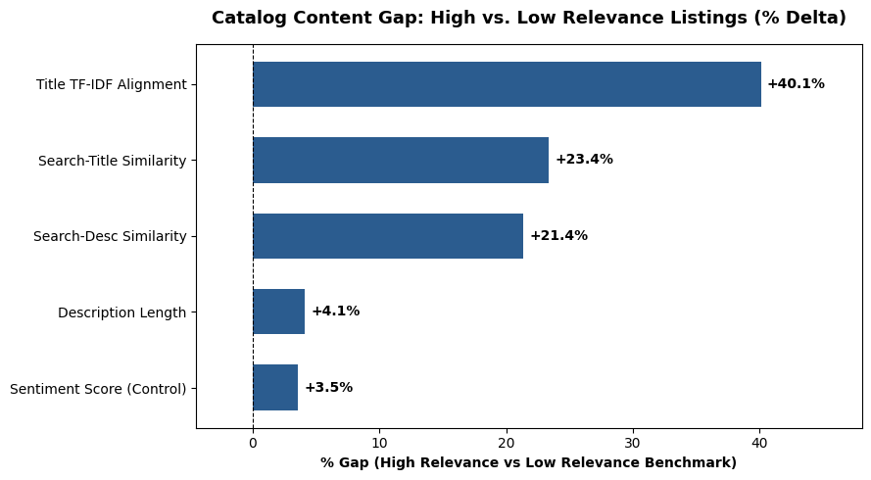

Slide 30
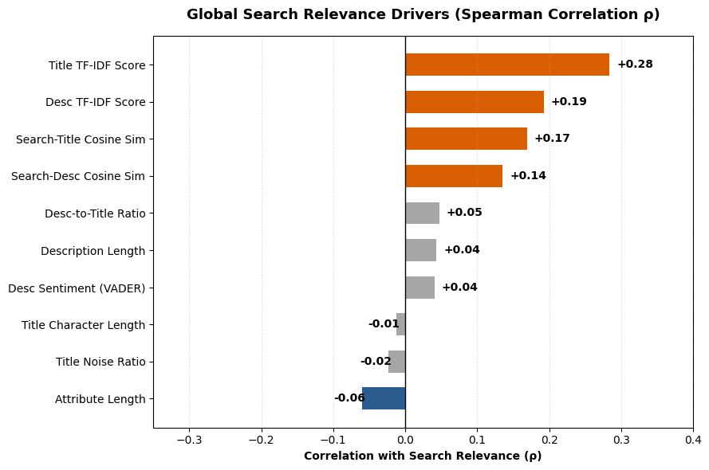

Slide 31
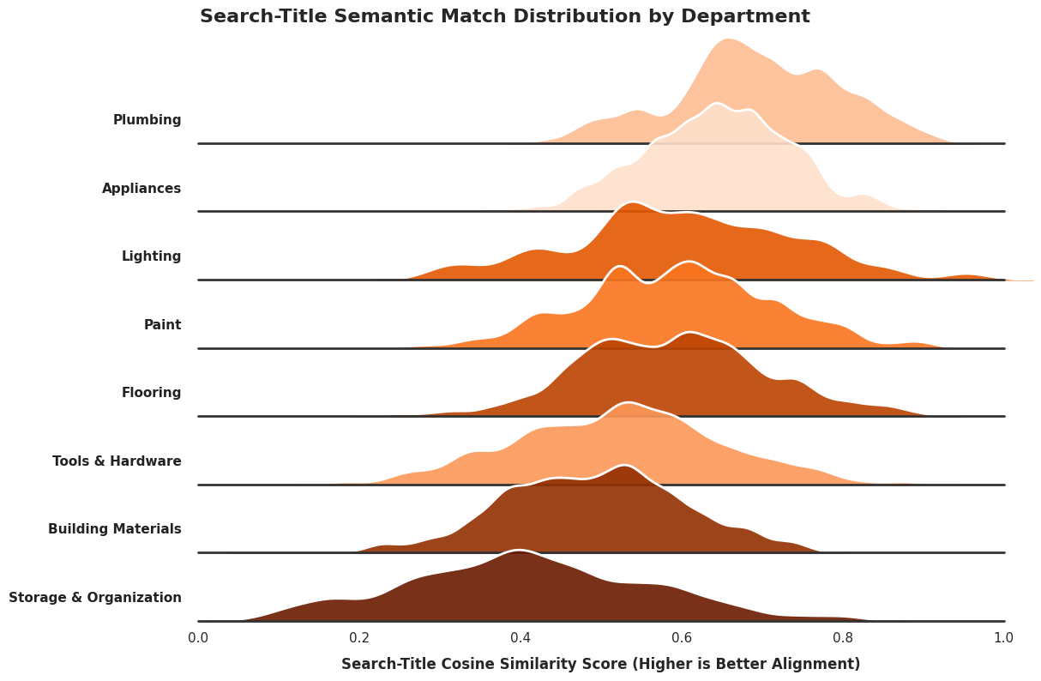

Slide 32
--- PLUMBING ---
• WORST TITLE (Ratio: 17.1%): "Everbilt 1-1/2 in. x 1-1/4 in. PVC P-Trap"
• AVERAGE TITLE (Ratio: 5.2%): “LDR Industries 2 in. x 2 in. PVC FPT x FPT No-Hub Coupling"
• BEST TITLE (Ratio: 0.0%): "Everbilt Water Heater Blanket"
--- STORAGE & ORGANIZATION ---
• WORST TITLE (Ratio: 14.7%): "Rubbermaid 37 Gal. 32-2/5 in. x 20-2/5 in. x 18-3/5 in. Hi-Top Storage Tote"
• AVERAGE TITLE (Ratio: 4.5%): “Edsal 36 in. W x 18 in. D x 72 in. H Steel Commercial Shelving Unit"
• BEST TITLE (Ratio: 0.0%): "Ameriwood Steel Storage Cabinet in Gray"

Slide 33


