Slide 2
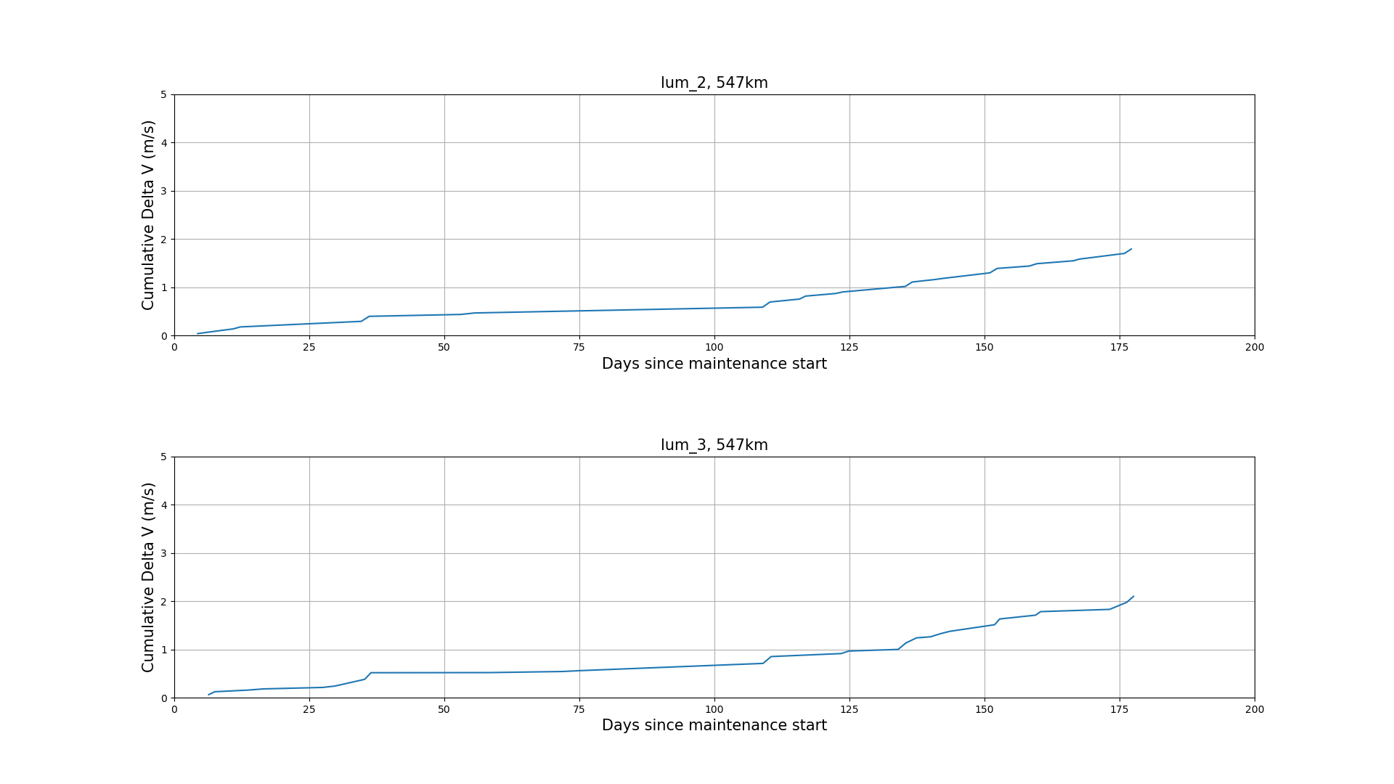
Del v maintenance cost- 547km

Slide 3
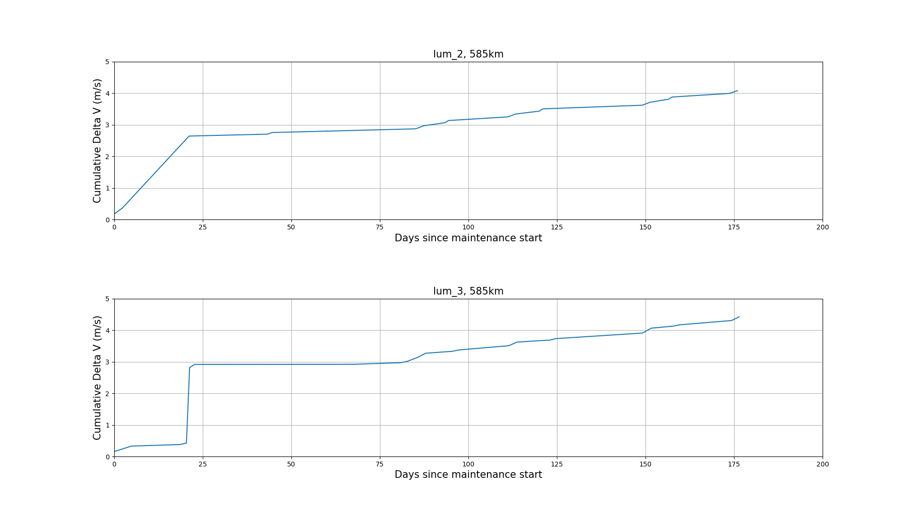
Del v maintenance cost- 585km

