Slide 1
FOR INFORMATIONAL PURPOSES ONLY | MGTA 495 — AI Coworker & Process Redesign | June 2026
Bridgewater AI
Research Coworker
Final Presentation — AI-Redesigned Investment Research Workflow
M
Macro
FRED API
F
Filings
SEC-style
N
News
Sentiment
S
Scenarios
Stress tests
PUBLIC API
SIMULATED
SYNTHETIC
SYNTHETIC
Andy Liu · Will Zheng

Slide 2
BACKGROUND
Why Bridgewater Associates?
$140B
1,300+
1975
Assets Under
Management
Employees
Worldwide
Year
Founded
Deep Research History
Systematic Logic
Radical Transparency
Since 1975, Bridgewater has pioneered principles-based macro analysis across 100+ countries, building proprietary quantitative models and rigorous economic frameworks.
Investment rules are codified and applied consistently through quantitative models — the same logic AI tools will learn to support and accelerate.
All decisions are openly debated across firm levels, creating rich documentation that serves as a data source for AI training and validation.
Project Goal
Redesign Bridgewater's investment research workflow using an AI coworker that assists human analysts — not an autonomous trading system. Human remains the final decision-maker at every gate.
MGTA 495 · Bridgewater AI Research Coworker · Andy Liu · Will Zheng

Slide 3
CURRENT PROCESS
Current Investment Research Workflow — As-Is
13 Steps · 4 Roles · 3 Decision Gates · Before AI Integration
Junior Analyst
①
②
③
④
Receive
Assignment
Collect
Macro Data
Compile
Indicators
Build Excel
Model
Senior Analyst
⑤
⑥
⑦
⑧
⚑
Validate
Data
Economic
Analysis
Form Investment
Thesis
Generate
Idea (L/S)
Thesis
Strong?
Risk Team
⑨
⑩
⚑
Review Risk
Parameters
Run Stress
Tests
Risk
Approved?
Portfolio Manager
⑪
⑫
⑬
⚑
Review
Proposal
Authorize
Execution
Monitor
Performance
Approve
Trade?
Key Inefficiencies
4–7 hrs manual data collection per cycle · Email-driven handoffs with no audit trail · Only 20 pre-defined stress scenarios · Reactive monitoring — no anomaly detection · ~5–10% manual data error rate
MGTA 495 · Bridgewater AI Research Coworker · Andy Liu · Will Zheng

Slide 4
AI REDESIGN
AI-Enhanced Investment Research Process
Human-Driven
AI-Automated
Human/AI Collab
Human Checkpoint
Junior Analyst
①
②
③
④
Receive
Assignment
Collect
Macro Data
Compile
Indicators
Build Financial
Model
Senior Analyst
⑤
⑥
⑦
⑧
⚑
Validate
Data Quality
Economic
Analysis
Form Investment
Thesis
Generate
Idea (L/S)
Thesis
Strong?
Risk Team
⑨
⑩
⚑
Review Risk
Params
Run Portfolio
Stress Tests
Risk
Approved?
Portfolio Manager
⑪
⑫
⑬
Review Full
Proposal
Authorize
Execution
Monitor
Performance
38% of steps AI-automated · All 3 original decision gates preserved as human checkpoints · Trade authorization (step ⑫) stays 100% human · AI never makes a final judgment call
MGTA 495 · Bridgewater AI Research Coworker · Andy Liu · Will Zheng

Slide 5
IMPACT
Time, Cost & Quality Improvements
85%↓
25×↑
57%↓
90%↓
Data collection
time
Stress test
scenarios
Full research
cycle
PM briefing
prep time
Metric | Current Baseline | With AI Coworker | Impact
Data Collection Time | 2–3 hours / cycle | < 15 min / cycle | ↓ 85%+
Stress Test Scenarios | 10–20 pre-defined | 500+ dynamic scenarios | ↑ 25×
Full Research Cycle | 5–7 business days | 2–3 business days | ↓ 57%
Data Error Rate | ~5–10% manual errors | < 1% (anomaly detection) | ↓ 85%+
PM Briefing Prep Time | 1–2 hours manual | < 10 min AI-generated | ↓ 90%+
Estimates based on published benchmarks from Man Group, Arootah, Carta (2024–25). Not live production results.
MGTA 495 · Bridgewater AI Research Coworker · Andy Liu · Will Zheng

Slide 6
ARCHITECTURE
System Architecture — How the AI Coworker Works
Data Layer
Skills
Tools + MCP
RAG Corpus
LLM Synthesis
FRED API · SEC Filings
News Sentiment · Scenarios
What to do
& when to do it
Deterministic calculation
MCP routes each call
Bridgewater frameworks
& investment checklists
Interprets evidence
Produces research memo
▸ Human Review & Approval — PM receives structured research memo · approves, overrides, or requests more analysis · trade authorization 100% human
🧮 Tools calculate
📚 RAG anchors judgment
🧠 LLM synthesizes
✅ Human decides
Deterministic outputs — no final verdicts, no buy/sell/hold labels in data
Internal frameworks from the corpus prevent LLM hallucination and drift
Combines evidence packet into a structured memo — reasoning made visible
Every gate requires human sign-off before the workflow can advance
MGTA 495 · Bridgewater AI Research Coworker · Andy Liu · Will Zheng

Slide 7
DATA & RAG
What Fuels the AI Coworker
M
PUBLIC API
F
SIMULATED
Macro Data
SEC-Style Filings
FRED API — real macro series (GDP, inflation, rates) as a legal proxy for Bloomberg-style inputs.
Structured multi-company financial data including revenue, margins, and filing risk flags.
N
SYNTHETIC
S
SYNTHETIC
News Sentiment
Scenario Stress Tests
Multi-company headlines + relevance scores. Raw text only — no pre-written verdicts.
500+ synthetic macro stress briefs covering shock scenarios for downstream model testing.
RAG Corpus — Institutional Knowledge Layer
Thesis-monitoring framework
Investment checklists
Escalation rules
Rules for when to escalate vs. hold
Step-by-step evidence requirements
Thresholds that trigger REVIEW SOON
MGTA 495 · Bridgewater AI Research Coworker · Andy Liu · Will Zheng

Slide 8
Section 03
UI Walkthrough
The analyst experience — NVDA thesis monitoring demo
MGTA 495 · Bridgewater AI Research Coworker · Andy Liu · Will Zheng

Slide 9
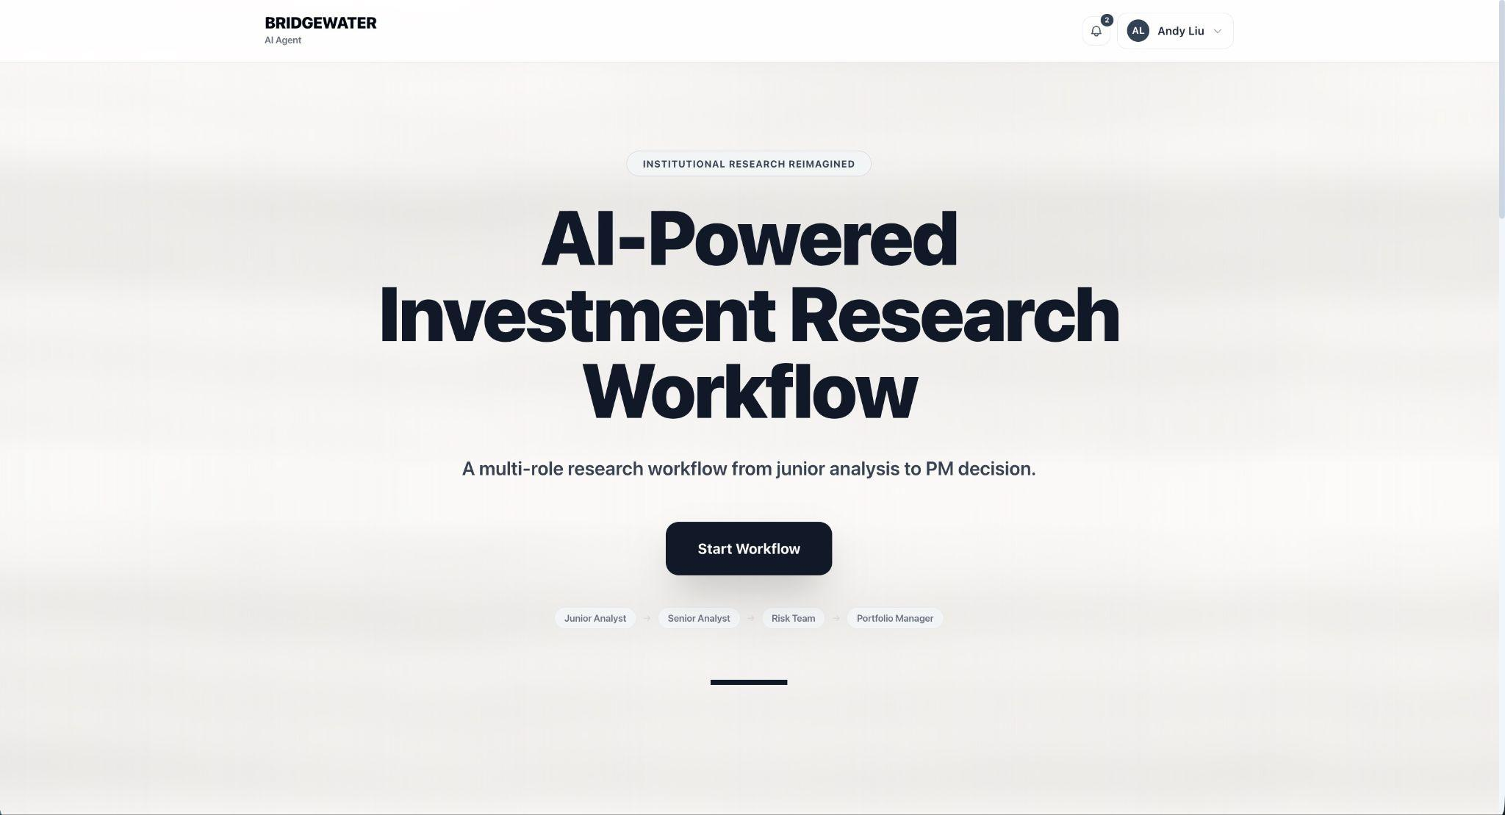
UI DEMO
AI Coworker Interface — Live Demo
1
Mandate input
Analyst types investment thesis in plain language
2
Evidence vault
AI returns sourced, traceable evidence items
3
AI analyst committee
Competing AI perspectives surfaced for review
4
Status badge
PRESSURED · REVIEW SOON — escalation triggered
MGTA 495 · Bridgewater AI Research Coworker · Andy Liu · Will Zheng

Slide 10
GOVERNANCE
Human Review & Governance — Who Stays in Control
Gate 1
Thesis Approval — Senior Analyst
Step ⑦
AI provides: Comparable thesis history, evidence summary, RAG-grounded gaps
Human decides: Is the thesis defensible enough to proceed?
New Gate
Data Quality Sign-Off — Senior Analyst
Step ⑤
AI provides: API pull logs, anomaly flags, stale data warnings
Human decides: Is this data fit for investment use?
Gate 2
Risk Approval — Risk Manager
Steps ⑨–⑩
AI provides: 500+ dynamic scenario results, VaR, position limits check
Human decides: Is the risk envelope acceptable?
Gate 3
Trade Authorization — Portfolio Manager
Steps ⑪–⑫
AI provides: Full consolidated briefing memo with all evidence
Human decides: Approve trade · 100% human · No AI authorization
Design principle: AI explains · Human approves. AI calculates · Human judges. AI flags · Human acts.
MGTA 495 · Bridgewater AI Research Coworker · Andy Liu · Will Zheng

Slide 11
VALIDATION
Testing & Validation — How We Know It Works
Tool validator
Demo validator
Pytest
OK
OK
12/12
All 4 MCP tools registered and callable
End-to-end workflow completed successfully
All unit tests passed across all skills
Component | What was tested | How validated
Macro skill | FRED API pull → macro_risk_flags output | Unit test + manual review
News skill | Raw headlines → news sentiment counts | Unit test
Filing skill | 10-K excerpts → filing_risk_flags + snippets | Unit test
Stress skill | Risk inputs → scenario scores | Unit test
MCP routing | LLM → MCP → correct tool selected & called | Integration test
RAG retrieval | Framework docs retrieved for NVDA query | End-to-end demo
LLM synthesis | Evidence packet → PRESSURED memo (no pre-labels) | Demo validator
★ RAG value in practice: During the NVDA demo, the LLM used the thesis-monitoring framework from the RAG corpus to correct a keyword-rule mistake it had made from raw data alone.
MGTA 495 · Bridgewater AI Research Coworker · Andy Liu · Will Zheng

Slide 12
LIMITATIONS
Failure Cases & How We Handle Them
⚠ LLM hallucination
High risk
⚠ Stale data triggers false hold
Medium risk
Risk: AI generates a plausible-sounding claim not supported by source data
Risk: An outdated FRED pull causes the thesis to show PRESSURED when markets have moved
Mitigation: All AI claims must trace to a specific tool output in the evidence vault. RAG corpus provides grounding rules.
Mitigation: Data freshness timestamp on every ingestion. Step ⑤ data quality gate catches stale feeds before analysis.
⚠ LLM overconfidence
Medium risk
⚠ Black-swan / novel events
High risk
Risk: AI produces a PRESSURED verdict with high confidence despite ambiguous evidence
Risk: Truly unprecedented macro events not represented in the scenario library or RAG corpus
Mitigation: Human review gate required before any action. Plain-language rationale required on every AI output.
Mitigation: Human override always available at every gate. AI escalates to REVIEW SOON rather than forcing a conclusion.
⚠ Synthetic data gap
Low risk
Risk: Synthetic SEC filings and news sentiment do not perfectly replicate live Bloomberg / Reuters feeds | Mitigation: Phase 2 roadmap: integrate live data APIs. Current system is explicitly advisory and for research only.
MGTA 495 · Bridgewater AI Research Coworker · Andy Liu · Will Zheng

Slide 13
SAMPLE OUTPUT
Sample Output — NVDA Thesis Monitoring Memo
NVDA — Investment Thesis Monitoring Report
Generated by Bridgewater AI Research Coworker · < 3 minutes
Generated in < 3 min
From mandate input to formatted memo — fully automated pipeline
STATUS: PRESSURED
ESCALATION: REVIEW SOON
Evidence Summary
Every claim sourced
Macro (FRED)
Each evidence item traces back to a specific tool output
10Y yield rose 42bps over 8 weeks → growth risk flag triggered. Macro risk score: ELEVATED.
News Sentiment
Human retains control
14 of 20 recent headlines negative/mixed on NVDA outlook. Sentiment score: −0.31 (bearish threshold).
PM must approve before any portfolio action is taken
Filing (10-K)
Gross margin compression flag: YoY margins down 180bps. Operating cash flow ratio: 0.82 (below threshold).
Plain-language rationale
▸ PM ACTION REQUIRED
No black-box outputs — PM understands the reasoning chain
Approve · Override · Request more analysis
MGTA 495 · Bridgewater AI Research Coworker · Andy Liu · Will Zheng

Slide 14
ROADMAP
Future Roadmap — What Comes Next
Phase 1
Phase 2
Phase 3
✓ Complete
6–12 months
12–24 months
Foundation
Live Data + Scale
Portfolio Intelligence
▸ FRED API + synthetic data pipeline
▸ Live Bloomberg / Reuters API integration
▸ Portfolio-level AI synthesis across all active theses
▸ Four connected skills (macro / news / filing / stress)
▸ Multi-company parallel thesis monitoring
▸ Cross-thesis conflict detection and surfacing
▸ MCP tool calling + RAG-grounded synthesis
▸ Expanded RAG corpus with more frameworks
▸ PM briefing automation ahead of IC meetings
▸ NVDA thesis monitoring demo — 12/12 tests passed
▸ Real-time anomaly detection on position P&L
▸ Feedback loop: PM decisions improve future AI outputs
Across all phases: Human governance model scales — all decision gates remain regardless of AI capability growth.
MGTA 495 · Bridgewater AI Research Coworker · Andy Liu · Will Zheng

Slide 15
THE OPPORTUNITY
GenAI doesn't replace
Bridgewater's principles.
It executes them faster.
38%
3
25×
57%
Steps
AI-automated
Human gates
preserved
More stress
scenarios
Faster
research cycle
Andy Liu · Will Zheng | MGTA 495 — AI Coworker & Process Redesign | Rady School of Management, UC San Diego | June 2026

