Slide 1
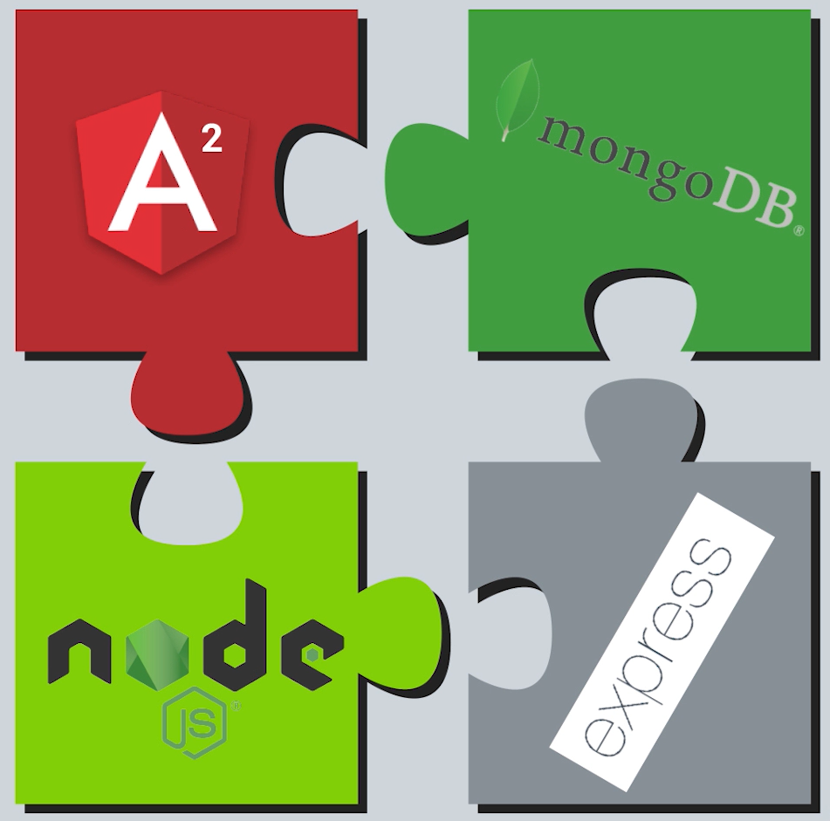
Mean stack

Slide 2
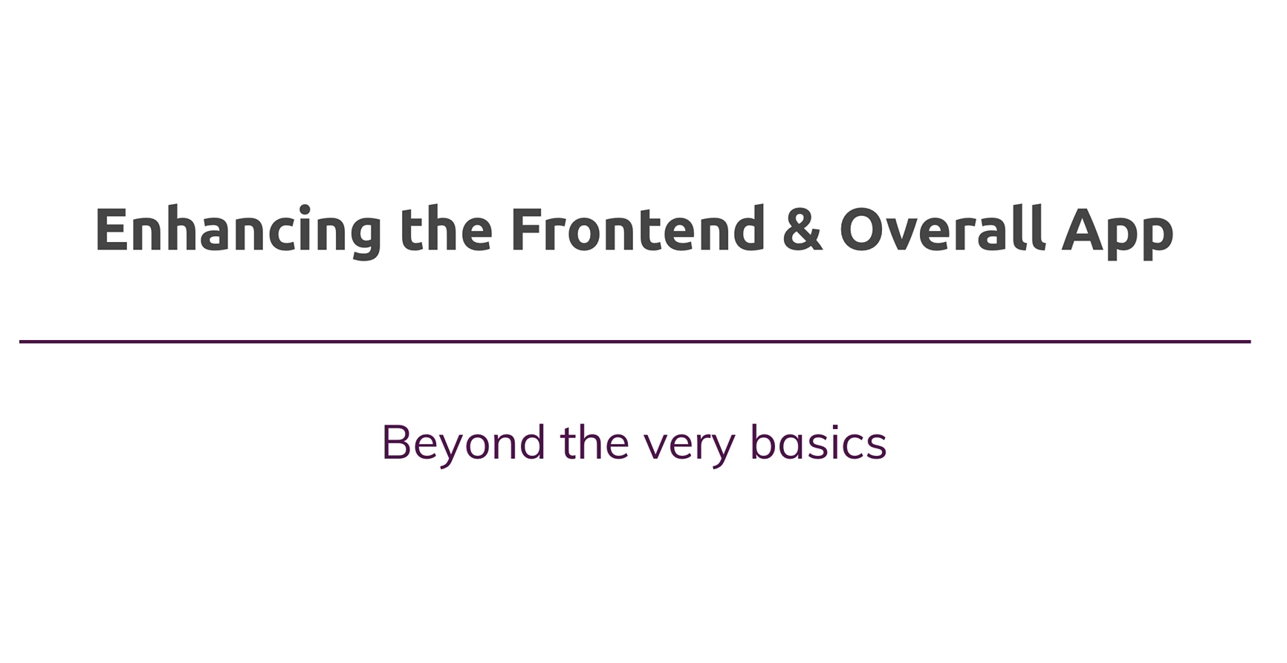

Slide 3
Agenda
Add routing to the app
Routes
Styling links
Client side vs server side routing
Adding Edit post functionality
Few Enhancements

Slide 4

Routing with Angular router
Angular router is a core part of the Angular platform.
It is a powerful JavaScript route built and maintained by the Angular core team that can be installed from the @angular/router package.
It allows developers to build Single Page Applications with multiple states and views using routes and components and allows client side navigation and routing between the various components.

Slide 5
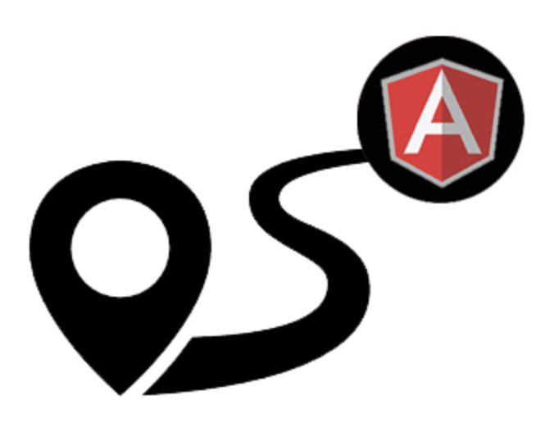
What are routes in Angular?
In Angular, a route is a JavaScript object that provides information about which URL maps to which component.
A route is defined a JS object of type Routes and is imported from @angular/router
A collection of routes defines the router configuration for the app.
import { Routes } from '@angular/router';

Slide 6
Setup routing in angular
Configure a route for each component
Define the options or actions for the user
Link a route to an option or action
Trigger the route based on user action (clicks)
When a route is activated, the component view is displayed

Slide 7
Router Module
The RouterModule is imported by @angular/router and helps us with angular routing.
It enables Angular router and is able to handle route configs to enable routing.
import { RouterModule } from '@angular/router';

Slide 8
Structure of routes
Every route has a predefined structure. In its simplest form, it consists of
path
component
Path is the fragment of a URL that determines where exactly is located the resource (or page) you want to access.
Component defines which component to load when the associated path is hit.
const routes: Routes = [
{ path: '', component: MyComponent},
{ path: 'pathA', component: MyOtherComponent},
{ path: 'pathA/:id, component: SomeOtherComponent}
];

Slide 9
Registering Routes for the app
Once the route is defined, we need to register the route object with Angular.
We import RouterModule into the AppRoutingModule and register the routes defined.
We then export it from routing module to be then imported by the main module for the app AppModule.
@NgModule({
imports: [RouterModule.forRoot(routes)],
exports: [RouterModule]
})
export class AppRoutingModule { }

Slide 10
Router Outlet
The Router-Outlet is a directive exported by RouterModule and acts as a placeholder that indicates to the router where it needs to insert the matched component(s).
This is a palaceholder in the main template where we indicate where angular should load the active routes.
<router-outlet> </router-outlet>

Slide 11
Creating Router links in Angular
A Router Link is a directive which angular routing used to convert a regular link into angular routing link.
<a routerLink=" ">My Link</a>
<a routerLink="/pathA">My Other Link</a>

Slide 12
routerLinkActive
The RouterLinkActive is a directive which can be used to detect the currently active route.
It takes in a css class and use the styling defined to highlight the link when the route defined for the link is currently active.
<a routerLink="/pathA"
routerLinkActive="myCSS">My Other Link</a>

Slide 13
ActivatedRoute
ActivatedRoute is an interface and it contains the information about a route associated with a component loaded into an outlet and it can also be used to traverse the router state tree
Activated route is imported from @angular/router package
constructor(public postsService: PostsService, public route: ActivatedRoute) {}

Slide 14
Thank you

