Slide 1
INTRODUCTION TO MEAN
Job ready training

Slide 2
MEAN – Close look
Angular
nodejs
agenda
express
mongodb
Mean – the big picture
Course outline

Slide 3
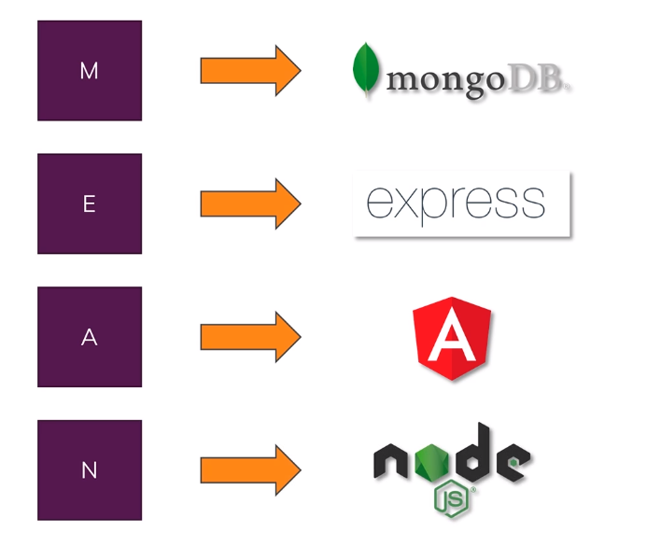
A close look at the different components
Notes:
So what does MEAN stand for and what are the different components that will learn about in this course.
Mean comprises of set off for technologies and this is what it stands for the M stands for mongo DB i.e. the database will use in this course.
So the part where we will be able to persist the data the users of all application generate like the user data itself but also like hosts or messages and things like that
E stands for express and express itself is hard to understand without the N.
The A stands for angular which is our client side technology it is a javascript framework in the end which weaves use to render a nice dynamic UI user interface to our users. It runs entirely in the browser not on the server at all and therefore it really has just has one job for sending a nice and pleasant interactive and reactive user interface.
Now what's the N? You probably already saw that something's missing, we got a database and we got something running in the browser.
But we certainly also need something that runs the logic on the server, for example authenticating users is not something we can do in the browser because a browser code can easily be hacked or changed and it's way too complex.
It would take up quite a significant amount of resources and slow down our fronted our user interface and stands for node JS and it's their Java script run time
Therefore our core business logic that runs on the server for which we will use nodeJS.
ExpressJS is a framework for running the NODJS language just like Angular is the framework and JS is the library on the framework.

Slide 4
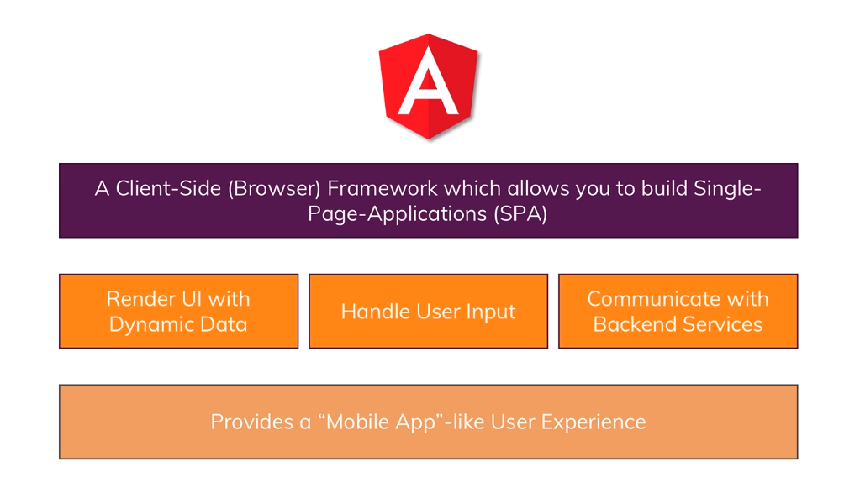
What is Angular?
Notes:
Angular is framework which allows us to build a SPA.
using javascript and it's used to create so called single page applications this essentially means that it handles the entire front and logic so everything your user is going to see angular is responsible for it.
Angular’s job is to render the user interface with dynamic data and that dynamic data part is a port of course it's job is not just to render some static HTML and in some CSS we wouldn't need Java script for that its job is to update the UI whenever we have new information.
Let's say when you create a new post we want immediately update the UI to showed if you post there it also is responsible for handling user input so validating that user input and all the sending it to the server for updating it.
It also is responsible for handling user input so validating that user input and also sending it to the server because that's the 1st part it does it communicates with our back and so with that node express mongo combination that seems to be responsible for it.
Angular also provides a mobile app like user experience because since we handle everything in a browser for jobs, we never need to reload the page which has changed in various parts of the page.

Slide 5
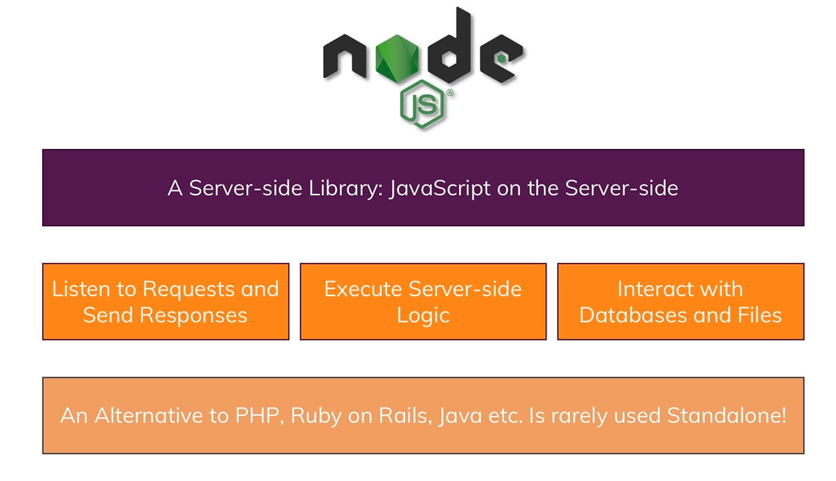
What is nodeJS?
Notes:
A server side library built on javascript runtime. We know that javascript is something that runs on the browser, while nodeJS just takes it and adds something like working with files, working with http calls and now we can use javascript on the server too.
Nodejs listens to incoming request and send responses for example ourt angular app can send a request to fetch a list of posts etc and node will do something, have some logic, reach out to Database etc.
Anything we don’t want to execute on browser for security and performance regions like authentication, handling certain data, reading from files etc will be executed on server side with logic.
NodeJs can interact with Databases and files. Angular cant do this as it doesn’t have access to DB on a remote machine. Theoretically we could connect to DB from Angular but we should be never be doing that as code on client side is visible in browser. It would be very unsecure on browser to do that. It will expose all your credentials and everythins.
It is alternative to PHP, Ruby on Rails , Java, Asp.Net etc but its rarely used as standalone. We use a framework along with it.

Slide 6
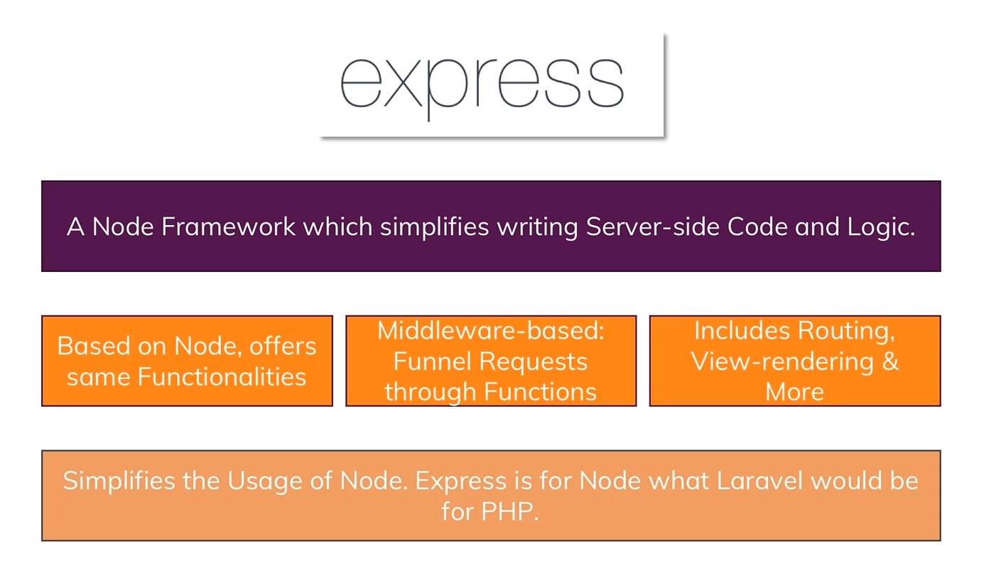
What is express?
Notes:
It’s a nodeJS framework which uses nodeJS and used for simplifying writing server side code and logic using Javascript.
It offers additional functionalities Its middleware based. Basically it funnel requests in proper way and provides a proper structure for writing the code on the server.
It includes routing, and view rendering. We will handle different requests to different endpoints.
It simplifies usage of nodeJs.

Slide 7
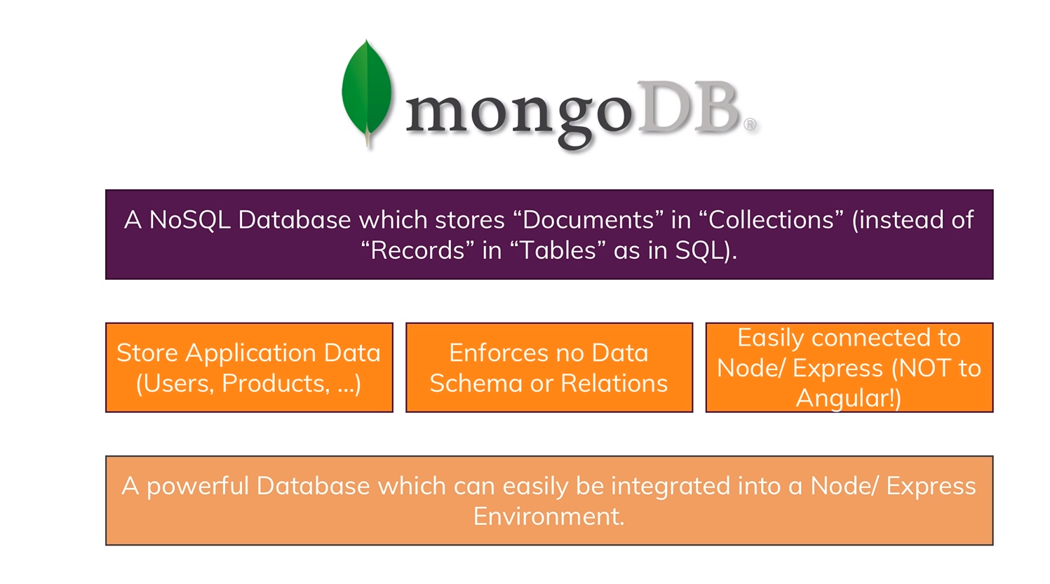
What is mongoDB?
Notes:
MongoDB is a NOSQL Databases, It stores documents in collections ( instead of records and tables )
It enforces no schema or relations. It helps in storing on
It stores application, data.
Easily connected to Node/Express ( not to Angular )
So it’s a powerful Database which can easily be integrated with node\express. It is very famous powerful Database now a days as it is flexible and highly scalable.
We can replace it with any other database. We are using MongoDB and for this training. For complex relational Database we can use a SQL Database.

Slide 8
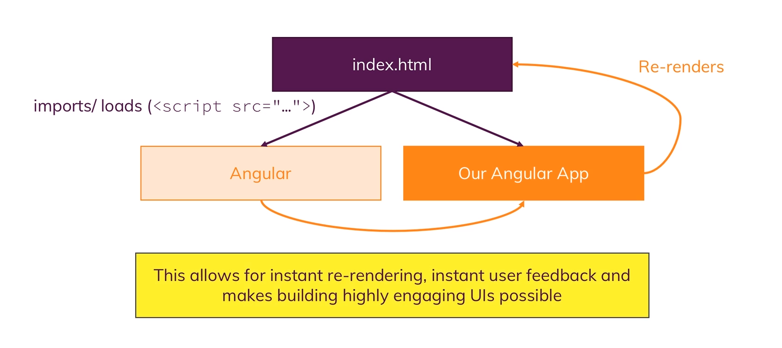
We build a Single Page Application
Notes:
In an Angular App we will have one root HTML file called index.html.
We can serve that from our node server or from a different server. It is important it can be totally decoupled of our node backend.
This HTML page basically includes some script imports that houses our angular app so the angular framework can load our own code.
And we use that application to dynamically re render what the user sees without ever requesting a second page to be rendered by the server.
Because by having this pattern we never need to reload the page just because the user may be clicked to load some details
And we can instead navigate to that page directly because on the page we would have just removed some elements from the page and added new elements.
And all of that is handled for us by the angular framework.
We have a powerful way of immediately changing the page.
During this call to server we may be showing a spinner while we were fetching some data behind the scenes so that list of posts which we probably still need to get but we will do that behind the scene and this will give us a feeling of a highly interactive mobile app.
We will get a feeling of very responsive and fast Web page where we never have to wait where things always happen and that of course is a great user experience.

Slide 9
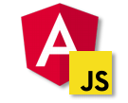

MEAN – The Big Picture
Client
Request\Responses
Server
Data
JSON Format
Business Logic
Presentation\UI
Persistent Data Storage
Single page is not necessarily served by node backend
Single-Page-Application
Authentication Logic
Notes:
We have the client side and server side
Client Side which the user sees and server side where we run our business rules and logic
On Client we use Angular which is a JavaScript framework which means we use JavaScript explicitly which we used to build the User Interface.
On the server side we used node, Express and mongoDB. Node\Express for logic and mongoDB for Database. The server side will be called from Angular.
Client side Angular is responsible for User Interface and it’s a single page application and that single page application can be rendered by a node backend so that we can have one route that will return the single page application. But it can be totally decoupled from node and can be published from a totally different host. Some static host like IIS, AWS, PCF etc.
On node application we can have business logic. We will have a persistent data storage. We will also have a authentication logic.
How do we connect the client and server. We will connect via request and responses. These request and responses are sent behind the scenes so called AJAX requests.
We have the same structure in Angular and is handled by Angular so that we don’t have to reload the page.
So while doing operation between the client and server we don’t have to send the HTML elements over browser. So the data is in format of something called JSON - JavaScript Object Notation
JSON is a is a lightweight data-interchange format. It is easy for humans to read and write. It is easy for machines to parse and generate. It is based on a subset of the JavaScript Programming Language Standard ECMA-262 3rd Edition - December 1999.

Slide 10
Course Outline
Getting Started
Data Pagination
Angular Frontend
Authentication
NodeJs + Express Backend
Authorization
Handling Data with MongoDB
Error Handling
Enhancing the App
Optimization
Image Upload
Deployment

Slide 11
Getting Most out of the course
Try attending all sessions
Go through presentations
Code along following Lab Manual
Ask questions in sessions
Post queries on Github

Slide 12
Lets Code
Lab Manual

