Slide 1
MEAN Best Practices

Slide 2
Agenda
Understanding Project and Folder Organization
Angular
Angular Module Organization
Component and Services Best Practices
Important performance best practices
Basic Coding best practices
NodeJs Best Practices
Project Structure Practices
Error Handling Practices
Code Style Practices
Links

Slide 3
File and Folder Structure
LIFT
L – Locate Code Quickly
I – Identify Code at a glance
F – Flattest structure possible
T – Try to be dry
Notes:
Try to be dry mean Try not to repeat code. Try to reuse code.

Slide 4
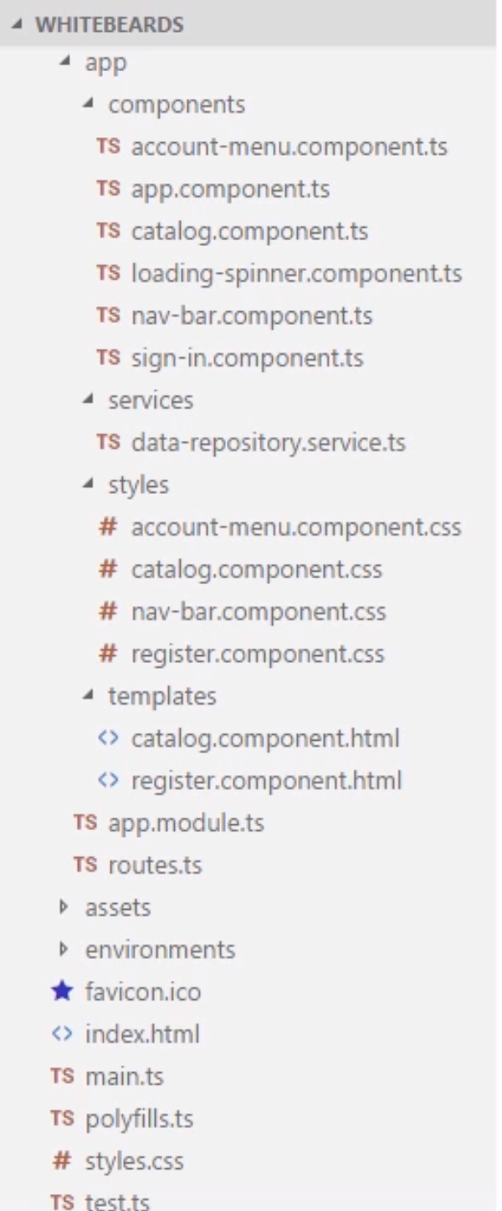
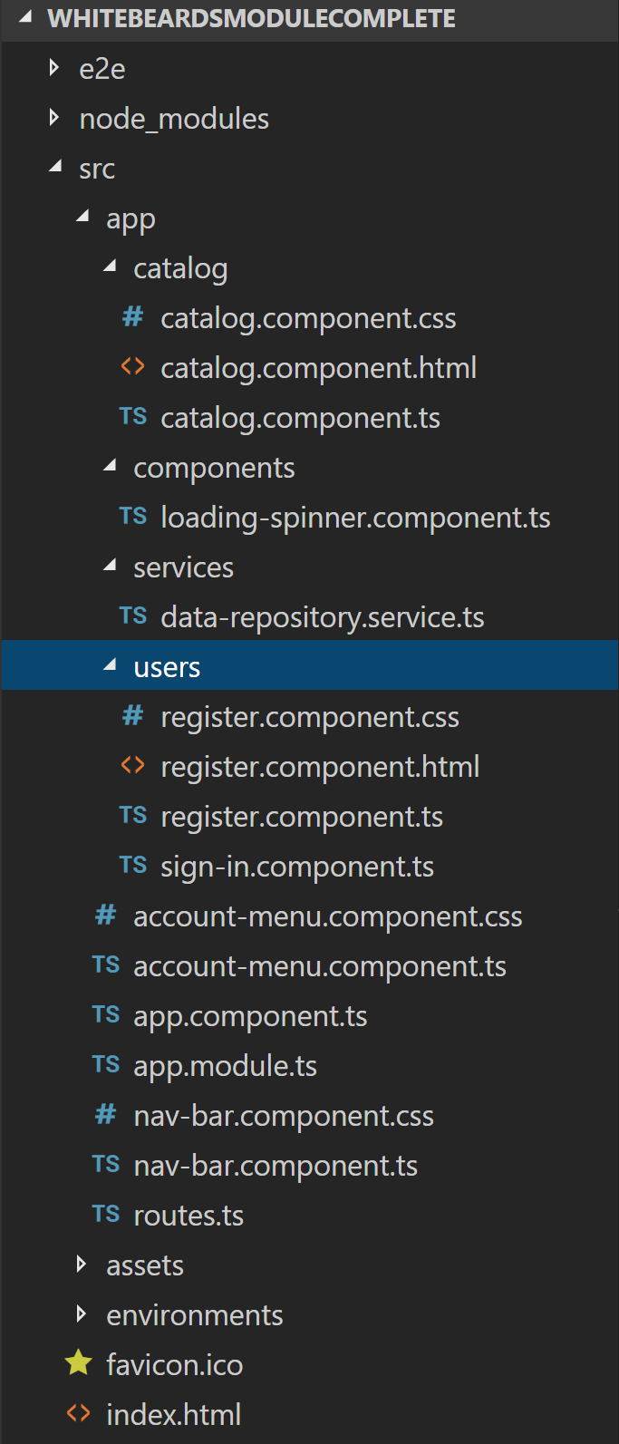
File and Folder Structure continued…
Explaining LI from LIFT
L – Locate Code Quickly
I – Identify Code at a glance
File Naming
Prefix-Descriptor.component.ts
Follow Exercise in Notes below
Folder Structure
Scalable in multi modules
Organize based on feature areas
Reusability
One Item per file
Each file do one activity. Refer to
sign in component in first application

Slide 5
Angular - General Coding Best Practices
Single responsibility principle
Single class or module should have single responsibility
Symbol Naming
Readable variable names, classes, properties etc.
Classes should be named Pascal Case
Properties and methods should be in lower camel case
Angular recommends line spacing on Imports ( between third party and our own imports)
Angular recommends use lower camel case for naming constants
Use Lint for checking possible code errors and fixing code style
Use arrow function expressions (=>)

Slide 6
General Coding Best Practices Continued…
Preferring immutability
It basically means not mutating existing objects in memory rather create new objects
Best Practice not only in Angular but also in JavaScript
Helps in avoiding bugs such as values unexpectedly changed
Identifies Change detection
Using small functions
Break big functions in smaller reusable functions

Slide 7
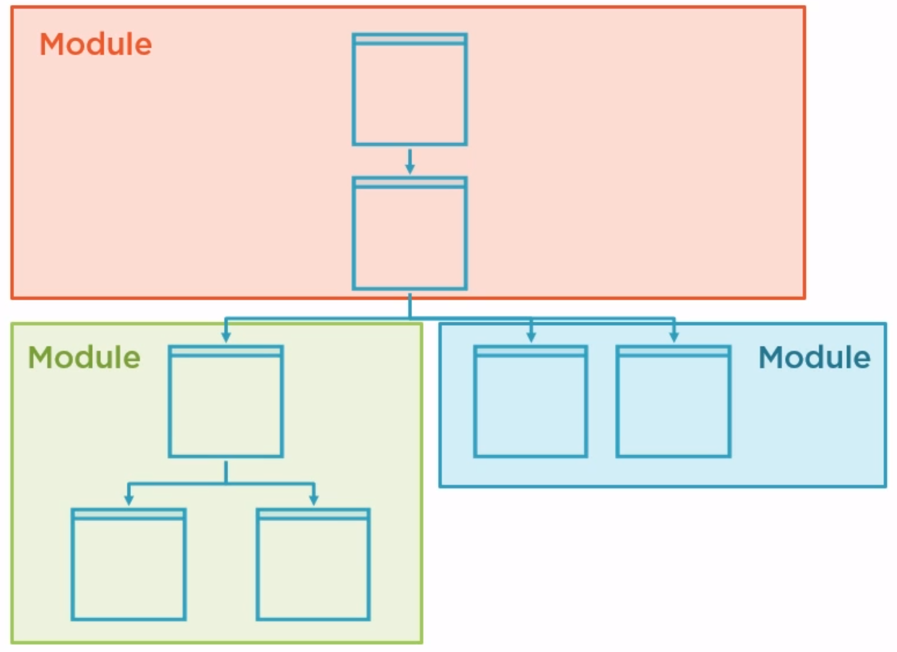
Angular Module Organization
Angular module overview
Creating a core module
Creating a shared module
Creating a feature module
Only import sections to your module that you need in your application
Advantages:
Provides high level of encapsulation
Feature modules are lazily loaded
which helps in performance.
Notes:
Lazy Loading

Slide 8
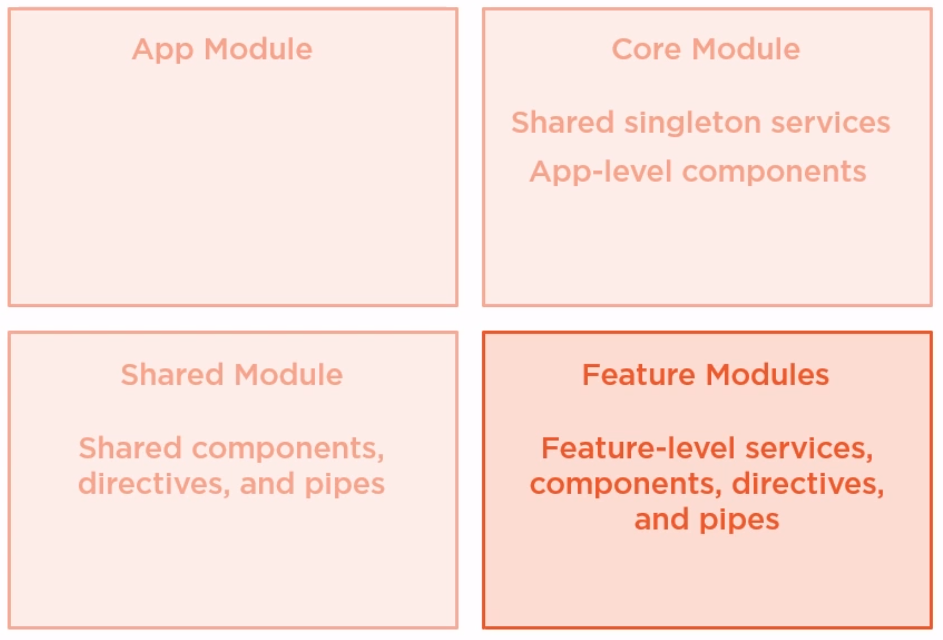
Recommended Modules

Slide 9
Angular Component Best Practices
Prefixing Component Selectors.
Add Prefix to Selectors in specific feature areas. It Avoid conflicts.
It should be two to four characters long
Separating Component, CSS and template files.
Angular Style guide suggests that if template or css are more than 3 line Separate them.
It should follow LI principle from LIFT.
Decorating Input and Output Properties
There are two ways to declare them. Using Decorators and using metadata
Delegating complex logic to services
Component should work on single responsibility principle.

Slide 10
Angular Component Best Practices continued…
Component Member sequence
Public properties and methods should be written above all private components ( as per style guide)
Implement Life Cycle Hook Interfaces.
Follow a similar order of Life Cycle Hooks across the application
When to (and not to) create components.
Decision about creating reusable component using content projection

Slide 11
Angular Services Best Practices
Marking Services as Injectable
Injectable decorator is needed whenever a service injects another service
Recommendation is to add Injectable as we never know when we want to inject dependency in a service.
Using Service for Data Retrieval
Use Service to get Data instead of getting data directly from component.

Slide 12
Service Injector best practices.
Angular Injector
App Module
Root Injector
Eager Feature Module
Lazy Feature Module
Injector
Services
Services
Notes:
Angular creates a root injector for every angular app. The root injector is responsible to inject services wherever they are needed.
Imagine an eager Feature module needs a service .Angular actually registers that using root injector. This makes it available to the entire app.
But here is a catch developers miss. If we provide a service in a lazily loaded module. Angular creates a new injector for that module and registers its there.
This instance of the service is now only available to the lazily loaded module.

Slide 13
Service Injector best practices.
Angular Injector
App Module
Root Injector
Core Services
Services
Services
Services
Services
Services
Services
Eager Feature Module
Lazy Feature Module
Injector
Notes:
Service in core module is injected in root module becomes singleton service which is reusable across all modules.
Now you might be wondering why not keep all services in Core Services .
Remember that the services that are only needed for Eager Feature Module should be registered in the module where its being used.
And only the service which is used by all modules should be part of feature module.
It gives a nice sense to organization to your project.

Slide 14
Angular Performance Best Practices
Ahead of time compiler and the CLI
Use the Angular CLI
Compile before deploying ( use webpack CLI commands properly)
Like use command npm run build -- -- prod.
This creates the dist folder which will be deployed.
Lazy Loading feature Modules
Take the example of User folder in current application
Monitoring bundle sizes
Observe the vendor bundle size in application
We can monitor bundle size using various tools like source-map-explorer
Pure and Impure Pipe performance
Pipes are pure by default so they don’t understand mutations
Never use impure pipes for sorting
Use mutations appropriately with pure pipes while filtering on UI.

Slide 15
Node Best Practices
Project Structure Practices
Structure your solution by components
Layer your components, keep Express within its boundaries
Wrap common utilities as npm packages
Separate Express 'app' and 'server’
Error Handling Practices
Use Async-Await or promises for async error handling
Use only the built-in Error object
Distinguish operational vs programmer errors
Handle errors centrally, not within an Express middleware to avoid duplicity and confusion
Document API errors using Swagger or GraphQL
Exit the process gracefully when a stranger comes to town
Test error flows using your favorite test framework

Slide 16
Node Best Practices Continued…
Code Style Practices
Use Lint for checking possible code errors and fixing code style
Use Node.js specific plugins like nodemon, eslint-plugin-node, eslint-plugin-node-security etc.
Use naming conventions for variables, constants, functions and classes
lowerCamelCase when naming constants, variables and functions
UpperCamelCase (capital first letter as well) when naming classes.
Prefer const over let. Ditch the var
Require modules by folders, opposed to the files directly
Use Async Await, avoid callbacks
Use arrow function expressions (=>)
Testing And Overall Quality Practices
Going To Production Practices
Security Best Practices
Performance Best Practices
Follow Link - https://github.com/goldbergyoni/nodebestpractices

Slide 17
MONGO DB Operations Best Practices

Slide 18
Links
Official : https://angular.io/guide/styleguide
https://www.pluralsight.com/paths/angular
https://github.com/goldbergyoni/nodebestpractices

