Slide 1
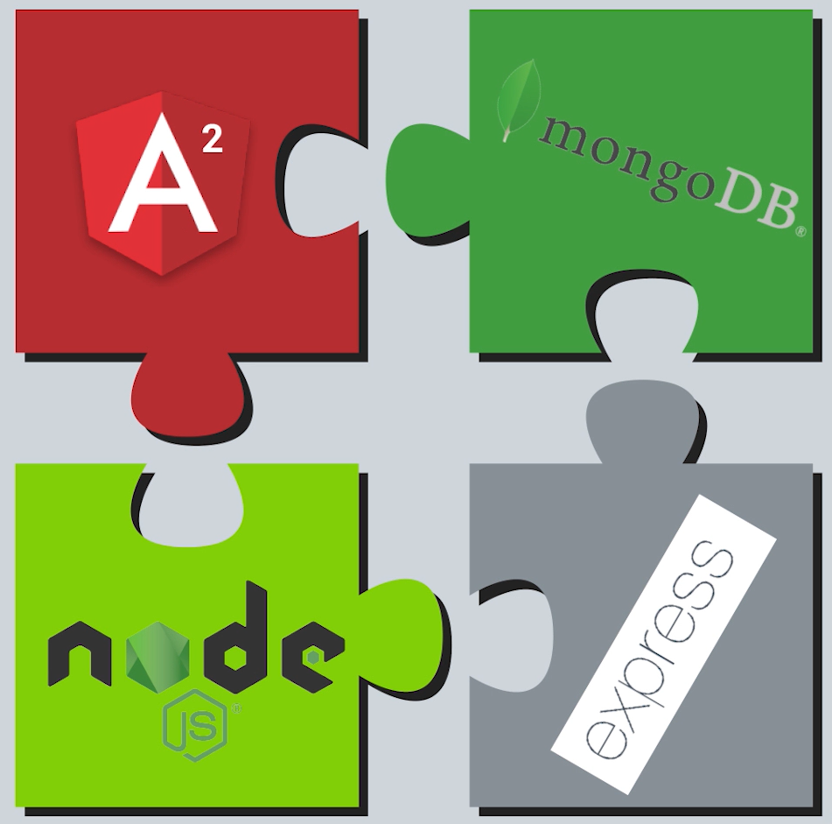
Mean stack

Slide 2
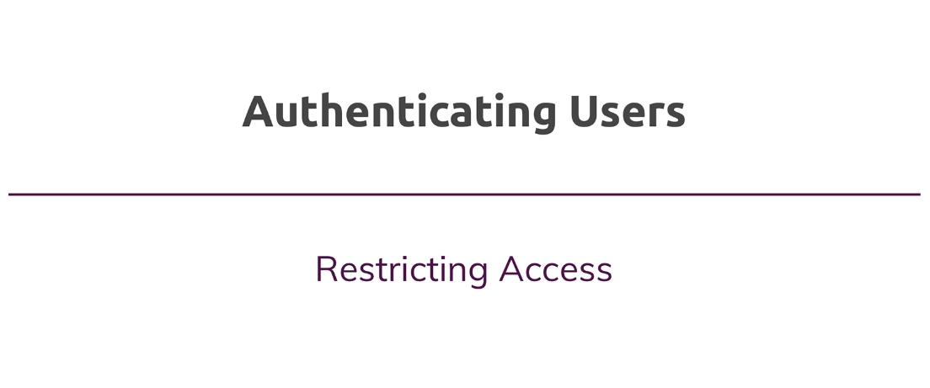

Slide 3
Agenda
Route Guards
Auto Authentication
Authorization - Associate posts with users
Protect resources with authorization
Pass and use user id on the frontend
TDD

Slide 4
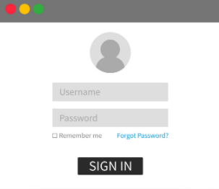
Authentication
Authentication is the process of verifying the identity of the user of the application.
Common example is entering a username and password when you log in to a website.
Single Factor Authentication, Multi-Factor Authentication, Biometrics are examples of types of authentication used in real world apps.

Slide 5
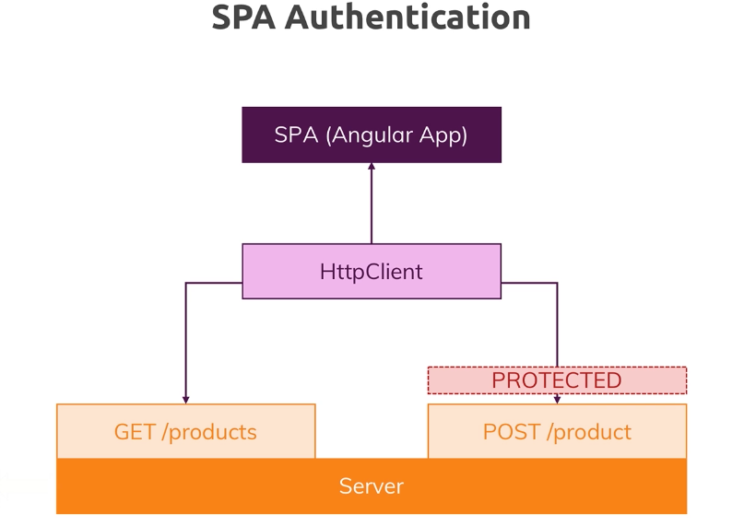

Slide 6
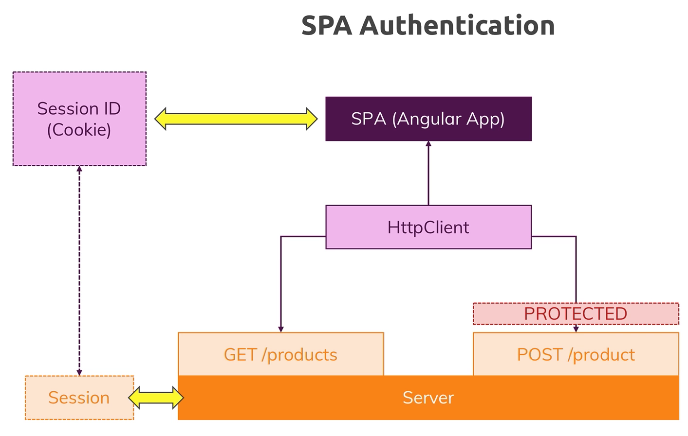

Slide 7
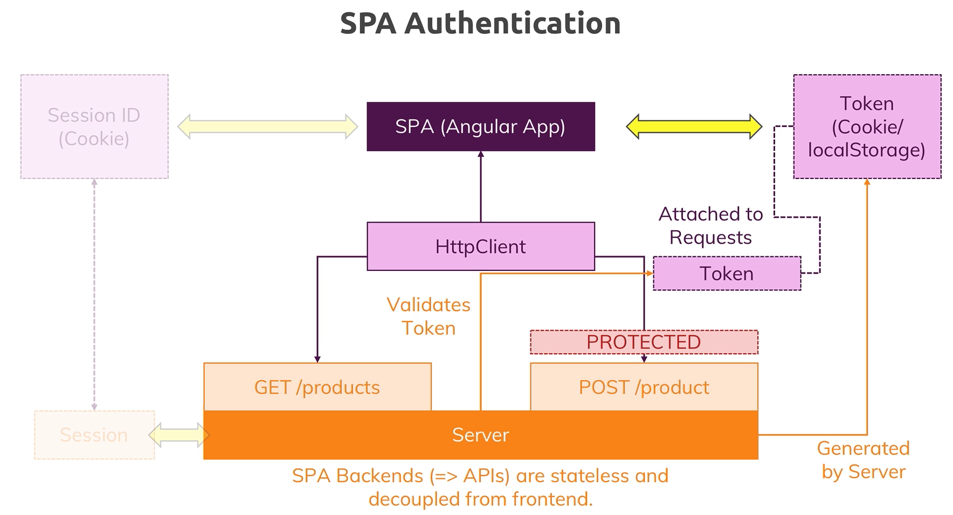

Slide 8
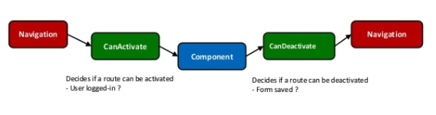
Route Guards
Angular's route guards are interfaces which can tell the router whether or not it should allow navigation to a requested route.
There are five different types of guards and each of them is called in a particular sequence. The router's behavior is modified differently depending on which guard is used.

Slide 9
Thank you

