Slide 1
INTRODUCTION TO MEAN
Job ready training

Slide 2
MEAN – Close look
Angular
nodejs
agenda
express
mongodb
Mean – the big picture
Course outline

Slide 3
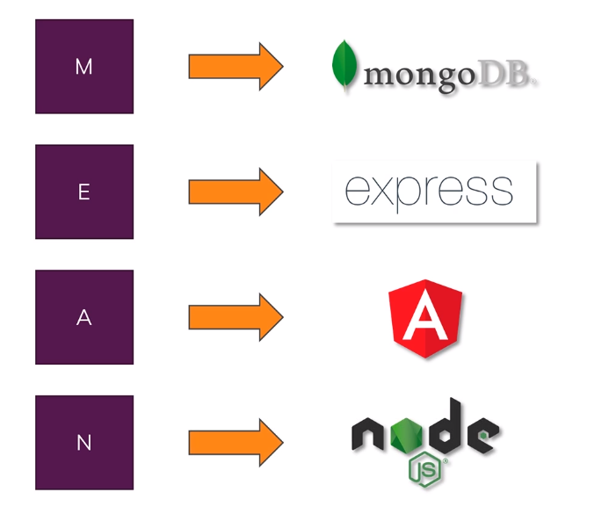
A close look at the different components

Slide 4
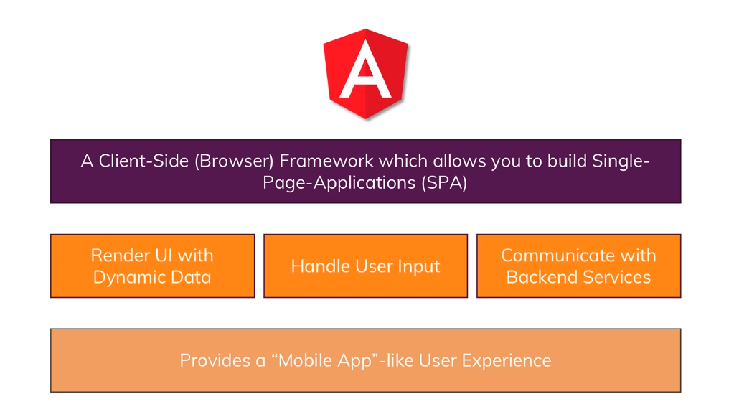
What is Angular?

Slide 5
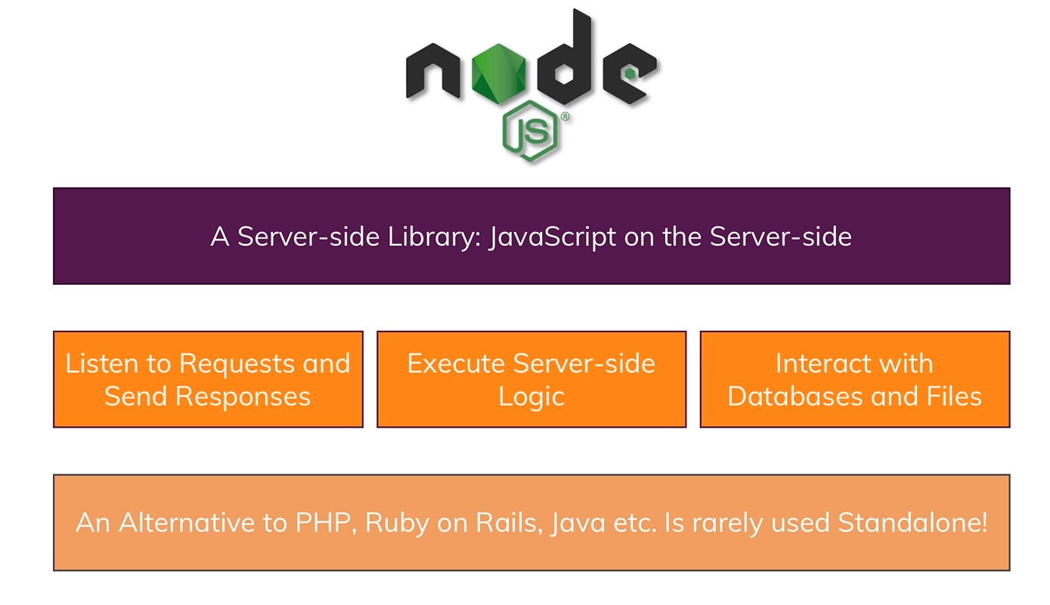
What is nodeJS?

Slide 6
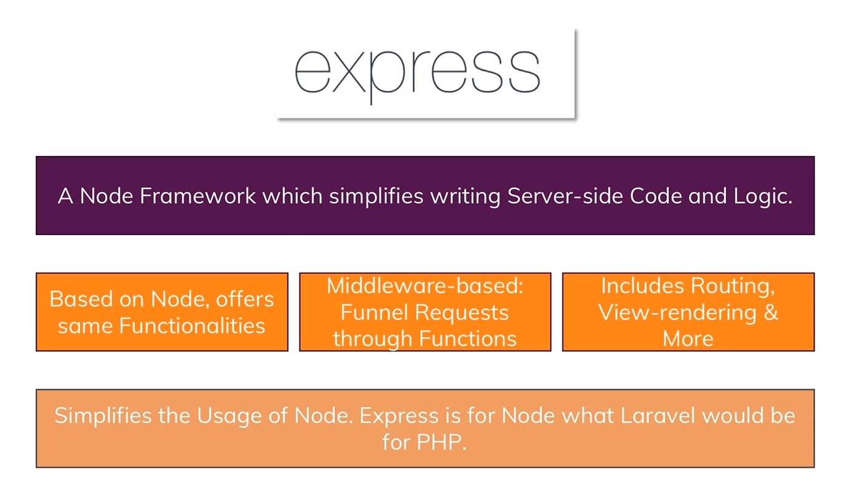
What is express?

Slide 7
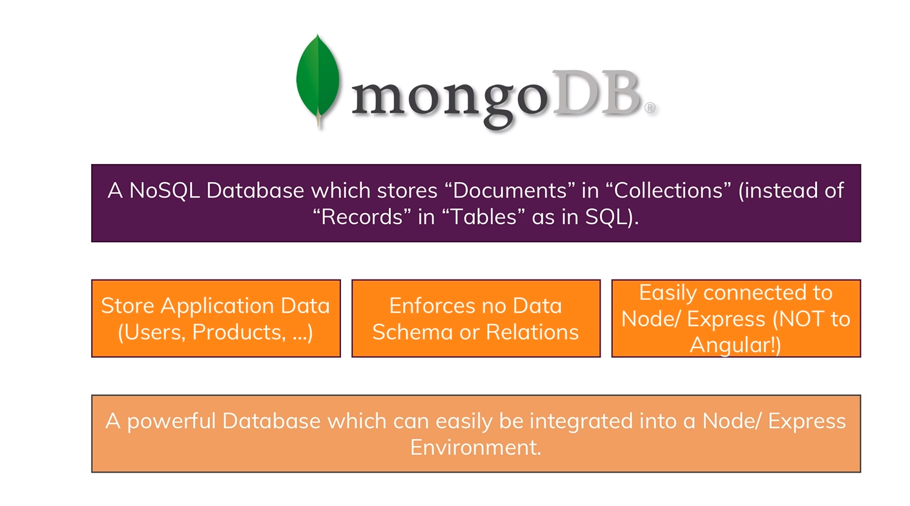
What is mongoDB?

Slide 8
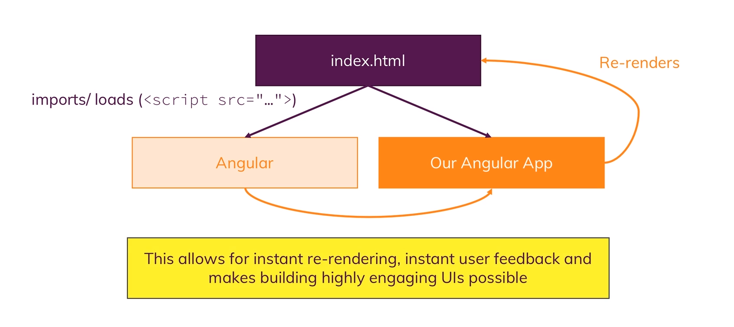
We build a Single Page Application

Slide 9


MEAN – The Big Picture
Client
Request\Responses
Server
Data
JSON Format
Business Logic
Presentation\UI
Persistent Data Storage
Single page is not necessarily served by node backend
Single-Page-Application
Authentication Logic

Slide 10
Course Outline
Getting Started
Data Pagination
Angular Frontend
Authentication
NodeJs + Express Backend
Authorization
Handling Data with MongoDB
Error Handling
Enhancing the App
Optimization
Image Upload
Deployment

Slide 11
Getting Most out of the course
Try attending all sessions
Go through presentations
Code along following Lab Manual
Ask questions in sessions
Post queries on Github

Slide 12
Lets Code
Lab Manual

