Slide 1
Angular
Authorization

Slide 2
Lab schedule
Adding User Id to Posts.
Protecting Resources with Authorization.
Passing the UserId to the frontend.
Using the UserId on the frontend

Slide 3
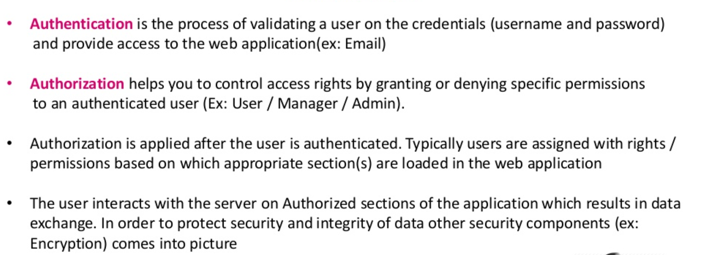
introduction

Slide 4
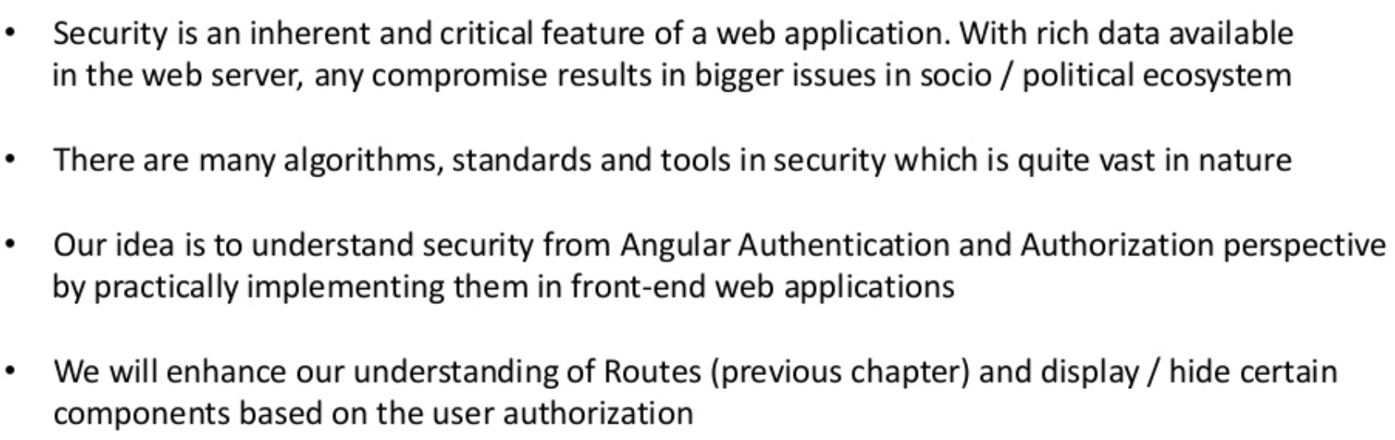
introduction

Slide 5
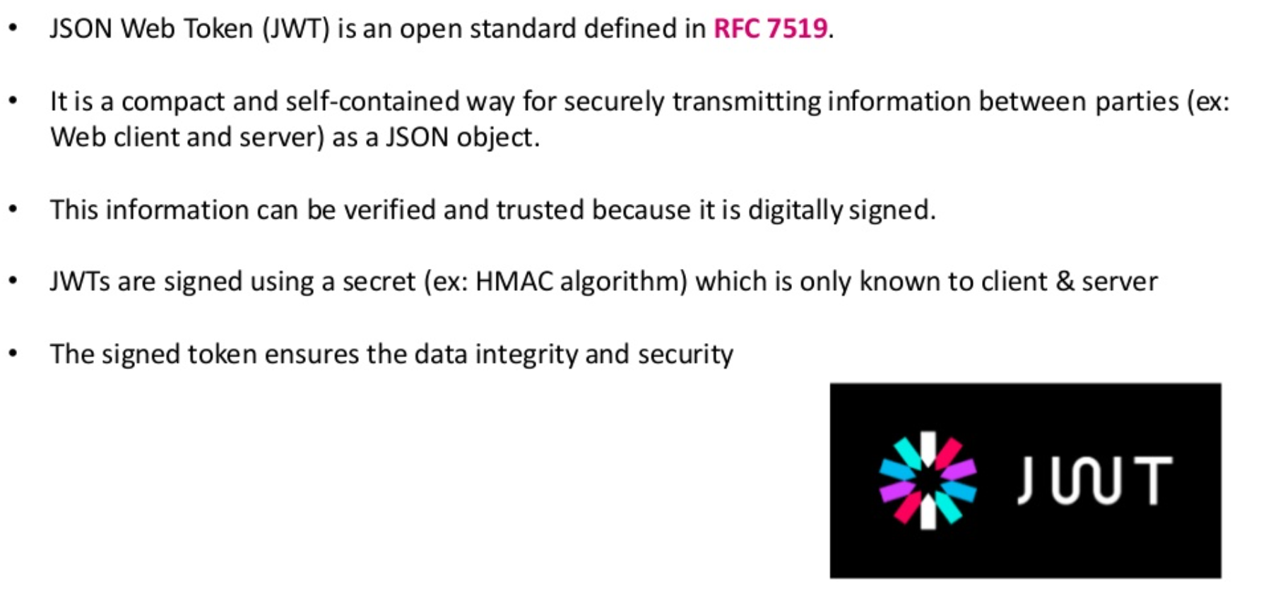
JSON Web Token (JWT)

Slide 6
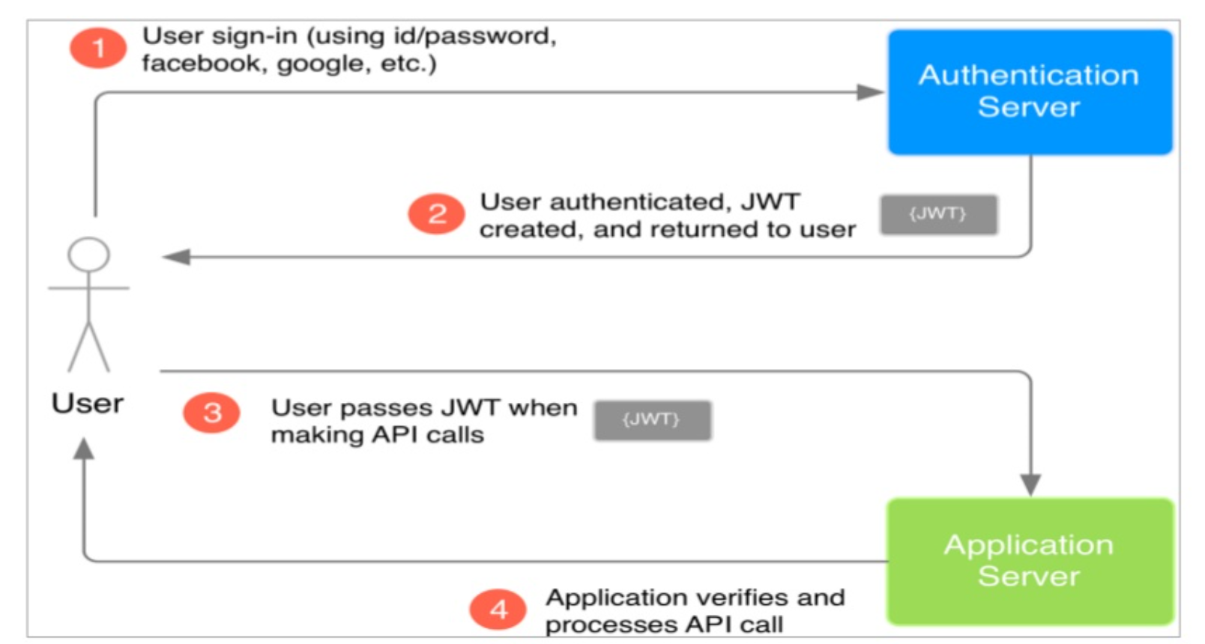
JWT CONTD..

Slide 7
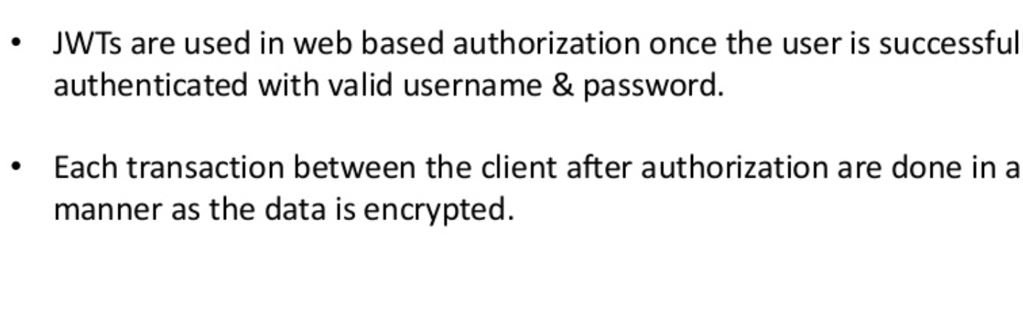
JWT Token’s Usage

Slide 8
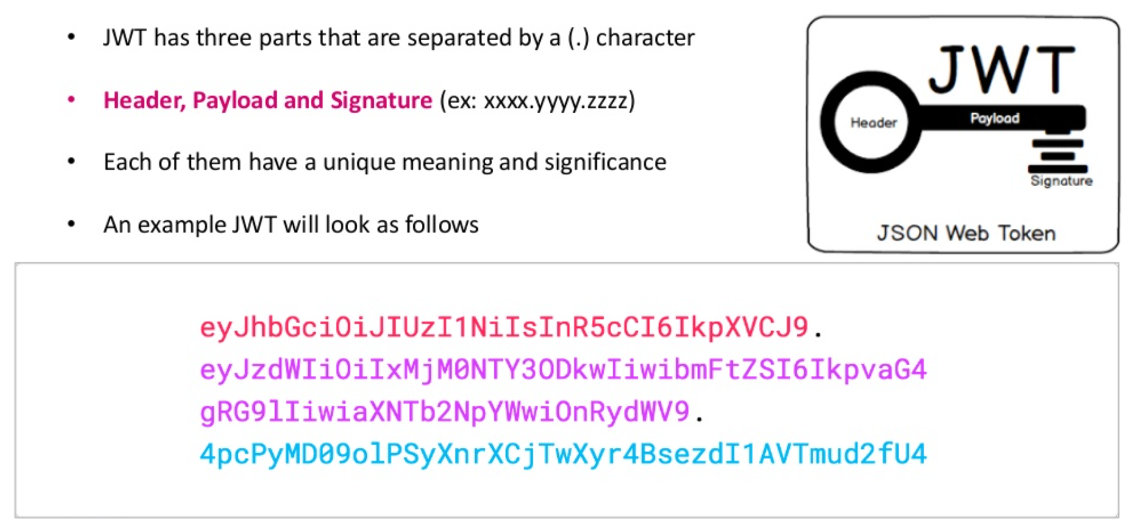
JWT Token’s Structure

Slide 9
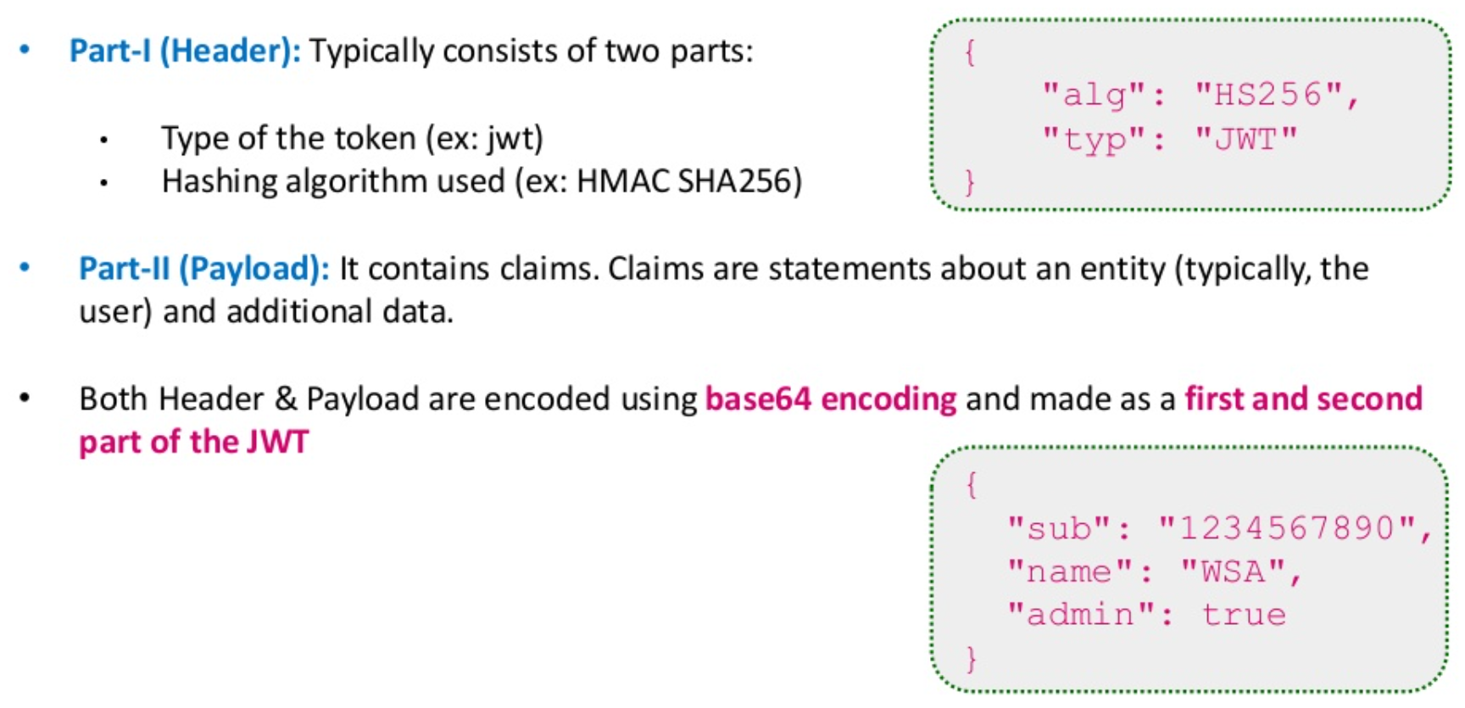
JWT Token’s Structure

Slide 10
JWT Token’s Structure

Slide 11
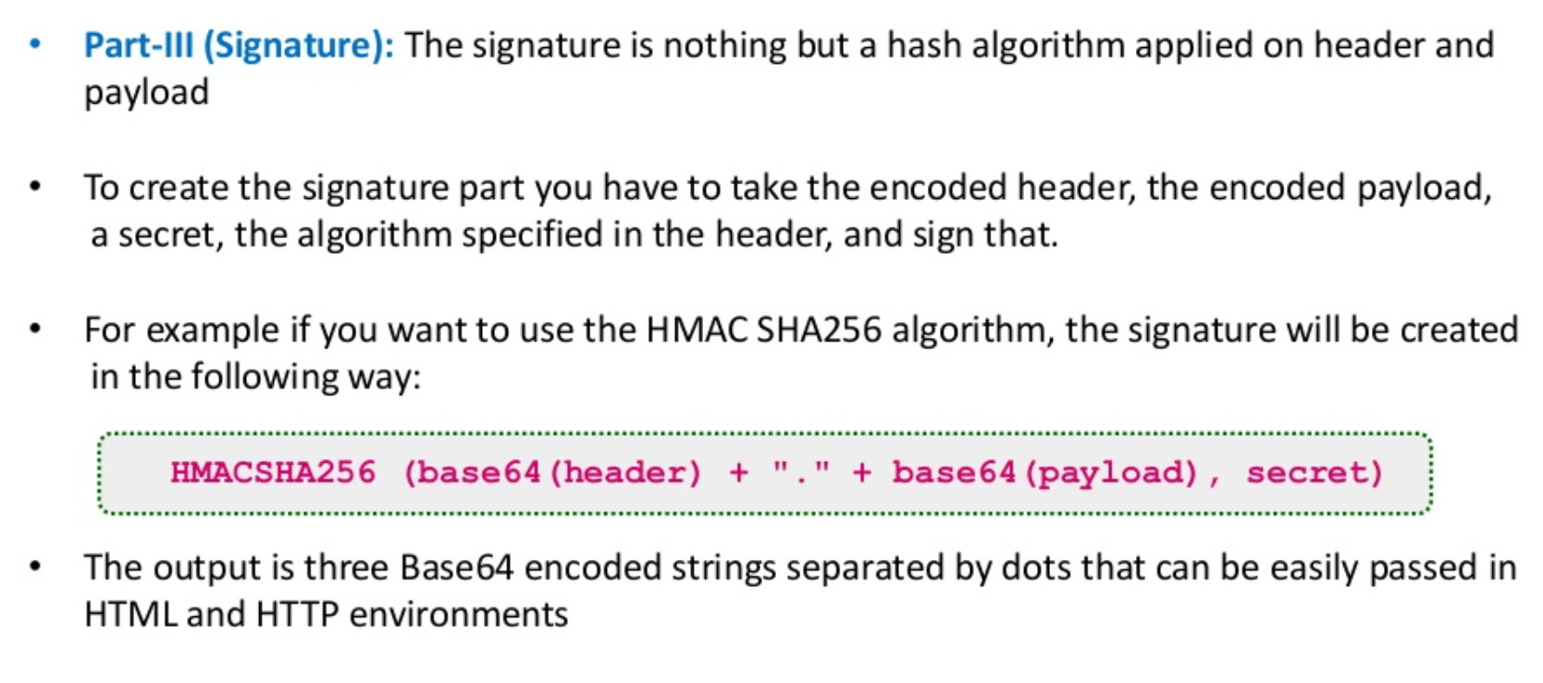
JWT Token’s Structure

