Slide 1
Test driven development

Slide 2
What is test driven development?
TDD is a development technique where a developer writes a unit test for new functionality before writing the actual functioning code.
The developer writes a unit test that asserts an expectation of the code. This test will fail until the developer writes the code that makes the test pass.
In TDD, you want to have the unit tests run as part of your Continuous Integration build process.
TDD takes discipline and it goes against any new developer’s natural tendency to write code first and then the tests later.
Adopting TDD will slow teams down at first as they adapt to it but will pay off in the long run with code quality, test coverage and reduced technical debt.

Slide 3
What is unit testing from a developer’s perspective?- my opinion
It is ..
It is not …
The act of writing automated tests that hook into your application to verify that your code is functioning as you expect.
Synonymous with the act of running your app and manually testing your application to see if your app works as expected.
- I refer to this as “testing”
or “integration testing”
depending on the scope.
Your opinion may vary, but personally I avoid using “unit testing” interchangeably for these two scenarios.

Slide 4
What makes a good unit test?
A meaningful assertion
- Example: You get much more value by verifying that your function does
what you want it to do,as opposed to simply verifying that your function exists.
Clean structure:
- Arrange, Act, Assert
- Given, When, Then
A meaningful description that reads like documentation.
- Example:
It(‘should call the Employee Service to fetch employee-related
information’, () => {
// blah
});
A thorough test should fail if the business logic in the associated code were to significantly change at a later time.

Slide 5
What makes a poor unit test?
An assertion that feels only partially done
- Example: An assertion that a page navigation occurs , without also asserting that the navigation applies to the expected page.
A description that doesn’t convey meaning or doesn’t read like a sentence.
- Example:
It(‘Employee Service- getDetails, () => {
// blah
});
If there is a significant change to the business logic in the code that is associated with your test and that change doesn’t break your test then your test probably is not sufficient.

Slide 6
Unit testing frameworks and tools
Jasmine
Karma
Mocha
Chai
Jest
Tape
JUnit
NUnit
… and many more!

Slide 7
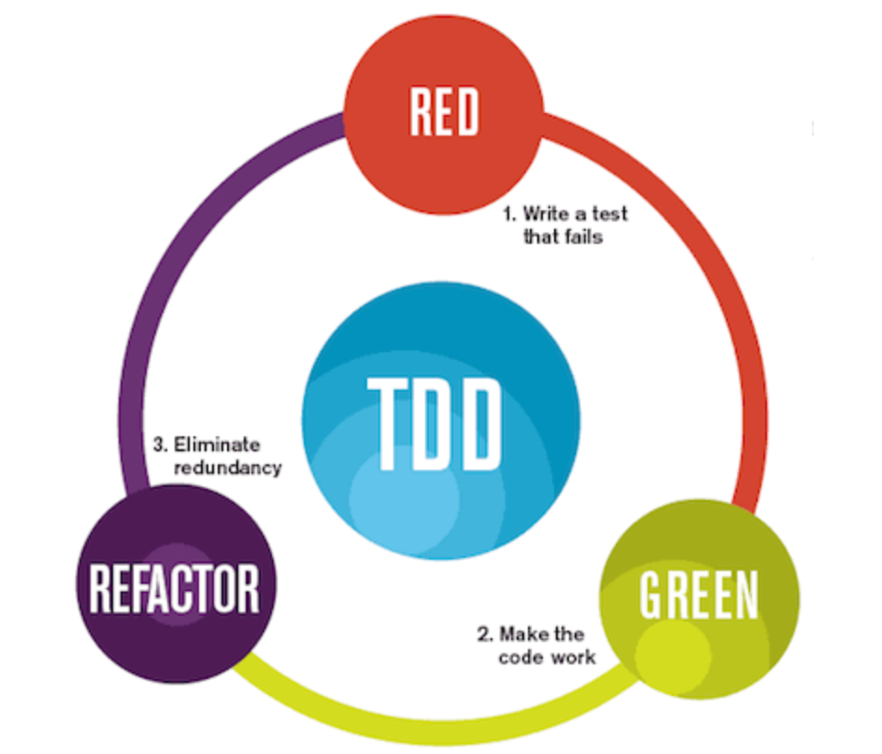
Unit testing frameworks and tools
Basic TDD Workflow:
- Red → Green → Refactor
Translation:
1) Write your test(s). This should fail (RED)
at this point because you haven’t written
any code.
2) Write the code that aligns with the test(s).
The goal is to make your code cause the
associated test(s) to pass (GREEN).
3) Refactor your code as needed.
4) Repeat this process and commit your code and test(s) when you’re ready

