Slide 1
Threat Model For Aaronic (oil and Energy) Website Using STRIDE analysis BY: ANENE JENNIFER IFUNANYA AND SECURITY TEAM OF 7 MEMBERS

Slide 2
INTRODUCTION
This report presents a threat model for Aaronic (Oil and energy) website, outlining potential security risks, vulnerabilities, and mitigation strategies to enhance its security posture.

Slide 3
OBJECTIVES
Identify Potential threats
Understand the Application Architecture
Identify and Classify Assets
Access Vulnerabilities
Identify threats and Risk levels
Define Mitigation strategies
Improve overall security postures

Slide 4
Identified Assets
User Data: vendor information, login credentials for databases.
Product Data: Product details, prices, inventory.
Website Availability: Ensuring the website remains operational and accessible.

Slide 5
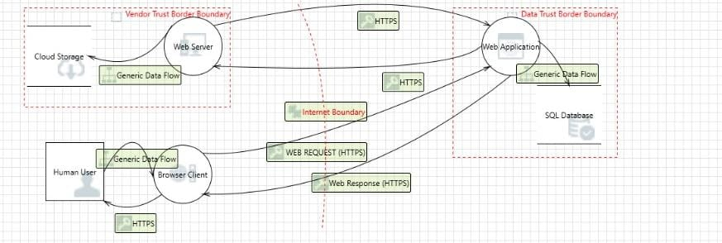
Data Flow Diagram

Slide 6
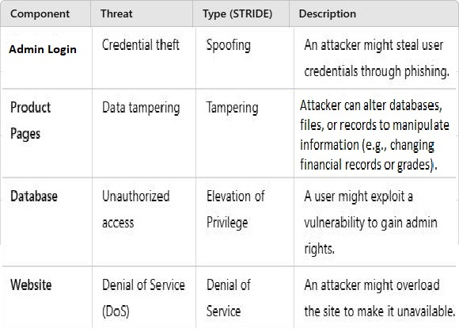
Identified Threats

Slide 7
Identified Vulnerabilities
Weak password policies allow brute-force attacks.
Lack of HTTPS encryption exposes data in transit.
Poor input validation enables SQL Injection attacks.
Misconfigured access controls may allow unauthorized database access.

Slide 8
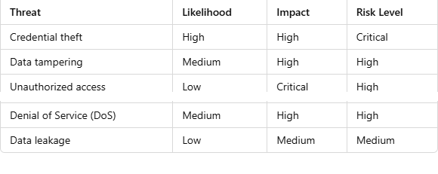
Risk Evaluation
This Risk Evaluation Matrix assesses cybersecurity threats based on their likelihood, impact, and overall risk level.
Credential theft is the most critical threat due to its high likelihood and high impact.
Unauthorized access has a low likelihood but a critical impact, making it a high-risk concern.
Denial of Service (DoS) and Data tampering are both medium-likelihood, high-impact threats, ranking as high risks.
Data leakage is a lower-priority risk with low likelihood and medium impact.
Overall, credential theft and unauthorized access pose the most significant risks, requiring strong mitigation strategies.

Slide 9
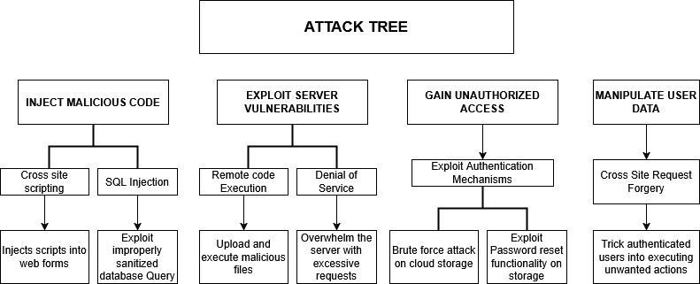
Attack Tree

Slide 10
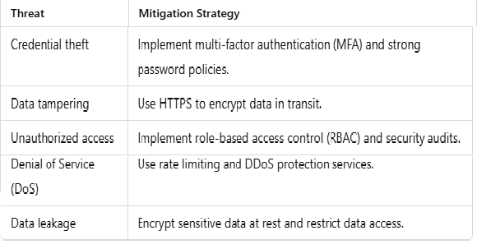
Mitigation Strategies

Slide 11
Conclusion
This threat model provides an in-depth analysis of the security threats facing Aaronic (Oil and Energy) website and proposes actionable mitigation strategies. Regular security audits, penetration testing, and continuous monitoring should be implemented to ensure the website remains protected against emerging threats.

