Slide 1



created by Anene Ifunanya
EXECUTIVEREPORT
CAPSTONE PROJECT – GRC208
April 22, 2026

Slide 2
PROBLEM AND OBJECTIVE
Problem
Traditional compliance is manual and slow
Cloud environments change rapidly
Leads to compliance gaps
Objective
Build an automated GRC platform on AWS
Enable continuous compliance monitoring
Improve visibility and audit readiness
Manual Compliance
Periodic Checks
Delayed detection
Human error risk
Automated GRC Platform
Continuous monitoring
Real-time alerts
Consistent enforcement

Slide 3
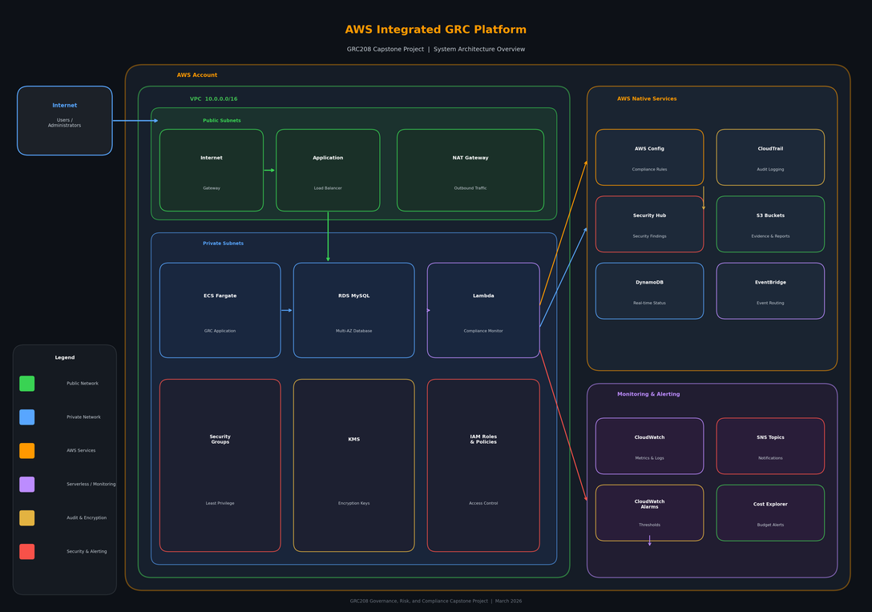
MULTI-TIER SYSTEM ARCHITECTURE
Network Layer (VPC, Subnets)
Data Layer (RDS, S3, DynamoDB)
Application Layer (Lambda, ECS)
Security & Monitoring (Config, CloudTrail, IAM)

Slide 4


KEY IMPLEMENTATION
CloudFormation - to deploy Infrastructure as Code
AWS Config - to continuously monitor 500+ resources
Lambda - to automate compliance checks
EventBridge - to trigger checks hourly
CloudTrail - to log all API activity

Slide 5
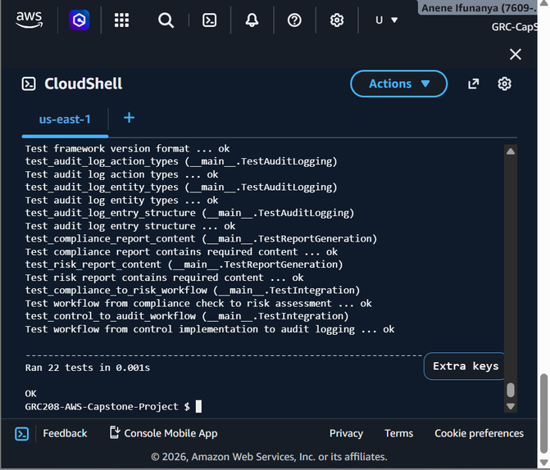
RESULTS AND VALIDATION
5/5 deployment phases completed
13+ AWS services deployed
22/22 tests passed
Continuous compliance monitoring enabled
Supports ISO, NIST, PCI DSS, HIPAA, GDPR, SOC 2

Slide 6


CHALLENGE AND CONCLUSION
Challenge
RDS was deployed in private subnet no external access
Solution
Used Lambda inside VPC to load data securely
Conclusion
Built a fully automated GRC system
Improved real-time compliance and visibility

Slide 7


THANK YOU
This learning opportunity significantly strengthened my understanding of compliance automation and cloud security.

