Slide 1

The distributed-representation of words
--the Word2Vec model inituion
powered by SA19225514 周渝茗

Slide 2

'Words' in computer:
1010100010100010101000101001
The Natural Language:
Love Liebe cest'la'vie 爱
Must find a way to teache computer how to treat natural language!!

Slide 3


Traditional way of representation
“This is my dream life.”
pipeline:
[1,0,0,0,0,0,0,0,...........]
build a vocabulary
find the index of each word in vocabulary
create a long vector which has the size of the vocabulary
computational expensive!

Slide 4
In One-Hot representaion,we lost information between each word.....
dog
cat
female
male
man
woman
In vector space,each word is orthogonality,they are completely independent from each other

Slide 5

The Word2Vec model
“We know a word's meaning by its context!”

Slide 6
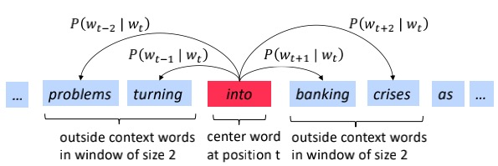
The Word2Vec model
CBOW: Use the context word to predict the center word
Skip-gram:Use the center word to predict context word

Slide 7
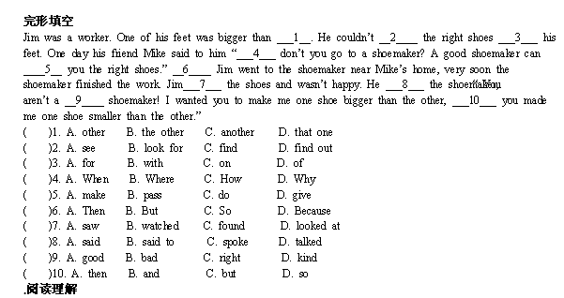
The Word2Vec model
the initution is so straightforward, all of us may have suffered from the Cloze test

Slide 8
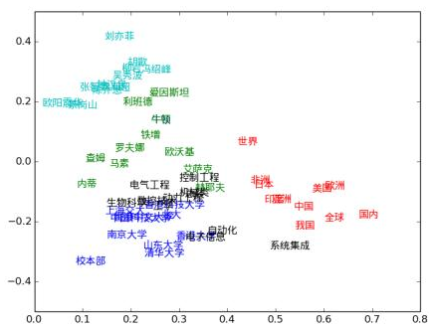
The Word2Vec model
Based on these models,we could get the wordvectors that are highly correlative

Slide 9

The Word2Vec model
Use the wordvector to explore the words
'父亲' - '母亲' = '祖父' - '祖母'
'国王' - '女王' = '皇帝' -'皇后'
The relationship between word could be reflect on vector space!

Slide 10
Some papers
Word2vec Parameter Learning Explained - Xin Rong
Efficient Estimation of Word Representation in Vector Space - Mikolov

Slide 11
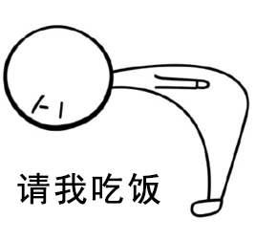
Thank You for Your Listening!

