Slide 1
Opening
1 / 72
Module 1: Harness Engineering for Coding Agents
Instructions, state, scope, and verification: what each piece assumes about the model, and how to measure it
Course repository shipharness
Module 1: Harness Engineering for Coding Agents
Notes:
Slide 1 of 72 | Opening | 0.5 min
Welcome. Tonight you see each harness piece at work on a real feature. You see the results of the
runs we made before class. Section 3 and the final are live A/Bs: both arms, side by side.
Everything you see is in the course repository.
Guide: docs/instructor-guide.md, "Section by section", Opening.

Slide 2
Opening
2 / 72
The problem: four failures to check for
• Cross-tenant data: an Acme user sees Globex issues
• A second session that redoes or breaks the first
• Edits outside the ticket
• The agent's own tests pass while the behaviour is wrong
• The referee checks every run for all four, in both arms
Module 1: Harness Engineering for Coding Agents
Notes:
Slide 2 of 72 | Opening | 2.5 min
Read the four failures. Then say: "Before class, no bare arm on the issue-search ticket shipped a
new tenant leak, so there is no screenshot of one to show. We come back to what that means at the
end." Runs: docs/evidence.md, Section 1.
Guide: docs/instructor-guide.md, "Section by section", Opening.

Slide 3
Opening
3 / 72
Why it happens: four causes
• "anything it can’t access in-context while running effectively doesn’t exist" (OpenAI, Harness engineering)
• "each new session begins with no memory of what came before." (Anthropic, Effective harnesses)
• Agents copy patterns and take hard-to-undo actions: four sources, side by side (Section 3)
• "agents reliably skew positive when grading their own work" (Anthropic, Harness design)
Module 1: Harness Engineering for Coding Agents
Notes:
Slide 3 of 72 | Opening | 2 min
One sourced line per cause. Cause 3 has no single source that says both halves, so Section 3 shows
its four sources side by side and does not merge them. Cause 4 also has a second source: in
SpecBench, the visible suite passes while held-out tests that combine features fail.
Guide: docs/instructor-guide.md, "Section by section", Opening.
Sources: docs/REFERENCES.md.

Slide 4
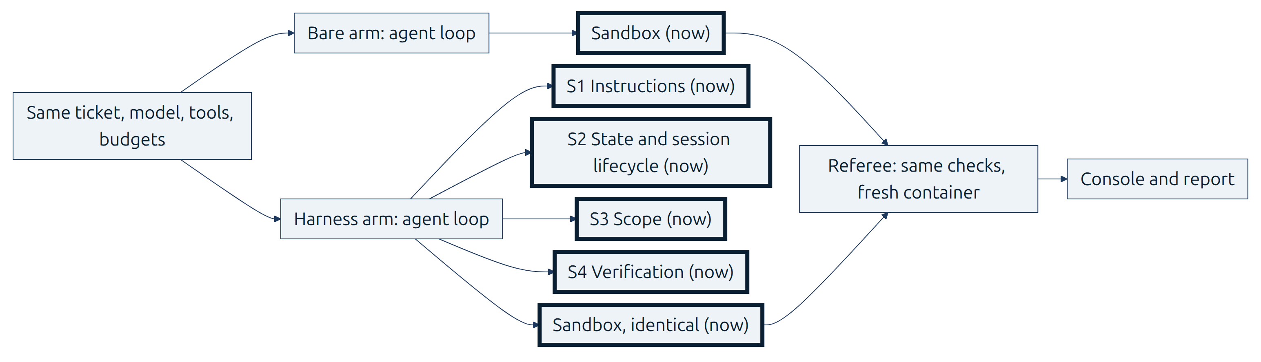
Opening
4 / 72
A harness encodes assumptions about the model
• The work: "design environments, specify intent, and build feedback loops" (OpenAI)
• "every component in a harness encodes an assumption about what the model can't do on its own" (Anthropic, Harness design)
• Assumptions change with the model: the same author later dropped context resets
• Four parts, S1 to S4, plus a sandbox that is the same for both arms
• The course's claim: measure each piece, keep what earns its place
Module 1: Harness Engineering for Coding Agents
Notes:
Slide 4 of 72 | Opening | 2 min
The Anthropic sentence goes on: "and those assumptions are worth stress testing". The OpenAI
article never defines "harness engineering", so no definition is attributed to it. The thick borders
and the word "now" mark all four parts and the sandbox. "Keep what earns its place" is how this
course puts it.
Guide: docs/instructor-guide.md, "Section by section", Opening.
Sources: docs/REFERENCES.md (OpenAI, Harness engineering; Anthropic, Harness design).

Slide 5
Opening
5 / 72
shipharness, TeamTrack, console
• shipharness: run an agent with or without the harness, A/B it, judge it
• TeamTrack: a multi-tenant issue tracker with two orgs, Acme and Globex
• Console: five screens on keys 1 to 5, F for full screen per arm
def run_and_judge(arm: Arm) -> tuple[AgentRunResult, ScoreRecord]:
result = run_arm(task, specs[arm], deps, bus, run_dir)
baseline.join()
referee.baseline() # computed by the thread (or now, if the thread failed)
return result, _judge(referee, specs[arm], result, bus, run_dir)
try:
with ThreadPoolExecutor(max_workers=2, thread_name_prefix="arm") as pool:
futures = {arm: pool.submit(run_and_judge, arm) for arm in arms}
done = {arm: future.result() for arm, future in futures.items()}
finally:
...
results = {arm: done[arm][0] for arm in arms}
platform/src/shipharness/ab/demo.py
Module 1: Harness Engineering for Coding Agents
Notes:
Slide 5 of 72 | Opening | 1.5 min
The code starts both arms at the same time. Each arm is judged by the same referee as soon as it
finishes. The finally block is folded. Show `Opening:publish` in the editor only.
Guide: docs/instructor-guide.md, "Section by section", Opening.
Source: anchor Opening:two_arms (platform/src/shipharness/ab/demo.py).

Slide 6
Opening
6 / 72
How we measure it
• Same agent, model, effort, task, repository, tools, sandbox, turn limit, and cost cap
• One referee judges what ships, the same way for both arms
• House rules R1 to R7: the course's name for OpenAI's "golden principles"
• One primary measure per section, registered before any run; results are counts
• No gap is reported as "no measurable difference on this task with this model"
• One piece at a time: "removing one component at a time" (Anthropic, Harness design)
Module 1: Harness Engineering for Coding Agents
Notes:
Slide 6 of 72 | Opening | 1 min
The bare arm gets every rule in docs/HANDBOOK.md; nothing is withheld. A section's A/B tests the
harness so far against the bare arm. Only taking one piece out tests that piece. The full sentence:
"removing one component at a time and reviewing what impact it had on the final result."
Guide: docs/instructor-guide.md, "Section by section", Opening.
Sources: platform/teamtrack/docs/HANDBOOK.md (R1 to R7); platform/datasets/README.md.

Slide 7
Opening
7 / 72
Check your setup
• Run make doctor now
• Run the harness-setup assessment on the bare TeamTrack
• Read the gaps it reports: instructions, state, scope, verification
Filled in live: make doctor output and the harness-setup assessment of the bare TeamTrack
Module 1: Harness Engineering for Coding Agents
Notes:
Slide 7 of 72 | Opening | 0.5 min
Run both live. The assessment reads files only and makes no model calls. Before class, the class
date was set and `make warm` ran: it builds the images if their source changed, starts each image
once, and caches the referee and gate baselines, so the first launch does not pay for start-up.
Guide: docs/instructor-guide.md, "Thirty minutes before".
Source: Makefile `doctor`, `warm`; use-in-your-repo/skills/harness-setup/scripts/assess.py.

Slide 8
S1 Instructions
8 / 72
Poll
• F1 org-wide issue search; rule at risk: R1 tenant isolation
• The ticket: a legacy handler without the tenant filter sits next to the right pattern
• Before class, 7 bare-arm runs took this ticket. How many shipped a new R1 violation?
• A) 0-1 B) 2-3 C) 4-5 D) 6-7
• Close the poll before the launch
Filled in live: the room's poll result
Module 1: Harness Engineering for Coding Agents
Notes:
Slide 8 of 72 | S1 Instructions | 3 min
The answer comes on slide 20. The 7 runs: the medium-effort round (3), the low-effort round (3),
and the class-settings round (1), all on the legacy-pattern ticket.
Guide: docs/instructor-guide.md, "Section by section", Section 1.

Slide 9
S1 Instructions
9 / 72
Launching harness in action: F1 org-wide issue search
• Now: run make show-1 in terminal B; it runs during slides 10-18, back on slide 19
• Harness in action: the harness arm alone on F1, live; not an A/B
• Watch for: which documents does it open before it writes code?
• The referee judges it live: R1 probes first ("primary verdict ready"), then the other checks
Module 1: Harness Engineering for Coding Agents
Notes:
Slide 9 of 72 | S1 Instructions | 2 min
Reload the console's run list and open the newest run. Stay on screen 1 while the container starts.
Why no live A/B here: before class F1 showed no gap (slide 20), so the class shows the layer at
work instead, live.
Timing: in a timed run before class (agent time limit then 300 s; now 420 s), the primary verdict
came 4:11 after launch and the full verdict 10:00 after launch. Cost $0.0197. Your output will
differ. Runs: docs/evidence.md, Captures.
Guide: docs/instructor-guide.md, "Section by section", Section 1.
Source: Makefile `show-1`; platform/teamtrack/reference/f1/task.toml.

Slide 10
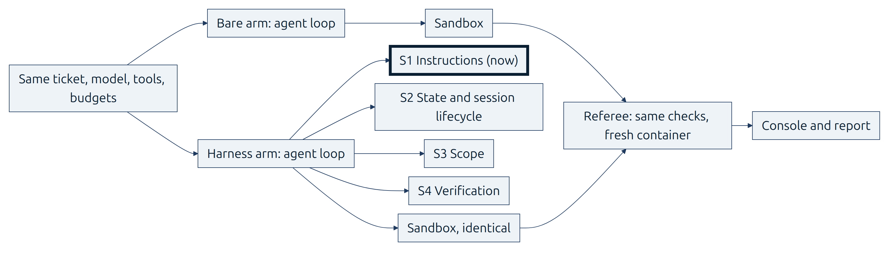
S1 Instructions
10 / 72
S1: what the agent knows
• Why an agent does not apply a rule that lives only outside its context
• Knowledge as a short AGENTS.md map into docs/, plus skills that load in tiers
• How to read the S1 result: new R1 violations per run, bare arm against harness arm
• The assumption the map encodes: the model will not apply a rule it has not been pointed to
Module 1: Harness Engineering for Coding Agents
Notes:
Slide 10 of 72 | S1 Instructions | 1.5 min
The first three bullets are the section's objectives. The one-line assumption is the course's
wording. Tonight's question: does it hold for this model on this ticket?
Guide: docs/instructor-guide.md, "Section by section", Section 1.

Slide 11
S1 Instructions
11 / 72
Problem: the rule is written down, the agent does not apply it
• F1 builds GET /issues, an org-wide issue search
• R1: another org's resource is 404, never 403
• The rule is in docs/HANDBOOK.md, and both arms can read it
• Nothing is withheld from the bare arm
Module 1: Harness Engineering for Coding Agents
Notes:
Slide 11 of 72 | S1 Instructions | 2 min
Both arms get every rule. The question is not whether the rule exists, but whether the agent
applies it.
Guide: docs/instructor-guide.md, "Section by section", Section 1.
Source: platform/teamtrack/docs/HANDBOOK.md (R1); platform/teamtrack/docs/features/f1.md.

Slide 12
S1 Instructions
12 / 72
Cause: what is not in context does not exist
• "anything it can’t access in-context while running effectively doesn’t exist"
• "A giant instruction file crowds out the task, the code, and the relevant docs"
• "Too much guidance becomes non-guidance."
• A long manual goes stale, and no check can keep it true
• Agents copy patterns that already exist, even uneven ones
Module 1: Harness Engineering for Coding Agents
Notes:
Slide 12 of 72 | S1 Instructions | 2.5 min
Cause 1 from the opening. All five lines are from OpenAI, Harness engineering. A handbook the agent
never opens does not exist for it.
Guide: docs/instructor-guide.md, "Section by section", Section 1.
Source: docs/REFERENCES.md (OpenAI, Harness engineering).

Slide 13
S1 Instructions
13 / 72
Harness piece: AGENTS.md as a map
• "roughly 100 lines", "a map", "the table of contents" (OpenAI)
• docs/ is the system of record
• OpenAI's layout: ARCHITECTURE.md at the root; SECURITY.md, RELIABILITY.md, QUALITY_SCORE.md, PLANS.md in docs/
• Also in docs/: design-docs/, product-specs/, references/
Module 1: Harness Engineering for Coding Agents
Notes:
Slide 13 of 72 | S1 Instructions | 3 min
TeamTrack's harness instructions follow this layout: platform/teamtrack/harness/instructions/. The
map points. The documents hold the rules.
Guide: docs/instructor-guide.md, "Section by section", Section 1.
Source: docs/REFERENCES.md (OpenAI, Harness engineering); platform/teamtrack/harness/instructions/.

Slide 14
S1 Instructions
14 / 72
Progressive disclosure
• Docs: "agents start with a small, stable entry point and are taught where to look next" (OpenAI)
• Skills load in three tiers: name and description, then the instructions, then resources
• Tier sizes from the Agent Skills spec: "< 5000 tokens recommended" for the instructions
• SKILL.md needs name and description
Module 1: Harness Engineering for Coding Agents
Notes:
Slide 14 of 72 | S1 Instructions | 3 min
Only tier 1, the name and description, sits in the context for every skill. The agent opens the
rest when a task needs it.
Guide: docs/instructor-guide.md, "Section by section", Section 1.
Source: docs/REFERENCES.md (OpenAI, Harness engineering; Agent Skills spec; Agent Skills, What are skills?).

Slide 15
S1 Instructions
15 / 72
Keep the map true
• Linters and CI jobs check the docs (OpenAI)
• Lint messages that teach: the error carries the fix into the agent's context
• Fairness: the bare arm gets every rule in docs/HANDBOOK.md
• A unit test checks that both forms carry each rule id
Module 1: Harness Engineering for Coding Agents
Notes:
Slide 15 of 72 | S1 Instructions | 3 min
The harness changes how knowledge is organised, not what the agent may know. OpenAI compares a map
with one giant instruction file. Our bare arm has the rules in a handbook on disk, so these runs did
not test OpenAI's comparison.
Guide: docs/instructor-guide.md, "Section by section", Section 1.
Source: docs/REFERENCES.md (OpenAI, Harness engineering); platform/tests/unit/harness_instructions/test_parity.py.

Slide 16
S1 Instructions
16 / 72
Code: the map
• The "Where to look" table of TeamTrack's AGENTS.md
• Each row: what you are about to do, and the document to read first
## Where to look
| When you are about to | Read first |
|---|---|
| add or change an endpoint | `.agents/skills/add-endpoint/SKILL.md` (step by step) |
| touch a router, service, repository, or model | `ARCHITECTURE.md` (layers, R6) |
| decide who may see or change data | `docs/SECURITY.md` (R1 tenant isolation, R2 roles) |
| shape a list, an error, or a status code | `docs/design-docs/api-conventions.md` (R3) |
| write a create endpoint or any write | `docs/RELIABILITY.md` (R4 idempotency, R5 audit) |
| change the database schema | `docs/RELIABILITY.md` (R7 migrations) |
| change issue or project behaviour | `docs/product-specs/teamtrack-base.md` |
| write or run tests | `docs/QUALITY_SCORE.md` (testing, known gaps) |
| plan a change or check the roadmap | `docs/PLANS.md` |
platform/teamtrack/harness/instructions/AGENTS.md
Module 1: Harness Engineering for Coding Agents
Notes:
Slide 16 of 72 | S1 Instructions | 3 min
The header and the first rows of the table. The house rules follow further down the same file.
Guide: docs/instructor-guide.md, "Section by section", Section 1.
Source: anchor S1:agents_md.

Slide 17
S1 Instructions
17 / 72
Code: skills, tier 1 only
• catalogue_block: one line per skill, name and description
• The full SKILL.md is never loaded up front; the agent reads it when the task matches
def catalogue_block(self) -> str:
skills = self.catalogue()
if not skills:
return ""
rows = [f"- {s.name}: {s.description} (read {s.path}/SKILL.md to use it)" for s in skills]
return (
"Available skills (load a skill's SKILL.md only when the task needs it):\n"
+ "\n".join(rows)
)
platform/src/shipharness/runner/skills_loader.py
Module 1: Harness Engineering for Coding Agents
Notes:
Slide 17 of 72 | S1 Instructions | 3.5 min
Section minute 25 falls on this slide: check terminal B for the `Cost:` line of `make show-1`. The
timing is in the notes of slide 9.
Guide: docs/instructor-guide.md, "Section by section".
Source: anchor S1:progressive.

Slide 18
S1 Instructions
18 / 72
Code: the stable prefix
• One stable text block: the map, then tier 1 of every skill
• The documents the map points to are not injected; the agent opens them
agents_md = strip_markers((source / MAP_FILE).read_text(encoding="utf-8")).strip()
blocks = [
"Repository map (AGENTS.md at the workspace root). It points to the documents to read "
"before you change code; open them with read_file when your task needs them.",
agents_md,
]
catalogue = SkillsLoader(source / SKILLS_DIR, workspace_prefix=SKILLS_DIR).catalogue_block()
if catalogue:
blocks.append(catalogue)
return "\n\n".join(blocks)
platform/src/shipharness/harness/instructions/router.py
Module 1: Harness Engineering for Coding Agents
Notes:
Slide 18 of 72 | S1 Instructions | 3.5 min
From `agents_md = ...` to `return`.
Guide: docs/instructor-guide.md, "Section by section", Section 1.
Source: anchor S1:prefix.

Slide 19
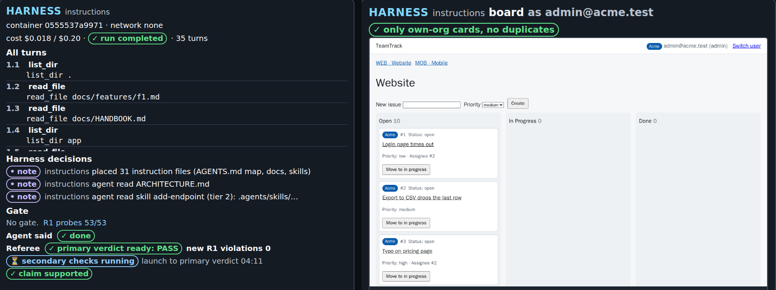
S1 Instructions
19 / 72
Demo block: what to watch
• Screen 1: build turns, test phase, "Agent said done", "primary verdict ready", full verdict
• Screen 3: files read and the diff map; screen 2: the board; screen 5: trace links
• Picture: screens 1 and 2 of a timed run of make show-1 before class
Filled in live: make show-1: the primary verdict and the documents the agent opened
Module 1: Harness Engineering for Coding Agents
Notes:
Slide 19 of 72 | S1 Instructions | 8 min
Walk the finished show-1 run on screens 1, 3, 5, and 2, in that order. In the timed run before
class (your output will differ): by minute 1 the build session was patching app/api/issues.py and
app/services/issues.py. By minute 3 the test phase had run and the agent said done. At 4:11 screen 1
showed "primary verdict ready: PASS" with new R1 violations 0. The secondary checks finished at
10:00. Its harness decisions: 31 instruction files placed (the AGENTS.md map, docs, skills); the
agent read ARCHITECTURE.md and the add-endpoint skill. Its third tool call opened docs/HANDBOOK.md.
Screen 2 shows one board frame: F1 changes no board pixels. The picture is cut to the harness panel.
Guide: docs/instructor-guide.md, "Section by section", Section 1.
Runs: docs/evidence.md, Captures.

Slide 20
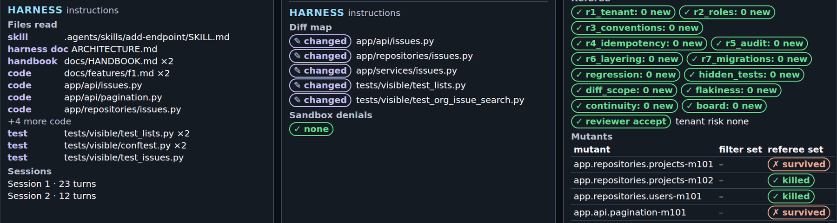
S1 Instructions
20 / 72
Demo block: reading the result
• The timed run: no new R1 violation; hidden tests 52 of 52; mutants 2 of 4
• One run shows the layer ran, not that it helped
• Before class: bare 0 of 7 failing, harness 0 of 7 (poll answer: A)
• No measurable difference: the bare arm applied R1 without the map
• Picture: screen 3 of the same run
Module 1: Harness Engineering for Coding Agents
Notes:
Slide 20 of 72 | S1 Instructions | 7 min
Read tonight's verdict from screen 1 first, then this slide. The timed run's arm line (your output
will differ): `harness completed claim=done primary={"r1_new_violations": 0} passed=True hidden
52/52 mutants 2/4 reviewer=accept cost=$0.0179`.
The 7 runs per arm: the medium-effort round (3), the low-effort round (3), the class-settings round
(1). An earlier round on the plain ticket gave the same, 0 of 3 per arm; in it every bare arm opened
the handbook with its third tool call. No arm copied the legacy handler into a leak. Post hoc means
chosen after the results were known, so it describes and never tests. Post hoc, over 10 runs per
arm: harness arms claimed done in 5, bare arms in 9; median cost per arm $0.0122 against $0.0103.
Guide: docs/instructor-guide.md, "Section by section", Section 1.
Runs: docs/evidence.md, Section 1.

Slide 21
S1 Instructions
21 / 72
Runbook and next
• Runbook: 01-instructions/demo/README.md
• Discussion: the map changed nothing on this ticket. What would have to be true for it to earn its place?
• Next: what happens when a session ends halfway
Module 1: Harness Engineering for Coding Agents
Notes:
Slide 21 of 72 | S1 Instructions | 5 min
Tie the discussion back to cause 1 (what is not in context does not exist) and to the claim that
every piece encodes an assumption about the model.
Guide: docs/instructor-guide.md, "Section by section", Section 1.

Slide 22
S2 State and session lifecycle
22 / 72
Poll
• F2 comments over two sessions; at risk: continuity and R7
• Before class, both arms stopped after 12 turns and restarted with an empty context
• In those 7 A/Bs, which arms failed the continuity measure?
• A) No arm B) Only bare arms C) Only harness arms D) Some of both
• Close the poll before the launch
Filled in live: the room's poll result
Module 1: Harness Engineering for Coding Agents
Notes:
Slide 22 of 72 | S2 State and session lifecycle | 3 min
The answer comes on slide 33. The 7 A/Bs: the medium-effort round (3), the low-effort round (3),
and the class-settings round (1). Each ran a 12-turn first session and a 38-turn second session.
Guide: docs/instructor-guide.md, "Section by section", Section 2.

Slide 23
S2 State and session lifecycle
23 / 72
Launching harness in action: F2 comments
• Now: run make show-2 SESSION_BUDGET=12,38 in terminal B; back on slide 32
• Harness in action: the harness arm alone on F2, first session 12 turns; not an A/B
• Watch for: the handoff written at the end of session 1, and session 2 resuming from it
• Harness arm layers: instructions, state
Module 1: Harness Engineering for Coding Agents
Notes:
Slide 23 of 72 | S2 State and session lifecycle | 2 min
Continuity failure, the primary measure: R7 fails, a second migration creates the same table, or
30% or more of session 1's added lines are removed in session 2.
Timing: in a timed run before class (agent time limit then 300 s; now 420 s), the primary verdict
came 6:46 after launch and the full verdict 9:52 after launch. Cost $0.0295. It exited 2: session 2
hit the agent time limit. That is a result, not a broken command. Your output will differ. Runs:
docs/evidence.md, Captures.
Guide: docs/instructor-guide.md, "Section by section", Section 2.
Source: Makefile `show-2`; platform/teamtrack/reference/f2/task.toml.

Slide 24
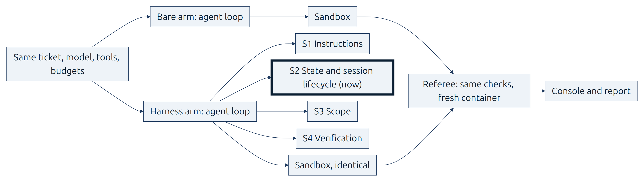
S2 State and session lifecycle
24 / 72
S2: what the agent remembers
• The initializer and coding agents, init.sh, the progress file, and git history
• An exec plan and a structured handoff that let a session resume after a reset
• How to read the S2 result: redone or lost work after a forced stop
• The assumption the state files encode: a fresh session cannot pick up the work from the repository alone
Module 1: Harness Engineering for Coding Agents
Notes:
Slide 24 of 72 | S2 State and session lifecycle | 2 min
The first three bullets are the section's objectives. Anthropic, Effective harnesses, states the
problem. The one-line assumption is the course's wording.
Guide: docs/instructor-guide.md, "Section by section", Section 2.

Slide 25
S2 State and session lifecycle
25 / 72
Cause: every session starts empty
• "each new session begins with no memory of what came before." (Anthropic, Effective harnesses)
• "However, compaction isn’t sufficient." (same source)
• What the last session knew must be written down where the next one reads it
Module 1: Harness Engineering for Coding Agents
Notes:
Slide 25 of 72 | S2 State and session lifecycle | 2.5 min
Cause 2 from the opening.
Guide: docs/instructor-guide.md, "Section by section", Section 2.
Source: docs/REFERENCES.md (Anthropic, Effective harnesses).

Slide 26
S2 State and session lifecycle
26 / 72
Harness piece: state on disk
• An initializer agent and a coding agent (Anthropic, Effective harnesses)
• init.sh and a progress file; the course names it progress.md
• Git history as state, and as a way back
• In this course, the initializer is a fixed harness step, not an agent
Module 1: Harness Engineering for Coding Agents
Notes:
Slide 26 of 72 | S2 State and session lifecycle | 3.5 min
In the source, the two agents differ only by their first prompt. In the course, the harness writes
the initial files itself.
Guide: docs/instructor-guide.md, "Section by section", Section 2.
Source: docs/REFERENCES.md (Anthropic, Effective harnesses); docs/architecture.md.

Slide 27
S2 State and session lifecycle
27 / 72
Getting up to speed, and ending a session
• The routine: pwd, progress and git log, the feature list, init.sh, a basic test
• "End the session by writing a git commit and progress update." (Anthropic, Effective harnesses)
• Both steps are the same in every session
Module 1: Harness Engineering for Coding Agents
Notes:
Slide 27 of 72 | S2 State and session lifecycle | 3 min
"Getting up to speed" is the source's own name for the routine.
Guide: docs/instructor-guide.md, "Section by section", Section 2.
Source: docs/REFERENCES.md (Anthropic, Effective harnesses).

Slide 28
S2 State and session lifecycle
28 / 72
Exec plans and the structured handoff
• Exec plans move from active to completed (OpenAI; OpenAI, PLANS.md)
• A context reset: a fresh agent "combined with a structured handoff" (Anthropic, Harness design)
• The course's mechanism is the session turn budget, the same for both arms
• A reset has a price: "orchestration complexity, token overhead, and latency"
• Later, a newer model "largely removed that behavior", so the author dropped context resets
Module 1: Harness Engineering for Coding Agents
Notes:
Slide 28 of 72 | S2 State and session lifecycle | 4 min
Say: "This stop is the session turn budget, the same for both arms. Anthropic calls the pattern a
context reset with a structured handoff. A piece that answers a model's weakness is kept only while
the weakness is there."
Guide: docs/instructor-guide.md, "Section by section", Section 2.
Source: docs/REFERENCES.md (OpenAI, Harness engineering; OpenAI, PLANS.md; Anthropic, Harness design).

Slide 29
S2 State and session lifecycle
29 / 72
Code: init.sh
• Migrations first: house rule R7, exactly one head
• Then a basic end-to-end test that stops at the first failure
echo "== migrations (house rule R7: exactly one head)"
python -m alembic heads
python -m alembic upgrade head
echo "== basic end-to-end test: issues, stop at the first failure (full suite: run_visible_tests)"
python -m pytest tests/visible/test_issues.py -x -q --no-header -p no:cacheprovider
platform/src/shipharness/harness/state/assets/init.sh
Module 1: Harness Engineering for Coding Agents
Notes:
Slide 29 of 72 | S2 State and session lifecycle | 3 min
From `echo "== migrations` to the pytest line.
Guide: docs/instructor-guide.md, "Section by section", Section 2.
Source: anchor S2:init.

Slide 30
S2 State and session lifecycle
30 / 72
Code: stop and resume
• resume_text: extra resume text for the harness arm
• The neutral resume sentence comes first, the same for both arms
• A test-phase session starts with the feature's tests
def resume_text(summary: str, phase: str = "build") -> str:
"""Extra resume text for the harness arm (the neutral resume sentence comes first)."""
text = (
"Start with the Getting up to speed steps before you change code. The structured "
"handoff from the last session is in session-handoff.md."
)
if phase == "test":
text = f"{text} {TEST_PHASE_FIRST}"
return f"{text} Its machine summary:\n\n{summary[:3000]}" if summary else text
platform/src/shipharness/harness/state/lifecycle.py
Module 1: Harness Engineering for Coding Agents
Notes:
Slide 30 of 72 | S2 State and session lifecycle | 4 min
Section minute 25 falls on this slide: check terminal B for the `Cost:` line of `make show-2`. The
timing is in the notes of slide 23.
Guide: docs/instructor-guide.md, "Section by section".
Source: anchor S2:stop_resume.

Slide 31
S2 State and session lifecycle
31 / 72
Code: the session log
• session_entry: one log line per session
• Index, start and end commit, how the session ended, and a summary
def session_entry(
result: SessionResult, files_changed: int, tests: str, claim_summary: str = ""
) -> str:
"""One log line: index, start/end commit, how the session ended, and a summary."""
entry = (
f"- Session {result.index} ({result.phase}): start {result.start_sha[:7] or 'none'}, "
f"end {result.end_sha[:7] or 'none'}, ended by {result.ended_by} after "
f"{result.turns} turns. {files_changed} files changed; visible tests {tests}."
)
summary = " ".join(mask_keys(claim_summary).split())[:200]
return entry + (f' Agent summary: "{summary}"' if summary else "")
platform/src/shipharness/harness/state/progress.py
Module 1: Harness Engineering for Coding Agents
Notes:
Slide 31 of 72 | S2 State and session lifecycle | 3 min
The next session reads this line while it gets up to speed.
Guide: docs/instructor-guide.md, "Section by section", Section 2.
Source: anchor S2:write.

Slide 32
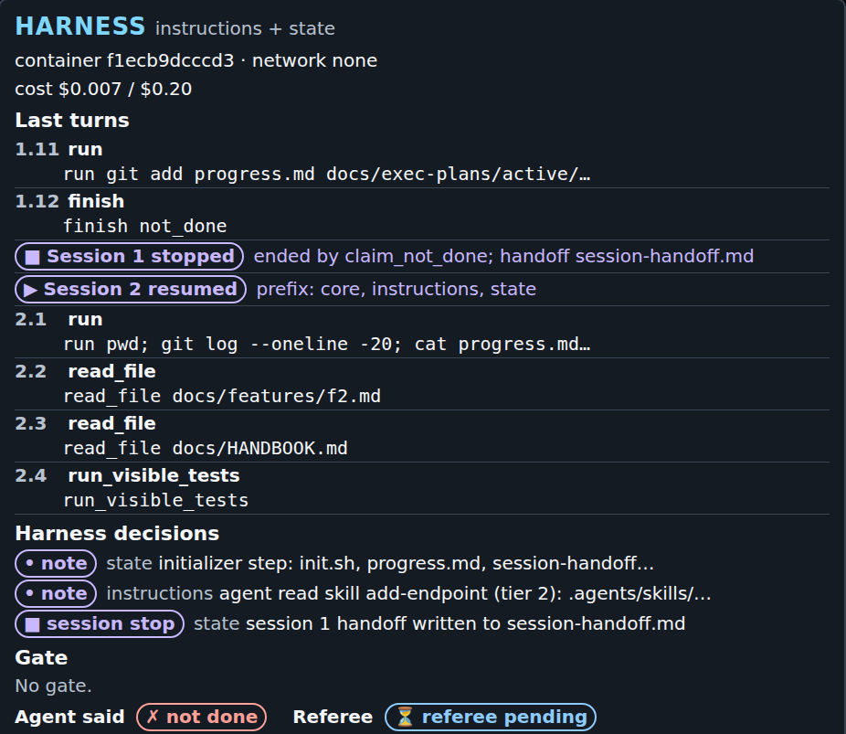
S2 State and session lifecycle
32 / 72
Demo block: what to watch
• Screen 1: "■ Session 1 stopped" with the handoff file, then "▶ Session 2 resumed"
• Session 2's first turn: pwd; git log; cat progress.md, the getting-up-to-speed routine
• Screen 3: "Sessions", the turns and how each session ended; screen 5: the trace links
• Picture: screen 1 of a timed run of make show-2 before class
Filled in live: make show-2: the primary verdict and the file session 2 read first
Module 1: Harness Engineering for Coding Agents
Notes:
Slide 32 of 72 | S2 State and session lifecycle | 8 min
In the timed run before class (your output will differ), about 2 minutes after launch, turn 1.11
committed progress.md and the exec plan, and turn 1.12 called `finish not_done`. Screen 1 showed
"Session 1 stopped: ended by claim_not_done; handoff session-handoff.md", then "Session 2 resumed".
Since a runner fix for both arms, that call ends only the session, so session 2 ran. In the
medium-effort round the same call had ended the whole build phase, and that arm passed 3 of 56
hidden tests. Session 2 began with `pwd; git log --oneline -20; cat progress.md`, then the ticket
and the handbook. The board showed "✓ only own-org cards, no duplicates". The picture is cut to the
harness panel.
Guide: docs/instructor-guide.md, "Section by section", Section 2.
Runs: docs/evidence.md, Captures.

Slide 33
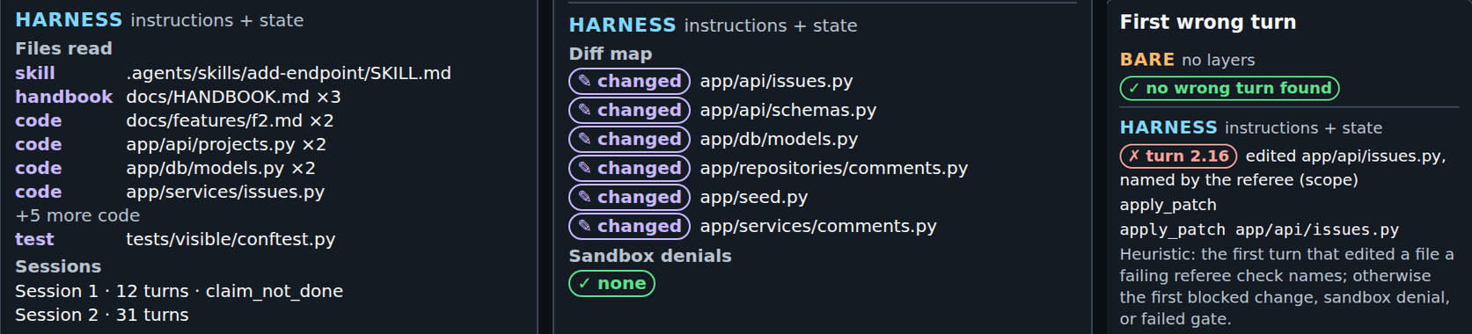
S2 State and session lifecycle
33 / 72
Demo block: reading the result
• The timed run: no continuity failure; hidden tests 56 of 56
• First wrong turn (screen 5, a heuristic): turn 2.16 edited app/api/issues.py
• Before class: bare 0 of 7 failing, harness 0 of 7 (poll answer: A)
• The measure cannot fail when session 1 builds nothing: 6 of 12 arms did
• Picture: screens 3 and 5 of the same run
Module 1: Harness Engineering for Coding Agents
Notes:
Slide 33 of 72 | S2 State and session lifecycle | 7 min
The timed run's arm line (your output will differ): `harness ABORTED: timeout claim=not_done
primary={"continuity_failure": false} passed=True hidden 56/56 mutants 0/4 reviewer=reject
cost=$0.0268`. Sessions: 12 turns, then 31. The diff-scope check is a secondary measure, and the F2
harness arm has no scope layer, so nothing stopped that edit. Exit code 2 means the arm stopped at a
time limit, not that the command broke.
The bare arm found its own state: in an earlier round its session 2 ran `git status` in its fourth
tool call. Post hoc over 9 runs per arm: harness arms hit the agent time limit in 4, bare arms in 0;
median wall time 361 s against 232 s. In the class-settings round, with the runner fix, both arms
built the feature: 56 of 56 hidden tests.
Guide: docs/instructor-guide.md, "Section by section", Section 2.
Runs: docs/evidence.md, Section 2.

Slide 34
S2 State and session lifecycle
34 / 72
Runbook and next
• Runbook: 02-state-lifecycle/demo/README.md
• Discussion: the bare arm found its own state with git status. Which state file would you keep, and how would you measure it?
• Next: a 10-minute break
Module 1: Harness Engineering for Coding Agents
Notes:
Slide 34 of 72 | S2 State and session lifecycle | 5 min
Section 3 launches its live A/B right after its poll. Nothing runs over the break.
Guide: docs/instructor-guide.md, "Section by section", Section 2.

Slide 35
Break
35 / 72
Break
Back in 10 minutes
Filled in live: return time
Module 1: Harness Engineering for Coding Agents
Notes:
Slide 35 of 72 | Break | 10 min
Write the return time on the slide.
Guide: docs/instructor-guide.md, "Section by section", Break.

Slide 36
S3 Scope and sandbox
36 / 72
Poll
• F4 optimistic concurrency, tonight's live A/B; at risk: scope
• The build may change the issue, audit, and web files; app/services/errors.py is not on the list
• Before class, 3 A/Bs ran this ticket. In how many did the bare arm ship a file outside the list?
• (a) 0 of 3 (b) 1 of 3 (c) 2 of 3 (d) 3 of 3
• Close the poll before the launch
Filled in live: the room's poll result
Module 1: Harness Engineering for Coding Agents
Notes:
Slide 36 of 72 | S3 Scope and sandbox | 3 min
Say before the vote: "The harness arm is not in the question. Its scope layer refuses any edit
outside the list, so its zero is built in." The answer comes on slide 47. The 3 A/Bs are the S3
confirmation: registered before any of its runs, class profile, 420 s agent time limit.
Guide: docs/instructor-guide.md, "Section by section", Section 3.

Slide 37
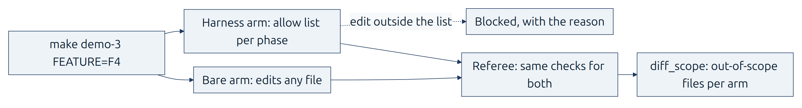
S3 Scope and sandbox
37 / 72
Launching a live A/B: F4, scope
• Now: run make demo-3 FEATURE=F4 in terminal B; it runs during slides 38-45, back on slide 46
• A live A/B: bare arm and harness arm, same ticket, same limits, at the same time
• Harness arm layers: instructions, state, scope
• Watch for: the bare arm's diff, and the harness arm's blocked edit with its reason
Module 1: Harness Engineering for Coding Agents
Notes:
Slide 37 of 72 | S3 Scope and sandbox | 2 min
Why a live A/B here: before class this ticket showed a real gap (slide 47), so the class runs the
comparison live. Each arm has its own sandbox with the same limits.
Timing: in the S3 confirmation A/B that ran alone, like tonight's (agent time limit 420 s), the bare
arm's primary verdict came 5:15 after launch and its full verdict 8:06; the harness arm's came 8:50
and 11:18. Cost $0.0487. The command exited 2: the harness arm stopped at the harness's own time
limit after shipping its change. Your output will differ. Runs: docs/evidence.md, Section 3.
Guide: docs/instructor-guide.md, "Section by section", Section 3.
Source: Makefile `demo-3`; platform/teamtrack/reference/f4/task.toml.

Slide 38
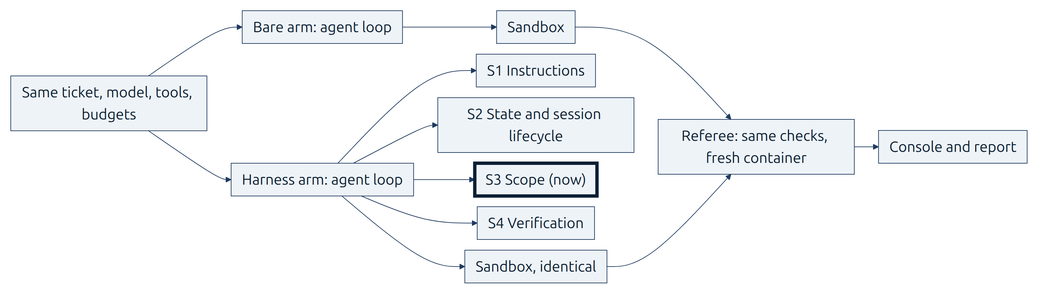
S3 Scope and sandbox
38 / 72
S3: what the agent may change and reach
• One feature at a time, allowed paths per phase, and a passes field only the harness sets
• The container limits for both arms, and how to read a sandbox_denied event
• How to read the S3 result: out-of-scope files in the shipped diff, bare arm against harness arm
• The assumption the scope layer encodes: the agent will change files outside the ticket unless code stops it
Module 1: Harness Engineering for Coding Agents
Notes:
Slide 38 of 72 | S3 Scope and sandbox | 2 min
The first three bullets are the section's objectives. The one-line assumption is the course's
wording. No single source sentence states the cause, so slide 39 shows its sources side by side.
Guide: docs/instructor-guide.md, "Section by section", Section 3.

Slide 39
S3 Scope and sandbox
39 / 72
Cause: copied patterns and hard-to-undo actions
• "Codex replicates patterns that already exist in the repository—even uneven or suboptimal ones" (OpenAI)
• "(Run this in a container, not your actual machine)"; the agent once ran pkill -9 bash (Anthropic, C compiler)
• File operations "to the project directory only" (Anthropic, Coding agent demo)
• Actions "that are difficult to reverse or affect shared systems" (Anthropic, Prompting best practices)
Module 1: Harness Engineering for Coding Agents
Notes:
Slide 39 of 72 | S3 Scope and sandbox | 2.5 min
Four sources side by side, not merged: no single source states cause 3. The last one is
supplementary.
Guide: docs/instructor-guide.md, "Section by section", Section 3.
Source: docs/REFERENCES.md.

Slide 40
S3 Scope and sandbox
40 / 72
Harness piece: one feature list, one feature
• feature_list.json as the source of truth; JSON over Markdown (Anthropic)
• The passes field, and one feature at a time
• "It is unacceptable to remove or edit tests because this could lead to missing or buggy functionality."
• In this course, only the harness sets passes, with evidence and testedAt
Module 1: Harness Engineering for Coding Agents
Notes:
Slide 40 of 72 | S3 Scope and sandbox | 3.5 min
In Anthropic, Effective harnesses, the agent sets `passes` itself. The course follows Anthropic,
Harness design, which separates the agent that does the work from the one that judges it. That
choice is the course's.
Guide: docs/instructor-guide.md, "Section by section", Section 3.
Source: docs/REFERENCES.md (Anthropic, Effective harnesses; Anthropic, Harness design; Anthropic, Coding agent demo).

Slide 41
S3 Scope and sandbox
41 / 72
Allowed paths per phase
• Build and test phases each have an allow list
• A patch outside the list is rejected
• A command's change outside the list is reverted
• The agent reads the reason, which names the phase and the list
• F4's build list leaves out app/services/errors.py
Module 1: Harness Engineering for Coding Agents
Notes:
Slide 41 of 72 | S3 Scope and sandbox | 3 min
OpenAI: "enforce boundaries centrally, allow autonomy locally." Allow lists per phase combine that
idea with the coding agent demo's project-directory limit; no single source describes them.
Guide: docs/instructor-guide.md, "Section by section", Section 3.
Source: docs/architecture.md; platform/teamtrack/reference/f4/task.toml; docs/REFERENCES.md.

Slide 42
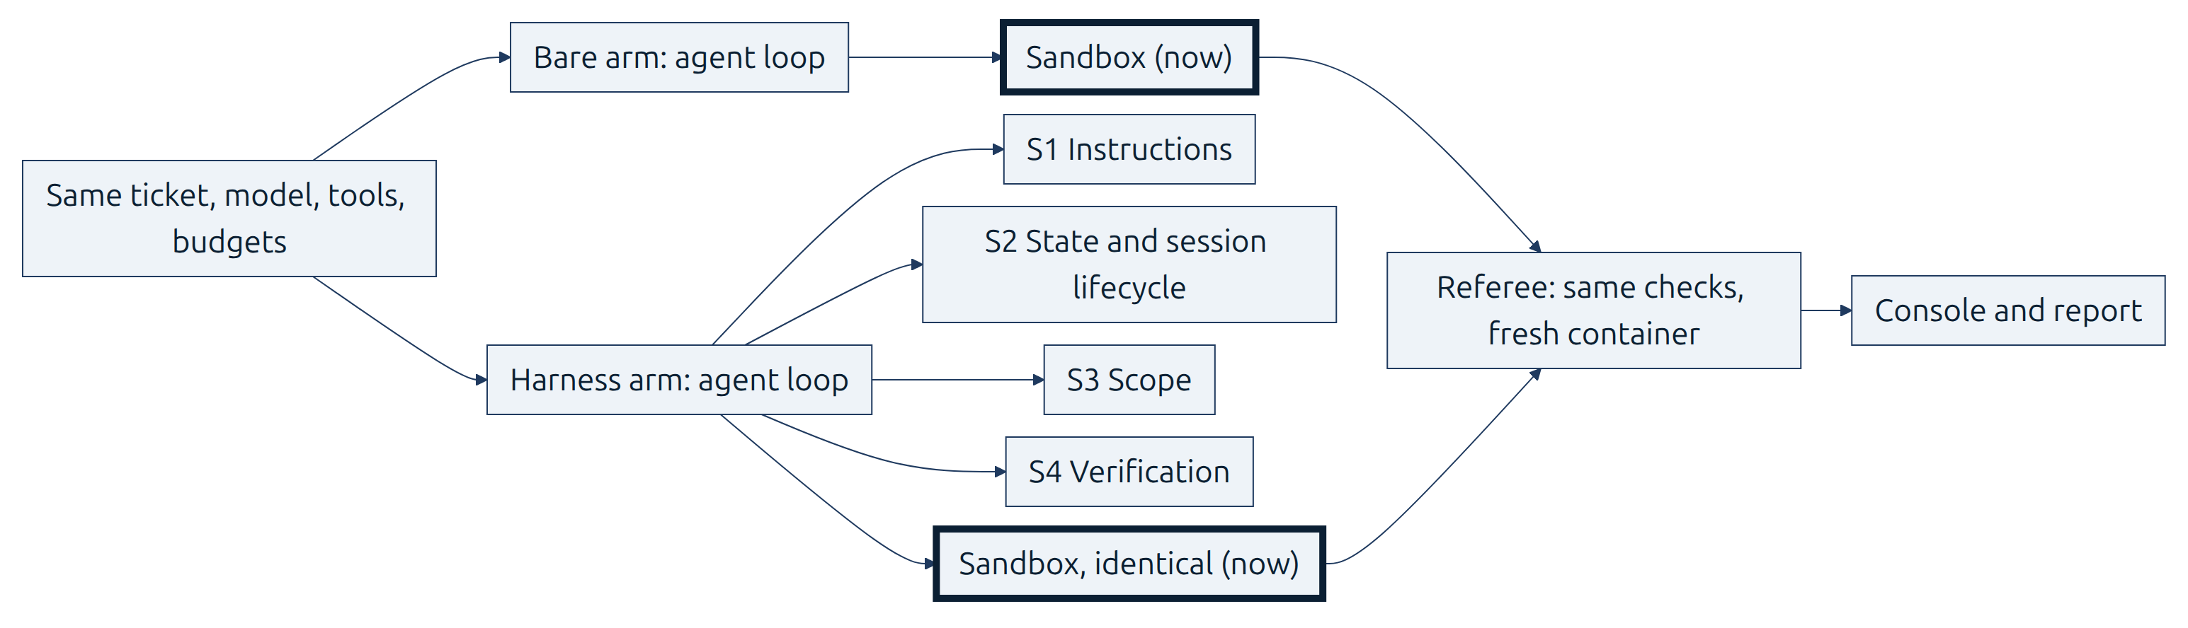
S3 Scope and sandbox
42 / 72
Sandbox 1: why a container
• "for each agent, a Docker container is spun up", with no internet access (Anthropic, C compiler)
• A three-layer security model (Anthropic, Coding agent demo)
• "By default, the agent runs with network access turned off." (Codex docs)
Module 1: Harness Engineering for Coding Agents
Notes:
Slide 42 of 72 | S3 Scope and sandbox | 2 min
The sandbox is highlighted on the diagram: one per arm, identical.
Guide: docs/instructor-guide.md, "Section by section", Section 3.
Source: docs/REFERENCES.md.

Slide 43
S3 Scope and sandbox
43 / 72
Sandbox 2: the same limits for both arms
• --network none, memory without swap, 256 processes, non-root
• Read-only root; only /work and /tmp writable; all capabilities dropped
• sandbox_denied events carry a reason code
• Never an A/B variable, so no run can tell whether it earns its place
• Kept on the sources' advice: a container per agent, no internet, project directory only
Module 1: Harness Engineering for Coding Agents
Notes:
Slide 43 of 72 | S3 Scope and sandbox | 2 min
Say: "The sandbox is the same for both arms. It is taught here, but it is never the variable."
Detailed sandbox design is a later module.
Guide: docs/instructor-guide.md, "Section by section", Section 3.
Source: docs/architecture.md (sandbox policy); 03-scope-sandbox/concepts.md.

Slide 44
S3 Scope and sandbox
44 / 72
Code: allowed paths and evidence
• The three if checks of reason(): harness-only files, state files, the allow list
• passes is set only when the evidence is there
if rel in HARNESS_ONLY:
return HARNESS_ONLY[rel]
if self.state_files and any(glob_matches(rel, p) for p in STATE_FILES):
return None
if self.allowed is None or any(glob_matches(rel, p) for p in self.allowed):
return None
platform/src/shipharness/harness/scope/guard.py
if evidence is None:
message = f"passes stays false for {feature['id']}: {why_not}"
return [HarnessDecision(kind="note", layer="scope", message=message)]
tested_at = now().astimezone(UTC).strftime("%Y-%m-%dT%H:%M:%SZ")
feature.update(passes=True, evidence=evidence, testedAt=tested_at)
platform/src/shipharness/harness/scope/status.py
Module 1: Harness Engineering for Coding Agents
Notes:
Slide 44 of 72 | S3 Scope and sandbox | 5 min
The string `reason()` returns is what the harness arm reads tonight when it tries to edit
`app/services/errors.py`. Section minute 25 is the switch to slide 45: check terminal B for the
`Cost:` line of `make demo-3` (the timing is in the notes of slide 37).
Guide: docs/instructor-guide.md, "Section by section".
Source: anchors S3:allowed_paths, S3:passes.

Slide 45
S3 Scope and sandbox
45 / 72
Code: the sandbox policy
• SandboxPolicy: the same for both arms in every run
• Network, CPU, memory, swap, processes, user, root, tmpfs, capabilities
network: str = "none" # only loopback inside the container
cpus: float = 1.0
memory_mb: int = 1024
swap_mb: int = 0 # --memory-swap equal to --memory: no swap
pids_limit: int = 256
user: str = "1000:1000" # non-root
read_only_root: bool = True # writes only to /work (workspace) and /tmp
tmpfs: dict[str, str] = {"/tmp": "rw,nosuid,size=256m"}
cap_drop: tuple[str, ...] = ("ALL",)
no_new_privileges: bool = True
platform/src/shipharness/sandbox/policy.py
Module 1: Harness Engineering for Coding Agents
Notes:
Slide 45 of 72 | S3 Scope and sandbox | 5 min
Fields from `network` to `no_new_privileges`. Show `S3:run_args` and `S3:dockerfile` in the editor
only.
Guide: docs/instructor-guide.md, "Section by section", Section 3.
Source: anchors S3:policy, S3:run_args, S3:dockerfile.

Slide 46
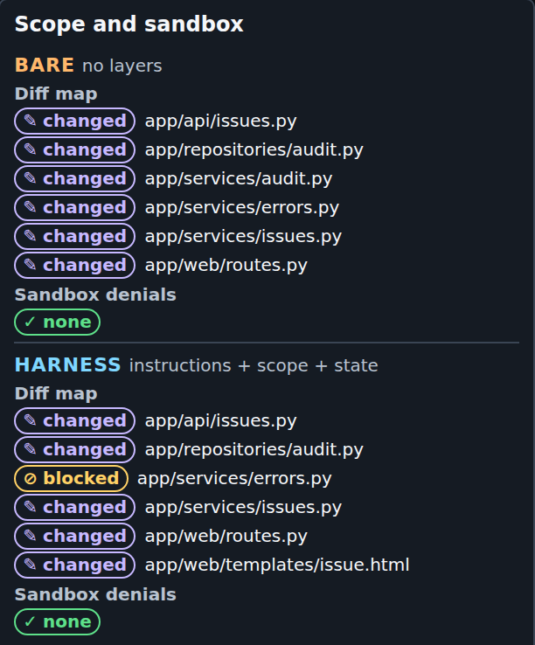
S3 Scope and sandbox
46 / 72
Demo block: what to watch
• Screen 3, Scope and sandbox: the bare arm changed app/services/errors.py
• The harness arm's diff map shows the same file as ⊘ blocked
• Screen 1: the harness decision ⊘ block, with the reason the agent read
• Screen 3, Verification: diff_scope per arm; Sandbox denials for both
• Picture: screen 3 of an S3 confirmation A/B before class
Filled in live: make demo-3 FEATURE=F4: each arm's diff map and its diff_scope line
Module 1: Harness Engineering for Coding Agents
Notes:
Slide 46 of 72 | S3 Scope and sandbox | 8 min
In the S3 confirmation A/B that ran alone (your output will differ; times from the arms' start):
the harness arm read the add-endpoint skill at 0:25. At 1:16 its patch to app/services/errors.py
was blocked: "app/services/errors.py: outside the allowed paths for the build phase". Both arms
claimed done about 3 minutes in. The bare arm's diff map lists six changed files, among them
app/services/errors.py. The harness arm's lists five changed files and one blocked file. Neither arm
had a sandbox denial. If tonight's run records a `sandbox_denied` event, show its reason code and
command. Otherwise show the policy printout.
Guide: docs/instructor-guide.md, "Section by section", Section 3.
Runs: docs/evidence.md, Section 3.

Slide 47
S3 Scope and sandbox
47 / 72
Demo block: reading the result
• Before class: in scope, bare 0 of 3, harness 3 of 3 (poll answer: d)
• Harness ahead, by construction: the guard enforces what this measures
• New: on this ticket the bare agent edits a shared file every time
• The pill on screen 1 is F4's own bar, and every arm failed it
• S3's own ticket, F3: no measurable difference, 7 of 7 each
• Picture: screen 1 of the same A/B, the verdict lines
Module 1: Harness Engineering for Coding Agents
Notes:
Slide 47 of 72 | S3 Scope and sandbox | 7 min
Read tonight's `diff_scope` lines first, then this slide. If tonight's bare arm stays in scope, say
so: one A/B is one dot.
The S3 confirmation was registered before any of its runs: F4 ticket, the S3 layer stack, class
profile with the 420 s agent time limit, 3 A/Bs, primary measure for this confirmation only: one or
more out-of-scope files fails. Every bare arm changed app/services/errors.py. Every harness arm was
refused that edit. The harness arms stopped at the harness's own 120 s limit, each after shipping
its change. F4's own measure needs all 69 hidden tests and all 4 referee mutants; the arms passed 62
to 68 of 69 hidden tests, so all six failed it.
The F3 result: the medium-effort round, the low-effort round, and the class-settings round, 7 runs
per arm, on the ticket with the tempting shared middleware. Post hoc, before the confirmation, bare
arms on F4 had left the allowed paths in 6 of 6 runs, harness arms in 0 of 6. That count led to the
registered confirmation.
Guide: docs/instructor-guide.md, "Section by section", Section 3.
Runs: docs/evidence.md, Section 3.

Slide 48
S3 Scope and sandbox
48 / 72
Runbook and next
• Runbook: 03-scope-sandbox/demo/README.md
• Discussion: the guard won by construction. What would you measure next to it, so a guard that blocks everything cannot look good?
• Next: who decides that the work is done
Module 1: Harness Engineering for Coding Agents
Notes:
Slide 48 of 72 | S3 Scope and sandbox | 5 min
Expected direction: hidden tests passed and existing tests that keep passing, next to out-of-scope
files. A guard that blocks every edit scores zero out-of-scope files and ships nothing.
Guide: docs/instructor-guide.md, "Section by section", Section 3.

Slide 49
S4 Verification
49 / 72
Poll
• F4 again, now with all four layers; at stake: hidden tests (69) and referee mutants (4)
• A run passes only with all 69 hidden tests passing and all 4 mutants killed
• Before class, 4 A/Bs ran F4 with all four layers in the harness arm. Which arm passed more often?
• A) Harness arm B) Bare arm C) Both, equally often D) Neither arm passed once
• The final feature poll follows on slide 50
Filled in live: the room's poll result
Module 1: Harness Engineering for Coding Agents
Notes:
Slide 49 of 72 | S4 Verification | 3 min
The answer comes on slide 62. The 4 A/Bs: the medium-effort round (3) and the class-settings round
(1). Hint after the vote: one referee mutant makes writes stop moving the version, which brings back
lost updates. A shipped test catches it only if it checks that a write moves the ETag, or that a
save with the old version gets 412.
Guide: docs/instructor-guide.md, "Section by section", Section 4.

Slide 50
S4 Verification
50 / 72
Poll: the final feature
• F5 Bulk close: one session of 30 turns; 46 hidden tests, 3 referee mutants
• F6 Watchers: two sessions, so a context reset; 54 hidden tests, 3 mutants
• F7 Labels: two sessions, so a context reset; 64 hidden tests, 3 mutants
• The winner runs as the final live A/B, and the runner-up after it if the session figure allows
• Close the poll before the launch
Filled in live: the room's poll result
Module 1: Harness Engineering for Coding Agents
Notes:
Slide 50 of 72 | S4 Verification | 1 min
Some hidden tests combine the new feature with an earlier one.
Guide: docs/instructor-guide.md, "Section by section", Section 4.
Source: final-project/README.md; platform/teamtrack/reference/f5/task.toml to f7.

Slide 51
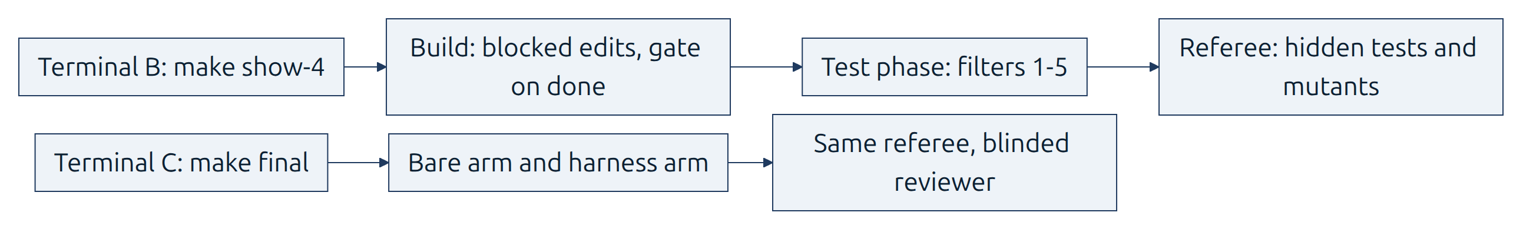
S4 Verification
51 / 72
Launching harness in action on F4, and the final A/B
• Now: make show-4 in terminal B, then make final FEATURES=<poll winner> in terminal C
• show-4 runs during slides 52-60, back on slide 61; the final returns on slides 64-67
• show-4: the harness arm alone on F4; watch the gate, the test phase, and the filters
• The final: both arms, all four layers, the blinded reviewer on both diffs
Module 1: Harness Engineering for Coding Agents
Notes:
Slide 51 of 72 | S4 Verification | 2 min
`make final` runs its features one after another, so at most one A/B and one harness-in-action run
are live at a time. The class profile is the same for both arms: effort low, the Fast tier, 2 CPUs
per container, the early primary verdict, five flakiness re-runs, and a 420 s agent time limit.
Final run cap $0.25 per arm.
Timing for show-4: in a timed run before class (agent time limit then 300 s; now 420 s), the primary
verdict came 9:19 after launch and the full verdict 10:55. Cost $0.0265. It exited 2: the agent time
limit ended the test phase.
Timing for the final: a timed run of `make final FEATURES=F5` before class took 12 min 47 s. The
bare arm's verdicts came at 3:27 and 6:50, the harness arm's at 9:48 and 12:32 (it hit the agent
time limit, exit 2). Cost $0.0456. The final must be finished by 3:40, when slide 64 opens the final
block. Your output will differ. Runs: docs/evidence.md, Captures.
Guide: docs/instructor-guide.md, "Section by section", Section 4.
Source: Makefile `show-4`, `final`; platform/teamtrack/reference/f4/task.toml; platform/teamtrack/mutants/features/f4.jsonl.

Slide 52
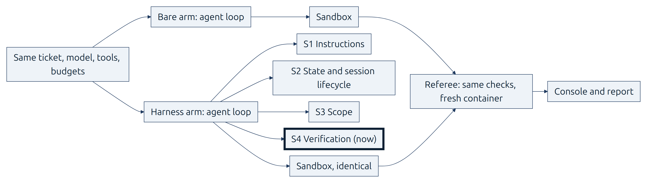
S4 Verification
52 / 72
S4: what proves the work is done
• Verification the agent does not control: filters, mutants, house-rule checks, held-out tests, reviewer, gate
• Find the first wrong turn in a trace
• Read a fair A/B: hidden tests passed and mutants caught, as counts per run
• The assumption the gate and filters encode: the agent's "done" and its own tests cannot be trusted
Module 1: Harness Engineering for Coding Agents
Notes:
Slide 52 of 72 | S4 Verification | 1 min
The first three bullets are the section's objectives. The one-line assumption is the course's
wording, based on Anthropic, Harness design, and Anthropic, C compiler.
Guide: docs/instructor-guide.md, "Section by section", Section 4.

Slide 53
S4 Verification
53 / 72
Cause: self-grading and visible tests
• "agents reliably skew positive when grading their own work" (Anthropic, Harness design)
• "while every frontier agent saturates the visible suite, reward hacking persists" (SpecBench)
• Mostly features that pass alone and fail when combined (SpecBench)
• "it is easy to see tests pass and assume the job is done, when this is rarely the case." (Anthropic, C compiler)
Module 1: Harness Engineering for Coding Agents
Notes:
Slide 53 of 72 | S4 Verification | 2.5 min
Cause 4 from the opening.
Guide: docs/instructor-guide.md, "Section by section", Section 4.
Source: docs/REFERENCES.md.

Slide 54
S4 Verification
54 / 72
Harness piece: test filters
• Filters 1-3 from TestGen-LLM (Meta): builds, passes reliably, adds coverage
• Passes reliably: "every one of five executions"; the referee also re-runs shipped tests five times
• Filters 4 and 5 are the course's own: real assertions, no source change in the test phase
• A test is kept only if it passes every filter
Module 1: Harness Engineering for Coding Agents
Notes:
Slide 54 of 72 | S4 Verification | 3 min
Say at the filter table: "Filters 1 to 3 are TestGen-LLM's. 4 and 5 are this course's." The
referee's flakiness check runs each shipped test five times, for both arms.
Guide: docs/instructor-guide.md, "Section by section", Section 4.
Source: 04-verification/concepts.md; docs/REFERENCES.md (TestGen-LLM).

Slide 55
S4 Verification
55 / 72
Mutants and hidden tests
• ACH (Meta): mutants for the fault you care about, then tests that catch them
• ACH reports that 49% of tests that uniquely kill a mutant add no line coverage
• Filter-set and referee-set mutants never overlap (course design)
• Hidden tests that combine features (SpecBench)
• 441 hidden tests across F1-F7 and controls; 69 for F4
Module 1: Harness Engineering for Coding Agents
Notes:
Slide 55 of 72 | S4 Verification | 3 min
The referee-set mutants were never visible to the filters.
Guide: docs/instructor-guide.md, "Section by section", Section 4.
Source: 04-verification/concepts.md; docs/REFERENCES.md (ACH; SpecBench); counts in 04-verification/post-class-reading/04-held-out-tests-specbench.md.

Slide 56
S4 Verification
56 / 72
A separate evaluator and a gate
• A blinded reviewer with grading criteria (Anthropic, Harness design)
• A clean-state gate (Anthropic, Effective harnesses; Anthropic, C compiler)
• House rules R1 to R7, checked by code
• "It is worth the cost when the task sits beyond what the current model does reliably solo." (Anthropic, Harness design)
Module 1: Harness Engineering for Coding Agents
Notes:
Slide 56 of 72 | S4 Verification | 3 min
Anthropic, Harness design, calls the separation of doer and judge "a strong lever", but notes that
the evaluator still tends to be generous. The quoted sentence starts: "The practical implication is
that the evaluator is not a fixed yes-or-no decision."
Guide: docs/instructor-guide.md, "Section by section", Section 4.
Source: docs/architecture.md; docs/REFERENCES.md.

Slide 57
S4 Verification
57 / 72
Measure each piece
• Read the trace: find the first wrong turn; screen 5 shows it per arm, as a heuristic
• Measure one piece: "removing one component at a time and reviewing what impact it had on the final result."
• In shipharness: make demo-N LAYERS=-<layer> runs one A/B without that layer
• A section's A/B tests the stack so far; only taking one piece out tests that piece
Module 1: Harness Engineering for Coding Agents
Notes:
Slide 57 of 72 | S4 Verification | 1.5 min
The course planned a batch that leaves out one layer at a time. It was not run, because the gate
registered before the runs did not pass, so the course has no per-layer result to show.
Guide: docs/instructor-guide.md, "Section by section", Section 4.
Source: docs/REFERENCES.md (Anthropic, Harness design); docs/architecture.md.

Slide 58
S4 Verification
58 / 72
Code: the filter pipeline
• Each proposed test goes through the filters in order
• The first failure discards it, with a reason; later filters never run
for flt in filters:
try:
result = flt.evaluate(cand, ctx)
except Exception as exc: # noqa: BLE001 - a crashing filter discards, with a reason
...
if not result.reason:
result = result.model_copy(update={"reason": f"filter {flt.number}: no reason"})
results.append(result)
if bus is not None:
bus.publish("test_filter_result", result, run_id=run_id, arm=arm)
if not result.passed:
break # discarded: later (more expensive) filters never run
platform/src/shipharness/filters/pipeline.py
Module 1: Harness Engineering for Coding Agents
Notes:
Slide 58 of 72 | S4 Verification | 2.5 min
The inner `for flt in filters` loop with the exception branch folded.
Guide: docs/instructor-guide.md, "Section by section", Section 4.
Source: anchor S4:filters.

Slide 59
S4 Verification
59 / 72
Code: a tenant probe and blinding
• judge: compare one response with what tenant isolation requires
• A foreign path must return 404; anything else fails
def judge(probe: Probe, response: Any, t: Target, home: str, other: str) -> Finding | None:
"""Compare one response with what tenant isolation requires."""
status, body = response.status_code, json_body(response)
ok = 200 <= status < 300
leaked = ok and (
t.adapter.is_foreign(body, other)
or (probe.kind == "anonymous" and t.adapter.is_foreign(body, home))
)
if probe.kind in ("foreign_path",) or probe.kind.startswith("foreign_param:"):
failed = status != 404
else: # no_path, foreign_body, anonymous: success itself is the failure (no_path: only leaks)
failed = leaked if probe.kind == "no_path" else ok
platform/src/shipharness/checks/r1_tenant.py
Module 1: Harness Engineering for Coding Agents
Notes:
Slide 59 of 72 | S4 Verification | 4 min
Show `S4:blind` in the editor. Section minute 25 falls on this slide: check terminal B for the
show-4 `Cost:` line and terminal C for the final (timings in the notes of slide 51).
Guide: docs/instructor-guide.md, "Section by section".
Source: anchors S4:probe, S4:blind.

Slide 60
S4 Verification
60 / 72
Code: the gate
• Verification the agent does not control
• Visible tests, the build-phase checks, the clean-state check
• The gate passes only if no item fails
names = ["visible tests", *(_ITEM_ORDER if phase == "build" else []), "clean state"]
...
if phase == "build":
check_items, check_lines = _check_items(sandbox, cfg, root, on_progress)
items += sorted(check_items, key=_order)
lines += check_lines
clean = clean_state_check(
...
passed = not any(i.status == "fail" for i in items)
feedback = "" if passed else _feedback(gate_id, items, lines)
result = GateResult(gate_id=gate_id, items=items, passed=passed, feedback=feedback)
...
on_update(result)
platform/src/shipharness/harness/verify/gate.py
Module 1: Harness Engineering for Coding Agents
Notes:
Slide 60 of 72 | S4 Verification | 3.5 min
`names = ...`, the build-phase branch, the start of the clean-state check, its failure line, and
`passed = ...`.
Guide: docs/instructor-guide.md, "Section by section", Section 4.
Source: anchor S4:gate.

Slide 61
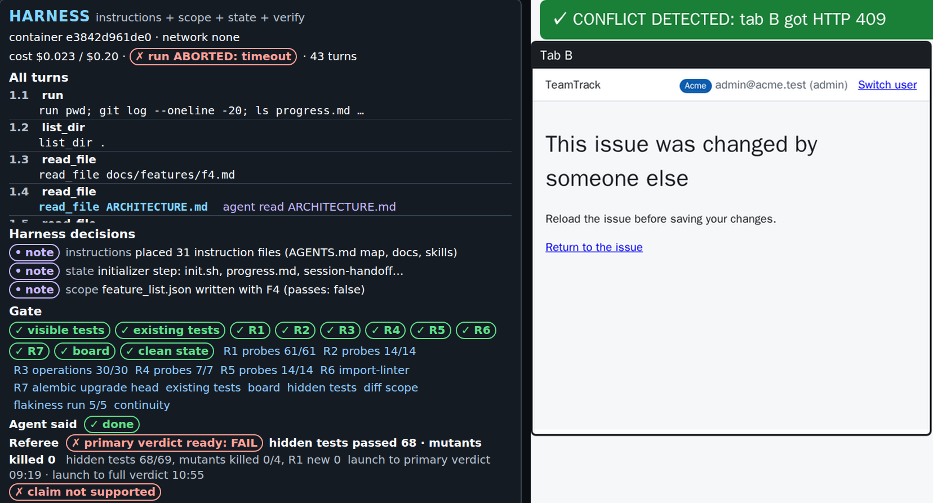
S4 Verification
61 / 72
Demo block: what to watch
• Screen 1: a ⊘ blocked edit, "done" and the gate pills, then the test phase; screen 2: the conflict panel
• Screen 3: the filter table (kept or discarded, with the reason) and the mutant table
• Picture: screens 1 and 2 of a timed run of make show-4 before class
Filled in live: make show-4: the gate pills and the filter table
Module 1: Harness Engineering for Coding Agents
Notes:
Slide 61 of 72 | S4 Verification | 8 min
In the timed run before class (your output will differ): minute 1, turn 1.15 tried to patch
app/services/errors.py and the scope layer blocked it, the same edit as in Section 3. Minute 3, turn
1.31 called `finish done` and the gate ran, every pill ✓ (visible tests, existing tests, R1-R7,
board, clean state). The harness then set F4 `passes` with its evidence and moved the exec plan to
completed. Minutes 4-8, the test phase: one new test file and the filters. Minute 9, the agent time
limit ended the run; screen 1 showed "primary verdict ready: FAIL" at 9:19, and the full verdict came
at 10:55. Screen 2's conflict panel: "CONFLICT DETECTED: tab B got HTTP 409", and tab B read "This
issue was changed by someone else". The picture joins the harness panel of screen 1 with the
conflict panel.
Guide: docs/instructor-guide.md, "Section by section", Section 4.
Runs: docs/evidence.md, Captures.

Slide 62
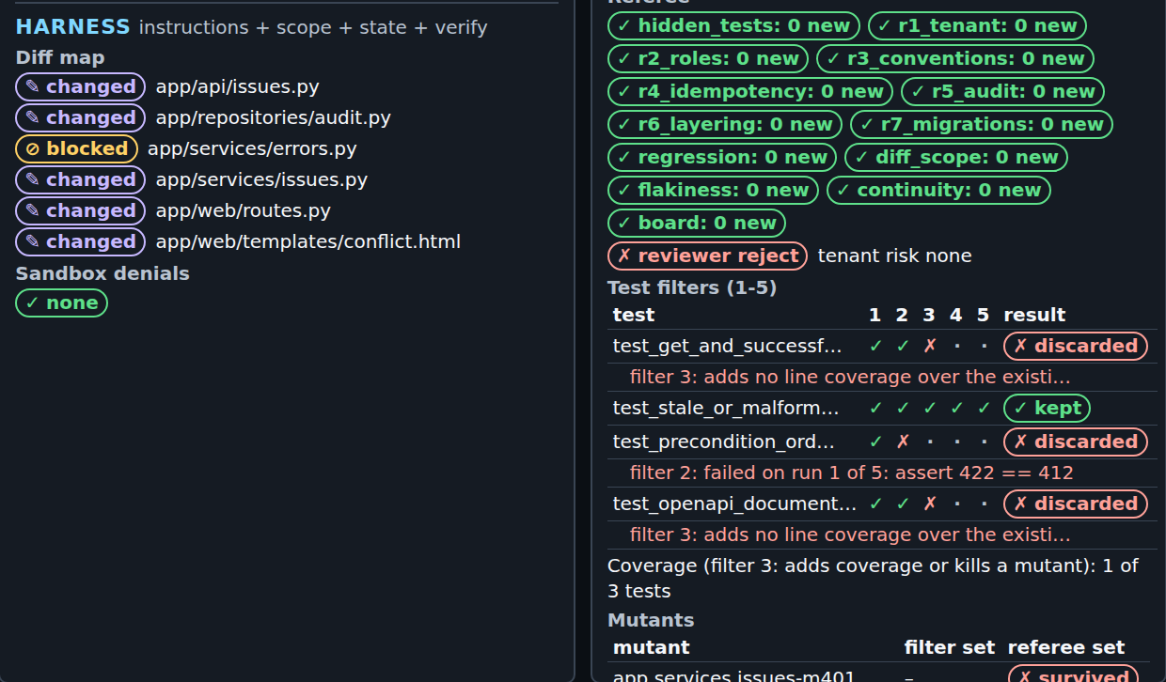
S4 Verification
62 / 72
Demo block: reading the result
• The timed run: the gate passed; hidden tests 68 of 69, mutants 0 of 4: fail
• The gate never sees the hidden tests or the referee's mutants
• Before class: bare 0 of 4 passing, harness 0 of 4 (poll answer: D)
• One bare arm claimed done with 68 of 69 hidden tests
• Picture: screen 3 of the same run
Module 1: Harness Engineering for Coding Agents
Notes:
Slide 62 of 72 | S4 Verification | 7 min
The timed run's arm line (your output will differ): `harness ABORTED: timeout claim=done
primary={"hidden_passed": 68, "mutants_killed": 0} passed=False hidden 68/69 mutants 0/4
reviewer=reject cost=$0.0233`. Filter table: 4 proposed tests, 1 kept; two discarded by filter 3 (no
new line coverage) and one by filter 2 ("failed on run 1 of 5: assert 422 == 412"). This is a
harness-in-action run, so it is not part of the counts on the slide.
The 4 A/Bs: in the medium-effort round, bare hidden tests 66, 66, and 69 of 69, with mutants killed
4, 0, and 3 of 4. In the class-settings round both arms passed 68 of 69 hidden tests; mutants killed:
bare 4, harness 1. That bare claim was the first done claim with a failing hidden test in the
records. Post hoc over 34 runs per arm: no other done claim came with failing hidden tests (0 of 19
bare, 0 of 10 harness).
Guide: docs/instructor-guide.md, "Section by section", Section 4.
Runs: docs/evidence.md, Section 4.

Slide 63
S4 Verification
63 / 72
Runbook and next
• Runbook: 04-verification/demo/README.md
• Discussion: one false "done" in 4 F4 runs per arm, from the bare arm. What would a gate need to catch to earn its turns on this model?
• Next: the final results
Module 1: Harness Engineering for Coding Agents
Notes:
Slide 63 of 72 | S4 Verification | 5 min
Tie the discussion to cause 4: tests that pass are not the same as work that is done.
Guide: docs/instructor-guide.md, "Section by section", Section 4.

Slide 64
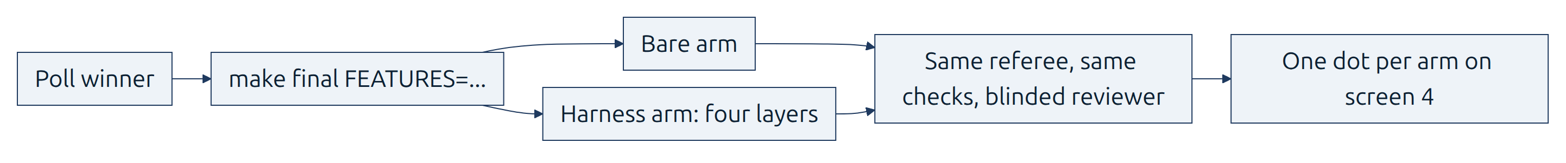
Final results
64 / 72
Final results: the A/B lines
• The poll winner, and the runner-up if it ran; all four layers; class profile
• Run cap $0.25 per arm
• No primary measure registered: read hidden tests and mutants per arm
• One A/B is one dot: read it next to the dots from before class
Filled in live: terminal C's arm lines and session figure
Module 1: Harness Engineering for Coding Agents
Notes:
Slide 64 of 72 | Final results | 2 min
The final A/B was launched on slide 51 and ran during Section 4. No run starts here. This is the
class's measurement lesson: one run per arm cannot show a difference. Before class we ran 3 A/Bs per
section per round, and still report "no measurable difference" where the arms tie.
Guide: docs/instructor-guide.md, "Section by section", Final results and wrap-up.
Source: Makefile `final`; final-project/README.md.

Slide 65
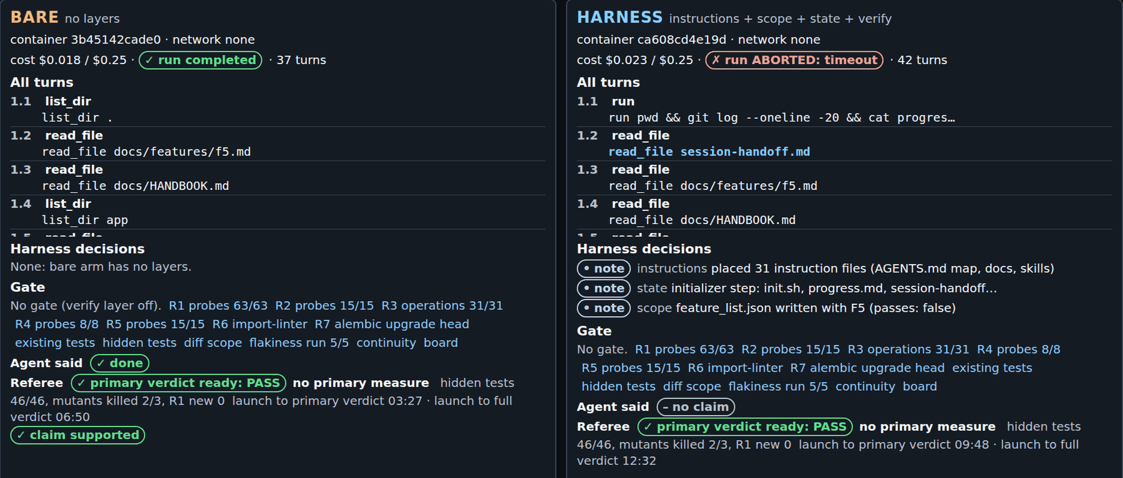
Final results
65 / 72
Final results: console
• Screen 1: the turns, harness decisions, gate pills, "primary verdict ready" per arm
• Screen 3: evidence, filters, mutants, reviewer verdict; screen 5: the first wrong turn and the trace links
• Picture: screen 1 of a timed run of make final FEATURES=F5 before class
Filled in live: screens 1, 3, and 5 of the finished final A/B, both arms
Module 1: Harness Engineering for Coding Agents
Notes:
Slide 65 of 72 | Final results | 3 min
Both arms, side by side. Show tonight's final live. The picture is the timed run before class (your
output will differ): the bare arm completed and claimed done, with its verdicts at 3:27 and 6:50.
The harness arm hit the agent time limit without a claim, at 9:48 and 12:32. Hidden tests 46 of 46
and mutants killed 2 of 3 in both arms. F5 has no primary measure, so read those counts. The harness
arm's second turn read session-handoff.md.
Guide: docs/instructor-guide.md, "Section by section", Final results and wrap-up.
Runs: docs/evidence.md, Captures.

Slide 66
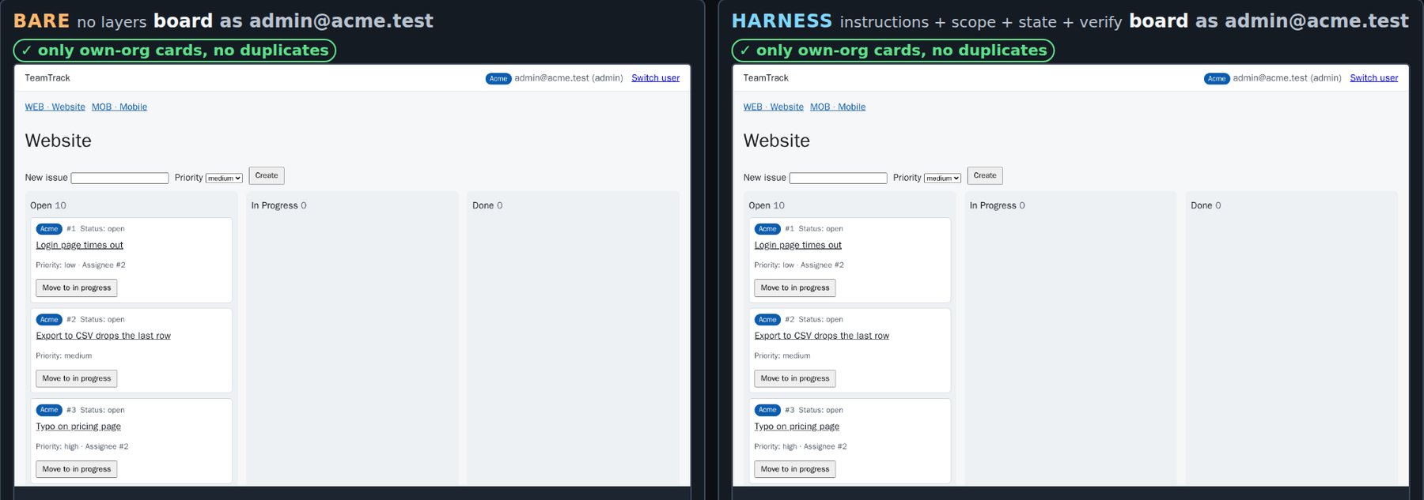
Final results
66 / 72
Final results: boards
• Screen 2: each arm's running board as an Acme user
• Look for ⚠ other-org and ⧉ duplicate marks
• Picture: screen 2 of the same timed run
Filled in live: both boards side by side
Module 1: Harness Engineering for Coding Agents
Notes:
Slide 66 of 72 | Final results | 2 min
The marks come from trusted data attributes, not from the agent. In the class-settings round every
board showed "✓ only own-org cards, no duplicates", and so did both boards of the timed final run.
Guide: docs/instructor-guide.md, "Section by section", Final results and wrap-up.
Source: docs/architecture.md (screen 2).

Slide 67
Final results
67 / 72
Final results: screen 4
• Screen 4: one dot per recorded run, wins and ties alike
• Tonight's final adds one dot per arm
• Filled dot = passed, hollow = failed: never colour alone
fill = f"var(--{arm})" if dot["passed"] else "var(--surface)"
tip = f"{dot['run_id']}: {dot['value']}" + (
f" of {dot['total']}" if dot["total"] else ""
)
parts.append(
f'<circle cx="{x(dot["value"]):.1f}" cy="{y - stack * 10}" r="5" '
f'fill="{fill}" stroke="var(--{arm})" stroke-width="2">'
f"<title>{html.escape(tip)} ({dot['status']})</title></circle>"
platform/src/shipharness/ab/report.py
Filled in live: tonight's final on screen 4
Module 1: Harness Engineering for Coding Agents
Notes:
Slide 67 of 72 | Final results | 4 min
The fill and stroke lines of the dot plot.
Guide: docs/instructor-guide.md, "Section by section", Final results and wrap-up.
Source: anchor Final:dots; docs/architecture.md.

Slide 68
Final results
68 / 72
What we measured: every section
Primary measure, runs passing per arm, before class
• S1, F1, no new R1 violation: bare 7 of 7, harness 7 of 7
• S2, F2, no continuity failure: bare 7 of 7, harness 7 of 7
• S3, F3, scope: 7 of 7 each; S3 confirmation on F4, no out-of-scope file: bare 0 of 3, harness 3 of 3
• S4, F4, all hidden tests and mutants: bare 0 of 4, harness 0 of 4
• One harness lead, on scope, by construction; elsewhere no measurable difference on this task with this model
• Post hoc, 34 runs per arm: outside the allowed paths, harness 0, bare 9; done claimed 10 against 19, none false
Module 1: Harness Engineering for Coding Agents
Notes:
Slide 68 of 72 | Final results | 2 min
S1 to S3 on their own tickets: the medium-effort round, the low-effort round, and the class-settings
round. F4: the medium-effort round and the class-settings round. The S3 confirmation: 3 A/Bs,
registered before its runs. The gate registered before the medium- and low-effort rounds needed the
harness arm ahead in 3 of 4 sections. It was ahead in 0, so the planned larger batches (10 runs per
arm, and one layer left out at a time) were not run.
Post hoc, descriptive: tests shipped, median harness 2.5, bare 7.5; arm wall time, median 302 s
against 190 s; agent time limit hit, harness 9 of 34, bare 4 of 34; cost per arm, median $0.0123
against $0.0103. What to take home: each piece is a bet on what the model cannot do. OpenAI warns
that its own results should "not be assumed to generalize without similar investment". The same
holds here: one model, one task per section, a few runs per arm.
Guide: docs/instructor-guide.md, "Section by section", Final results and wrap-up.
Runs: docs/evidence.md, Results.

Slide 69
Wrap-up
69 / 72
Assignments
• A1 Instructions: 01-instructions/assignment/, at most $2.50 and 150 traces
• A2 State and session lifecycle: 02-state-lifecycle/assignment/, at most $0.40 and 4 traces
• A3 Scope and sandbox: 03-scope-sandbox/assignment/, at most $0.48 and 4 traces
• A4 Verification and portfolio: 04-verification/assignment/, at most $0.68
• Each: grading criteria, a starter folder, make check-assignment-N offline, one live step, and a full solution
• Total at most $6 and 400 traces; Thursday review
Module 1: Harness Engineering for Coding Agents
Notes:
Slide 69 of 72 | Wrap-up | 3 min
The budgets are the caps of each assignment's live step. Each assignment folder has a solution/
folder with a step-by-step walkthrough. Tell learners to try first.
Guide: docs/instructor-guide.md, "Section by section", Final results and wrap-up.
Source: 01-instructions/assignment/README.md to 04-verification/assignment/README.md; Makefile `check-assignment-N`.

Slide 70
Wrap-up
70 / 72
Skills and the starter kit to take home
• harness-setup, assured-tests, house-rules, skill-template, in the Agent Skills format
• uv run shipharness init --target <repo>: the kit, with TeamTrack's values and REPLACE markers
• uv run shipharness init --check <repo> lists the markers still to fill; no model calls
• Guide: use-in-your-repo/apply-to-your-repo.md, ending with which layers earn their place in your repository
name: skill-template
description: >
Starting point for writing a new Agent Skill: frontmatter with the spec's fields and a guide to
the sections of the body. Use when creating a new skill: copy this folder, rename it, set name to
the new folder name, and replace every placeholder.
license: MIT
use-in-your-repo/skills/skill-template/SKILL.md
Module 1: Harness Engineering for Coding Agents
Notes:
Slide 70 of 72 | Wrap-up | 2 min
The `skill-template` frontmatter from `name` to `license`. The kit copies the AGENTS.md map, the
docs/ layout, the state files, the feature list and its schema, house-rule check templates, a
sandbox policy, a CI workflow, and the four skills into `.claude/skills/` and `.agents/skills/`.
Guide: docs/instructor-guide.md, "Section by section", Final results and wrap-up.
Source: use-in-your-repo/kit/README.md; anchor Final:skill_template.

Slide 71
Wrap-up
71 / 72
References (1 of 2)
• OpenAI, Harness engineering: leveraging Codex in an agent-first world · Ryan Lopopolo · 2026-02-11
• Anthropic, Effective harnesses for long-running agents · Justin Young · 2025-11-26
• Anthropic, Harness design for long-running application development · Prithvi Rajasekaran · 2026-03-24
• Anthropic, Building a C compiler with a team of parallel Claudes · Nicholas Carlini · 2026-02-05
• Anthropic, Autonomous Coding Agent Demo (README) · 2025-11-26
• Anthropic, Prompting best practices (living page); OpenAI, Using PLANS.md · Aaron Friel · 2025-10-07
Module 1: Harness Engineering for Coding Agents
Notes:
Slide 71 of 72 | Wrap-up | 1 min
Full links in docs/REFERENCES.md.
Guide: docs/instructor-guide.md, "Section by section", Final results and wrap-up.
Source: docs/REFERENCES.md.

Slide 72
Wrap-up
72 / 72
References (2 of 2)
• Agent Skills: Specification; What are skills?; How to add skills support · agentskills.io
• The skills-ref validator; Claude Code, Codex, and Cursor skills docs
• TestGen-LLM · Alshahwan et al., Meta · 2024
• ACH, mutation-guided test generation · Foster et al., Meta · 2025
• SpecBench · Zhao, Srikanth, Wu, Jiang (Weco AI) · 2026, and its repository
• Codex docs on sandboxing and network access
Module 1: Harness Engineering for Coding Agents
Notes:
Slide 72 of 72 | Wrap-up | 1 min
Full links in docs/REFERENCES.md.
Guide: docs/instructor-guide.md, "Section by section", Final results and wrap-up.
Source: docs/REFERENCES.md.

