Slide 1
Intersection Collision Warning (v2v)
Group - 7
Sai Sundeep Innamuri
Harsha Puvvada
Sravan Peddi

Slide 3
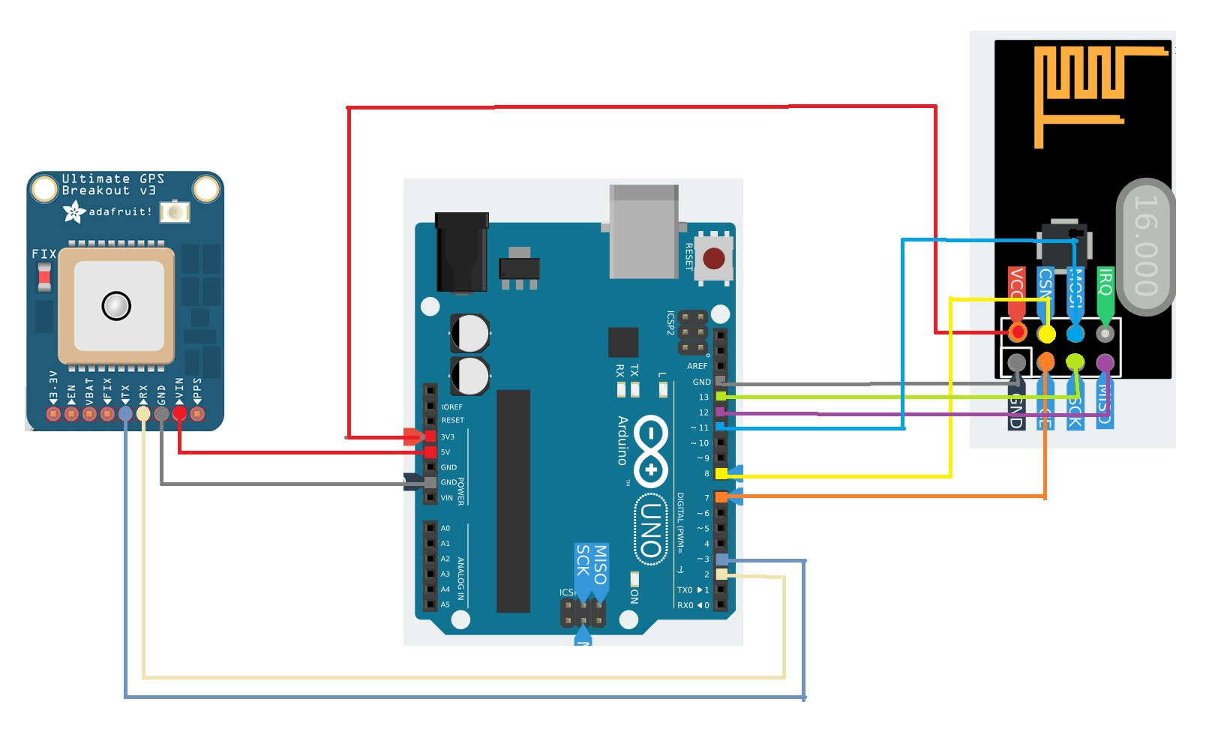
Schematic Diagram
NRF24L01
AdaFruit GPS

Slide 4
Basic Safety Message (BSM)
used in a variety of applications to exchange safety data regarding vehicle state.
It is broadcast frequently (rate 10 times per second is typical) to surrounding vehicles
contains a variety of data content as required by safety and other applications.
Typically around 300 bytes, but BSM in this project is about 30 bytes due to the wireless interface limitations

Slide 5
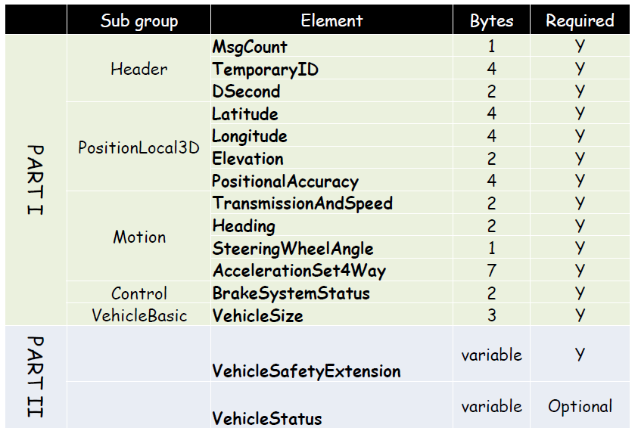
BSM Parts

Slide 8
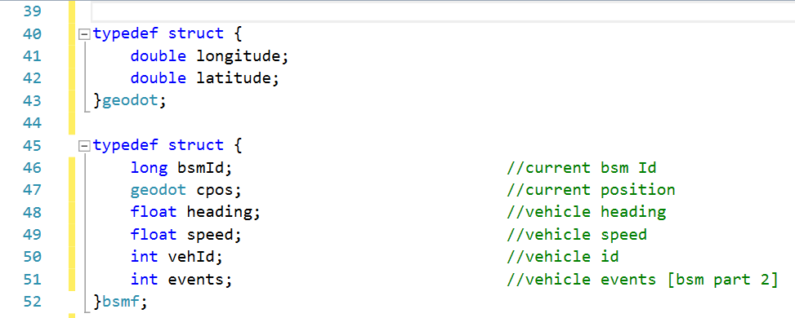
BSM Structure used here!

