Slide 1
Session Handling

Slide 2
What is session

Slide 3
Introduction
Session management is used to facilitate secure interactions between a user and some service or application and applies to a sequence of requests and responses associated with that particular user.

Slide 4
Intro…
Session tokens serve to identify a user’s session within the HTTP traffic being exchanged between the application and all of its users.

Slide 5
Intro…
HTTP traffic on its own is stateless, meaning each request is processed independently, even if they are related to the same session.

Slide 6
Intro..
Vulnerabilities introduced with lack of session management. (Session hijacking)

Slide 7
Handling Session
URL rewriting (token)
Session Variable
Hidden input filed

Slide 8
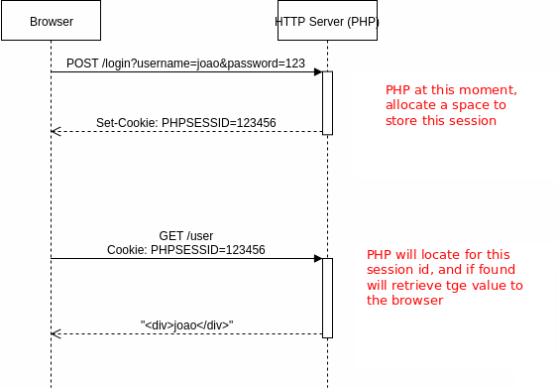
Standard Session Management

Slide 9
JWT

Slide 10
JWT: JSON Web Token
JSON Web Token or JWT is an open standard (RFC 7519) that defines a compact and self-contained way for securely transmitting information between parties as a JSON object.

Slide 11
JWT: JSON Web Token
Allow users to enter their username and password in order to obtain a token, which allows them to fetch a specific resource — without using their username and password.

Slide 12
JWT…
Once their token has been obtained, the user can offer the token — which offers access to a specific resource for a time period — to the remote site.

Slide 13
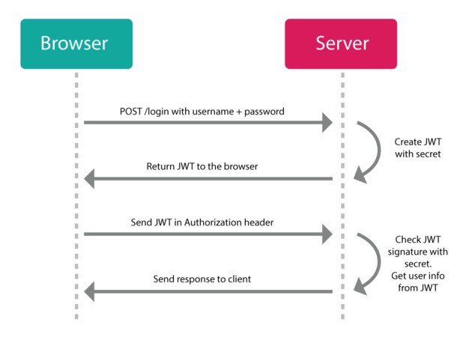
JWT Session Management

Slide 14
For more details on JWT
https://github.com/firebase/php-jwt

