Slide 1
Retail Sales Data
Exploratory Data Analysis: step by step with pandas
1,000 orders | January to December 2025 | 9 fields

Slide 2
EDA workflow: the 10 steps
1
Import libraries and load data
2
Understand the data (head, info, describe)
3
Correct column names and text
4
Convert data types
5
Detect and treat missing values
6
Check duplicates
7
Detect outliers (IQR)
8
Univariate analysis
9
Bivariate analysis
10
Group-by and multivariate analysis

Slide 3
Step 1: Import libraries and load the data
import numpy as np
import pandas as pd
import matplotlib.pyplot as plt
data = pd.read_csv("sales_data.csv")
print("data read successfully")
df = data.copy() # work on a copy, keep raw data safe
What it does
Loads the CSV into a DataFrame
Keeps the original in data and cleans a copy in df
Fields: Order_ID, Order_Date, Customer_Name, City, Category, Product, Quantity, Unit_Price, Discount
Result
1,000 rows x 9 columns

Slide 4
Step 2: Understand the data
df.head() # first 5 rows
df.tail() # last 5 rows
df.shape # (1000, 9)
df.info() # dtypes and non-null counts
df.describe() # numeric summary
df.describe(include="object") # text columns
df.dtypes
df.columns
for e in df.columns:
print("\n---", e, "---")
print("unique:", df[e].nunique(dropna=True))
print(df[e].value_counts(dropna=False).head(5))
What we learned
Quantity runs 0 to 75; mean 4.2
Unit_Price loaded as text (str)
Missing: Customer_Name, City, Discount
988 unique Order_IDs for 1,000 rows
City has 40 unique values; Category 5; Product 20
Result
Several columns need fixing before analysis

Slide 5
Step 3: Correct column names and text
# 1. standardise column names
df.columns = (df.columns.str.strip().str.lower()
.str.replace(r"[^a-z0-9]+", "_", regex=True))
# 2. trim spaces in every text column
for c in df.select_dtypes(include=["object","string"]).columns:
df[c] = df[c].astype("string").str.strip()
What it does
Column names become order_id, order_date, unit_price and so on
Strips leading and trailing spaces from text
The recommended line unifies city casing, which reduces the 40 city labels
# Recommended addition (not yet in the notebook)
df["city"] = df["city"].str.title() # fixes "PUNE", "jaipur"
Result
Clean, consistent names

Slide 6
Step 4: Convert data types
df["order_date"] = pd.to_datetime(df["order_date"],
errors="coerce")
for c in ["quantity", "unit_price", "discount"]:
df[c] = pd.to_numeric(df[c], errors="coerce")
df.dtypes
What it does
Dates become real datetimes
unit_price becomes float64
errors="coerce" turns bad values into NaN so they can be treated next
Result
order_date: datetime64; unit_price: float64

Slide 7
Step 5: Detect and treat missing values
missing = pd.DataFrame({
"count": df.isna().sum(),
"percent": (df.isna().mean()*100).round(2)})
display(missing[missing["count"] > 0])
df["discount"] = df["discount"].fillna(0)
df["unit_price"] = df["unit_price"].fillna(
df["unit_price"].median())
df = df.dropna(subset=["order_date"])
df["customer_name"] = df["customer_name"].fillna("Unknown")
df["city"] = df["city"].fillna("Unknown")
# re-check: should show no missing values
df.isna().sum()
Missing before treatment
order_date: 20 (2.0%)
city: 18 (1.8%)
discount: 15 (1.5%)
unit_price: 12 (1.2%)
customer_name: 10 (1.0%)
Result
980 rows left, 0 missing values

Slide 8
Steps 6 and 7: Duplicates and outliers
# duplicates
print("duplicate rows:", df.duplicated().sum())
df = df.drop_duplicates().reset_index(drop=True)
# outliers with the IQR rule
rows = []
for c in df.select_dtypes(np.number):
q1, q3 = df[c].quantile([.25, .75])
iqr = q3 - q1
lo, hi = q1 - 1.5*iqr, q3 + 1.5*iqr
n = ((df[c] < lo) | (df[c] > hi)).sum()
rows.append([c, q1, q3, lo, hi, int(n),
round(n/len(df)*100, 2)])
display(pd.DataFrame(rows, columns=["column","q1","q3",
"lower","upper","outlier_count","outlier_percent"]))
Findings
0 fully duplicate rows (but 12 repeated Order_IDs)
quantity: 21 outliers (2.16%)
unit_price: 79 outliers (8.14%)
discount: 0 outliers
Outliers were flagged, not removed
Result
Keep outliers, but review quantity 0, 50, 75

Slide 9
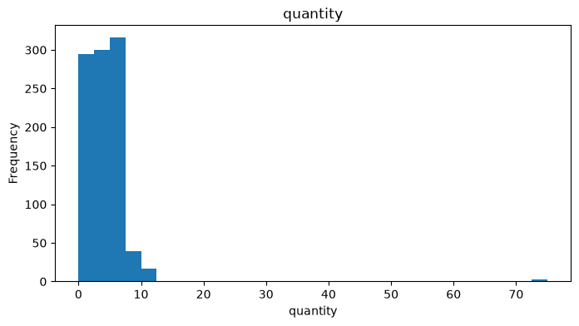
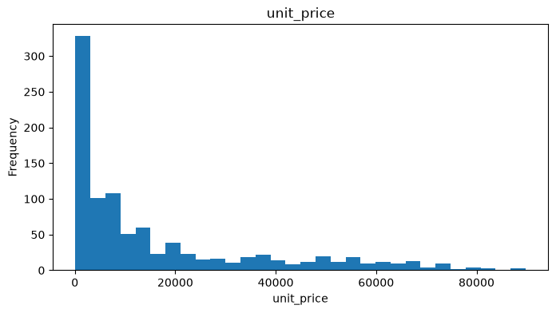
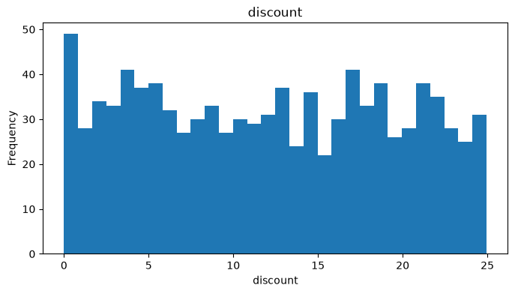
Step 8: Univariate analysis
for c in df.select_dtypes(np.number):
plt.figure(figsize=(8,4)); plt.hist(df[c].dropna(), bins=30)
plt.title(c); plt.xlabel(c); plt.ylabel("Frequency"); plt.show()
Quantity: mostly 1 to 6 units; 50 and 75 are outliers
Unit price: right-skewed, long tail to about ₹90,000
Discount: roughly even from 0% to 25%

Slide 10
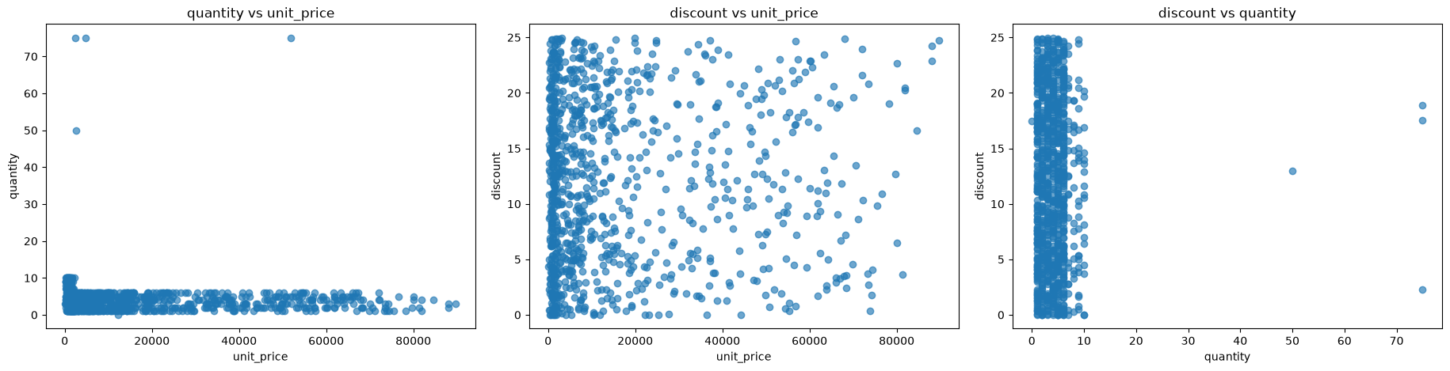
Step 9: Bivariate analysis
pairs = [("unit_price","quantity"), ("unit_price","discount"),
("quantity","discount")]
for x, y in pairs:
if x in df.columns and y in df.columns:
plt.figure(figsize=(7,5))
plt.scatter(df[x], df[y], alpha=0.65)
plt.xlabel(x); plt.ylabel(y); plt.title(f"{y} vs {x}"); plt.show()
Quantity stays under about 10 at every price
No visible link between discount and price
No visible link between discount and quantity
The 50 and 75 unit orders are isolated outliers.

Slide 11
Step 10: Group-by and multivariate analysis
# units sold per product
df.groupby("product")["quantity"].agg(["sum","mean","count"]) \
.sort_values("sum", ascending=False)
# discount per product
df.groupby("product")["discount"].agg(["sum","mean","count"]) \
.sort_values("sum", ascending=False)
# discount per order size
df.groupby("quantity")["discount"].agg(["sum","mean","count"]) \
.sort_values("sum", ascending=False)
# city x category (multivariate)
dims = ["city", "category"]
df.groupby(dims)[["quantity","discount"]].sum() \
.sort_values("quantity").head(20)

Slide 12
Key findings and next steps
Key findings
Next steps
980 of 1,000 orders kept; 2% lost to missing dates
Rice and Jeans lead on units (306 and 294); Tablets, Microwaves and Laptops trail at about 130
Discounts average about 12% and are unrelated to price or order size
City has 40 labels because of spelling and case variants, so city results are not yet reliable
Standardise city text (the str.title() line on step 3)
Check the 12 repeated Order_IDs and quantity 0, 50, 75 rows
Add revenue = quantity x unit_price x (1 - discount/100) and analyse by category, month and city
Re-test filling missing discounts with the median instead of 0

