Slide 1
Bank Marketing case study
Yuncheng LIANG

Slide 2
Agenda:
Dataset backgroup
Feature exploration using powerBI
Data and overall architecture preparation
Azure autoML training results and metrics presenting
Feature importance inspection and derive business insights
Recommendations
Appendix: other trails and sample analysis on individual level using shapely and lime

Slide 3
Dataset background:
Abstract: The data is related with direct marketing campaigns (phone calls) of a Portuguese banking institution. The classification goal is to predict if the client will subscribe a term deposit (variable y).
Data Set Information: The data is related with direct marketing campaigns of a Portuguese banking institution. The marketing campaigns were based on phone calls. Often, more than one contact to the same client was required, in order to access if the product (bank term deposit) would be ('yes') or not ('no') subscribed.
Source:
Dataset from : http://archive.ics.uci.edu/ml/datasets/Bank+Marketing#

Slide 4
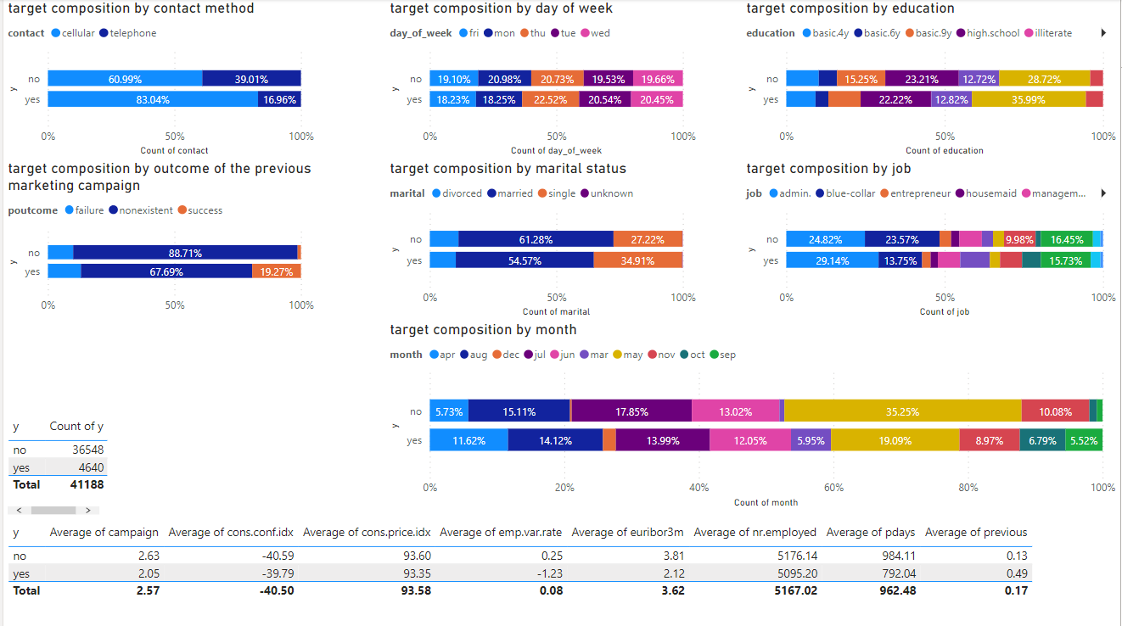
Feature exploration using powerBI:
Feature exploration using powerBI:

Slide 5
Feature exploration take away: assume no feature interaction involved
To drive up conversion, it is suggested to contact customer by cellular, make calls from Tuesday to Thursday, try not to host event and call customer in May, try to engage more customer in campaign even if they do not convert this time since their engagement in event may facilitate future conversion in subsequent campaigns
And from customer profile perspective, it is suggested to target more on customers with university degree, single, and with admin as job category.

Slide 6
Preparation:
Get rid of rows which duration column has value equals to 0 (only 4), then get rid of the duration column, since the duration is not known before a call is performed and after the end of the call y is obviously known. Thus, duration column should be discarded for a realistic predictive model.
Use 10-fold cross validation for training and a hold out of 10% data for testing.
Since data is highly imbalanced, techniques of oversampling like smote, down sampling and changing sample weights could be trailed and weighted AUC should be used as primary metric for evaluation.

Slide 7
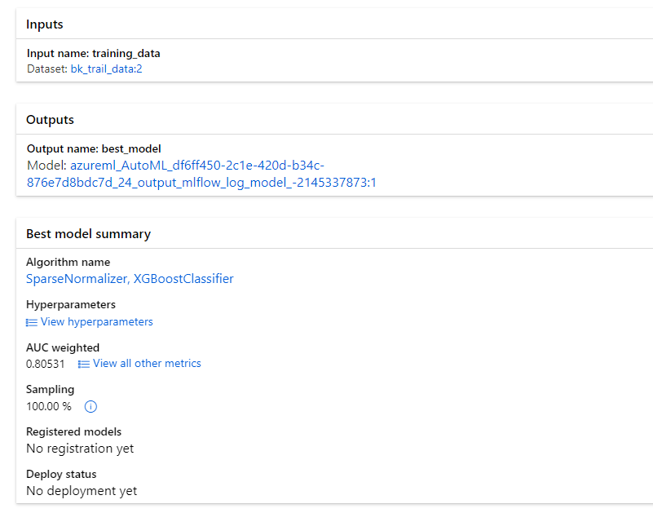
AutoML in Azure
Notes:
AutoML in Azure was being used for this tabular data due to its efficiency to establish high quality baseline.

Slide 8
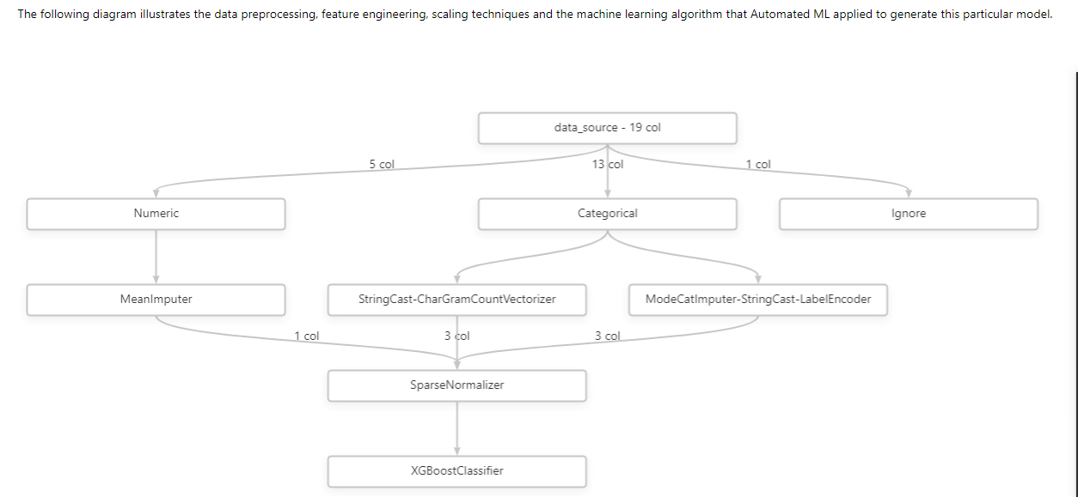
Entire training pipeline

Slide 9
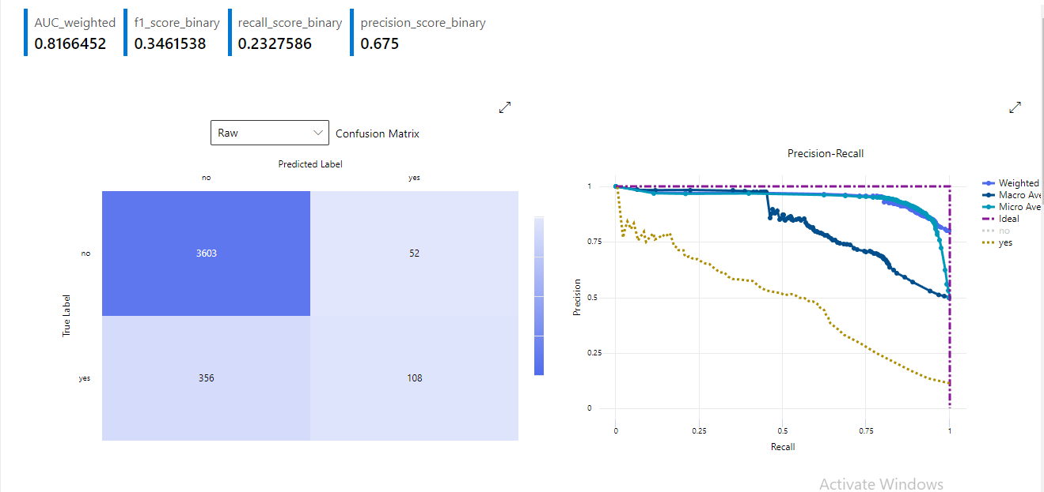
Results: no over/down sampling at training
Notes:
Wieghted AUC is used as primary metric for hyperparameter tuning, it is a better way to measure the imbalanced data learning classifiers. When computing the weighted area under the ROC curve, weights vary with the values of the true positive rate (TPrate) among regions in a bid to focus on the accuracy of minority class that is more important in common. As AUC is a special case of wAUC, wAUC is compared with other common performance evaluation measures by isometric analysis.

Slide 10
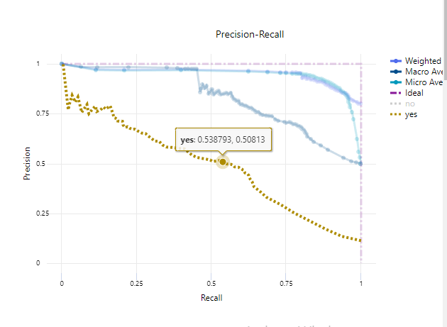
Tune threshold for customized optimization
Notes:
Threshold tuning should be performed to weigh the preference of recall and precision to better meet business objectives

Slide 11
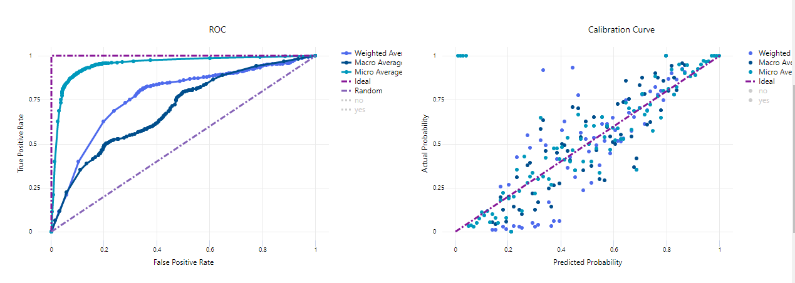
Other metrics’ visualization:

Slide 12
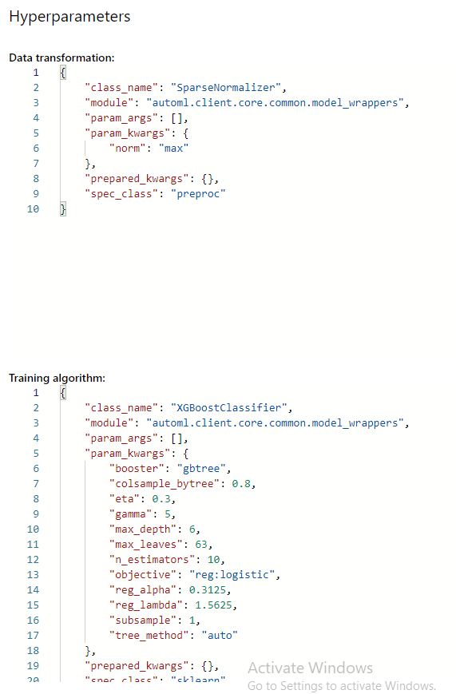
Hyperparamters:
Notes:
Did not see scale_pos_weight which is used to adjust sample weights to mitigate the effect of imblanced data. Even though using weighted AUC as metric could help with imbalanced dataset. Other external sampling techniques such as smote for synthetic oversampling of minority class, different ratio of down sampling for majority class should be trialed.

Slide 13
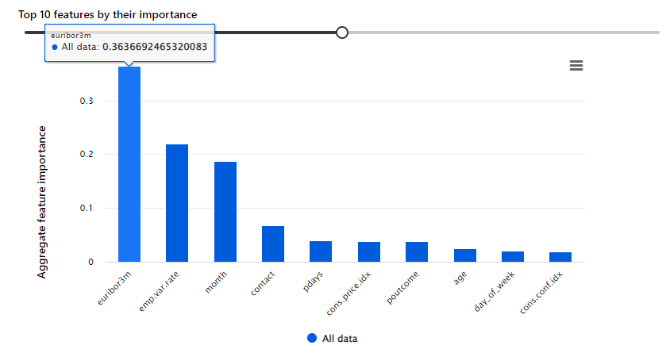
Feature importance:
Notes:
As could be seem, Euribor3m: euribor 3 month rate - daily indicator (numeric), Emp.var.rate: employment variation rate - quarterly indicator (numeric), Month: last contact month of year (categorical: 'jan', 'feb', 'mar',…, 'nov', 'dec’) are the top 3 features with dominant importance

Slide 14
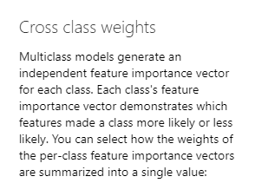
Feature importance:
Notes:
As could be seem, Euribor3m: euribor 3 month rate - daily indicator (numeric), Emp.var.rate: employment variation rate - quarterly indicator (numeric), Month: last contact month of year (categorical: 'jan', 'feb', 'mar',…, 'nov', 'dec’) are the top 3 features with dominant importance

Slide 15
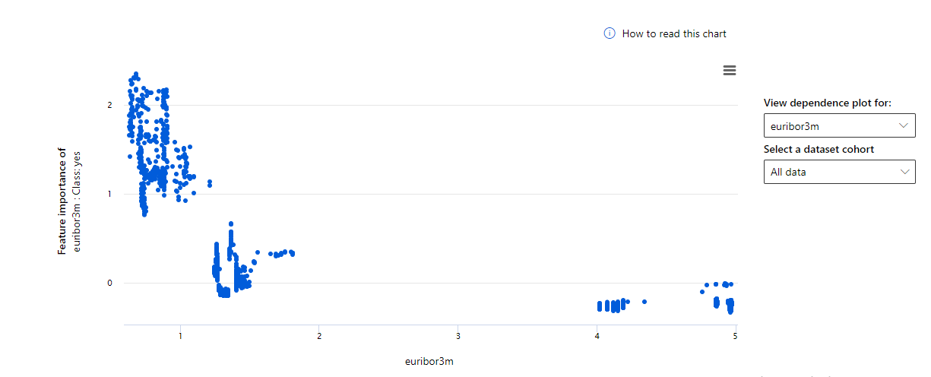
Small euribor 3-month rate suggest higher conversion
Notes:
As could be seem, Euribor3m: euribor 3 month rate - daily indicator (numeric), Emp.var.rate: employment variation rate - quarterly indicator (numeric), Month: last contact month of year (categorical: 'jan', 'feb', 'mar',…, 'nov', 'dec’) are the top 3 features with dominant importance

Slide 16
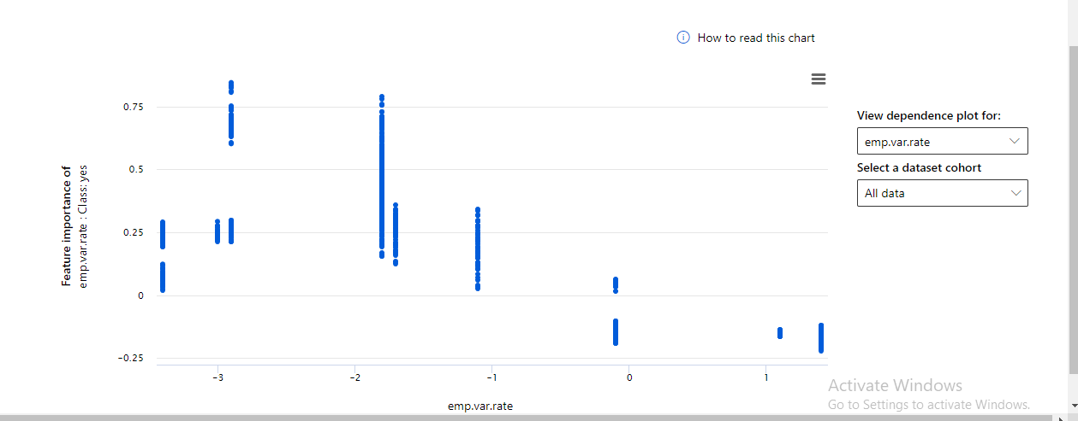
Negative employment variation rate suggest higher conversion
Notes:
As could be seem, Euribor3m: euribor 3 month rate - daily indicator (numeric), Emp.var.rate: employment variation rate - quarterly indicator (numeric), Month: last contact month of year (categorical: 'jan', 'feb', 'mar',…, 'nov', 'dec’) are the top 3 features with dominant importance

Slide 17
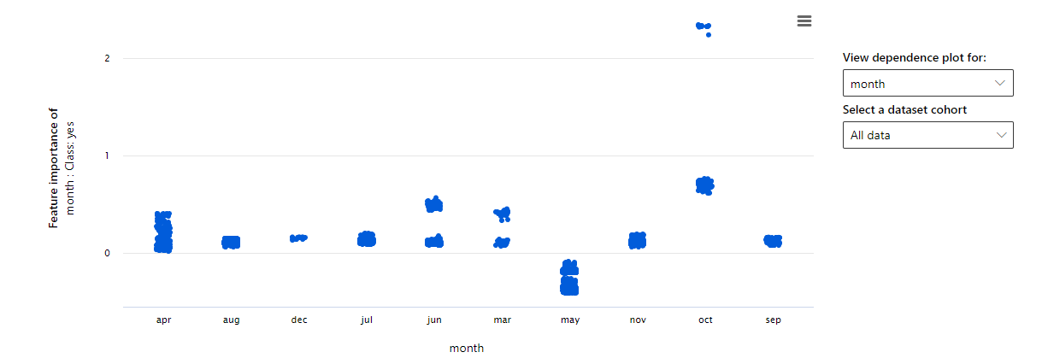
October has higher conversion while May has lowest conversation, suggest to host the marketing event and phone customers at months other than May and host more events in October
Notes:
As could be seem, Euribor3m: euribor 3 month rate - daily indicator (numeric), Emp.var.rate: employment variation rate - quarterly indicator (numeric), Month: last contact month of year (categorical: 'jan', 'feb', 'mar',…, 'nov', 'dec’) are the top 3 features with dominant importance

Slide 18
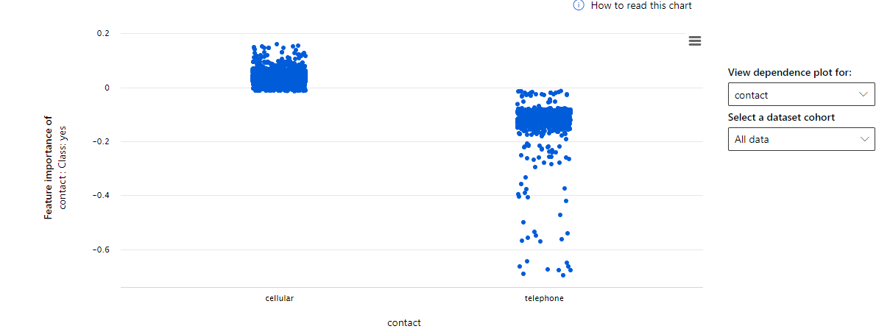
Suggest to phone customer with contact communication type as cellular due to higher conversion
Notes:
As could be seem, Euribor3m: euribor 3 month rate - daily indicator (numeric), Emp.var.rate: employment variation rate - quarterly indicator (numeric), Month: last contact month of year (categorical: 'jan', 'feb', 'mar',…, 'nov', 'dec’) are the top 3 features with dominant importance

Slide 19
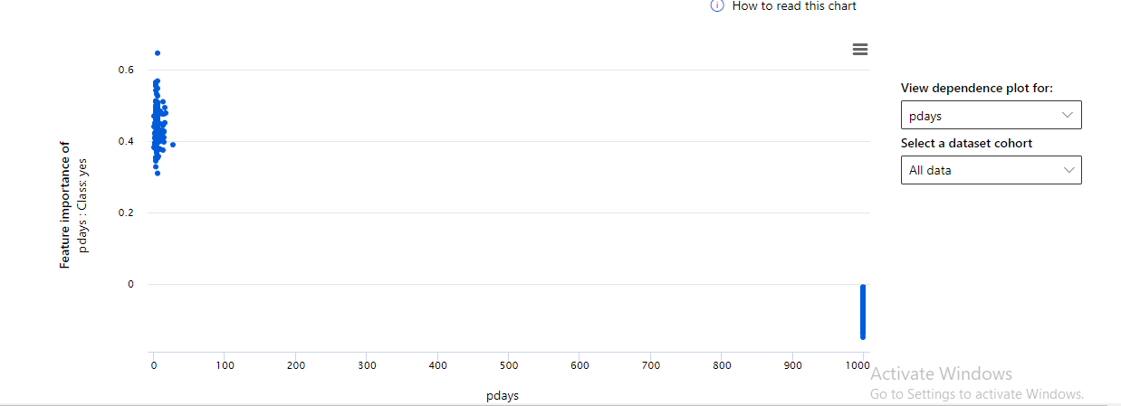
If a client is previously contacted, then he/she has higher chance of conversion, thus we should encourage more call which would lead to positive increment in conversation in the future even if not converted at present
Notes:
As could be seem, Euribor3m: euribor 3 month rate - daily indicator (numeric), Emp.var.rate: employment variation rate - quarterly indicator (numeric), Month: last contact month of year (categorical: 'jan', 'feb', 'mar',…, 'nov', 'dec’) are the top 3 features with dominant importance

Slide 20
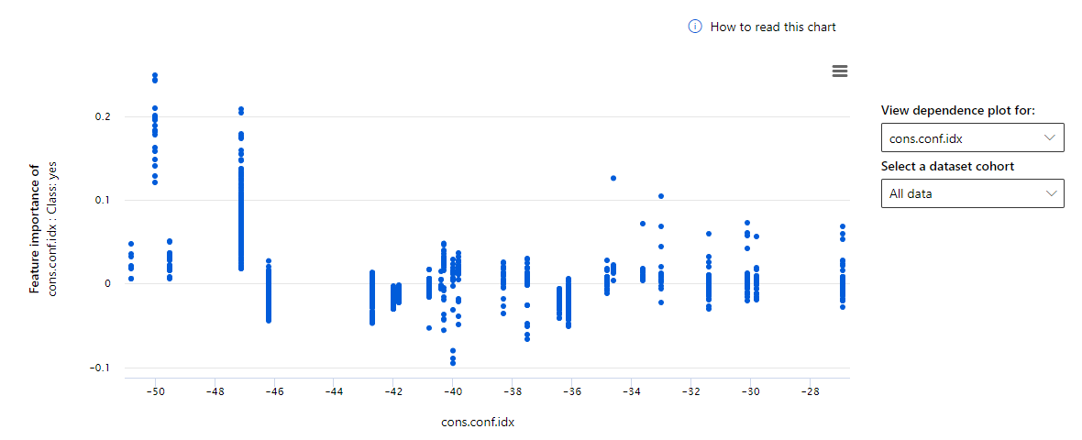
Low consumer confidence index suggests higher conversion
Notes:
As could be seem, Euribor3m: euribor 3 month rate - daily indicator (numeric), Emp.var.rate: employment variation rate - quarterly indicator (numeric), Month: last contact month of year (categorical: 'jan', 'feb', 'mar',…, 'nov', 'dec’) are the top 3 features with dominant importance

Slide 21
Recommendations:
Once estimated profit of per person converted and estimated cost of phoning a customer is established, this becomes an easy optimization problem of picking a classification threshold which maximize revenue.
Put it simple, if human cost is minimal, the company should choose a classification threshold which prefers a high recall with a somewhat acceptable precision to engage more customers and drive revenue..

Slide 22
Appendix:
As mentioned, other sampling ratio of training set were trailed as well in search of the best imbalance-handling technique, however, elevation in performance was not observed in these trails.
Following is one of the trail using down sampled ratio of 2:1 with a 10% hold out set for testing with original ratio between two labels using AutoML

Slide 23
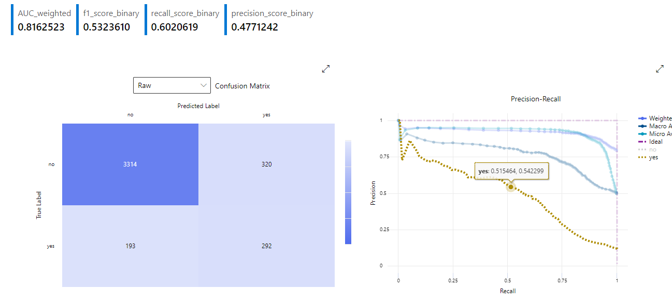
Appendix:
Notes:
No observable change in primary metric performance, be mindful that single point recall/precision/f1 should not be used as a metric for side-to-side comparison of two model since as classification threshold moves all three metrics changes

Slide 24
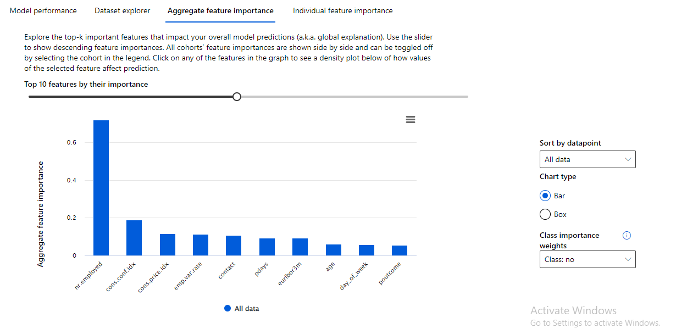
Appendix:
Notes:
This down sampled model, however, has different feature importance assignment compared to previous one

Slide 25
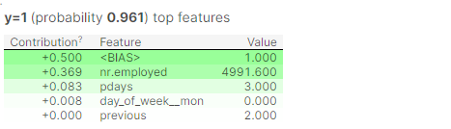
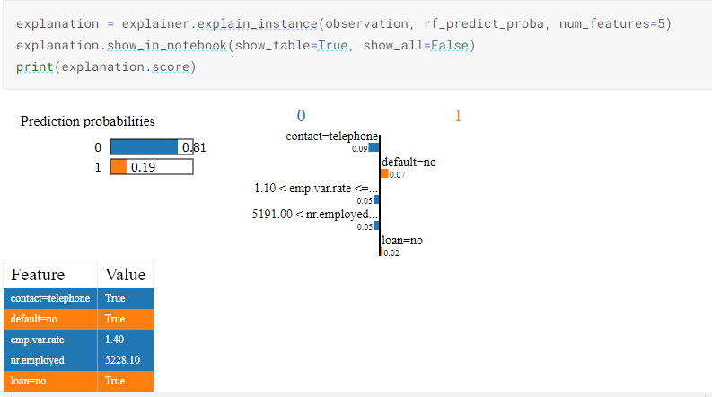
Sample individual level analysis using shap value and lime:
Target, customer number 4
Notes:
On the left is the interpretation using shapely value , on the right is the one using lime

