Slide 1
Aniket Guru School of Computing National College of Ireland Dublin, Ireland Student ID: x22119914 email-x22119914@student.ncirl.ie
Vehicle insurance Fraud claim detection
Using Machine learning Algorithm

Slide 2

INTRODUCTION
Vehicle insurance is process using which a company accepts to provide an assurance of compensation for mentioned. Loss or damage to the vehicle in return for a payment of a specified premium.
Filing of false claims against a vehicle insurance policy is termed as vehicle insurance fraud.
Research question:
a)Who are the target customers who are likely going to falsely claim the vehicle insurance?
b) what are the features that are more concerned with detecting that this claim could be fraud ?
c)What new features can we introduce to help identify if a claim is fraudulent?
Vehicle insurance
Fraud claim

Slide 3
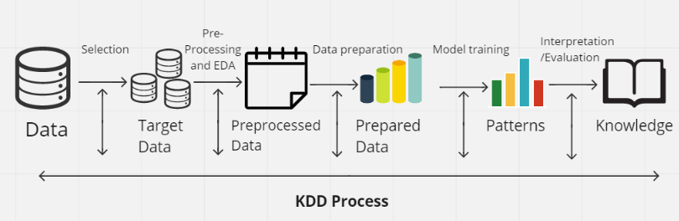
METHODOLOGY
Vehicle insurance
Fraud claim
Knowledge Discovery in Databases(KDD)
Data Selection,
Pre-processing and EDA,
Data preparation,
Model training and Evaluation performance,
Interpretation.

Slide 4
Machine Learning Algorithms
Vehicle insurance
Fraud claim
Logistic Regression
Random Forest.
XG Boost.
scikit-learn Library
Stats- Module
scikit-learn Library
H2o Library
XG Boost Classifier

Slide 5
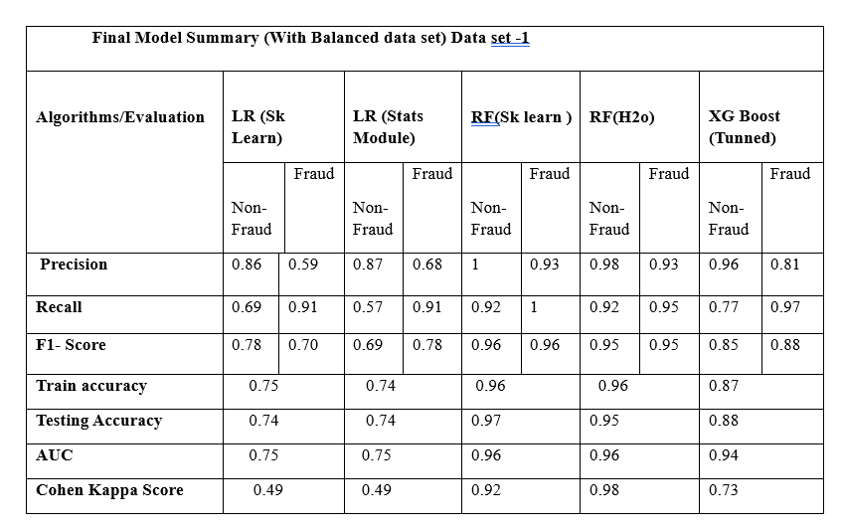
Result Summary Vehicle Insurance Claim Fraud DetectionDataset-1
Vehicle insurance
Fraud claim
Table shows that the Tuned Random Forest with H20 outperformed all other models in
predicting fraud and non fraud cases , with a 95 percent accuracy and having pest precision
recall and f1 score for both class. And Auc is 0.96 best in all .

Slide 6
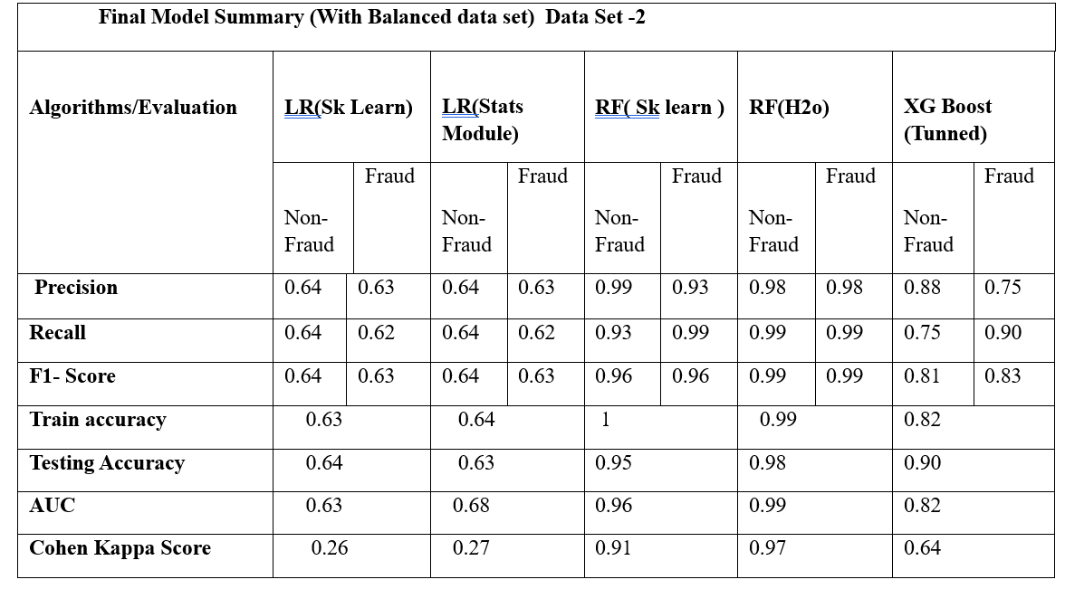
Result Summary Fraudulent Claim on Cars Physical Damage(Dataset-2
Vehicle insurance
Fraud claim
From The Table
it can be observed that the RF model with the H2O framework
It also has the highest precision, recall, and F1-score for the non-fraud class.

Slide 7
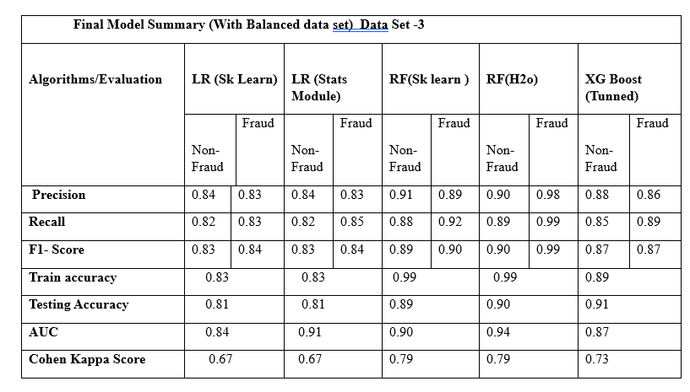
Result Summary Car insurance Fraud claim Dataset-3
Vehicle insurance
Fraud claim
From Table the Random Forest algorithm with
H2O framework had the best performance with a precision of 0.90 and
recall of 0.89. and has the best au 0.94 and Cohen kappa score 0.79

Slide 8
Thank You

