Slide 1



Wine Quality Predictor

Slide 2
Research Question?
1. What are the key chemical characteristics that are most strongly correlated with wine quality?
2. How much variation in wine quality can be explained by differences in pH, alcohol content, and sulfur dioxide levels?
Hypothesis: - If wine is exposed to high levels of sulfur dioxide (SO2), then it will negatively impact the quality of the wine
Predicting wine quality is important for several reasons:
Quality control
Marketing
Customer satisfaction
How do we predict the wine quality and how can we earn through it?
We use the machine techniques like KNN( K-nearest neighbor) to plot the graphs and calculate the accuracy of this data set.
Consulting services: We can provide consulting services to wineries and vineyards to help them optimize their wine production process and improve the quality of their wines. This can include analyzing data and making recommendations based on the results of wine quality prediction models.

Slide 3
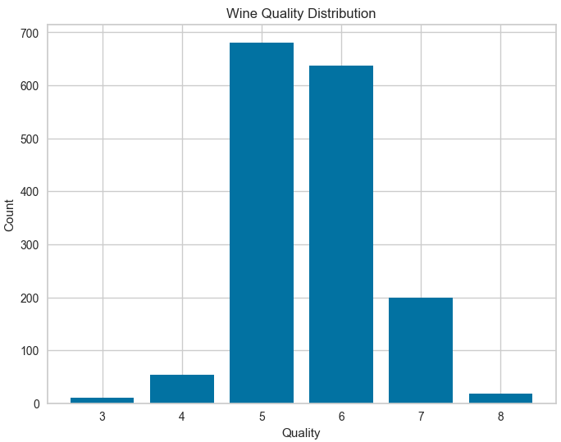
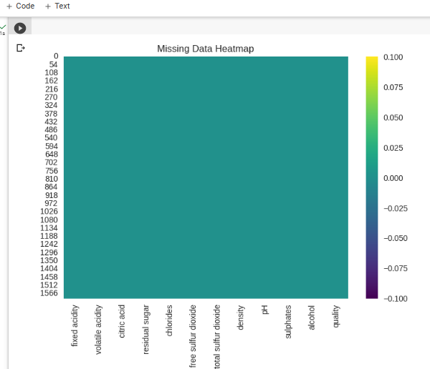
Data set
We have collected the data set from Kaggle also we have some 1599 kinds of wine quality with 12 different permutations. Each row of data set is gives specific wine and each column defines its characteristics.
The `quality` feature in this dataset is a rating of the wine quality based on sensory data and expert opinions, ranging from 0 (lowest) to 10 (highest) in integer values

Slide 4
Variables
Independent Variables
citric acid: Citric acid is often added to wines to increase acidity, complement a specific flavor, or prevent ferric hazes
residual sugar: Residual sugar or 'RS' is from the natural grape sugars left in a wine after the alcoholic fermentation finishes
fixed acidity: Fixed acidity corresponds to the set of low-volatility organic acids such as malic, lactic, tartaric, or citric acids and is inherent to the characteristics of the sample
volatile acidity: Volatile acidity (VA) is a measure of the wine's volatile (or gaseous) acids
free sulfur dioxide: it basically determines how much SO2 is available in the active, molecular form to help protect the wine from oxidation and spoilage
total sulfur dioxide: it is basically the portion of SO2 that is free in the wine plus the portion that is bound to other chemicals in the wine
pH: pH is a way to measure ripeness in relation to acidity
Alcohol: It acts as a preservative during the wine maturation process
Dependent Variable
The dependent variables in our data set are:
Quality: This depicts the quality of the wine which is the main focus of our project.

Slide 5
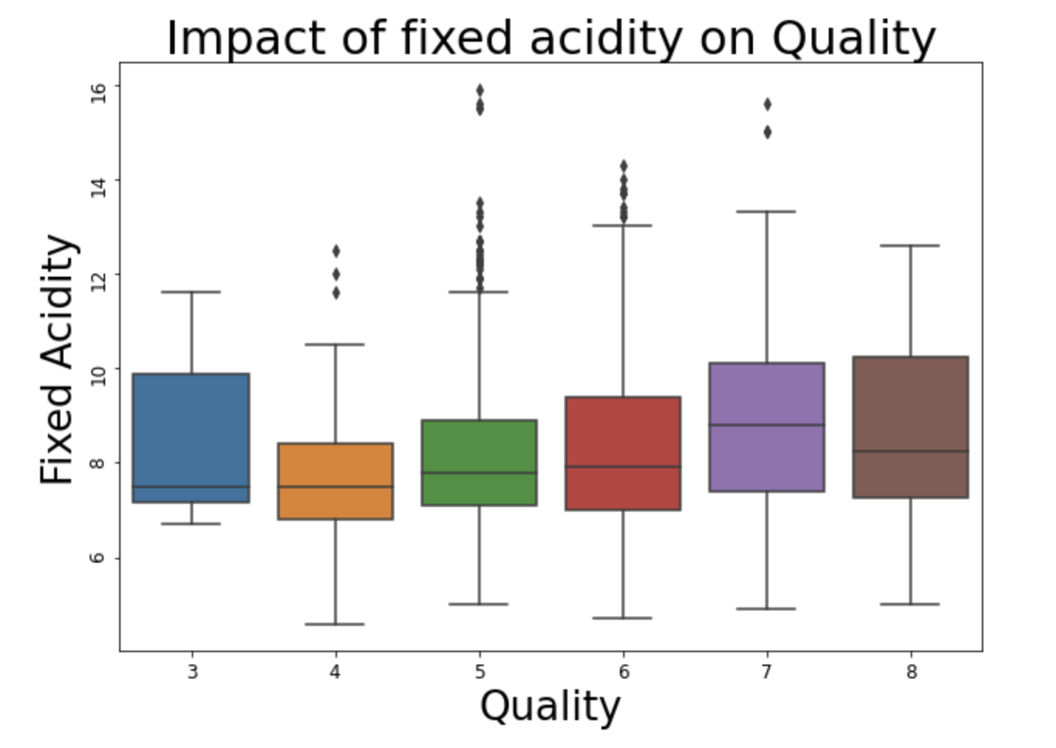
Data visualization
For displaying impact of fixed acidity on Quality we have ploted a box plot by taking Quality on X-axis and Fixed Acidity of Y-Axis

Slide 6
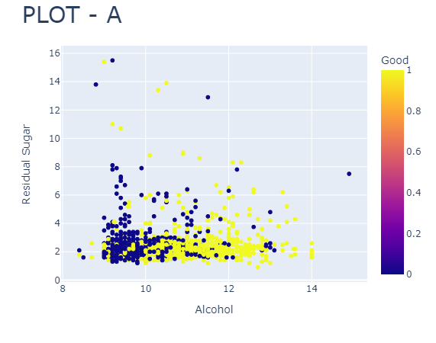
Data visualization
In the previous slide, we have shown a box and bar chart depicting the quantity of quality wine and its index. And the outlier depicts the impact of fixed acidity on the wine quality. And when it comes to the pictures in this slide, we are plotting a scatter plot for both residual sugar and alcohol and looking at the quality of the wine.

Slide 7
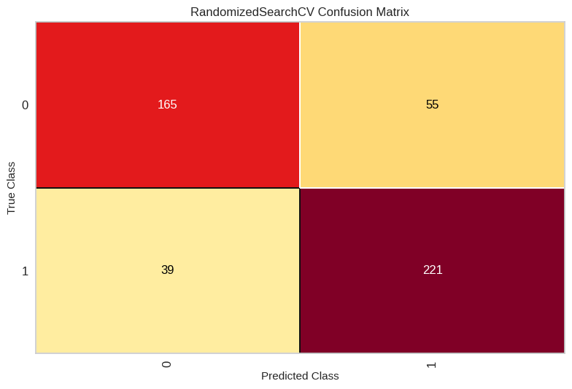
Methodology
We have used a classifier and hyper-parameter tuning to RandomizedSearchCV which basically checks on random combinations and this GridSearchCV basically Checks on all combinations and we use a random forest classifier to train the model. Also, we use a confusion matrix to plot the graph between the true value and the predicted value.

Slide 8
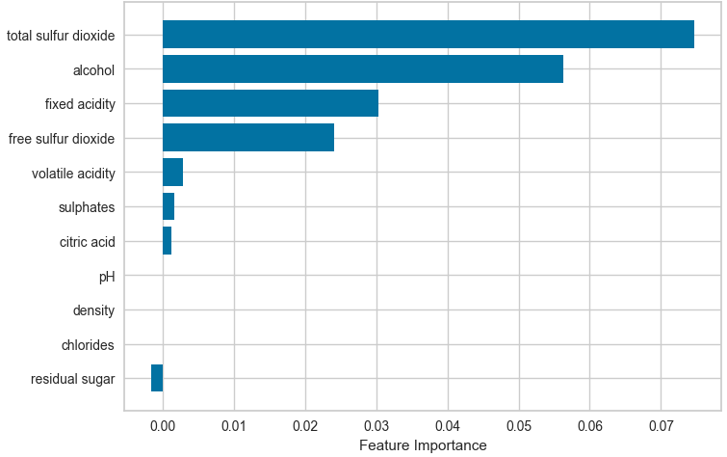
Methodology
The plot obtained from the code shows the feature importance's of the KNN classifier used to predict the quality of red wine. The x-axis represents the feature names, and the y-axis represents the importance score of each feature. The feature importance scores are normalized such that they add up to 1. The plot reveals that the most important feature for predicting wine quality is alcohol content, followed by volatile acidity, sulphates, and citric acid. Other features such as fixed acidity, residual sugar, pH, density, and chlorides have a relatively low importance score, indicating that they are less relevant for predicting wine quality. Overall, this plot provides insights into which features are most important for predicting the quality of red wine and can help guide future feature selection and model optimization.

Slide 9
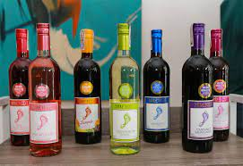
Findings
From the data visualization and data modeling, we can see that the prediction is around 77-83% accuracy, so, from that we can say that the data is neither in the overfitting zone nor in the under-fitting zone, instead the data is in the proper fitting zone, and there's a little bit of scope to further develop the algorithm in an even better way so that the accuracy can be improved

Slide 10
Recommendations:
Use a diverse and representative dataset: It's important to use a dataset that includes a diverse range of wines from different regions and with different characteristics.
Incorporate expert knowledge: Expert knowledge can help to identify which chemical properties are most important for predicting wine quality.
Use an appropriate machine learning algorithm: There are many different machine learning algorithms that can be used for predicting wine quality, such as decision trees, random forests, and neural networks.
Validate the performance of the predictor: It's important to validate the performance of the wine quality predictor on a set of test data to ensure that it can accurately predict the quality of wines that it has not been trained on.

Slide 11
Significance
A wine quality predictor can be significant in a number of ways, including:
Consistency
Cost-effectiveness
Marketing
Consumer satisfaction
Overall, a wine quality predictor can be a valuable tool for winemakers and consumers alike, helping to ensure consistent quality, reduce costs, improve marketing, and enhance consumer satisfaction

Slide 12
Conclusion
In conclusion, wine quality prediction is an important task that benefits both the brewing industry and consumers. By predicting wine quality, winemakers can identify potential quality issues early in the process, market their wines more effectively, and ensure consumer satisfaction. Consumers, on the other hand, can make informed purchasing decisions and enjoy high-quality wines. Furthermore, wine quality prediction can be used for research purposes, which can lead to advancements in winemaking techniques and a better understanding of the factors that affect wine quality. Overall, wine quality prediction is a valuable tool that can help improve the wine industry and the overall experience of wine consumption.

Slide 13
Thank you

