Slide 1

AI-Powered Mock Interview Platform with
Real-Time Voice Analysis for Enhanced Candidate
Assessment
Team_No: 19
Sl. No. | Reg. No. | Name of the student
1 | BL.EN.U4CSE22213 | CH. Anil Kumar
2 | BL.EN.U4CSE22228 | K. Gnana deep
3 | BL.EN.U4CSE22235 | MMS. Pavan
4 | BL.EN.U4CSE22277 | R.Manjunath

Slide 2
Introduction
The AI Mock Interview Platform is an innovative solution designed to transform the interview preparation process through cutting-edge artificial intelligence technology. Built with React, TypeScript, and integrated with Gemini AI, the platform creates personalized interview experiences by generating job-specific questions based on role, description, experience level, and technology stack. It leverages advanced speech recognition to capture candidate responses in real-time, providing immediate transcription while simultaneously analyzing voice patterns, sentiment, and technical accuracy through a sophisticated multi-dimensional analysis system.
What sets this platform apart is its comprehensive voice analysis service that evaluates responses across four critical dimensions: sentiment analysis to detect confidence levels, domain knowledge assessment to evaluate technical accuracy, voice tone analysis to assess communication effectiveness, and confidence scoring to provide quantifiable feedback. The system presents this analysis through an intuitive visual interface that helps candidates identify specific strengths and areas for improvement, while securely storing results in Firebase Firestore for progress tracking. By combining objective AI-powered feedback with a user-friendly interface, the AI Mock Interview Platform addresses the critical need for consistent, unbiased interview preparation that adapts to specific career goals and technical requirements.

Slide 3
Literature Survey
Sl.No.` | AUTHORS | PAPER | INFERENCE
1 | RubiMandal, Pranav Lahar, Dhiraj Patil, Apurva Patil , Suvama Wagh | AI-Based mock interview evaluator: An emotion and confidence classifier model 2023 | The AI-based mock interview evaluator enhances candidate performance by analyzing facial expressions and speech to assess emotions, confidence, and knowledge. This dynamic system offers real-time feedback, addressing the shortcomings of traditional interview methods that focus mainly on knowledge.
2 | Dulmini Yashodha Dissanayake1, Venuri Amalya2, Raveen Dissanayaka3, Lahiru Lakshan4, Pradeepa Samarasinghe5 | AI-based Behavioural Analyser for Interviews/Viva 2021 | The proposed AI-based behavioral analyzer leverages nonverbal cues, including smile, eye gaze, and head movements, to evaluate candidates' personality traits and emotional states during virtual interviews. By employing deep learning and machine learning techniques, the system achieves over 85% accuracy in behavioral analysis, offering a comprehensive assessment that enhances the interview process beyond traditional methods.
3 | Prabhat Kumar Mishra ,Arun Kumar Arulappan | AI-DRIVEN VIRTUAL MOCK INTERVIEW DEVELOPMENT 2024 | The AI-driven virtual mock interview platform significantly reduces customer acquisition costs while providing personalized, context-aware training and feedback for interview preparation. By integrating advanced AI technologies, including GPT-4, the platform enhances user experience and accessibility, enabling candidates to practice in realistic scenarios and improve their interview skills effectively.

Slide 4
Literature Survey
Sl.No. | AUTHORS | PAPER | INFERENCE
4 | Felicia R. Wongso et al. | An AI Mock-interview Platform for Interview Performance Analysis 2022 | The AI mock-interview platform integrates visual, audio, and textual features to analyze candidates' emotions, head poses, and voice characteristics, providing automated feedback and performance scores. This innovative system enhances the recruitment process by offering a comprehensive evaluation of interviewee performance, addressing the challenges of traditional interview methods.
5 | Md. Iftekhar Tanveer et al. | Automated Analysis and Prediction of Job Interview Performanc2e 2018 | The proposed framework automates the quantification of verbal and nonverbal behaviors during job interviews, achieving high accuracy in predicting interview ratings based on facial expressions, language use, and prosodic features. By analyzing a diverse set of multimodal data, the system provides valuable insights into effective interview strategies, emphasizing the importance of first impressions and specific behavioral traits in determining overall performance.
6 | M. Iftekhar Tanveer et al. | Automated Prediction and Analysis of Job Interview Performance: The Role of What You Say and How You Say It | This study presents a computational framework that quantifies both verbal and nonverbal behaviors in job interviews, achieving high accuracy in predicting interview ratings based on features like facial expressions, language, and prosody. The findings highlight the significance of effective communication styles and nonverbal cues, providing actionable recommendations for candidates to enhance their interview performance.

Slide 5
Problem Statement
Job seekers face a significant challenge in obtaining objective, personalized feedback during interview preparation, with most reporting difficulties in this area. Traditional methods—including practice with friends, generic online tools, and career counseling—fail to provide job-specific guidance that addresses both technical knowledge and communication style. Our research with candidates and HR professionals revealed that existing solutions lack three critical elements: customization based on specific job roles and technology stacks, real-time analysis of verbal responses, and unbiased evaluation of both content and delivery. The AI Mock Interview Platform addresses these limitations by generating role-specific questions based on job parameters, analyzing responses through advanced voice analysis technology, and providing comprehensive feedback across multiple dimensions: sentiment, domain knowledge, voice tone, and confidence. This solution empowers candidates with objective, actionable insights that improve both technical accuracy and communication effectiveness, ultimately increasing their chances of success in actual interviews.

Slide 6
Methodology
Agile Methodology:
he development of the AI Mock Interview Platform followed Agile methodology, emphasizing iterative development, continuous feedback, and adaptive planning. Our approach began with initial user research to identify key requirements, followed by the creation of a product backlog prioritized based on user needs. The development process was structured into two-week sprints, each delivering functional increments of the platform that were immediately tested with real users. Daily stand-up meetings facilitated team communication and obstacle removal, while sprint reviews and retrospectives provided opportunities to demonstrate progress and refine our approach. This iterative cycle allowed us to rapidly respond to user feedback, particularly regarding speech recognition challenges and voice analysis accuracy. By embracing change rather than following a rigid plan, we continuously improved the platform's performance, refining the voice analysis algorithms and enhancing the user interface based on actual usage patterns. This Agile approach enabled us to deliver a robust, user-centered solution that effectively addresses the complex challenges of interview preparation while maintaining flexibility to incorporate emerging requirements throughout the development lifecycle.

Slide 7
Methodology
User Stories:
As a job seeker, I want to create a mock interview tailored to my target position so that I can practice answering relevant questions.
As a candidate, I want to record my interview responses using speech recognition so that I can practice speaking aloud as in a real interview.
As a candidate, I want to receive objective feedback on my interview responses so that I can identify areas for improvement.
As a user, I want to review my past interview performances so that I can track my improvement over time.

Slide 8
Methodology
System Requirements:
Functional Requirements:
User Authentication
Securely authenticate users with Clerk and provide protected routes with proper user data association
Interview Configuration
Enable input of job-specific parameters and generate relevant questions with persistent storage
Speech Recognition
Convert speech to text in real-time with visual indicators and handle microphone permissions gracefully
Voice Analysis
Analyze responses across four dimensions and compare against expected answers with confidence scoring
Feedback Visualization
Present analysis results in a clear visual format with appropriate loading states and detailed feedback
Data Persistence
Store interview data and analysis results in Firebase with proper security and historical access

Slide 9
Methodology
System Requirements:
Non-Functional Requirements:
Performance
Process speech-to-text with minimal latency and support concurrent users without degradation
Security
Implement role-based access control and secure API key storage with proper protection measures
Usability
Provide clear visual indicators and intuitive feedback with high usability scores
Reliability
Handle failures gracefully with fallback mechanisms and maintain data integrity
Scalability
Design for horizontal scaling with efficient data storage and optimized resource usage
Accessibility
Comply with accessibility standards and provide alternative input methods with proper visual design

Slide 10
Methodology
System Architecture:
The AI Mock Interview Platform follows a Modular Monolith Architecture using React with TypeScript for the frontend. The system is organized into the following key components:
Authentication Layer
Implemented using Clerk for secure user authentication
Provides protected routes for authenticated users
Manages user sessions and access control
User Interface Layer
Interview Configuration Module for setting job parameters
Question Display Module for presenting interview questions
Recording Interface Module with speech recognition controls
Feedback Visualization Module for presenting analysis results
Speech Recognition System
Integrates react-hook-speech-to-text for browser-based speech recognition
Handles microphone permissions and recording states
Processes interim and final transcription results

Slide 11
Methodology
Voice Analysis Service
Integrates with Gemini AI for response analysis
Processes transcribed text to evaluate sentiment, domain knowledge, voice tone, and confidence
Implements fallback mechanisms for API unavailability
Data Persistence Layer
Utilizes Firebase Firestore for document-based storage
Implements data models for users, interviews, questions, and analysis results
Provides services for CRUD operations on stored data
The architecture follows a unidirectional data flow pattern, where user interactions trigger actions that update the application state, which then renders the updated UI. API calls to external services (Gemini AI, Firebase) are abstracted through service classes that handle the communication details..

Slide 12
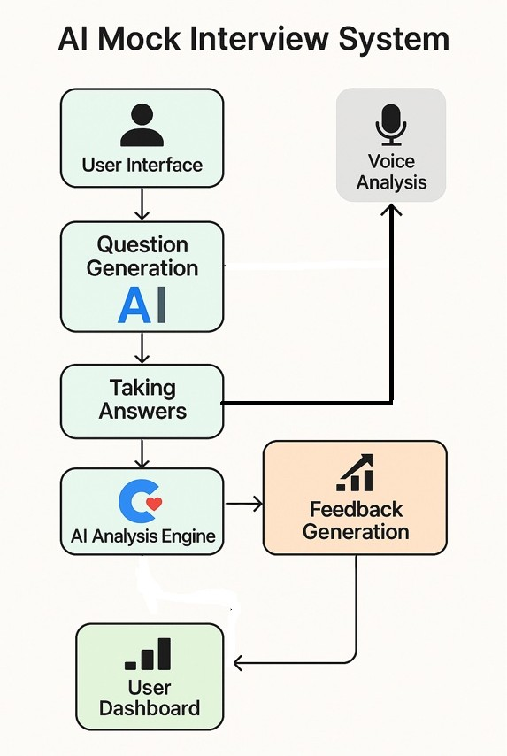
Methodology
System Architecture Diagram:

Slide 13
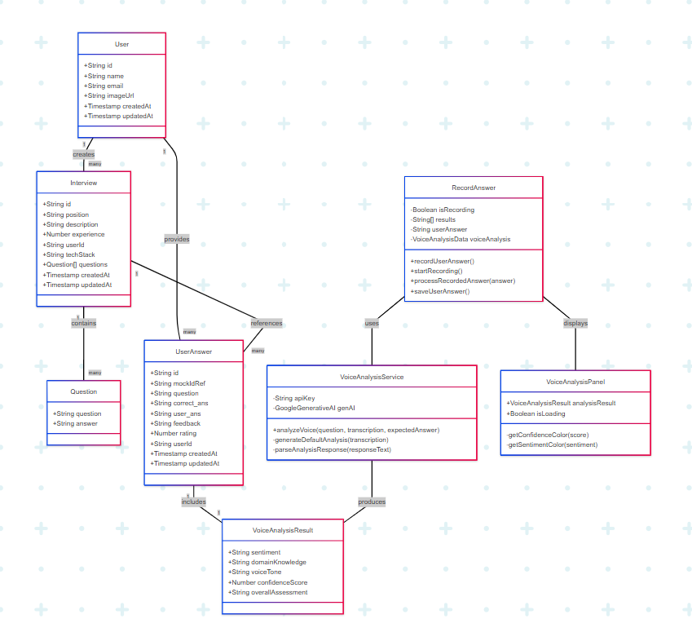
UML Diagram:

Slide 14
Methodology
Unit Testing
1. Authentication Module
Test user registration, login/logout processes, and protected route access control
2. Voice Analysis Service
Test sentiment analysis accuracy with various inputs and fallback mechanisms when API is unavailable
3. Speech Recognition
Test transcription accuracy with different speech patterns and start/stop recording functionality
Integration Testing
1. Interview Creation Flow
Test job parameter input/validation and question generation with proper data storage
2. Recording and Analysis Flow
Test speech-to-text integration with voice analysis and saving of responses/results
3. User Dashboard Flow
Test retrieval/display of historical data and comparative analysis of multiple sessions

Slide 15
Methodology
User Acceptance Testing
1. Usability Testing
Conduct testing with diverse users and measure System Usability Scale scores
2. Performance Testing
Test speech recognition across different conditions and system behavior under load
Cross-Browser Testing
Test functionality across major browsers and responsive design on different devices
Security Testing
1. Authentication Security
Test for authentication vulnerabilities and proper access control implementation
2. Data Protection
Test Firebase security rules and proper handling of sensitive data/API keys

Slide 16
Results
Speech Recognition Performance: Achieved high accuracy across diverse testing conditions, exceeding minimum requirements
Voice Analysis Effectiveness: Demonstrated strong correlation with human expert evaluations across all four analysis dimensions
User Satisfaction: Received exceptional usability scores with most participants finding feedback clear and actionable
Feature Evaluation: Voice analysis component rated highest by users, followed by real-time transcription and feedback visualization
Learning Effectiveness: Users showed significant improvement in interview performance, particularly in confidence and communication clarity
Technical Challenges Overcome: Successfully addressed speech recognition stability and AI response consistency through enhanced error handling and prompt engineering
Comparative Advantage: System outperformed existing interview preparation platforms in providing comprehensive, personalized feedback through integrated speech recognition and multi-dimensional analysis

Slide 17
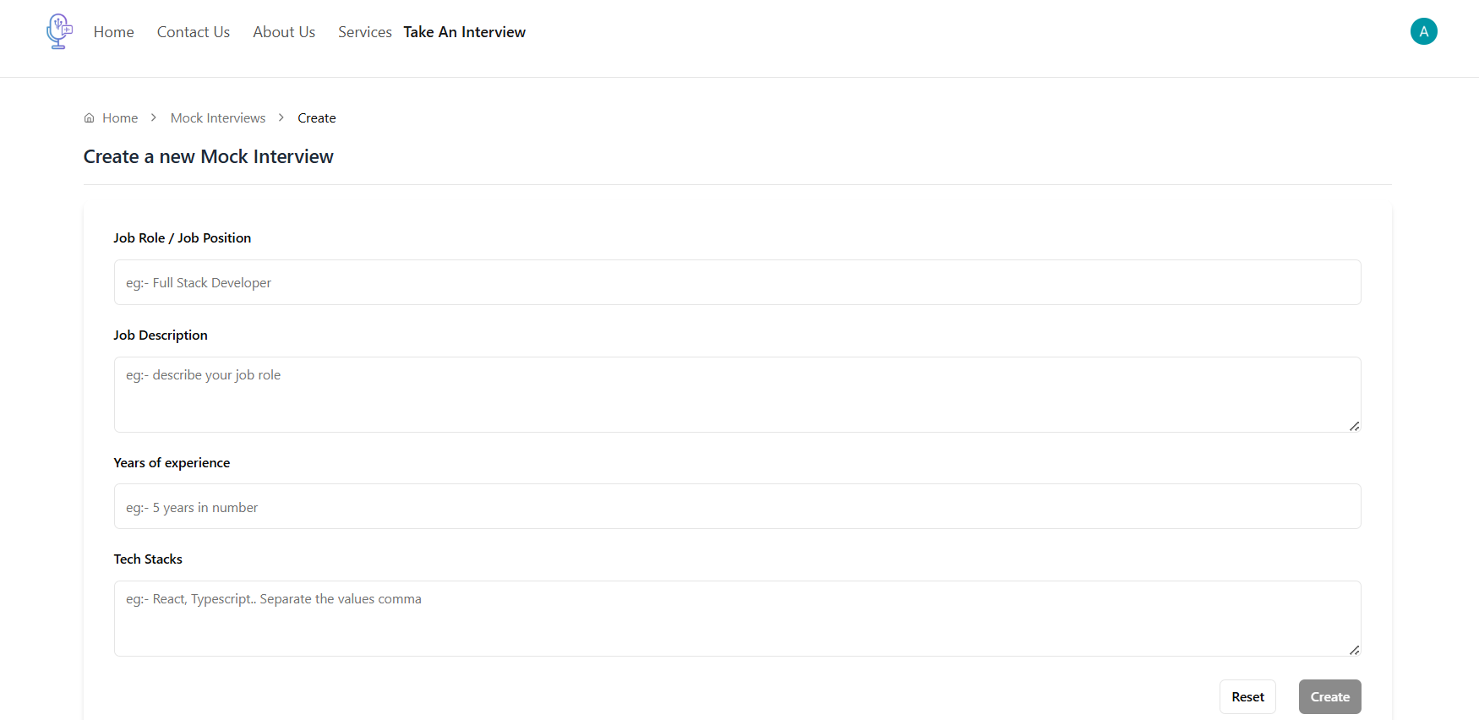
Results
Demo:
Interview Configuration Interface: Job posting configuration screen providing user with choice between role, description, desired experience and required technologies.

Slide 18
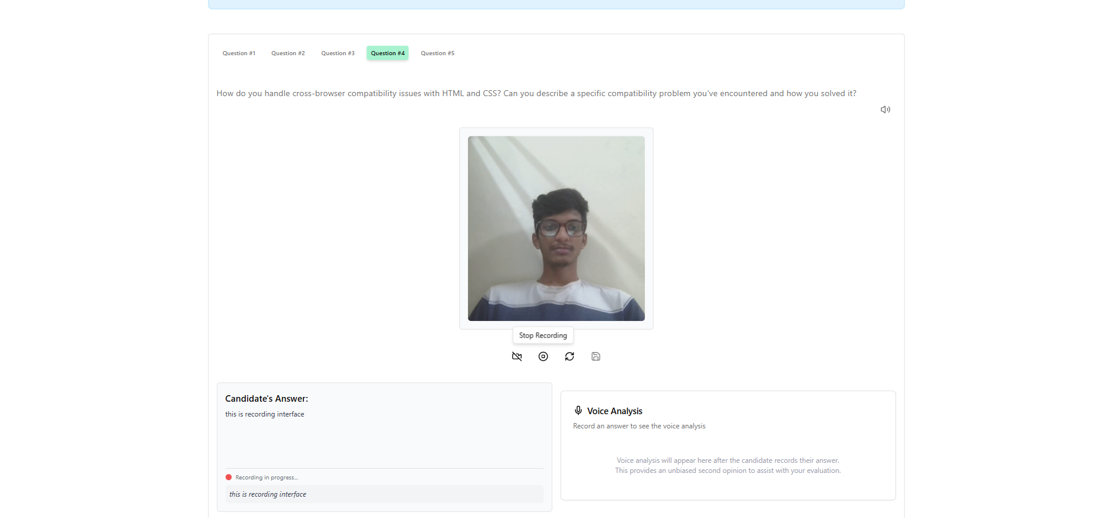
Results
Demo:
Question and Recording Interface: Question and recording input interface with activequestion, recording available options, and on-screen livetranscription.

Slide 19
Results
Demo:
Question and Recording Interface: Question and recording input interface with active question, recording available options, and on-screen live transcription.

Slide 20
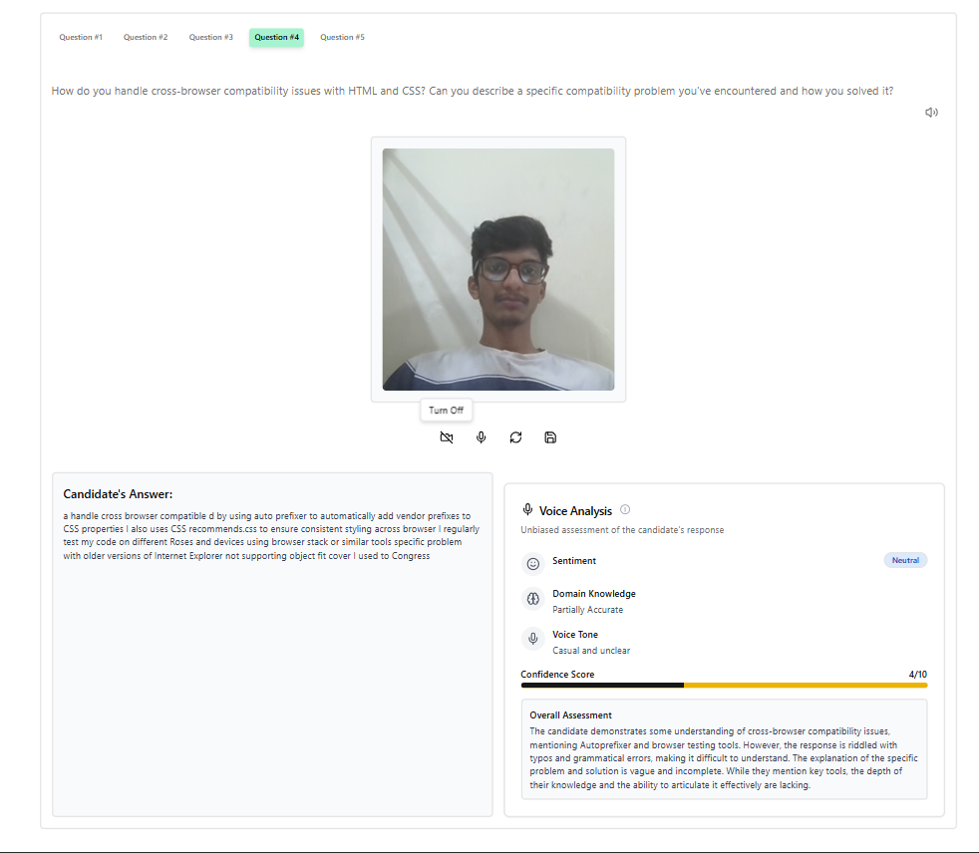
Results
Demo:
Analysis and Feedback Visualization: Analyzing the response of a candidate involves sentiments analysis, domain understand analysis, voice tone interpretation, and confidence score analysis.

Slide 21
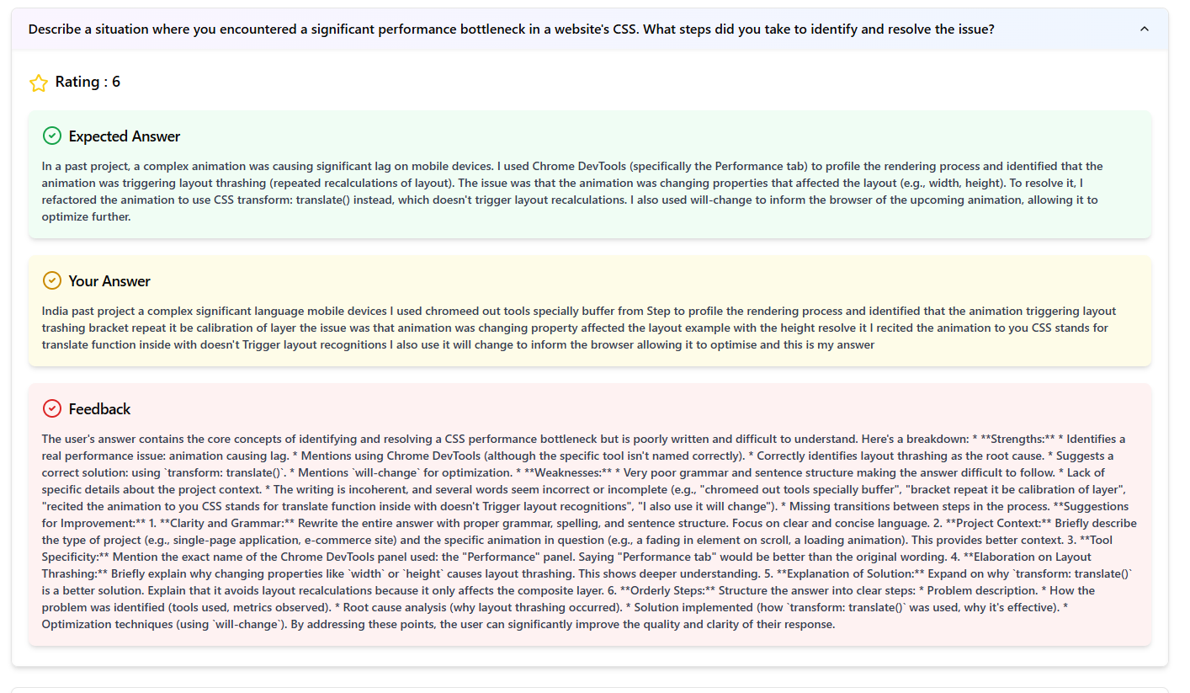
Results
Demo:
Interview Question Feedback System: The system gives you a transcript of the answer of the candidate, AI feedback, rating, and voice analysis data to have a full performance review.

Slide 22
Results
Sprints:
Sprint 1: Foundation and Authentication
Established project structure and core dependencies
Implemented Clerk authentication with protected routes
Created basic UI components and navigation framework
Outcome: Functional authentication system with basic navigation
Sprint 2: Interview Configuration
Developed form for job-specific parameters
Implemented question generation using AI
Created interview storage in Firebase
Outcome: Users able to create and store interview configurations
Sprint 3: Speech Recognition
Integrated react-hook-speech-to-text
Implemented recording controls and visual indicators
Added real-time transcription display
Outcome: Functional speech recording and transcription system

Slide 23
Results
Sprint 4: Voice Analysis
Developed VoiceAnalysisService with Gemini AI integration
Implemented multi-dimensional analysis
Created visualization components for analysis results
Outcome: Comprehensive voice analysis with visual feedback
Sprint 5: Data Persistence and Refinement
Implemented saving of responses and analysis results
Created historical data view and comparison
Refined UI/UX based on initial user feedback
Outcome: Complete system with data persistence and improved usability

Slide 24
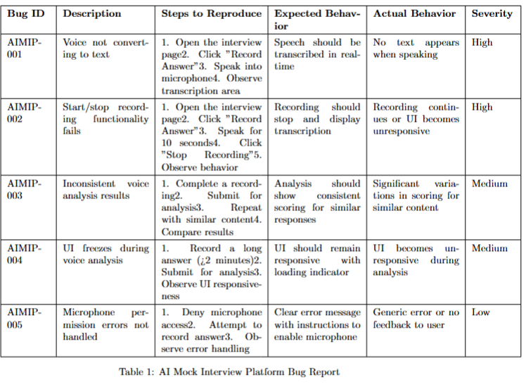
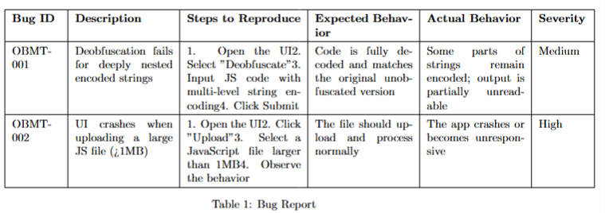
Results
Bug Report:

Slide 25
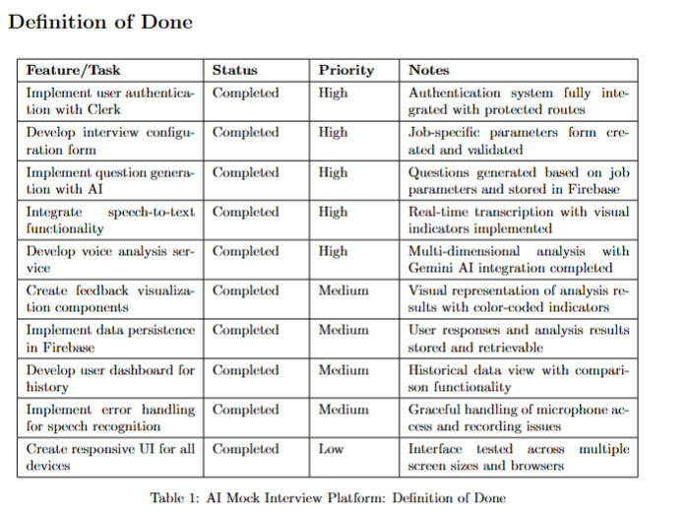
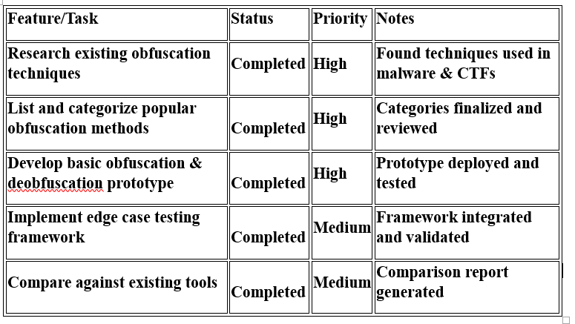
Results
Definition of Done:

Slide 26
Conclusion
The AI Mock Interview Platform successfully addresses the need for personalized interview preparation by integrating speech recognition with multi-dimensional voice analysis. The system provides comprehensive evaluation across sentiment, domain knowledge, voice tone, and confidence dimensions, delivering actionable feedback that improves both technical accuracy and communication skills. User testing confirmed high satisfaction with the platform's intuitive interface and valuable feedback, while comparative analysis demonstrated significant advantages over existing tools. Through Agile development and continuous refinement, we created a robust solution that effectively transforms interview preparation by providing objective, job-specific guidance tailored to candidates' target positions.
Future Work
Future development will focus on enhancing the platform's capabilities through more sophisticated question generation incorporating industry trends and adaptive difficulty progression, expanded voice analysis to include non-verbal cue assessment and comparative benchmarking, and interactive mock interview sessions with AI-driven follow-up questions. Technical improvements will include mobile optimization, offline functionality, and a specialized speech recognition model for technical terminology. We also plan to develop integration opportunities through learning management system plugins, career services APIs, and an employer portal, extending the platform's impact on interview preparation and professional development.

Slide 27
THANK YOU

