Slide 1

A Comprehensive Business Analytics Framework for E-Commerce: Customer Segmentation, Churn Prediction & Sales Forecasting
Team_No: 15
Sl. No. | Reg. No. | Name of the student
1 | Ch. Dinesh | BL.EN.U4CSE22015
2 | G. Krishna Koushik | BL.EN.U4CSE22023
3 | P. Jaya Chetan | BL.EN.U4CSE22044
4 | Ch. Anil Kumar | BL.EN.U4CSE22213

Slide 2
Problem Statement & Objective
E-commerce businesses struggle to understand diverse customer behavior, leading to inefficient marketing and decreasing retention.
Lack of clear customer segmentation makes it difficult to target high-value customers or identify at-risk segments.
Increasing customer churn impacts long-term revenue, yet businesses often fail to predict churn early using data-driven methods.
Future sales trends are uncertain, making inventory planning and financial decision-making challenging without forecasting.

Slide 3
Dataset Description
Relevance of the Dataset used:
The dataset used in this project is a recent and comprehensive e-commerce transactional dataset that captures real customer purchase behavior, including invoice details, product categories, payment methods, and geographic information. Its richness and recency make it highly suitable for business analytics tasks such as RFM-based customer segmentation, churn prediction, CLV estimation, and sales forecasting. Because it reflects realistic and modern e-commerce trends, the dataset provides meaningful insights that can directly support strategic decision-making and improve customer retention, marketing effectiveness, and revenue planning.
Dataset Information:
Category: Customer and Shopper Data Rows: 1,000,000
Industry: Retail & E-Commerce Columns: 14
Country: Nigeria Date Generated: 2025-10-06
Format: CSV, Parquet Location: Nigeria

Slide 4
Dataset Description Contd..
Dataset Schema:
Column | Type | Sample Values
purchase_id | String | PUR0000000
customer_id | String | CUST738296
purchase_date | String | 2023-03-07
product_category | String | Sports & Outdoors
product_subcategory | String | Sports Equipment
quantity | Integer | 5
unit_price_ngn | Float | 136977.89
total_amount_ngn | Float | 684889.45
payment_method | String | cash_on_delivery
channel | String | online
city | String | Abuja
is_repeat_purchase | Boolean | True
discount_applied | Boolean | True
discount_amount_ngn | Float | 0.0

Slide 5
Nigerian Context:
This dataset incorporates authentic Nigerian retail and e-commerce characteristics:
E-Commerce Platforms Jumia (35% market share) - Leading marketplace Konga (25% market share) - Major competitor Jiji (20% market share) - Classifieds platform PayPorte, Slot, and other platforms | Geographic Coverage Lagos - Commercial capital, highest retail density Abuja - Federal capital, high e-commerce penetration Kano - Northern commercial hub Port Harcourt - Oil city, strong purchasing power Ibadan - Large urban market Plus 10+ other major cities
Physical Retail Shoprite, Spar, Game - Major supermarket chains Slot, Pointek - Electronics retailers Mr Price - Fashion retail Traditional markets: Balogun Market, Computer Village | Currency & Pricing Currency: Nigerian Naira (NGN, ₦) Exchange Rate: ~₦1,500/USD Price Ranges: Realistic Nigerian market prices Time Zone: West Africa Time (WAT, UTC+1)

Slide 6
Data Preprocessing
Loaded multi-feature e-commerce dataset
Read and combined the data into a consistent DataFrame
Ensured Numeric / Date / Categorical types were correctly parsed
Feature Engineering
Created TotalAmount = Quantity × UnitPrice
Extracted InvoiceMonth for time-series sales forecasting
Built Recency, Frequency, Monetary (RFM) features
Created churn label using Recency threshold (e.g., > 60 days → churn)

Slide 7
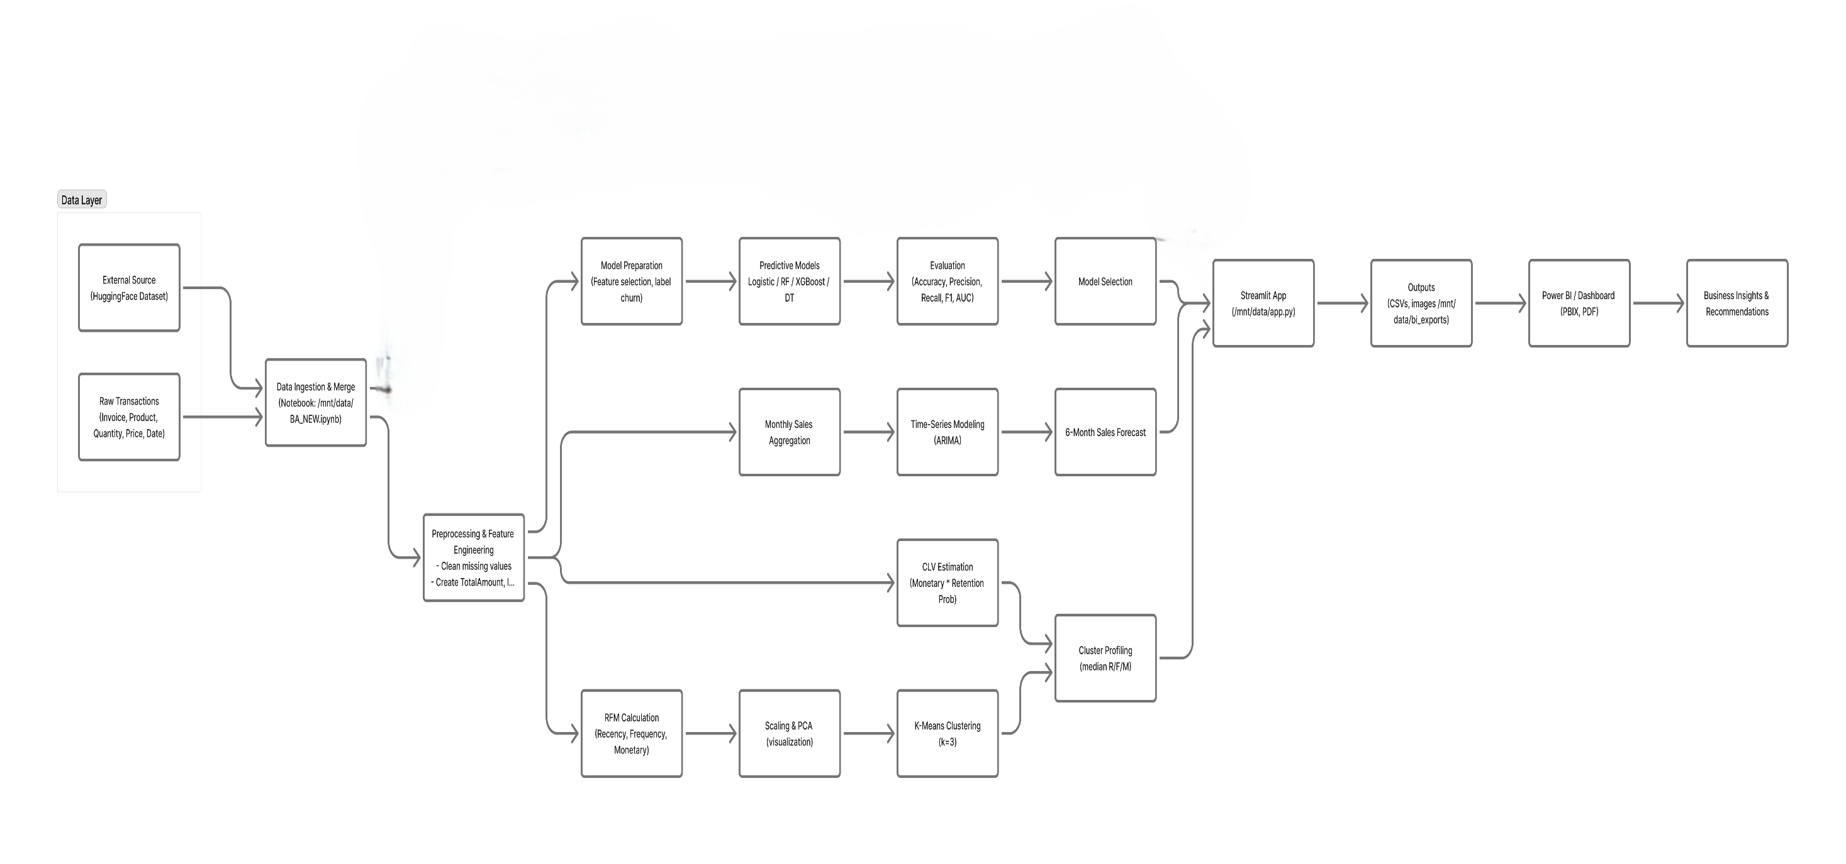
Analytical Approach/ Methodology

Slide 8
Analytical Approach/ Methodology
Overview
This project follows an end-to-end analytics pipeline: Data ingestion → Preprocessing → EDA → RFM & segmentation → Predictive modeling (churn) → CLV estimation → Time-series forecasting → Recommendation mining → Deployment (Streamlit & Power BI)
1. Data ingestion & consolidation
Goal: Load and unify raw transaction sources into a single analysis-ready table.
Actions taken:
  Loaded raw files and HuggingFace dataset where applicable.
  Standardized column names.
2. Data cleaning & preprocessing
Goal: Ensure data correctness and build the base features for analysis.
Actions taken:
  Removed invalid/negative quantities and zero/negative unit prices.
  Handled missing CustomerID / Invoice rows (drop or impute as appropriate).
  Standardized date fields (convert InvoiceDate to datetime).
  Created TotalAmount = Quantity × UnitPrice.
  Resampled/aggregated date fields to monthly for forecasting.

Slide 9
Analytical Approach/ Methodology
3. Feature engineering
Goal: Create features needed for segmentation and modeling.
Actions taken:
  Built RFM features per customer:
    Recency (days since last purchase),
    Frequency (total transactions),
    Monetary (total spend).
  Created churn label using recency threshold (e.g., >30/60 days → churn).
4. Exploratory Data Analysis (EDA)
Goal: Understand distributions, trends and relationships to guide modeling and business actions.
Actions taken:
  Descriptive stats (mean, median, std) for Quantity, UnitPrice, TotalAmount.
  Distribution plots for Recency, Frequency, Monetary.
  Monthly sales trend visualization (time series).
  Payment method analysis (revenue share & counts).
  City / geographic revenue heatmap or bar chart.
  Correlation analysis and key variable checks.

Slide 10
Analytical Approach/ Methodology
5. RFM scoring and Customer Segmentation (K-Means)
Goal: Segment customers into meaningful groups for targeting.
Actions taken:
  Computed RFM scores and scaled features (StandardScaler).
  Used Elbow method and Silhouette score to choose k=3.
  Applied K-Means and profiled clusters by median RFM and counts.
  Labeled clusters (e.g., Loyal, Regular, At-Risk).
6. Predictive modeling — Churn prediction
Goal: Predict which customers are likely to churn so we can prioritize interventions.
Actions taken:
  Prepared modeling dataset (features: Frequency, Monetary, cluster, f_score/m_score etc.).
  Split into train/test; handled class imbalance (class_weight='balanced').
  Trained models: Logistic Regression, Random Forest, Decision Tree, XGBoost.
  Evaluated using Accuracy, Precision, Recall, F1, ROC-AUC and confusion matrices.

Slide 11
Analytical Approach/ Methodology
8. Model selection & interpretability
Goal: Choose final model balancing accuracy and interpretability.
Actions taken:
  Compared models; selected Logistic Regression for interpretability and XGBoost for high performance.
  Extracted feature importance from tree models.
9. Customer Lifetime Value (CLV) estimation
Goal: Quantify future monetary value of each customer to prioritize retention spending.
Actions taken:
  Used CLV = Monetary × (1 − Churn_Prob) where Churn_Prob comes from the logistic regression (or chosen model).
  Ranked customers by CLV and produced cluster-wise CLV averages.

Slide 12
Analytical Approach/ Methodology
10. Time-series modeling & Sales Forecasting
Goal: Forecast short-term (6 months) sales to guide inventory and planning.
Actions taken:
  Aggregated daily/weekly invoices to monthly sales (monthly_sales).
  Ensured monthly frequency (.asfreq('M')).
  Fitted ARIMA (or auto-ARIMA) and forecasted next 6 months. Addressed convergence/frequency warnings by choosing parsimonious ARIMA (1,1,1) and setting freq='ME’.
11. Evaluation, validation & business recommendations
Goal: Validate models and translate insights into actionable business steps.
Actions taken:
  Evaluated models on hold-out test set and reported metrics. Performed error analysis and model stability checks.
  Produced prioritized action list by combining CLV and churn risk:
  High CLV + High churn → immediate retention offers.
  Forecast insights used for inventory & campaign planning.

Slide 13
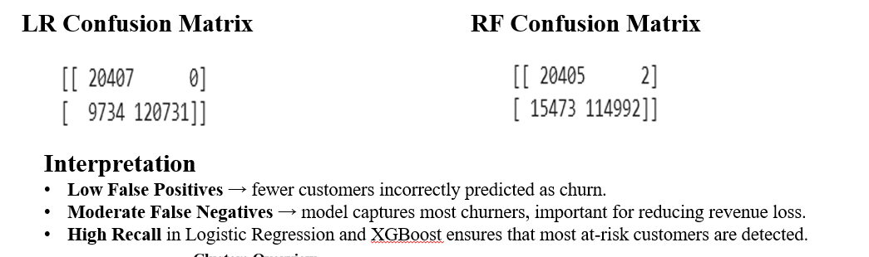
Results & Evaluation
Comparative Performance Table
 | Model | Accuracy | Precision | Recall | F1 | ROC_AUC
0 | Logistic Regression | 0.935482 | 1.000000 | 0.925390 | 0.961249 | 0.964245
1 | Random Forest | 0.897430 | 0.999983 | 0.881401 | 0.936955 | 0.963927
2 | Decision Tree | 0.732237 | 0.986728 | 0.699766 | 0.818833 | 0.894165
3 | XGBoost | 0.935475 | 0.999992 | 0.925390 | 0.961246 | 0.963967

Slide 14
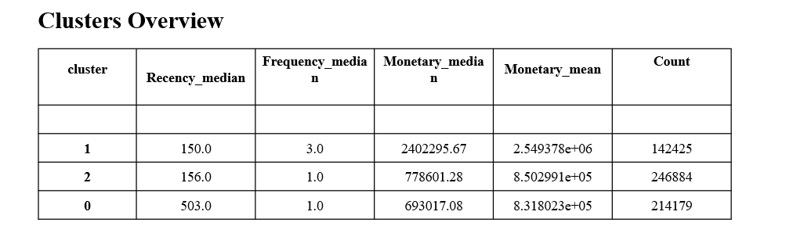
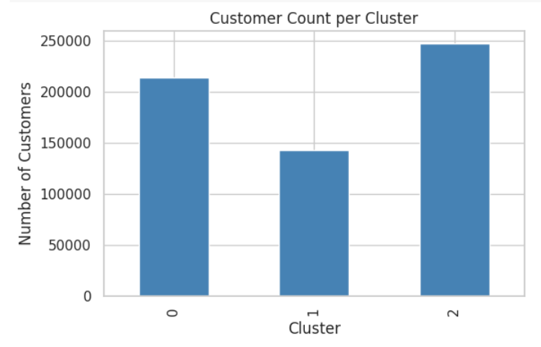
Results & Evaluation
Cluster Profiles
Cluster 0 – High-Value Loyal Customers
  High frequency, high monetary value, low recency
  Strong CLV
Cluster 1 – At-Risk Customers
  High recency, moderate frequency → higher churn probability
Cluster 2 – Regular Customers
  Moderate RFM values, average CLV

Slide 15
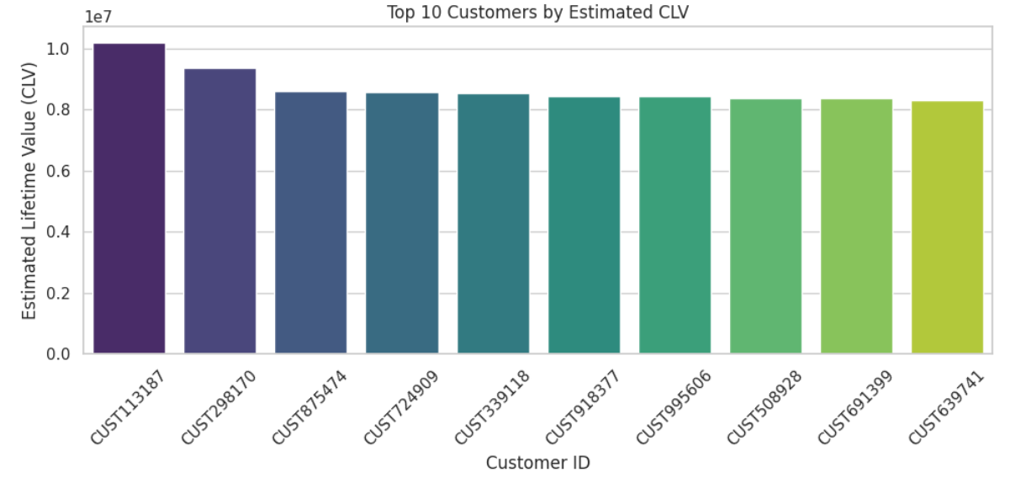
Results & Evaluation
Customer Lifetime Value (CLV) Evaluation
CLV was estimated as:
Results
High-value customers with low churn probability were identified as prime retention targets.
High-CLV but high churn probability customers were flagged as critical for intervention.
Cluster-wise CLV comparison shows Cluster 0 has the highest lifetime revenue potential.

Slide 16
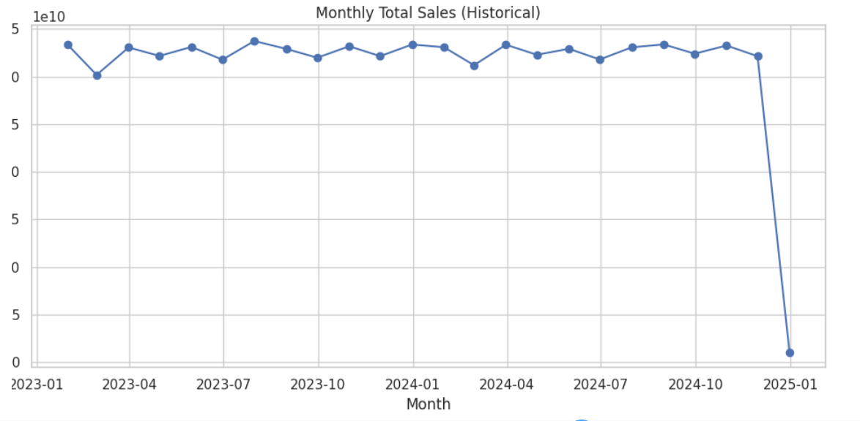
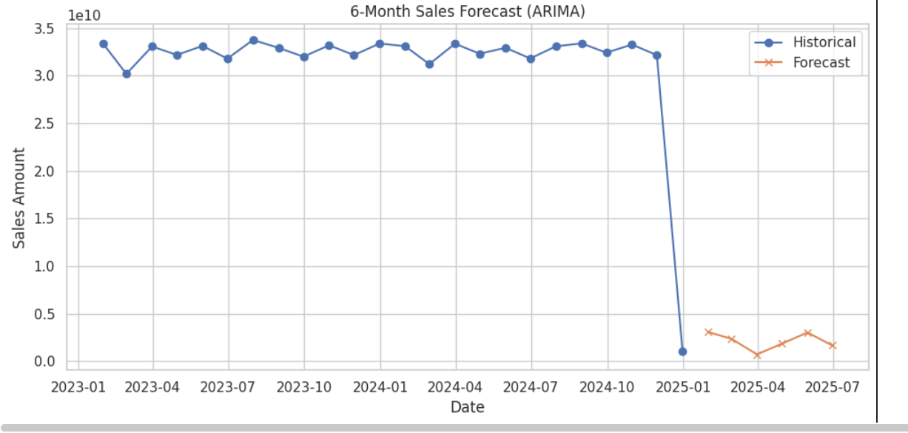
Results & Evaluation
Sales Forecasting Evaluation
Using ARIMA, a 6-month sales forecast was generated.
Evaluation Points
Monthly sales trend is stable with seasonal fluctuations.
Forecast shows moderate growth in coming months.
The ARIMA model achieved a good fit after frequency correction (asfreq('M')).

Slide 17
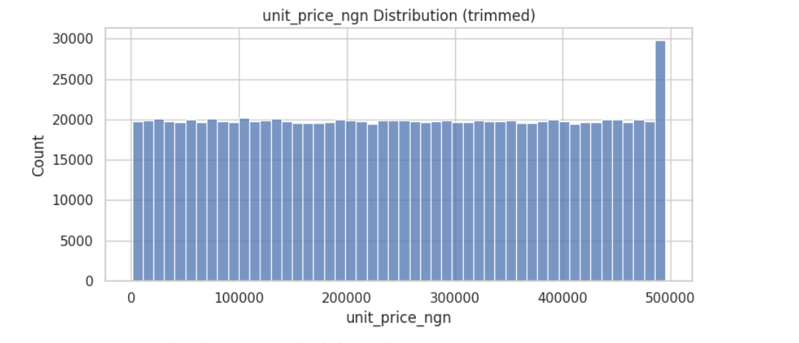
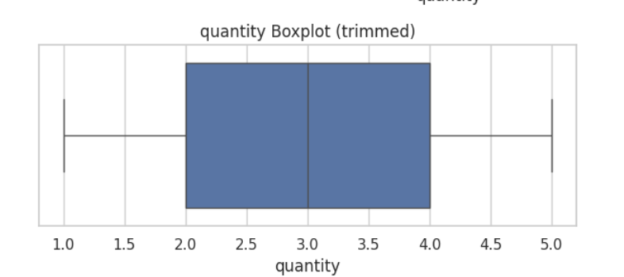
Visualizations & Insights

Slide 18
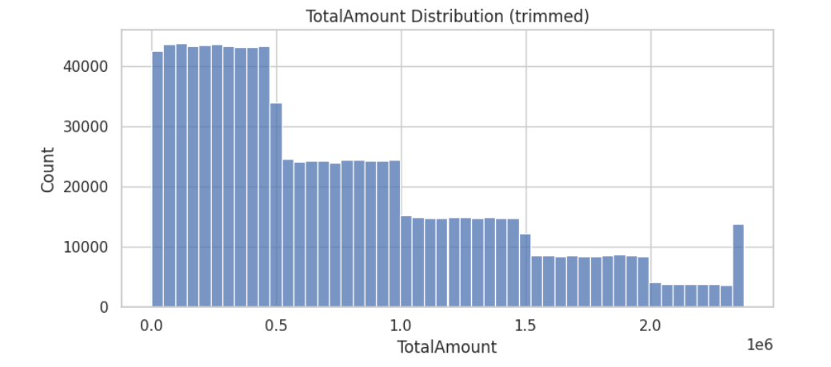
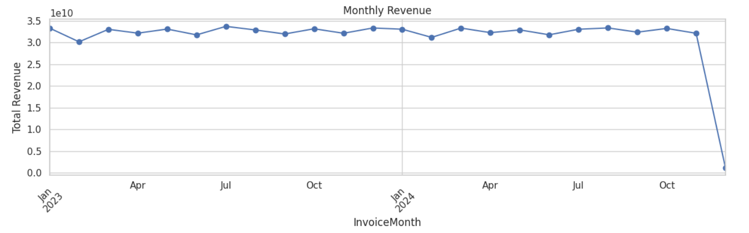
Visualizations & Insights

Slide 19
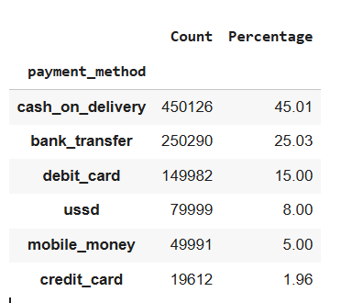
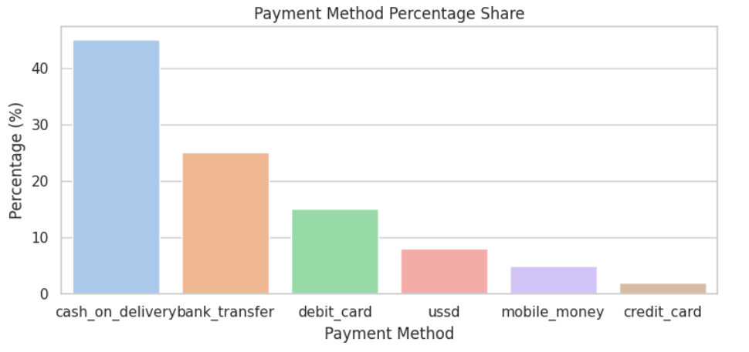

Visualizations & Insights

Slide 20
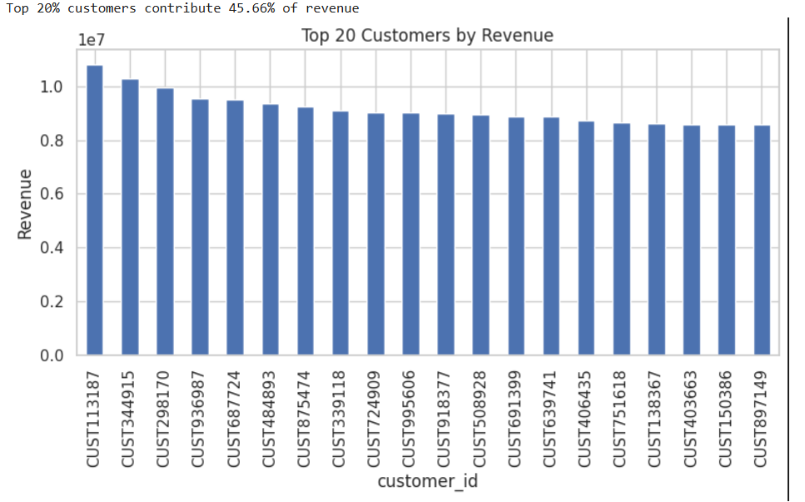
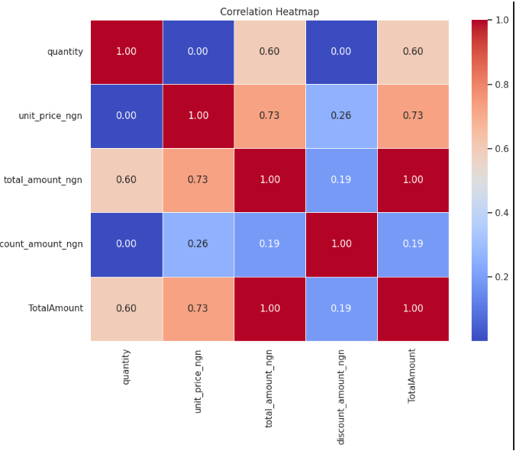
Visualizations & Insights

Slide 21
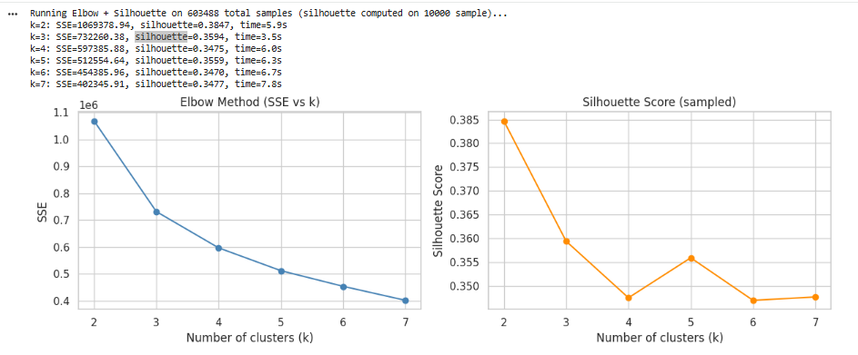
Visualizations & Insights

Slide 22
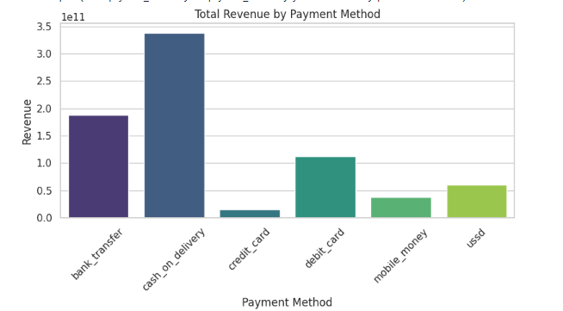
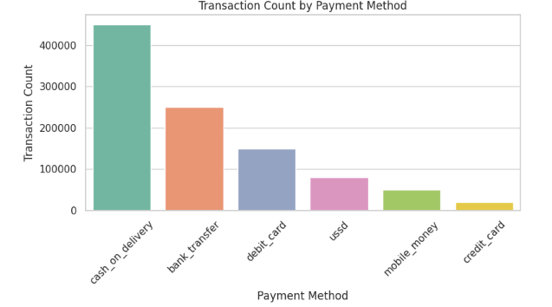
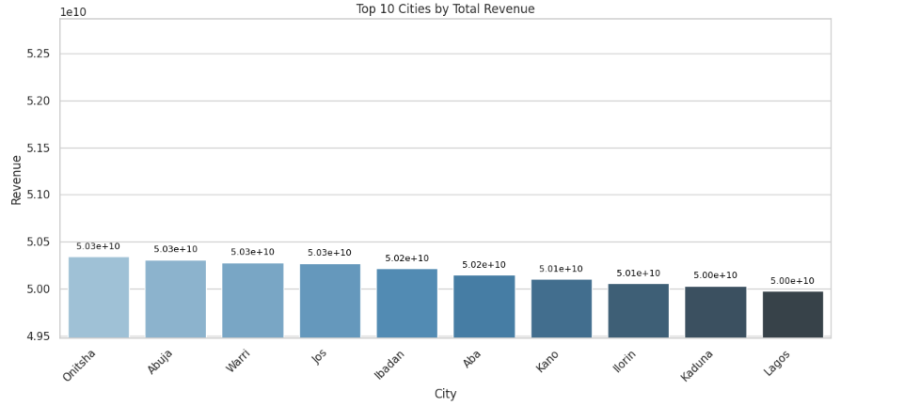
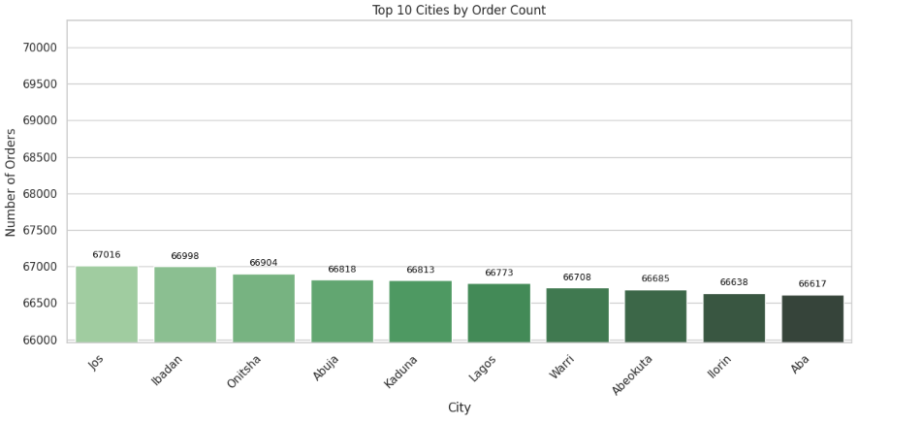
Visualizations & Insights

Slide 23
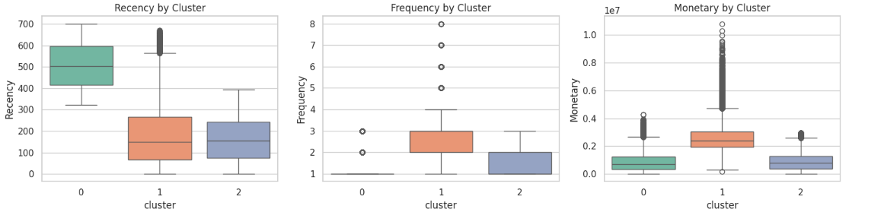
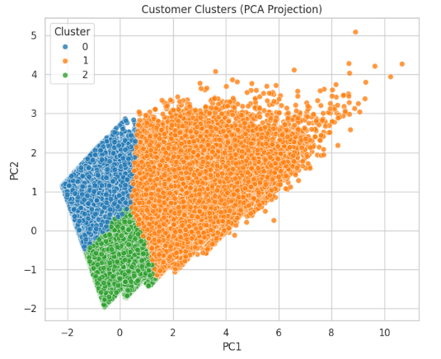
Visualizations & Insights

Slide 24
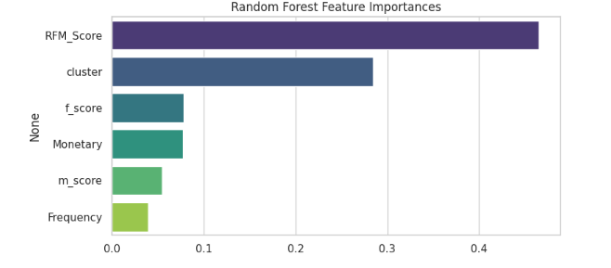
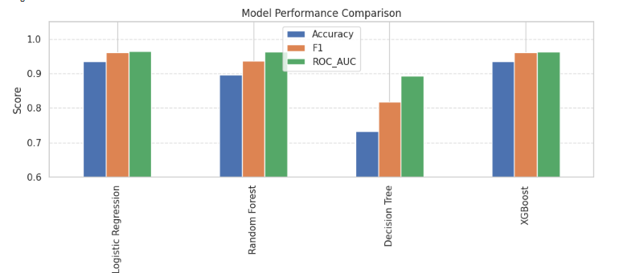
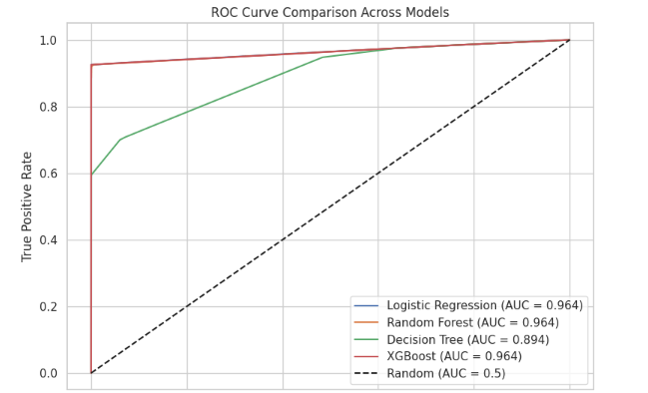
Visualizations & Insights

Slide 25
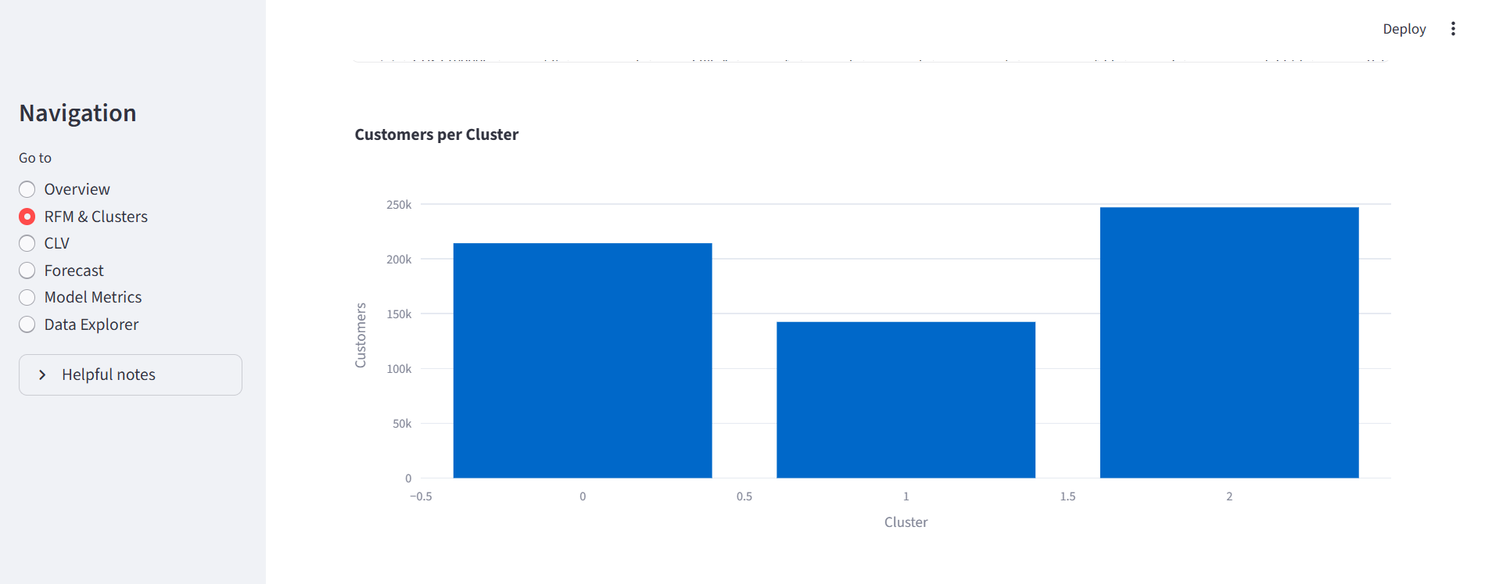
Visualizations & Insights

Slide 26
Business Insights & Decision Support
Customer Segmentation (RFM + Clustering)
Identified 3 customer segments: Loyal, Regular, At-Risk.
Loyal customers drive highest revenue; At-Risk customers show high Recency & churn risk.
Action: Target At-Risk with retention offers; reward Loyal customers to increase loyalty.
Churn Prediction
ML models (Logistic, XGBoost) accurately detect customers likely to churn.
High recall ensures early detection of at-risk users.
Action: Trigger personalised retention interventions for high-risk customers.
Customer Lifetime Value (CLV)
CLV highlights long-term revenue potential of each customer.
High-CLV + High-Churn customers are critical for retention.
Action: Prioritize top-CLV customers and apply cost-effective engagement strategies.

Slide 27
Business Insights & Decision Support
Sales Forecasting (ARIMA)
Forecast shows stable to slightly increasing sales over the next 6 months.
Action: Plan inventory, supply chain, and marketing campaigns based on forecasted demand.
EDA & Behavior Insights
Digital payments contribute most revenue; key cities dominate sales.
RFM distributions and trends reveal customer spending patterns.
Action: Optimize payment promotions and focus marketing on high-performing regions.
Overall Decision Support
Enables data-driven CX, marketing, and revenue planning.
Helps reduce churn, increase CLV, and improve targeting efficiency.
Power BI + Streamlit dashboards support real-time decision making for management.

Slide 28
Business Insights & Decision Support
1. Programming & Data Processing
Python 3 – core language for analysis & modeling
Pandas, NumPy – data cleaning, transformation, preprocessing
2. Data Visualization
Matplotlib, Seaborn – EDA charts, distributions, trends
Power BI – interactive BI dashboards for business insights
Streamlit – deployed interactive analytics web app
3. Machine Learning & Modeling
Scikit-Learn – Logistic Regression, Random Forest, Decision Tree, PCA
XGBoost – advanced churn prediction
Statsmodels – ARIMA time-series forecasting
4. Clustering & Segmentation
K-Means (scikit-learn) – customer segmentation
StandardScaler – feature normalization
PCA – dimensionality reduction for cluster visualization
5. Deployment & Reporting
Streamlit App (app.py) – customer insights dashboard
Power BI (.pbix) – executive-level dashboards
Google Colab / Jupyter Notebook – analysis development environment

Slide 29
Conclusion
  Built a complete business analytics framework combining segmentation, churn prediction, CLV, and forecasting.
  RFM + K-Means effectively segmented customers into Loyal, Regular, and At-Risk groups.
  Churn prediction models (Logistic & XGBoost) achieved high accuracy, enabling early detection of at-risk customers.
  CLV estimation helped prioritize valuable customers and optimize retention strategies.
  ARIMA forecasting provided reliable sales projections for effective planning and decision-making.
  Streamlit and Power BI dashboards made insights interactive, accessible, and business-friendly.
  Overall, the project demonstrates how data-driven analytics can enhance customer understanding and support strategic growth in e-commerce.

Slide 30
THANK YOU

