Slide 1
Automated Report
Generated from images/ outputs

Slide 2
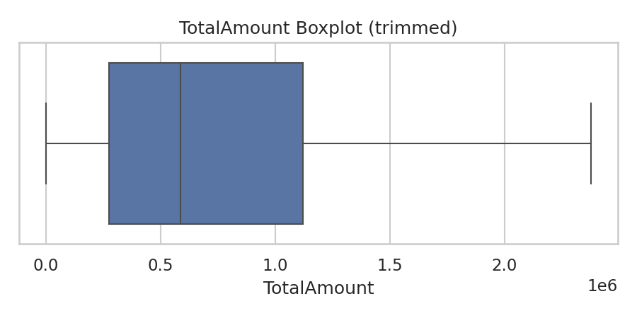
box_TotalAmount.png

Slide 3
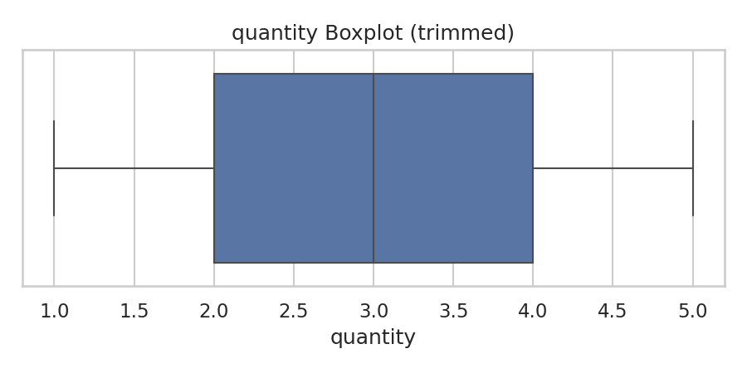
box_quantity.png

Slide 4
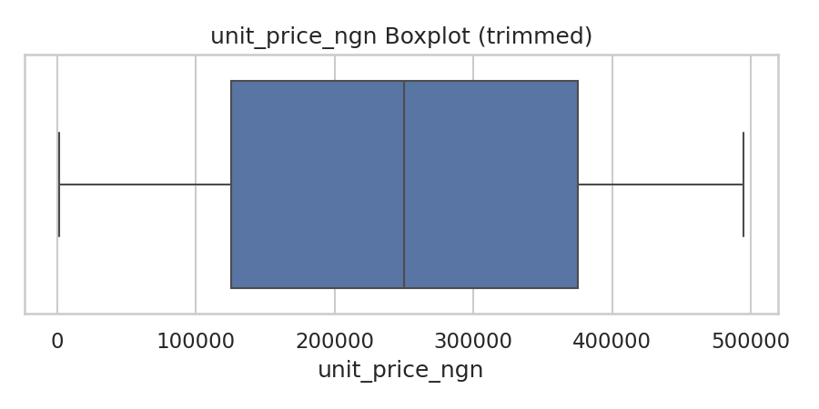
box_unit_price_ngn.png

Slide 5
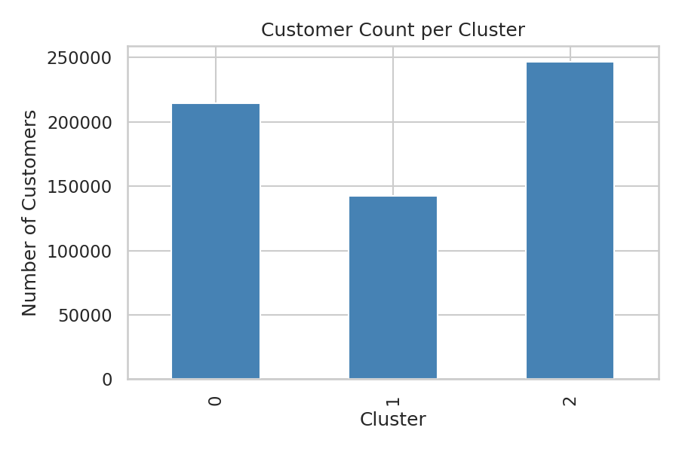
cluster_counts.png

Slide 6
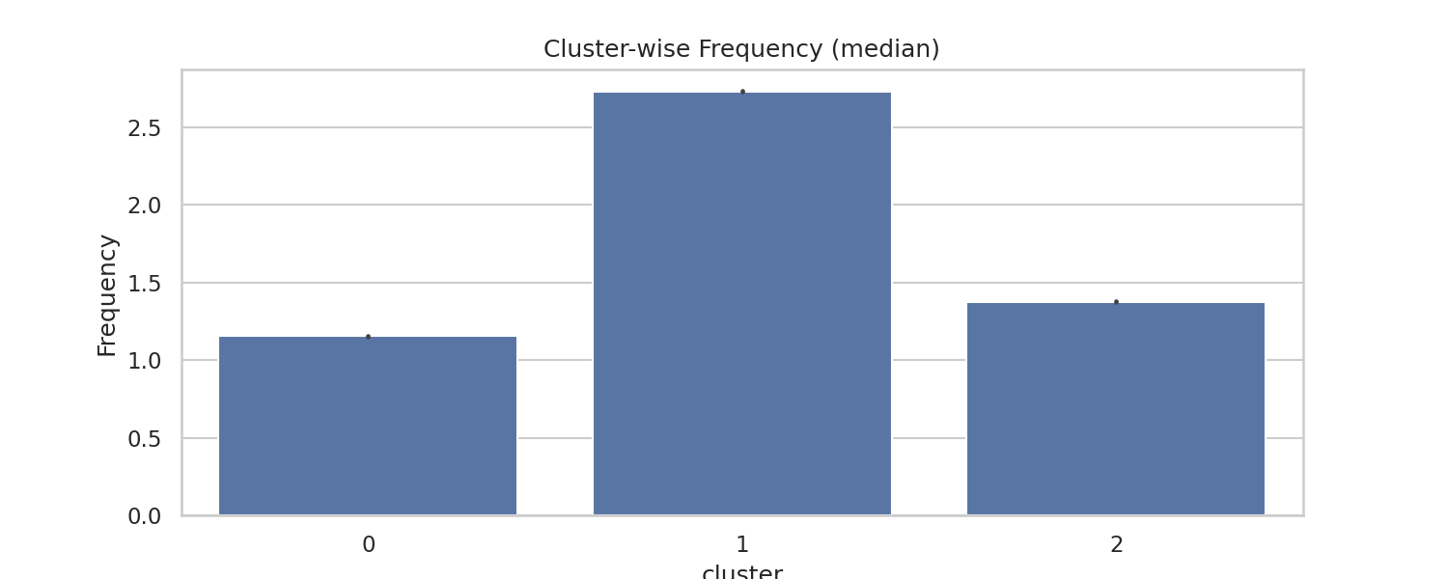
cluster_frequency.png

Slide 7
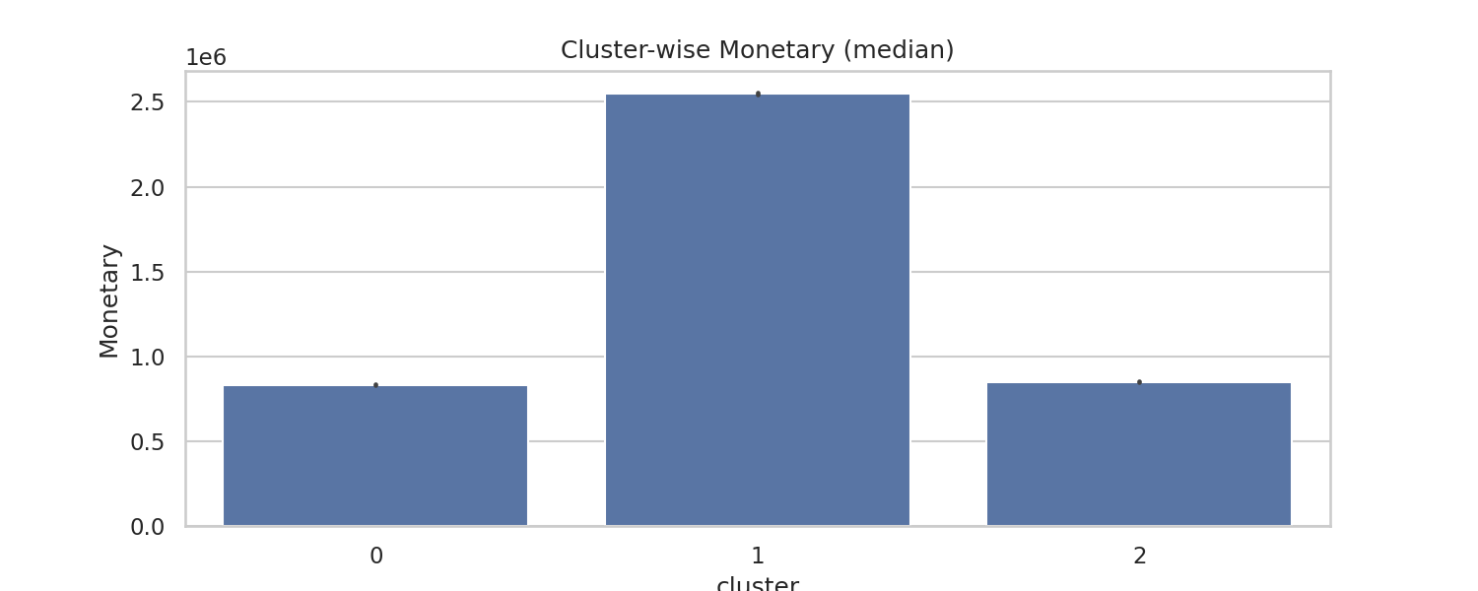
cluster_monetary.png

Slide 8
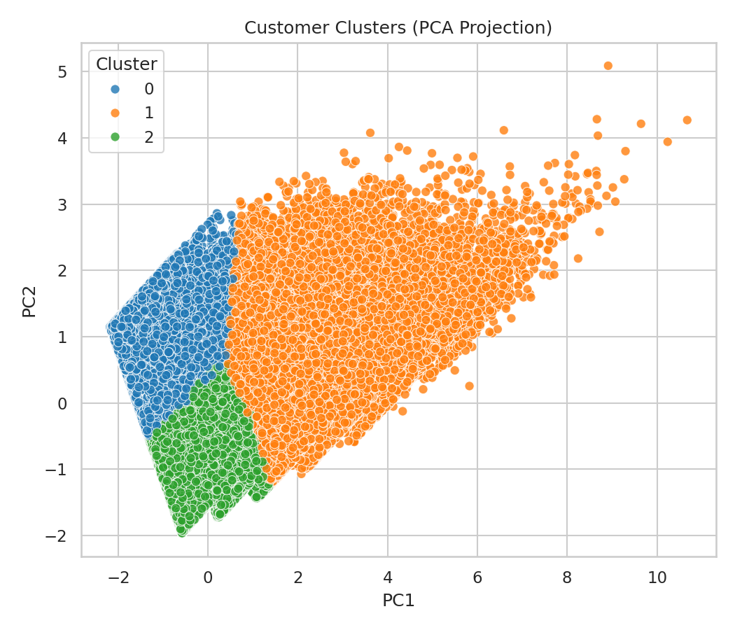
cluster_pca_projection.png

Slide 9
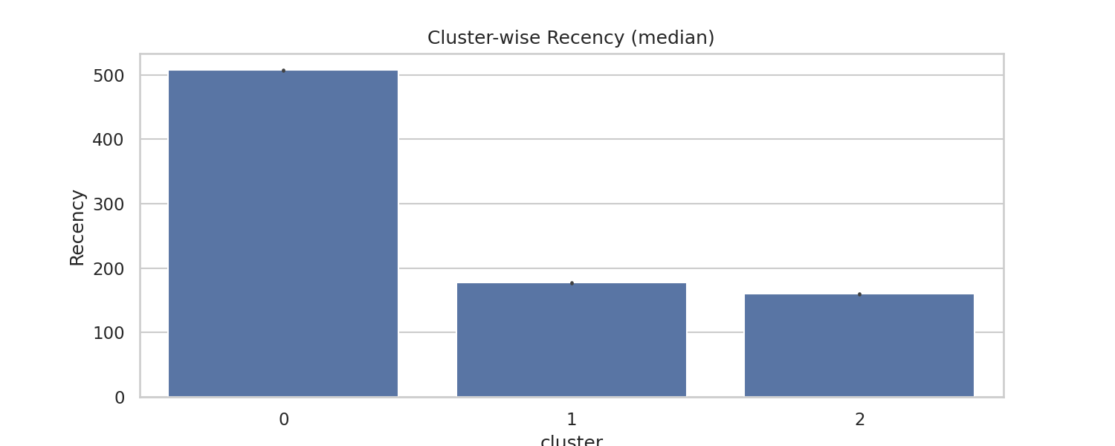
cluster_recency.png

Slide 10
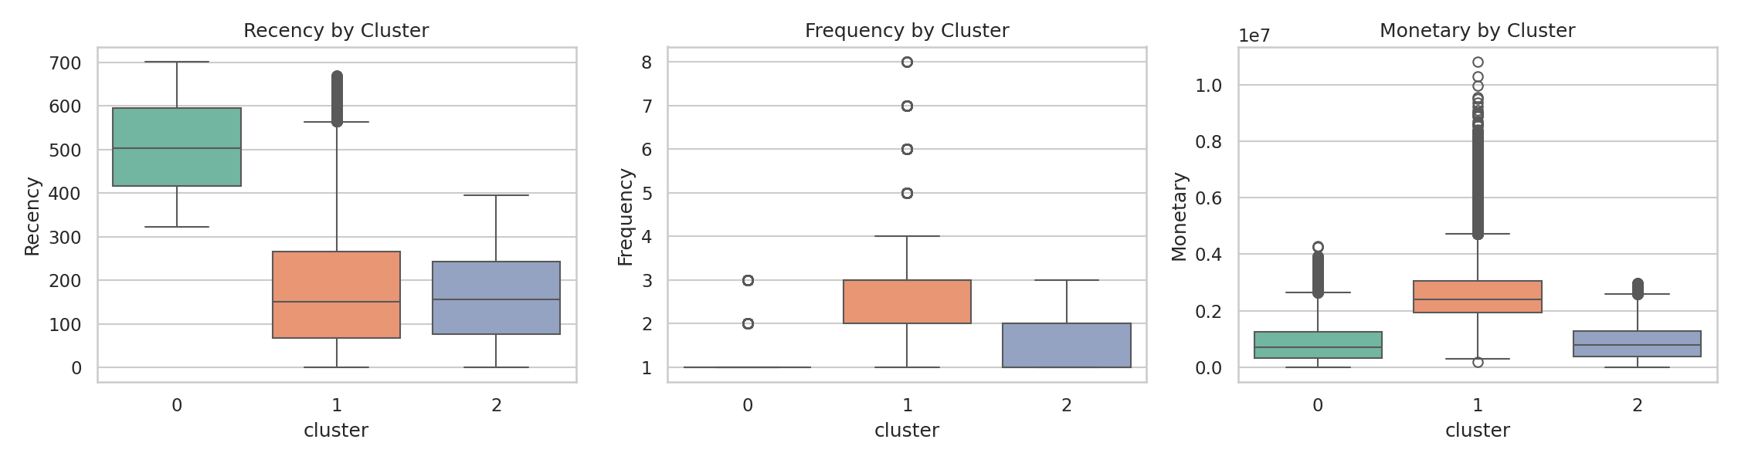
cluster_rfm_boxplots.png

Slide 11
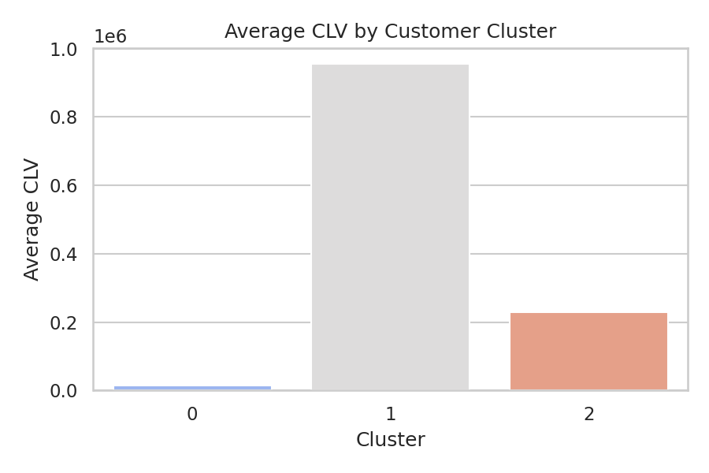
cluster_wise_clv.png

Slide 12
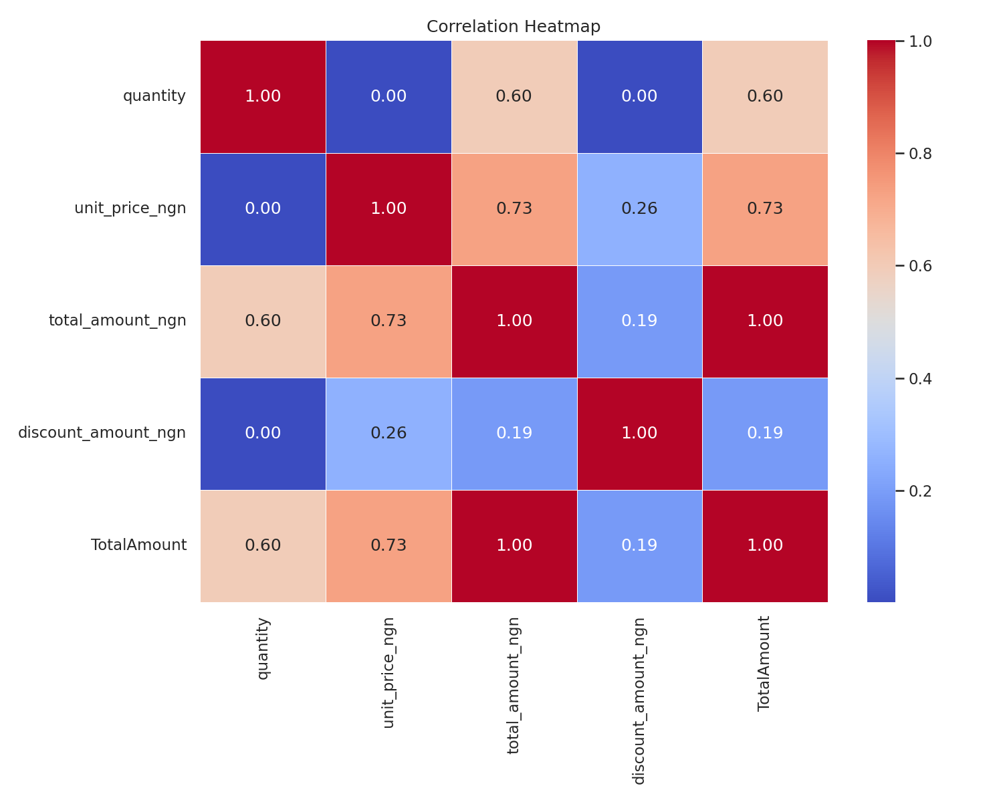
correlation_heatmap.png

Slide 13
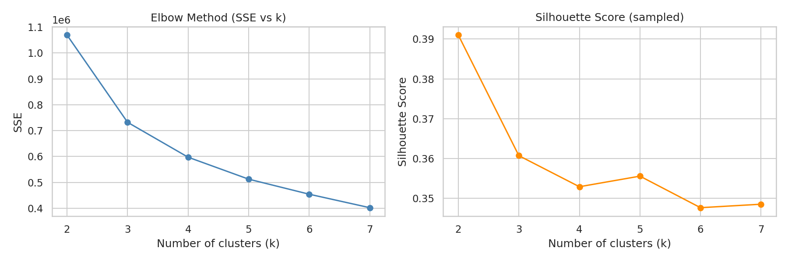
elbow_silhouette_fast.png

Slide 14
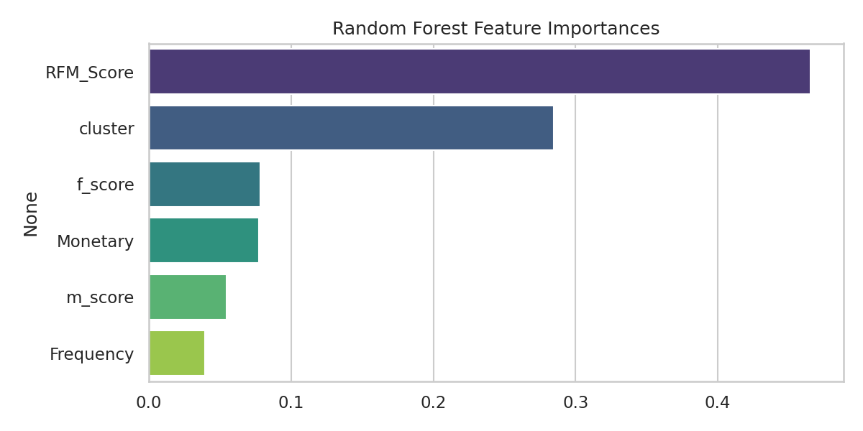
feature_importance_rf.png

Slide 15
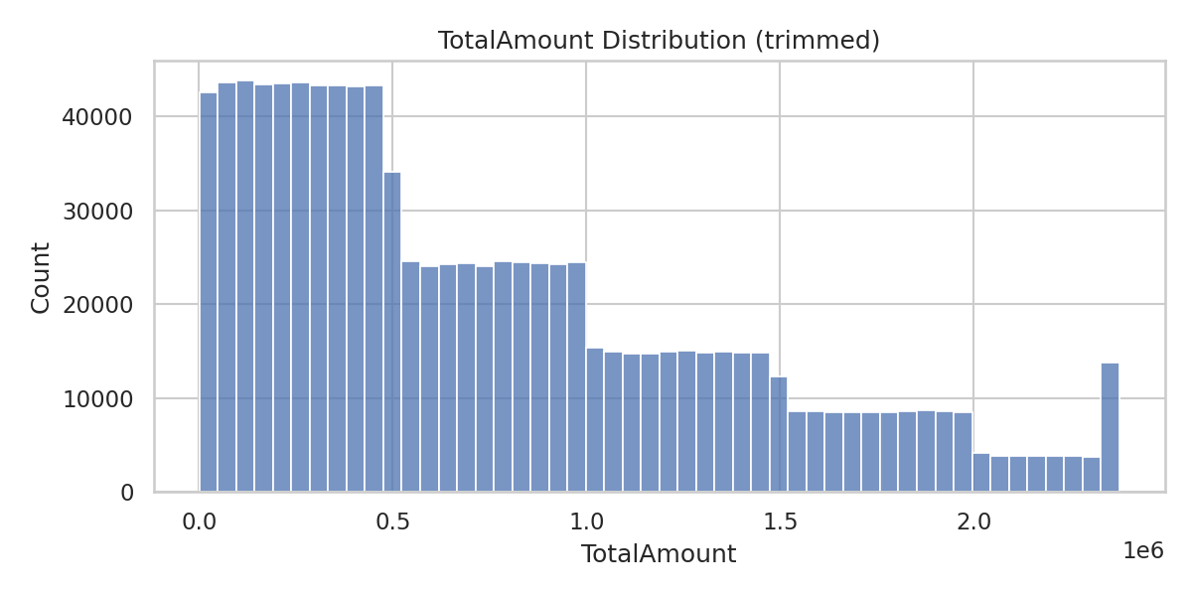
hist_TotalAmount.png

Slide 16
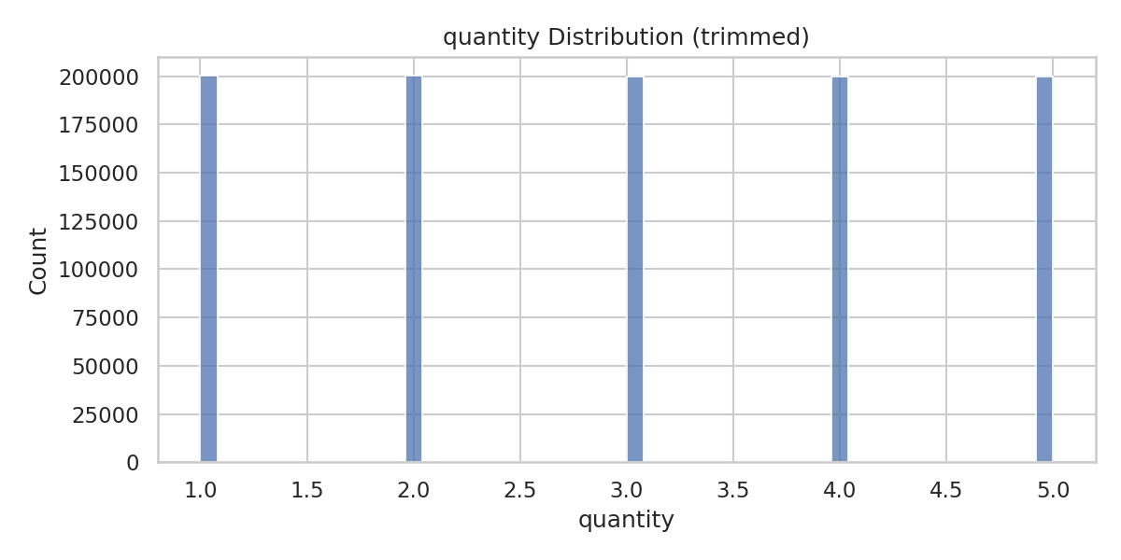
hist_quantity.png

Slide 17
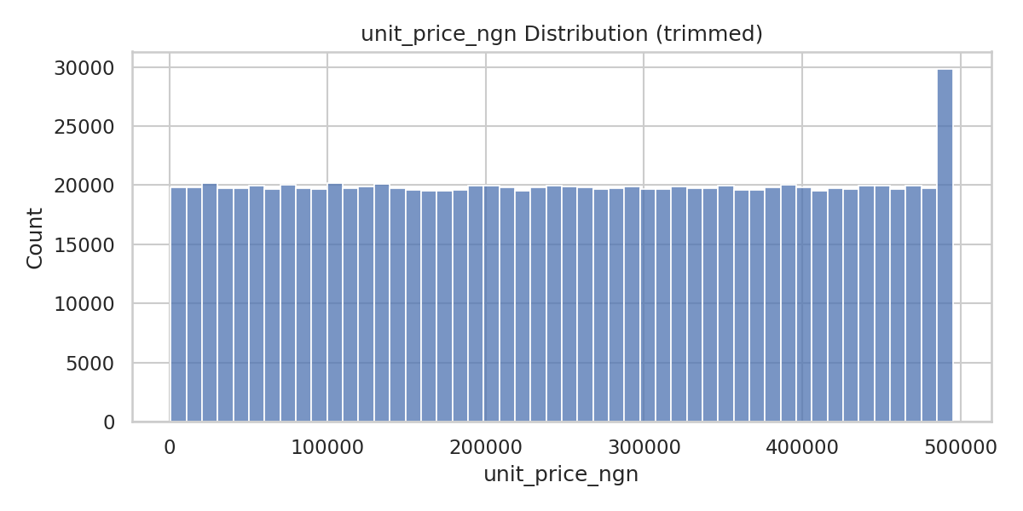
hist_unit_price_ngn.png

Slide 18
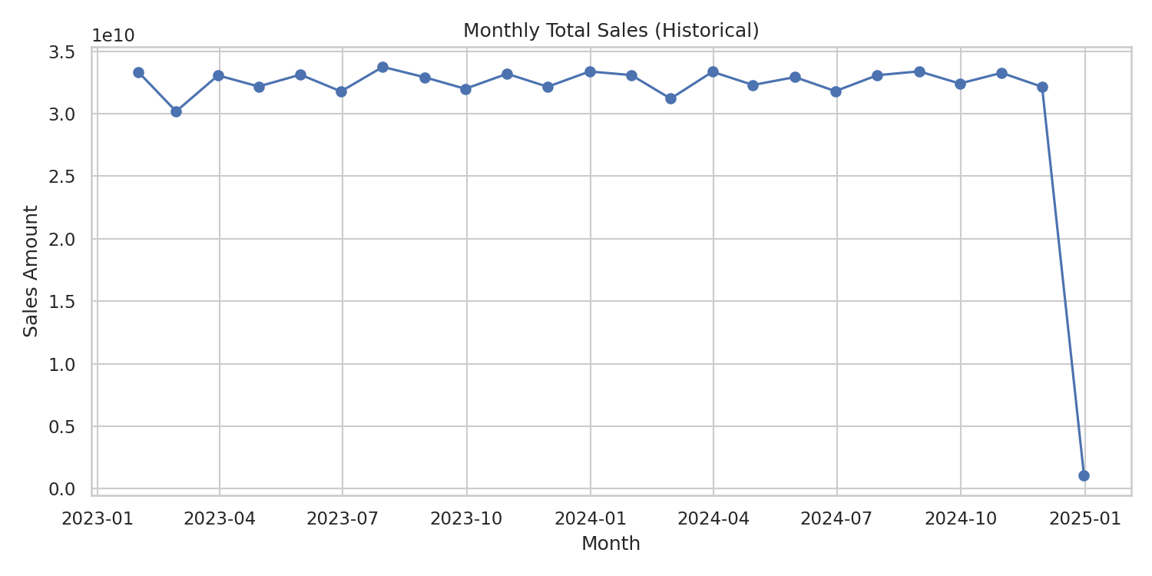
historical_monthly_sales.png

Slide 19
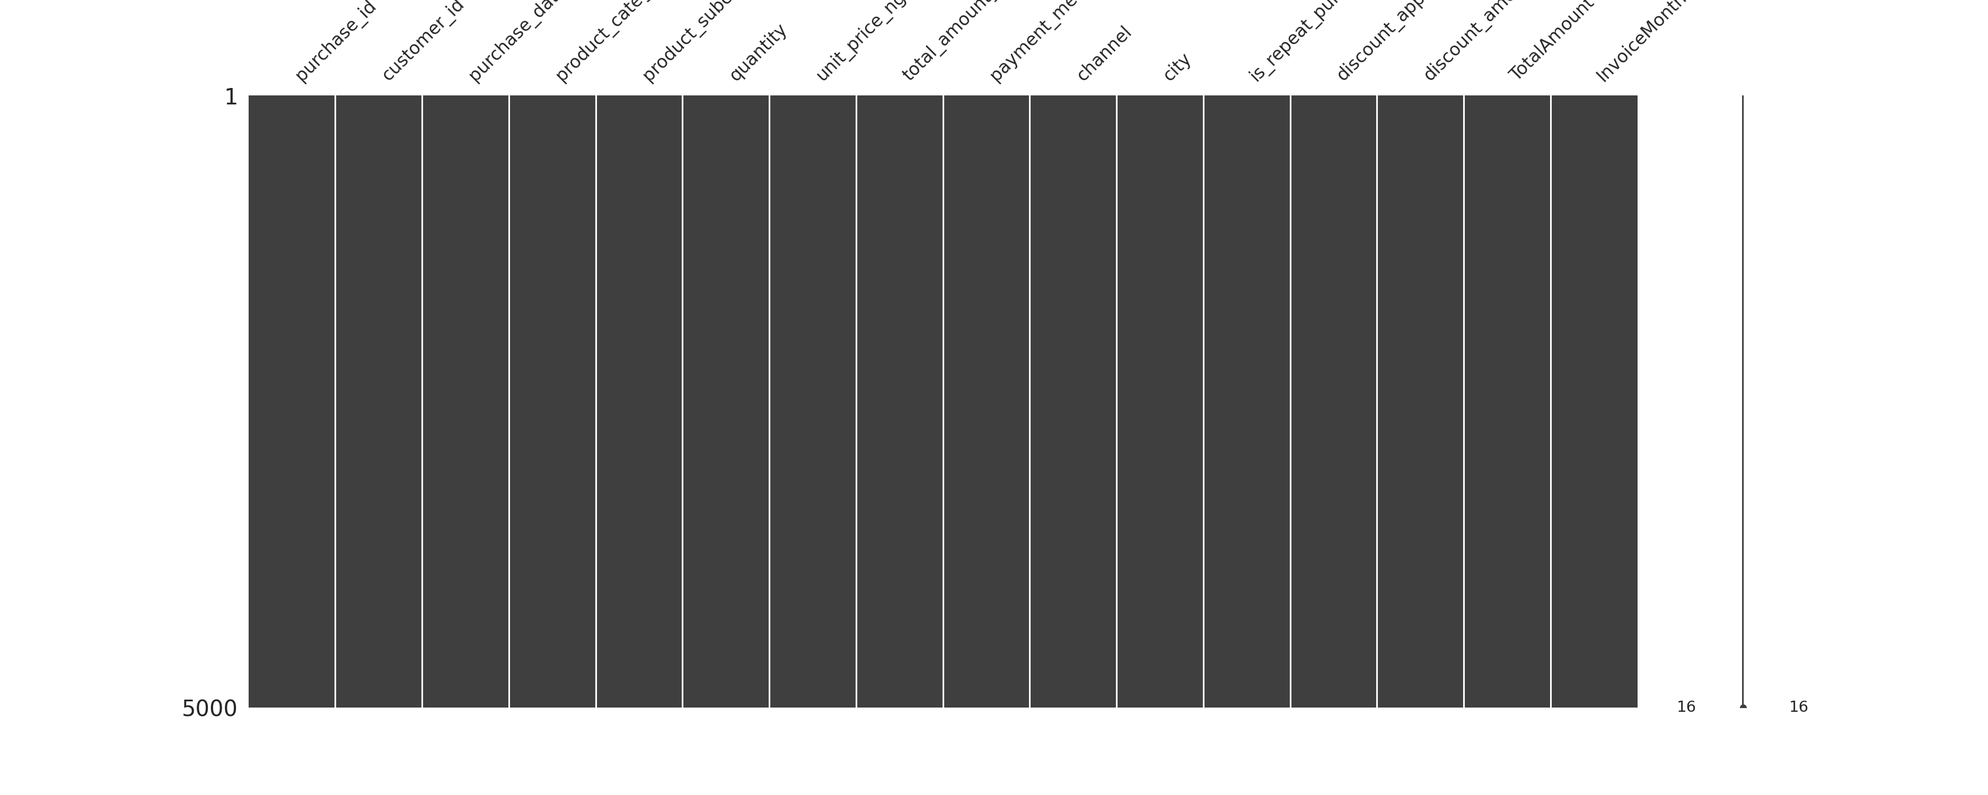
missingness_matrix.png

Slide 20
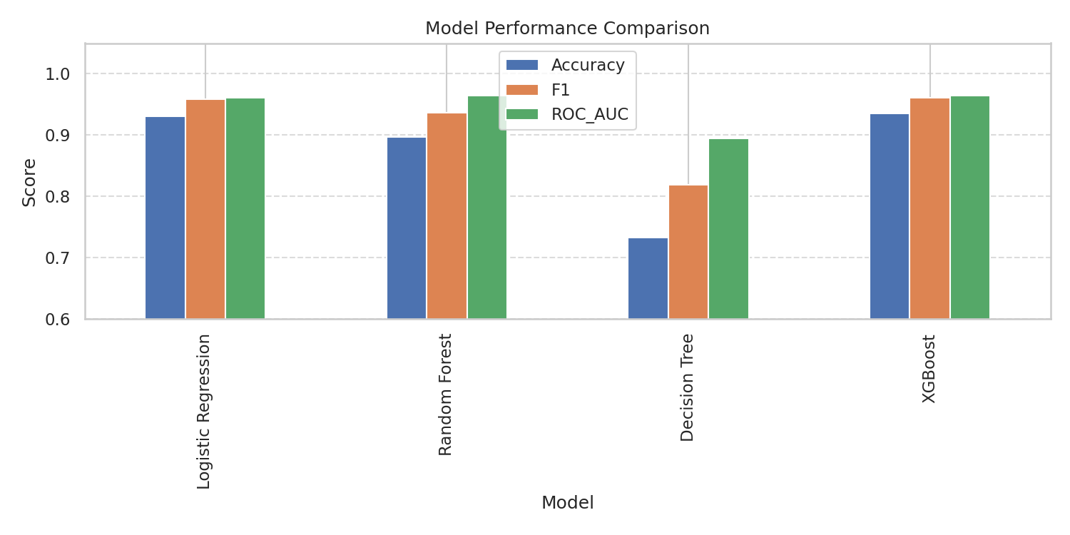
model_comparison_bar.png

Slide 21
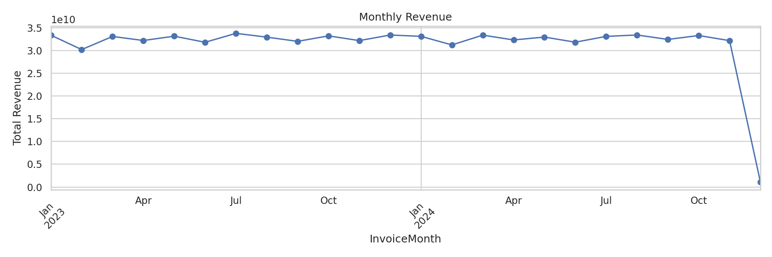
monthly_revenue.png

Slide 22
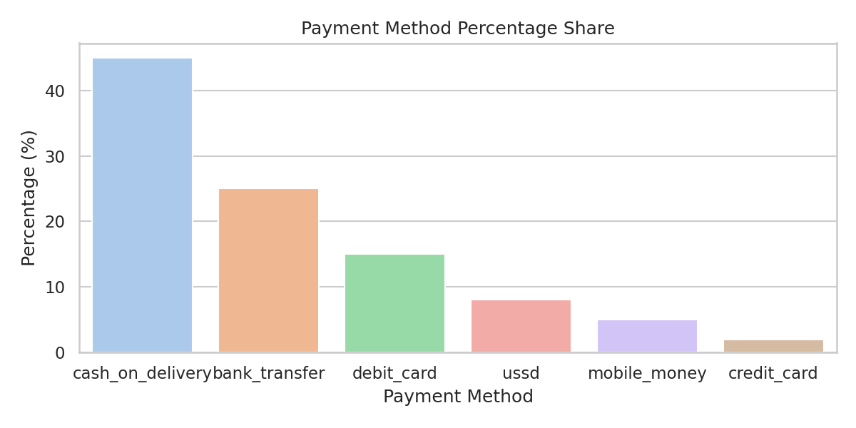
payment_method_bar.png

Slide 23
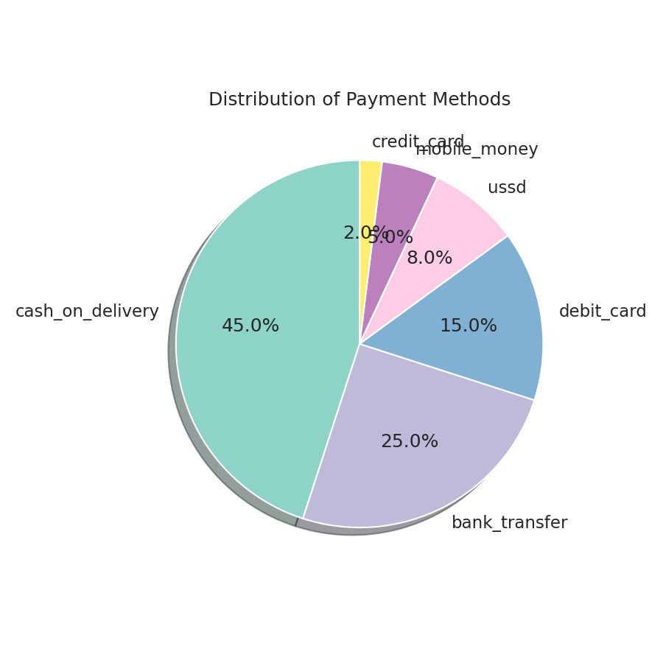
payment_method_pie.png

Slide 24
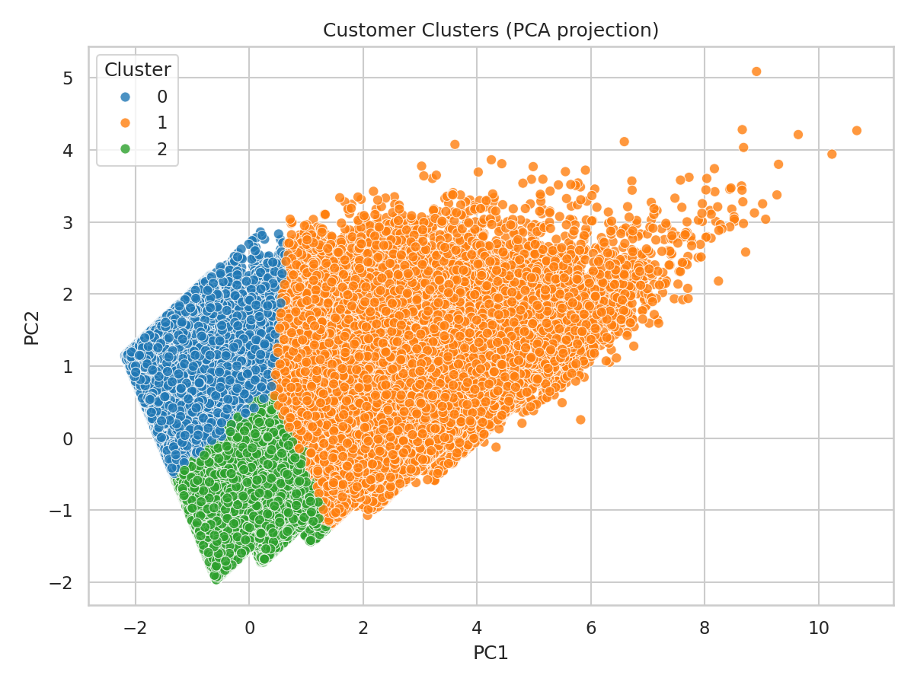
rfm_clusters_pca.png

Slide 25
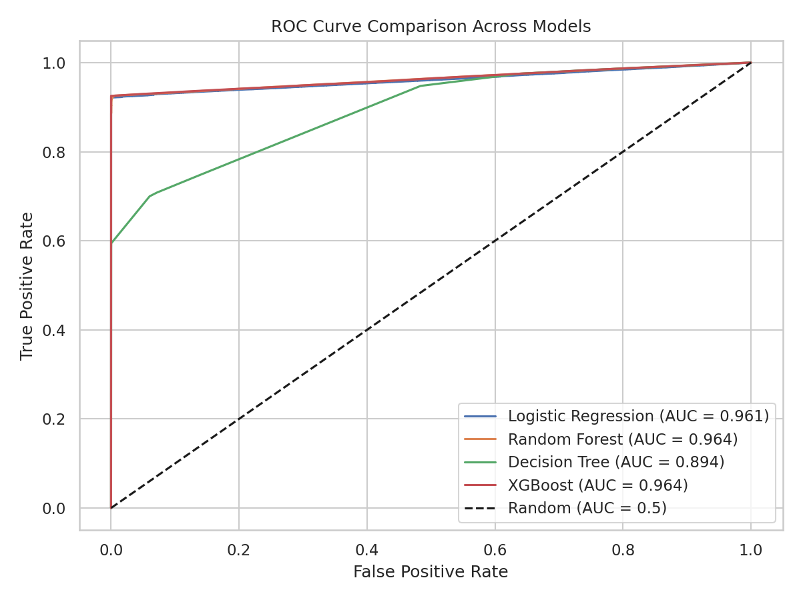
roc_comparison.png

Slide 26
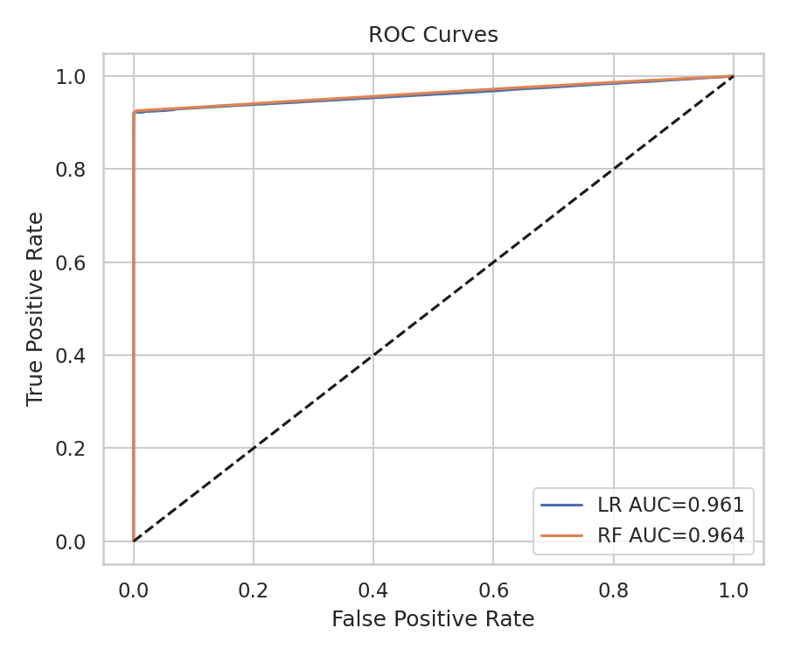
roc_curves.png

Slide 27
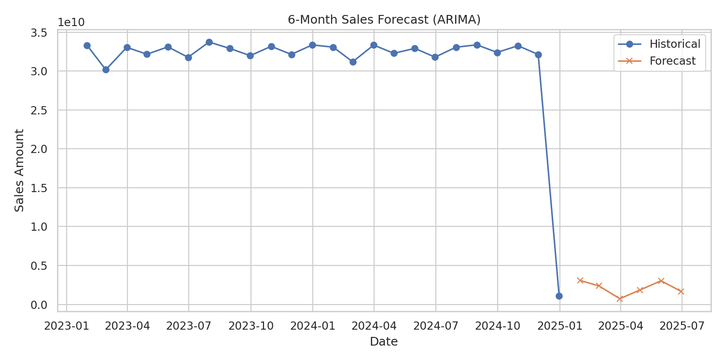
sales_forecast_arima.png

Slide 28
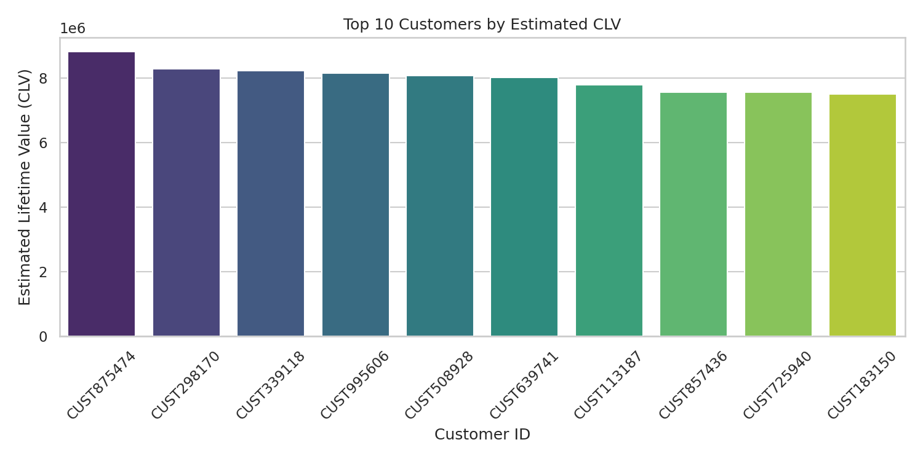
top10_clv_customers.png

Slide 29
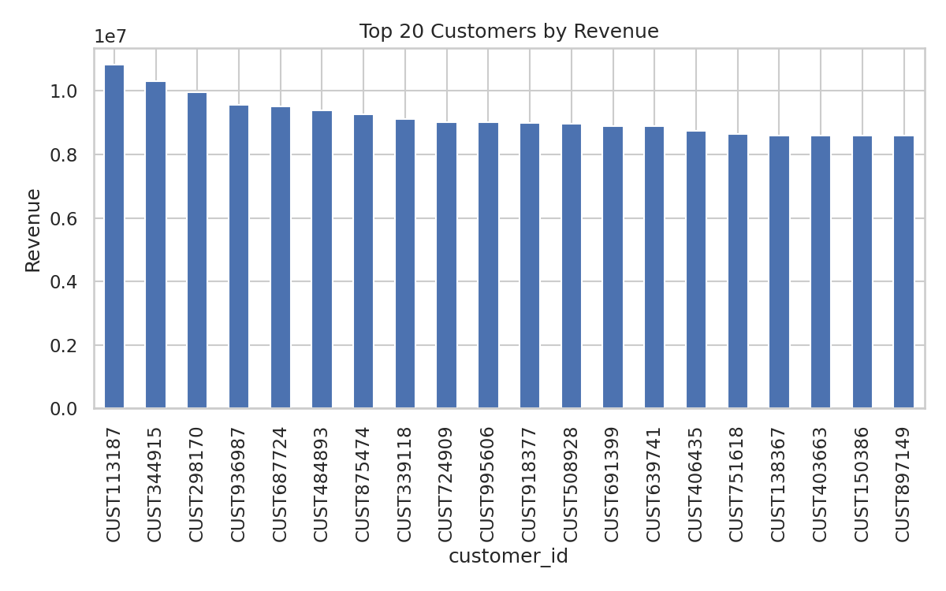
top_customers.png

Slide 30
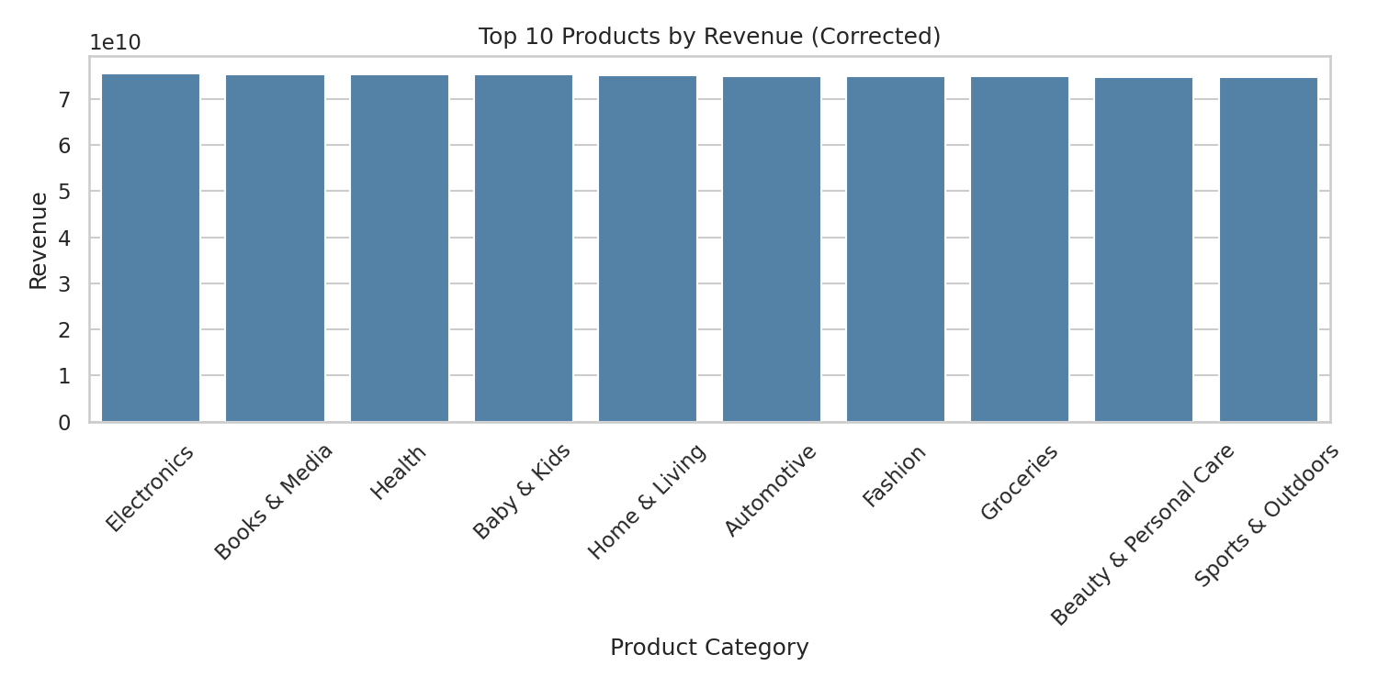
top_products_corrected.png

Slide 31
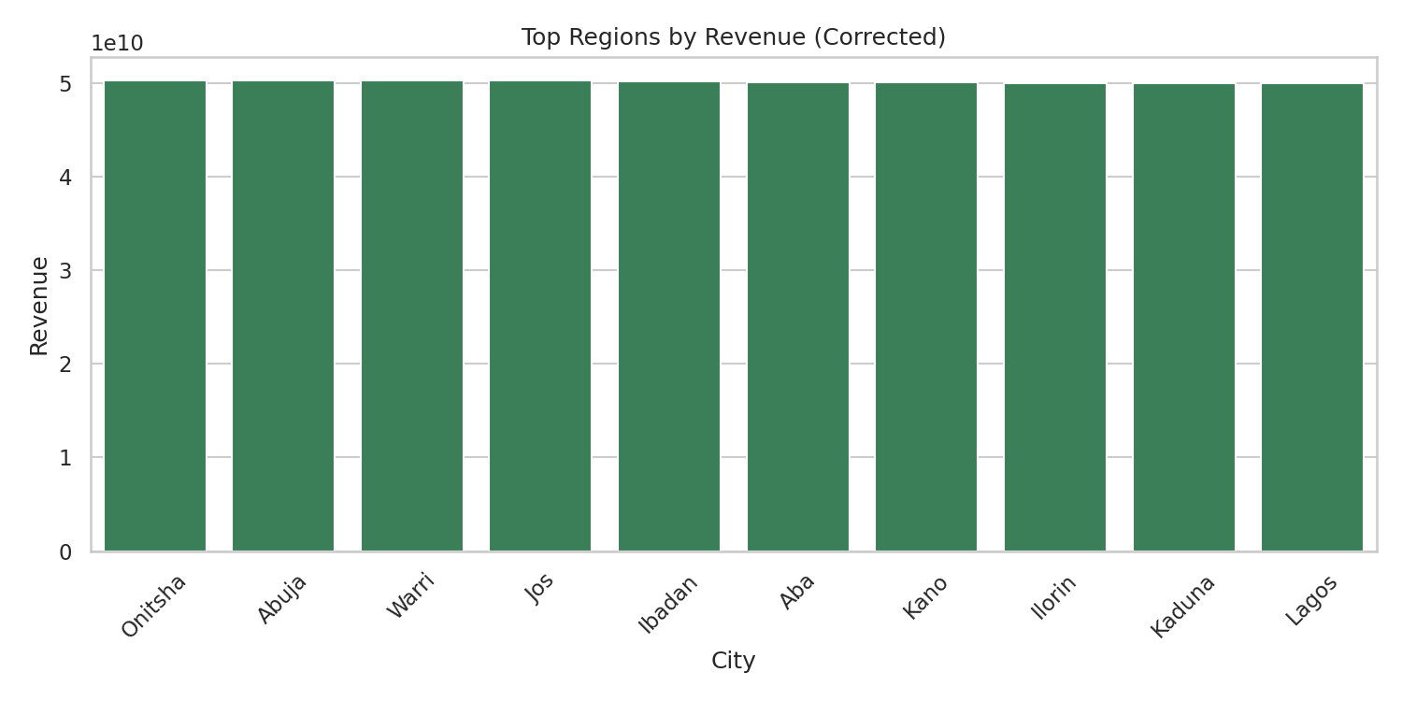
top_regions_corrected.png

Slide 32

wordcloud_products.png

