Slide 1

Movie review analysis: A data centric approach
Team_No: 24 Panel Number: Panel
Project Advisor: Ms. Amulyashree Sridhar
Sl. No. | Reg. No. | Name of the student
1 | BL.EN.U4CSE22285 | Jaykishor Prasad Chauhan
2 | BL.EN.U4CSE22234 | M.Navaneeth
3 | BL.EN.U4CSE22230 | K.S.Vamsi Krishna

Slide 2
Introduction
As the film industry produces an increasing number of movies annually, viewers often turn to movie reviews to help decide what to watch. These reviews are crucial as they provide insights into the quality of a film according to viewer experiences. By using sentiment analysis, a technique in data science, we can extract the emotional tone from these reviews, determining whether opinions are generally positive, negative, or neutral.
For this project, we applied sentiment analysis to movie reviews to understand the overall sentiment expressed by the reviewers. This involves examining how specific words in the reviews relate to each other to predict whether the feedback is positive or negative. The goal is to help movie producers understand audience preferences and assist potential viewers in making informed decisions about which movies to watch based on their interests.

Slide 3
Problem Statement
Influencer Impact on Movie Reviews and Success
In today’s digital age, social media influencers have a profound impact on movie success by shaping public opinion through their reviews. Despite their significant influence, there is a notable lack of systematic analysis that measures how these influencers affect movies' commercial performance and audience reception. This study aims to fill this gap by utilizing sentiment analysis and machine learning to examine the influence of influencers on movie reviews and ratings.
Objective and Methodology
The project will focus on analyzing social media data to understand how influencers' opinions sway public sentiment and correlate with movie outcomes. By developing a data-driven framework using natural language processing (NLP), the study will provide insights into the dynamics of influencer impact on movies. This approach will help filmmakers and marketers tailor their strategies to better align with viewer preferences influenced by influencers.

Slide 4
Background and Motivation
Shift in Influence: The role of traditional film critics is being overshadowed by social media influencers, whose reviews can reach and impact millions quickly, affecting both audience perceptions and a movie's financial success.
Emerging Dynamics: Influencers have the power to significantly sway public opinion, making some films hits and others flops based on their social media commentary.
Research Necessity: There is a significant gap in systematic analysis tools to measure and understand the influence of social media influencers on movie outcomes.
Study Aim: This research aims to use sentiment analysis and machine learning to explore how influencers' reviews influence audience attitudes and behaviors.
Industry Relevance: Insights from this study are vital for filmmakers, marketers, and platform developers who need to navigate the influencer-driven landscape effectively.
Strategic Impact: Understanding influencer impact will help in better marketing campaign planning and execution, enhancing viewer engagement and potentially increasing profitability.

Slide 5
Literature Survey
Sl.No. | AUTHORS | PAPER | INFERENCE
1 | Wankhede, Rasika, and A. N. Thakare. | Design approach for accuracy in movies reviews using sentiment analysis | The author presented the improvement in sentiment analysis, with special emphasis on movie reviews of the ”The Times of India” website,themethodology includes aspects of data collection, feature selection, and application of machine learning techniques for attaining classification accuracy at 90 percent in effective identification of sentiment polarity in reviews.
2 | Amrutiya, Vrushabh, Disney Javiya, and Hemang Thakar. | Machine Learning-Based Sentiment Analysis of Movie Review. | implemented different algorithms, such as Naive Bayes, Decision Trees, and Support Vector Machines. Case study-a Sentiment analysis has been carried out by analyzing 50,000 IMDB movie reviews in an attempt to make a fair comparison between the algorithms used in classifying it as a positive or negative one.
3 | Kit, Brentton Wong Swee, and Minnu Helen Joseph. | Aspect-Based Setiment Analysis on Movie Reviews. | explored the aspect-based sentiment analysis of movie reviews in using different machine learning techniques such as extraction of specific aspects, such as the cast and director and the story behind such movies, as well as analyzing their respective sentiments.

Slide 6
Literature Survey
Sl.No. | AUTHORS | PAPER | INFERENCE
4 | Sindhu, Irum, and Faryal Shamsi. | Prediction of IMDB Movie Score Movie Success By Using The Facebook | predicted movie success by deriving sentiment from social media data particularly comments on Facebook, applying Lexalytics to the score calculation for such comments-categorized as either positive or negative-and using tools like Graph API, FacePager, R Studio, and Shiny Package for pulling and processing the data.
5 | Wadhwa, Parth, and Prabhishek Singh. | A New Sentiment Analysis based Application for Analyzing Reviews of Web Series and Movies of Different Genres | proposed an application for sentiment analysis of web series and movie reviews across different genres from 2017-2019. It collects Twitter data through API keys and hashtags and runs it on a machine learning algorithm. It analyses reviews for 10 movies, 10 web series each in four genres: comedy, romance, horror, and crime.
6 | Putrada, Aji Gautama | Feature Importance on Text Analysis for a Novel Indonesian Movie Recommender System. | aimed to improve film recommendations by putting text analysis together with the use of feature importance from the IMDb Indonesian Movies dataset.used the Bag of Words technique and compare different models, such as SVM, Naïve Bayes, and logistic regression.

Slide 7
Literature Survey
Sl.No. | AUTHORS | PAPER | INFERENCE
7 | Topal, Kamil, and Gultekin Ozsoyoglu. | Movie review analysis: Emotion analysis of IMDb movie reviews | included novel approach in the selection of movies will be on the emotional content of reviews from online platforms like IMDb. The paper argues that the traditional rating and reviewing systems can be an inefficient way for bringing up the viewer's experience on emotional grounds
8 | Rizal, Syamsul, and Mahendra Dwifebri Purbolaksono. | Sentiment analysis on movie review from rotten tomatoes using word2vec and naïve bayes. | explored the application of movie reviews using sentiment analysis with feature extraction from Word2Vec and classification by the Naive Bayes classifier. The paper deems preprocessing as one of the key techniques, especially stemming, in the process of preprocessing the dataset.
9 | Sangeetha, B., S. Sangeetha, and D. T. Goutham. | Sentiment Analysis on Movie Reviews: A Comparative Analysis. | included the analysis of sentiments in movie reviews by numerous machine learning techniques that classify them into either positive or negative or neutral. At the very outset, it highlights why such analysis, like sentiment analysis, becomes inevitable to know the standard of the content and distinguish great writing from poor reviews .

Slide 8
Literature Survey
Sl.No. | AUTHORS | PAPER | INFERENCE
10 | Cahyanti, Fitri Eka, and Said Al Faraby. | On the feature extraction for sentiment analysis of movie reviews based on SVM. | include the application of sentiment analysis on movie reviews from Internet Movie Database (IMDB) in classification using SVM has remained a subject of research. This paper aims at classifying positive and negative movie reviews by applying feature extraction techniques such as Term Frequency-Inverse Document Frequency and Latent Dirichlet Allocation.
11 | Gowri, S., R. Surendran, and J. Jabez. | Improved sentimental analysis to the movie reviews using naive bayes classifier. | focused on the sentiment analysis of movie reviews with the use of Naive Bayes Classifier. It provides an organized approach of Data Gathering, Data Preprocessing, Feature engineering through the Bag of words model and Classification into Sentiments as Positive, Negative or Neutral.
12 | Verma, Shikha, | Improving and Analyzing the Movie Sentiments Using the SVM Approach. | dealt with the study on the performance of movie review using Positive and Negative classification based on the IMDb dataset. H2 uses three machine learning algorithms including Linear SVM, Logistic Regression and Multinomial Naïve Bayes optimise d using hyperparameter tuning.

Slide 9
Literature Survey
Sl.No. | AUTHORS | PAPER | INFERENCE
13 | Athish, V. P., D. Rajeswari, and Sree Nandha SS. | Movie Reviews using Sentiment Analysis with Natural Language API. | proposed a sentiment analysis approach for movie reviews collected from Twitter under topic-based approach and utilizing natural language API and Hadoop. It handles issues like slack terms like slang and misspellation of words in the tweets, using a lexical analyzer to identify the sentiments of the result as either positive, negative or neutral.
14 | Rangkuti, Fachrul Rozy Saputra | Sentiment analysis on movie reviews using ensemble features and pearson correlation based feature selection. | worked in line with a form of data analysis known as sentiment analysis, which targets at analyzing the reviews on movies made on a social media platform known as Twitter; the ensemble features and Pearson correlation coefficient are the types of features we used in this paper work for feature selection.
15 | Mittal, Vanshika, | Sentimental Analysis of Movie Review Based on Naive Bayes and Random Forest Technique. | focused on the sentiment classification of movie reviews through machine learning, with especial focus on Naive Bayes and Random Forest. It sets out a method that involves data scraping from IMDB, pre-processing the text data which is used in a number of text pre-processing techniques such as the Bag of Words and the TF-IDF.

Slide 10
Literature Survey
Sl.No. | AUTHORS | PAPER | INFERENCE
16 | Reddy, BV Suresh, | Sentimental Analysis of Movie Reviews Using NLP Techniques. | aimed at designing a sentiment analysis model for movie reviews according to the sentiment where a movie review holds a positive, negative or a neutral sentiment. It presents that a clear approach depending on data preprocessing with feature extraction method like bag-of-words or TF-IDF
17 | Arora, Kavita, Neha Gupta, and Sonal Pathak. | Sentimental analysis on imdb movies review using bert. | presented the sentiment analysis system of IMDb movie reviews is proposed by employing BERT to improve the overall classification accuracy. The proposed approach involves three stages; pre-processing, feature extraction, and sentiment classification, using a sample set of 50000 balanced reviews that are distinguishing between positive and negative sentiments.
18 | Vavilapalli, Soma Sekhar, | Summarizing Sentiment Analysis on Movie Critics Data. | described the use of a machine learning strategy in summarizing movie reviews where key issues are text feature extraction and sentiment analysis. It uses Semantic K-Means Clustering (SKM) to cluster semantically related sentences thus improving the summarization process since it only involves a cluster and avoids issues like repetition and obscurity.

Slide 11
Literature Survey
Sl.No. | AUTHORS | PAPER | INFERENCE
19 | Krishnan, B. Bhattacharjee, M. Pratap, J. K. Yadav, and M. Maiti | Survival strategies for family-run homestays: analyzing user reviews through text mining | explored in text mining on 5,056 online customer reviews from family homestays in Kerala. It shows that cleanness and kindly welcome, and such and such services are significant and estimable by the guests. The findings imply that homestay owners could pay particular attention to the emotional bonds and service delivery to increase customer satisfaction and refine marketing communications.
20 | W. M. Lim, S. Kumar, N. Pandey, D. Verma, and D. Kumar, | Evolution and trends in consumer behaviour: Insights from Journal of Consumer Behaviour | compiled a list of trends, major topics, and novelties that consumer behaviour research has discovered and discussed in the Journal of Consumer Behaviour between 2009 and 2022. It identifies more efficiency and effectiveness through cooperation with authors and interdisciplinary approaches. These are; sustainable consumption practices consumer neuroscience and ethical consumption suggesting the complexity of the subject.
21 | S. Gunasekar, P. Das, S. K. Dixit, S. Mandal, and S. R Mehta, | Wine-experienscape and tourist satisfaction: through the lens of online reviews | identified influential more rats of customer satisfaction of wine tourists in India based on the TripAdvisor reviews. Organized around the S-O-R model, it defines five experience dimensions based on experiences: sensory experience, functional experience, social experience, natural experience, cultural hospitality experience. The analysis emphasizes some areas for further development, as the results indicate that the use of sensory and natural figures significantly increases satisfaction.

Slide 12
Literature Survey
Sl.No. | AUTHORS | PAPER | INFERENCE
22 | G. Rejikumar, V. Nimisha, and S. V Mohan, | An examination of customer reviews for service process innovations: A study with respect to E-travel services, | conducted focused on 629 online reviews of e-travel services where majority of the consumer feedback was negative and mainly reflected on complaints to do with customer service and communication in the context of the Indian e-travel services subsector. Among the intensification, the areas that emerged included hotel and ticket bookings, grievance management.
23 | J. Gobinath and D. Gupta, | Online reviews: Determining the perceived quality of information | understood the role of online consumer reviews with a focus on how they influenced consumer buying decision. This concludes that, detailed informative reviews are more useful as opposed to the over abundance of many number of reviews. The research seems to recommend that platforms focusing on interfering with consumers’ decisions must ensure that only the best, credible reviews predominate.
24 | U. Rawat and R. Prasad | Is Viral Marketing an effective and reliable method of advertising and branding? A perspective of Gen- Y of India | The research on this paper seeks to find out what entices the Gen-Y in India to interact with online ads and it emerges that usefulness of the feature being advertised worked as the biggest incentive and secondly comes social cause. YouTube and Facebook are the most preferred sites, although celebrity endorsements do not inspire confidence. It makes a suggestion to the effect that viral marketing is one of the cheapest forms that brands can use to reach the end users, given the circumstances that companies face in conventional advertising.

Slide 13
Research Gaps and Challenges

Slide 14
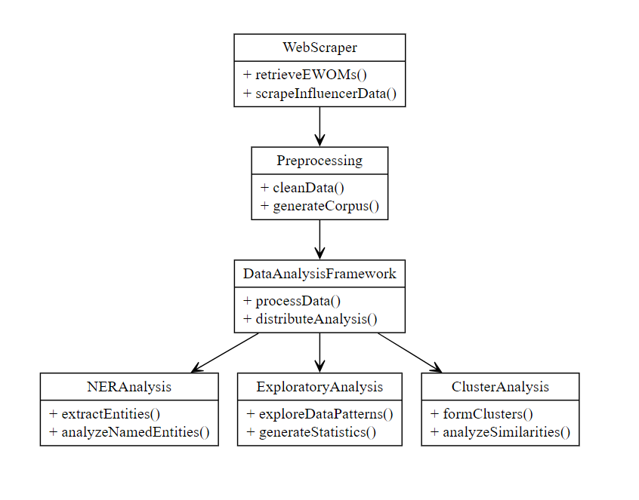
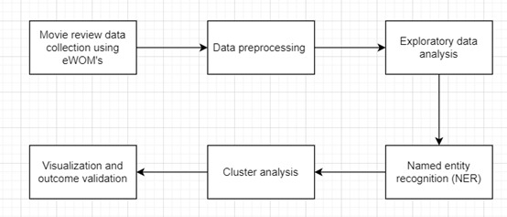
System Architecture
Fig: Proposed Framework

Slide 15
Methodology
1. Data Collection:
-Gathered electronic word-of-mouth (eWOM) samples from YouTube and Twitter.
-Data included comments, source, and date to ensure genuine opinions.
Data Preprocessing
Text Analysis:
- Extracted significant terms using Term Frequency (TF) and Bag of Words (BoW).
-Generated visualizations like word clouds to highlight prominent terms.
Named Entity Recognition:
-Identified key entities like brands, products, and descriptive terms to determine public sentiments.
Clustering:
-Conducted hierarchical clustering to find relationships and patterns among terms.

Slide 16
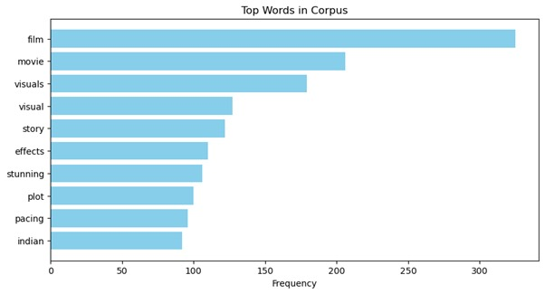
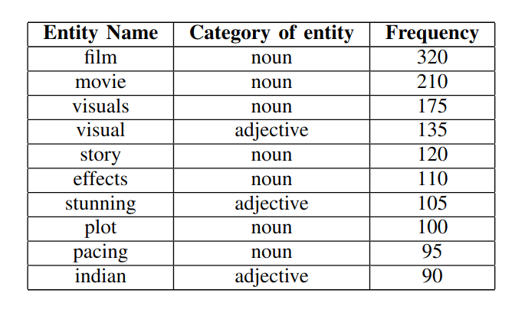
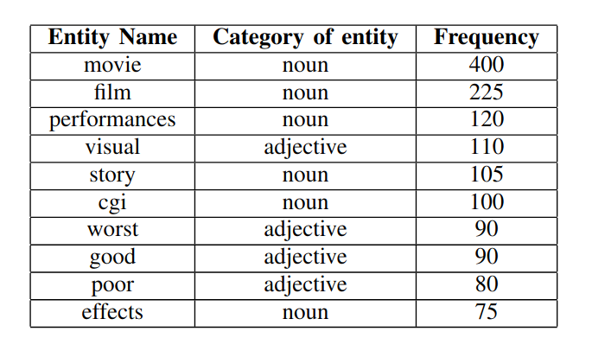
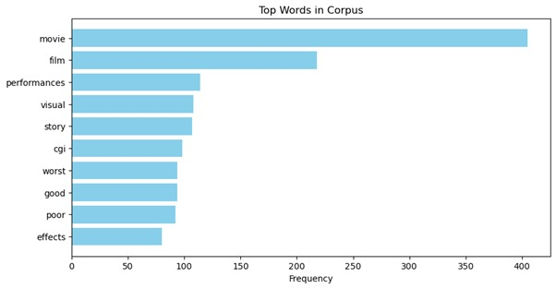
Results and Analysis
Fig: Top Words from Corpus for hit movie
Fig: Named Entities identified from Corpus for hit movie
Fig: Named Entities identified from Corpus for flop movie
Fig: Top Words from Corpus for flop movie

Slide 17
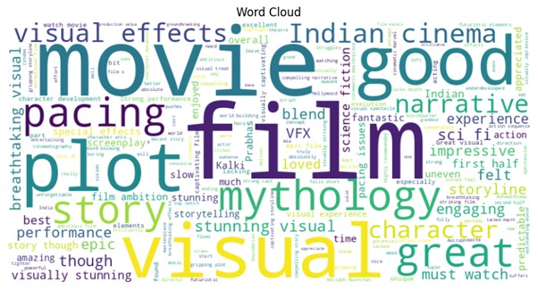
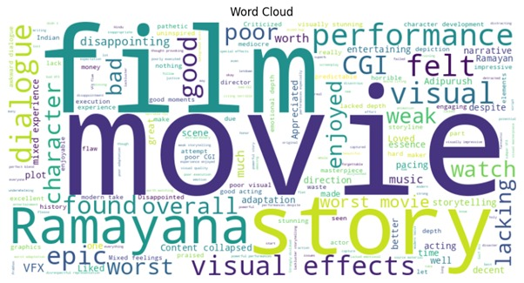
Results and Analysis
Fig: Word Cloud for hit movie
Fig: Word Cloud for flop movie

Slide 18
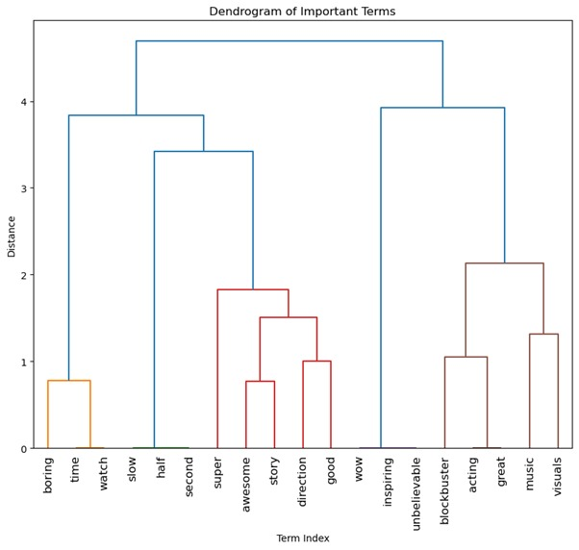
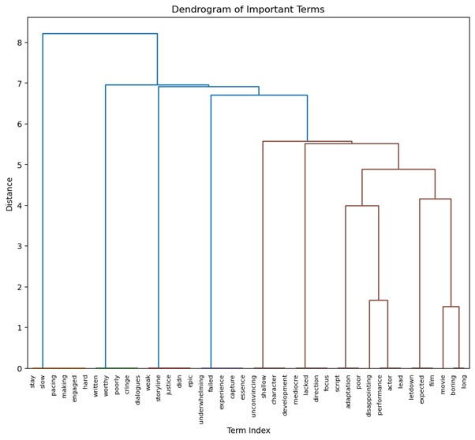
Results and Analysis
Fig: Dendrogram of important terms for hit and flop moview

Slide 19
Conclusion

Slide 20
Future Work
Future research can expand this study by incorporating data from additional social media platforms, such as Instagram and Facebook, to capture a more diverse range of public opinions. Analyzing temporal trends in sentiment over longer periods could provide insights into how perceptions evolve and the factors driving these changes. Advanced machine learning models could be employed for more detailed sentiment analysis and to predict the impact of influencers on audience behavior.

Slide 21
References
[1] Wankhede, Rasika, and A. N. Thakare. "Design approach for accuracy in movies reviews using sentiment analysis." 2017 international conference of electronics, communication and aerospace technology (ICECA). Vol. 1. IEEE, 2017.
[2] Amrutiya, Vrushabh, Disney Javiya, and Hemang Thakar. "Machine Learning-Based Sentiment Analysis of Movie Review." 2023 World Conference on Communication & Computing (WCONF). IEEE, 2023.
[3] Kit, Brentton Wong Swee, and Minnu Helen Joseph. "Aspect-Based Sentiment Analysis on Movie Reviews." 2023 15th International Conference on Developments in eSystems Engineering (DeSE). IEEE, 2023.
[4] Sindhu, Irum, and Faryal Shamsi. "Prediction of IMDB Movie Score & Movie Success By Using The Facebook." 2023 International Multi-disciplinary Conference in Emerging Research Trends (IMCERT). Vol. 1. IEEE, 2023.
[5] Wadhwa, Parth, and Prabhishek Singh. "A New Sentiment Analysis based Application for Analyzing Reviews of Web Series and Movies of Different Genres." 2020 10th International Conference on Cloud Computing, Data Science & Engineering (Confluence). IEEE, 2020.
[6] Putrada, Aji Gautama, et al. "Feature Importance on Text Analysis for a Novel Indonesian Movie Recommender System." 2023 11th International Conference on Information and Communication Technology (ICoICT). IEEE,
[7] Topal, Kamil, and Gultekin Ozsoyoglu. "Movie review analysis: Emotion analysis of IMDb movie reviews." 2016 IEEE/ACM International Conference on Advances in Social Networks Analysis and Mining (ASONAM). IEEE, 2016.

Slide 22
References
[8] Rizal, Syamsul, and Mahendra Dwifebri Purbolaksono. "Sentiment analysis on movie review from rotten tomatoes using word2vec and naive bayes." 2022 1st International Conference on Software Engineering and Information Technology (ICoSEIT). IEEE, 2022.
[9] Sangeetha, B., S. Sangeetha, and D. T. Goutham. "Sentiment Analysis on Movie Reviews: A Comparative Analysis." 2023 International Conference on Intelligent Systems for Communication, IoT and Security (ICISCoIS). IEEE, 2023.
[10] Cahyanti, Fitri Eka, and Said Al Faraby. "On the feature extraction for sentiment analysis of movie reviews based on SVM." 2020 8th International conference on information and communication technology (ICoICT). IEEE, 2020.
[11] Gowri, S., R. Surendran, and J. Jabez. "Improved sentimental analysis to the movie reviews using naive bayes classifier." 2022 International Conference on Electronics and Renewable Systems (ICEARS). IEEE, 2022.
[12] Verma, Shikha, et al. "Improving and Analyzing the Movie Sentiments Using the SVM Approach." 2022 IEEE Conference on Interdisciplinary Approaches in Technology and Management for Social Innovation (IATMSI). IEEE, 2022.

Slide 23
References
[13] Athish, V. P., D. Rajeswari, and Sree Nandha SS. "Movie Reviews using Sentiment Analysis with Natural Language API." 2023 Eighth International Conference on Science Technology Engineering and Mathematics (ICONSTEM). IEEE, 2023.​
[14] Rangkuti, Fachrul Rozy Saputra, et al. "Sentiment analysis on movie reviews using ensemble features and pearson correlation based feature selection." 2018 International Conference on Sustainable Information Engineering and Technology (SIET). IEEE, 2018.
[15] Mittal, Vanshika, et al. "Sentimental Analysis of Movie Review Based on Naive Bayes and Random Forest Technique." 2023 IEEE 4th Annual Flagship India Council International Subsections Conference (INDISCON). IEEE, 2023.
[16] Reddy, BV Suresh, et al. "Sentimental Analysis of Movie Reviews Using NLP Techniques." 2023 5th International Conference on Inventive Research in Computing Applications (ICIRCA). IEEE, 2023.
[17] Arora, Kavita, Neha Gupta, and Sonal Pathak. "Sentimental analysis on imdb movies review using bert." 2023 4th International Conference on Electronics and Sustainable Communication Systems (ICESC). IEEE, 2023.
[18] Vavilapalli, Soma Sekhar, et al. "Summarizing & Sentiment Analysis on Movie Critics Data." 2021 6th International Conference on Inventive Computation Technologies (ICICT). IEEE, 2021.

Slide 24
References
[19] Krishnan, B. Bhattacharjee, M. Pratap, J. K. Yadav, and M. Maiti, “Survival strategies for family-run homestays: analyzing user reviews through text mining,” Data Science and Management, vol. 7, no.3, pp. 228–237, Sep. 2024, doi: 10.1016/j.dsm.2024.03.003.
[20] W. M. Lim, S. Kumar, N. Pandey, D. Verma, and D. Kumar, “Evolution and trends in consumer behaviour: Insights from Journal of Consumer Behaviour,” Journal of Consumer Behaviour, vol. 22, no. 1, pp. 217–232, Jan. 2023, doi: 10.1002/cb.2118.
[21] S. Gunasekar, P. Das, S. K. Dixit, S. Mandal, and S. R Mehta, “Wine-experienscape and tourist satisfaction: through the lens of online reviews,” Journal of Foodservice Business Research, vol. 25, no. 6, pp. 684–701, Nov. 2022, doi: 10.1080/15378020.2021.2006039.
[22] G. Rejikumar, V. Nimisha, and S. V Mohan, “An examination of customer reviews form service process innovations: A study with respect to E-travel services,” in 2019 11th International Conference on Advanced Computing (ICoAC), IEEE, Dec. 2019, pp. 152–157. doi: 10.1109 ICoAC48765.2019.246832.
[23] J. Gobinath and D. Gupta, “Online reviews: Determining the perceived quality of information,” in 2016 International Conference on Advances in Computing, Communications and Informatics (ICACCI), IEEE, Sep. 2016, pp. 412–416. doi: 10.1109/ICACCI.2016.7732080.
[24] U. Rawat and R. Prasad, “Is Viral Marketing an effective and reliable method of advertising and branding? A perspective of Gen- Y of India,” in 2015 International Conference on Advances in Computing, Communications and Informatics (ICACCI), IEEE, Aug. 2015, pp. 1839–1842. doi: 10.1109/ICACCI.2015.7275885.

Slide 25
THANK YOU

