Slide 1
19AIE113 Introduction to Electronics TEAM - 4
TOPIC: Generating a clock signal for driving a digital clock and demonstrating the working of the digital clock

Slide 2
TEAM-MEMBERS:
ANIRUDH EDPUNGATI - CB.EN.U4AIE20005
BHOOMIKA M - CB.EN.U4AIE20008
GOKUL R - CB.EN.U4AIE20018
RISHEKESAN S.V - CB.EN.U4AIE20058
SHREYA SANGHAMITRA- CB.EN.U4AIE20066

Slide 3
Aim of the Project
01
Generating a clock signal for driving a digital clock and demonstrating the working of the digital clock

Slide 4
Introduction
02
The design, implementation, and modelling of a clock that can display seconds, minutes

Slide 5
Components and Software used
Input Signal (AC) Schmitt Trigger Mod-10 Counter Mod-6 Counter AND gate 7 Segment Decoder 7 Segment Display SOFTWARE - FALSTAD

Slide 6
Theory
Schmitt Trigger
Mod-6 Counter
Input Signal (AC)
Mod-10 Counter
Acts as a source of voltage to the circuit.
A binary counter which counts from 0-9.
Helps in controlling the duty cycle of the input signal and also converts it from analog signal to the digital ones.
A binary counter which counts from 0-6.

Slide 7
Theory
7 Segment Decoder
AND gate
7 Segment Display
This works based on the inputs given from the 7 segment decoder and lightens up each segment based on the outputs of the decoder.
Used to provide a connection to the successive counter based on the present counters count limit.
Takes the input from the binary Mod counter and outputs 7 segments where each of them is responsible for each line in the following diagram in 7 segment display.

Slide 8
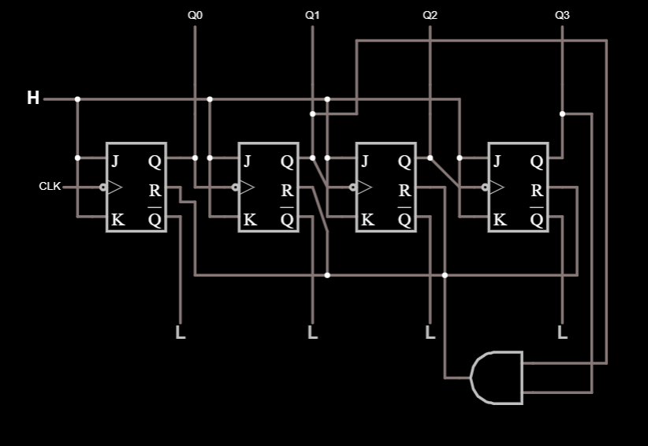
Sub-Circuit(Mod-10 Counter):
The whole circuit works on a single clock signal that is given to the first JK flip flop, subsequent flip flops works based on the first one.
The counter counts from 0 to 9 and resets
We identify when the circuit reaches the 9 and reset it.
This works as an infinite loop and stops only if the user interrupts.

Slide 9
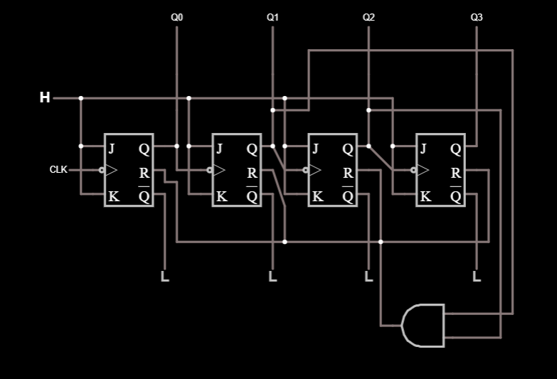
Sub-Circuit(Mod-6 Counter)
whole circuit works on a single clock signal that is given to the first JK flip flop, subsequent flip flops works based on the first one.
The counter counts from 0 to 5 and resets
We identify when the circuit reaches the 5 and reset it.
This works as an infinite loop and stops only if the user interrupts.

Slide 10
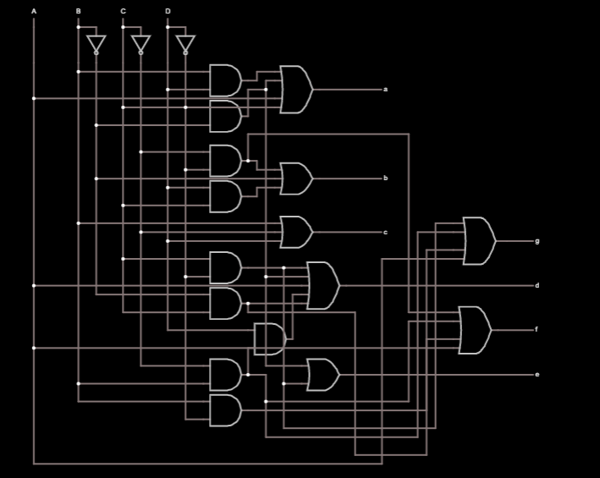
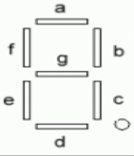
Sub-Circuit(7 Segment Decoder)
We connect the output of the 7 segment decoder for displaying the output.
Lets take an example, If we need to display 0 every bit expect g should lighten up.
In this manner we give the binary input to the corresponding 7 bits to show the output.

Slide 11
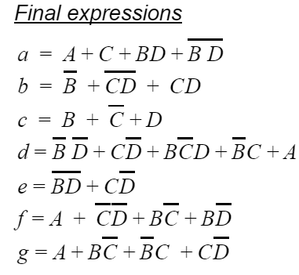
Sub-Circuit(7 Segment Decoder)
A | B | C | D | a | b | c | d | e | f | g
0 | 0 | 0 | 0 | 1 | 1 | 1 | 1 | 1 | 1 | 0
0 | 0 | 0 | 1 | 0 | 1 | 1 | 0 | 0 | 0 | 0
0 | 0 | 1 | 0 | 1 | 1 | 0 | 1 | 1 | 0 | 1
0 | 0 | 1 | 1 | 1 | 1 | 1 | 1 | 0 | 0 | 1
0 | 1 | 0 | 0 | 0 | 1 | 1 | 0 | 0 | 1 | 1
0 | 1 | 0 | 1 | 1 | 0 | 1 | 1 | 0 | 1 | 1
0 | 1 | 1 | 0 | 1 | 0 | 1 | 1 | 1 | 1 | 1
0 | 1 | 1 | 1 | 1 | 1 | 1 | 0 | 0 | 0 | 0
1 | 0 | 0 | 0 | 1 | 1 | 1 | 1 | 1 | 1 | 1
1 | 0 | 0 | 1 | 1 | 1 | 1 | 1 | 0 | 1 | 1

Slide 12
Procedure
Our main objective is to create a timer that adds up to an hour and display it.
We used 2 Mod-10 counters to count the one place of several seconds and minutes and 2 Mod-6 counters to count the 10th place of seconds and minutes.
Finally, we can use an AC signal as a clock input and we are using a Schmitt trigger to control the duty cycle of the input, which gives us control over the delay of the clock compared to our normal clock.

Slide 13
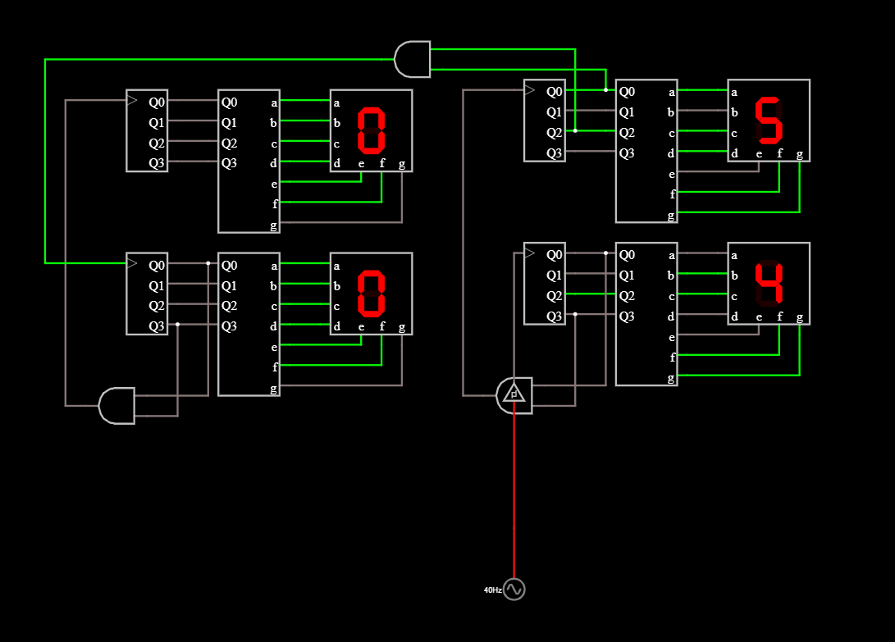
Circuit Diagram:

Slide 14
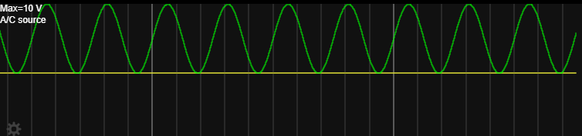
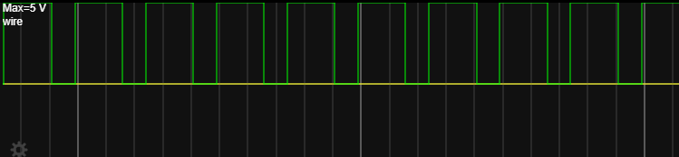
RESULTS:
Input signal
Schmitt Trigger Output

Slide 15
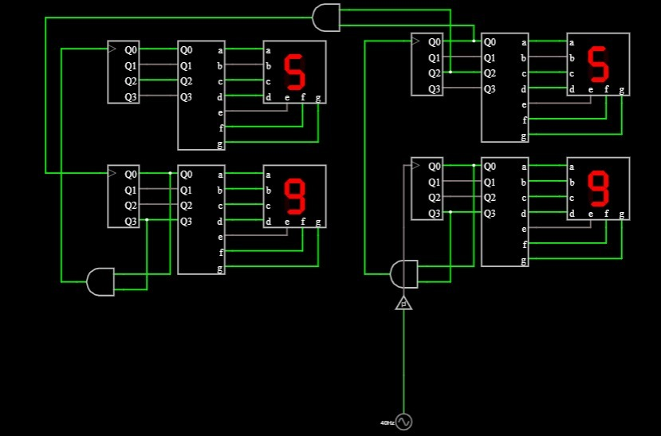
RESULTS:
OUTPUT

Slide 16
Inference
We learnt the working of a Digital Clock which can take many kinds of noisy inputs and give out the correct time.
We learnt the real-world applications of Schmitt Trigger.
We learnt to apply the usage of decoders and counters in the real world.

Slide 17
Conclusion
Usage of simple and cost-free basic chips was enough to build the whole circuit.
Not only up to 1 hour, but we can extend it to 24 hours just by replicating the same logic.

Slide 18
Live Demo

Slide 19
THANK YOU SIR

