Slide 1
19AIE112 Elements of Computing System-2 TEAM – 4

Slide 2
TEAM-MATES
ANIRUDH EDPUNGATI
20005
GOKUL R
20018
SHREYA SANGHAMITRA
20066
BHOOMIKA M
20008
RISHEKESAN S.V
20058

Slide 3
01
AIM of the Project
To Implement the Heap, stack and static storage allocation strategies in Jack

Slide 4
02
Introduction
>> One of the most basic problems that every compiler faces is figuring out how to translate the various types of variables in the source program to the target platform's memory.
>> This isn't a simple job.
>> A single duplicate of each, for example. The length of the program, a static variable should be kept "alive.“
>> Each object instance of the class, on the other hand, should contain a unique copy of all its instance variables (fields).

Slide 5
03
SOFTWARE Suit Used
Nand2tetris

Slide 6
Theory
01
02
HEAP
>>The heap is a section of memory reserved for dynamic allocation.
>>The allocation and deallocation of blocks from the heap, unlike the stack, has no prescribed pattern; you can allocate and free a block at any moment.
STACK
>>The stack is a global data structure that is used to save and restore all of the VM functions' resources (memory segments) as they move up the calling hierarchy (e.g. main and factorial).

Slide 7
Theory
03
04
STATIC
>> Data is stored to and from the stack to several separate memory segments In memory segments have the same access semantics One of the memory segments m is called static
CPU
>>A central processing unit, is the electronic circuitry within a computer that executes instructions that make up a computer program.
>>The control unit controls all CPU operations, including ALU operations, the movement of data within the CPU, and the exchange of data and control signals across external interfaces.

Slide 8
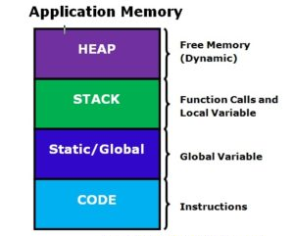
WORKING

Slide 9
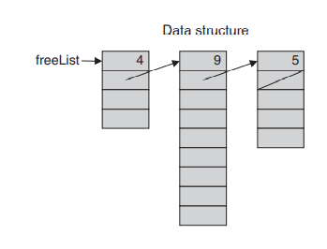
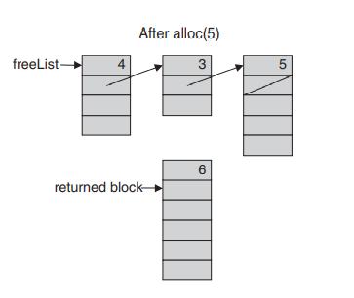
Memory Allocation Algorithm

Slide 10
class Memory {
static int MEMORY, HEAP_BASE, NEXT_POINTER, SIZE, HEAP_LIMIT, OOM, freeList, i;
/** Initializes memory parameters. */
function void init() {
let MEMORY = 0;
let SIZE = 0;
let NEXT_POINTER = 1;
let HEAP_BASE = 2048;
let HEAP_LIMIT = 16383;
let freeList = HEAP_BASE;
let freeList[SIZE] = HEAP_LIMIT - HEAP_BASE;
let OOM = 137;
let i = 0;
return;
}

Slide 11
/** Returns the value of the main memory at the given address. */
function int peek(int address) {
return MEMORY[address];
}
/** Sets the value of the main memory at this address
* to the given value. */
function void poke(int address, int value) {
let MEMORY[address] = value;
return;
}

Slide 12
/** finds and allocates from the heap a memory block of the
* specified size and returns a reference to its base address. */
function int alloc(int size) {
var bool defragged;
var int currentFreeSegment, block, newFreeSegment, previousFreeSegment;
let defragged = false;
let currentFreeSegment = freeList;
while (~block) {
if (currentFreeSegment[SIZE] > size) {
if (currentFreeSegment = freeList) {
if (currentFreeSegment[NEXT_POINTER]) {
let freeList = currentFreeSegment[NEXT_POINTER];
} else {
let freeList = currentFreeSegment + size + 1;
let freeList[SIZE] = currentFreeSegment[SIZE] - size - 1;
}
}

Slide 13
else {
if (size < (currentFreeSegment[SIZE] - 2)) {
let newFreeSegment = currentFreeSegment + size + 1;
let newFreeSegment[SIZE] = currentFreeSegment[SIZE] - size - 1;
let previousFreeSegment[NEXT_POINTER] = newFreeSegment;
} else {
let previousFreeSegment[NEXT_POINTER] = currentFreeSegment[NEXT_POINTER];
}
}
let block = currentFreeSegment + 1;
}

Slide 14
else {
if (currentFreeSegment[NEXT_POINTER] = null) {
if (defragged) {
do Sys.error(OOM);
} else {
do Memory.defrag();
let defragged = true;
let currentFreeSegment = freeList;
}
} else {
let previousFreeSegment = currentFreeSegment;
let currentFreeSegment = currentFreeSegment[NEXT_POINTER];
}
}
}
let block[-1] = size + 1;
let block[0] = null;
return block;
}

Slide 15
function void defrag() {
var int currentFreeSegment, nextFreeSegment;
let currentFreeSegment = freeList;
let nextFreeSegment = currentFreeSegment[NEXT_POINTER];
while (~(nextFreeSegment = 0)) {
if ((currentFreeSegment + currentFreeSegment[SIZE]) = nextFreeSegment) {
let currentFreeSegment[SIZE] = currentFreeSegment[SIZE] + nextFreeSegment[SIZE];
let currentFreeSegment[NEXT_POINTER] = nextFreeSegment[NEXT_POINTER];
let nextFreeSegment[SIZE] = null;
let nextFreeSegment[NEXT_POINTER] = null;
}
let currentFreeSegment = nextFreeSegment;
let nextFreeSegment = currentFreeSegment[NEXT_POINTER];
}
return; }

Slide 16
/** De-allocates the given object and frees its space. */
function void deAlloc(int block) {
var int segment, segmentLength, oldFreeList, currentFreeSegment, oldNextSegment;
let segment = block - 1;
let segmentLength = segment[0];
while (i < (segmentLength - 1)) {
let block[i] = null;
let i = i + 1;
}
if (segment < freeList) {
let oldFreeList = freeList;
let freeList = segment;
let freeList[NEXT_POINTER] = oldFreeList;
return;
}

Slide 17
let currentFreeSegment = freeList;
while ((currentFreeSegment[NEXT_POINTER] < segment) & currentFreeSegment[NEXT_POINTER]) {
let currentFreeSegment = currentFreeSegment[NEXT_POINTER];
}
if (currentFreeSegment[NEXT_POINTER] > 0) {
let oldNextSegment = currentFreeSegment[NEXT_POINTER];
let currentFreeSegment[NEXT_POINTER] = segment;
let segment[NEXT_POINTER] = oldNextSegment;
} else {
let currentFreeSegment[NEXT_POINTER] = segment;
}
return;
}
}

Slide 18
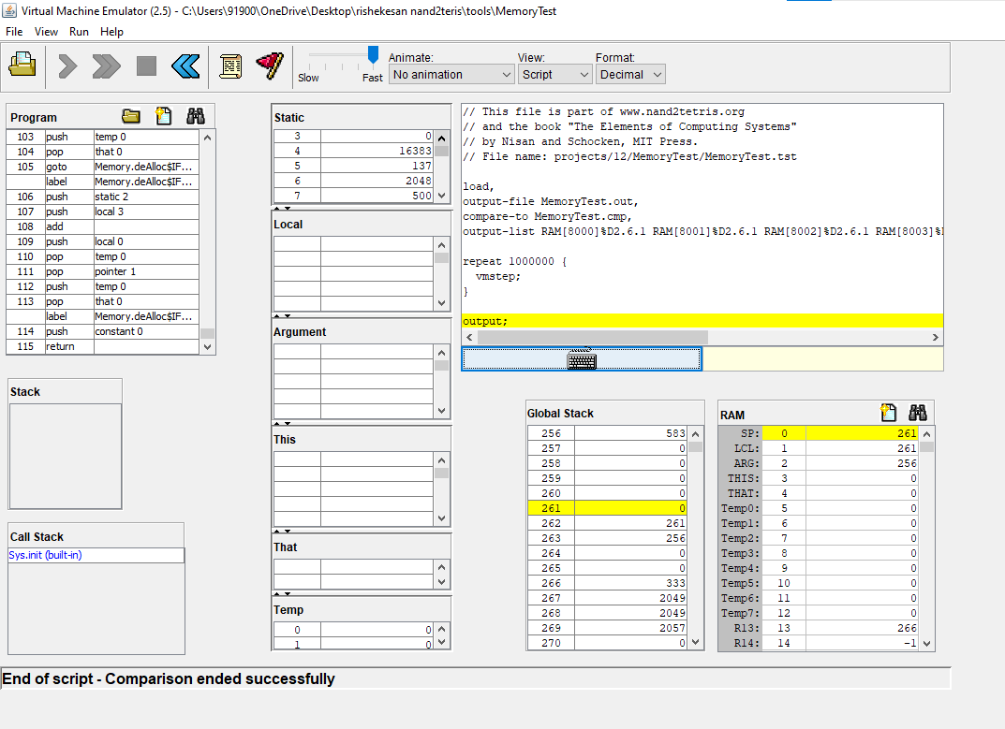
Simulation in VM Emulator

Slide 19
CPU(CENTRAL PROCESSING UNIT)
Majorly Three parts connected to the CPU:
Instruction Memory , Data Memory, and User.
Instruction Memory : Contains 16 bit instruction input and output of the PC
Data Memory : Contains 16bit input 'intM' and three outputs out, WriteM, and address.
User : the user has only one input, reset pin. If the user sets the value to reset the PC, A and D resgister is reset.

Slide 20
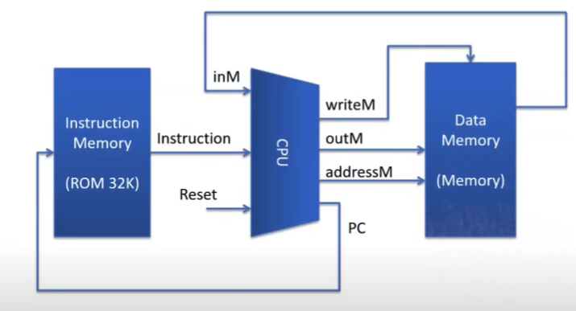

Slide 21
INSTRUCTION BITS
Two types of Instruction bits are present,
These 16 bit instructions are told apart using the very first bit If the first bit is '0' then it’s A instruction or if its '1' then it’s a C instruction
A instruction – Stores 15 bit values which is passed to A register.
C instruction - these 15 bit can be broken down into three part.
Parts : ALU control bits , destination bits and Jump bits.

Slide 22
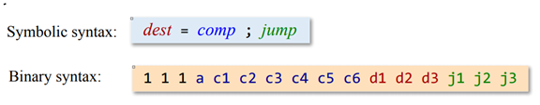
C Instruction
The first bits remain constant for the C instruction
4th bit – A bit , it is used to instruction the CPU from where the values are to be taken I.e. either from Memory or Registers.
5th to 10th bit – control bits which is passed to ALU
11th to 13bit - destination bits
14th to 16th bit - jump control bits

Slide 23
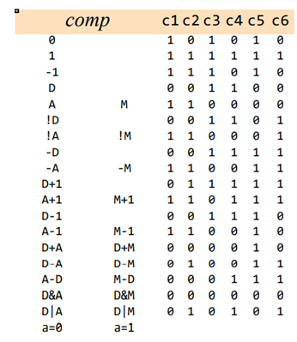
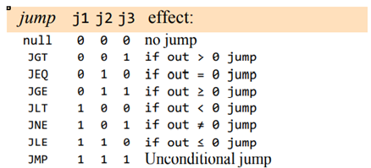
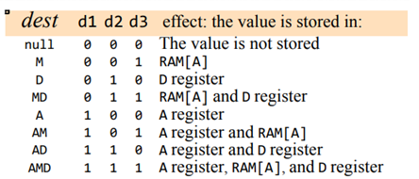

Slide 24
ALU
The 5th to 10th bit is given to the ALU from the register as an input which it requires to compute.
The ALU has two operands X and Y on which it performs the operations.
We may consider X as the value from the D register and Y either from the A register or from the memory depending on the a-bit in the C instruction.
So here we use mux16 to decide which it is going to access.

Slide 25
Program Counter
Does three major operations, Reset, Jump and Increment.
In Reset, the program counter is set to become zero, used to start and restart the execution of the program.
If the three jump bits are 0, then there is no jump and here PC is incremented by one step.
If the current instruction has all the jump bits as 1 then we have an unconditional goto.
In this case, PC = A and it means the PC will emit the address of the next instruction that has to be executed.

Slide 26
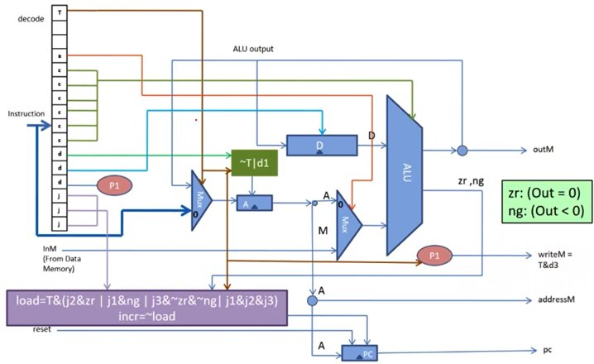

Slide 27
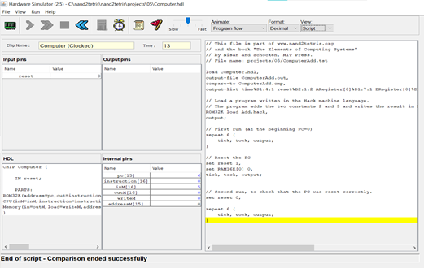
Simulation in Hardware simulator.

Slide 28
INFERENCE
We observed that CPU Emulator has less capacity, which made us build our own CPU, but in cases, it's memory might also be not enough.

Slide 29
CONCLUSION
Thus we have allocated the storage for heap , stack and static in jack programming and converted it into a VM file and verifying the three constraints and also checked the correctness of the CPU which we built.

Slide 30
THANK YOU SIR
THANK YOU SIR

