Slide 1
FinFET Process Flow
ANIRUDH B S (EE21B019)

Slide 2
FinFET Fabrication
Substrate Selection
Si Substrate
Cross section along Fin

Slide 3
FinFET Fabrication
2. Sidewall Image Transfer (SIT) : Grow PadOx
Oxide
Si Substrate
Cross section along Fin

Slide 4
FinFET Fabrication
3. Sidewall Image Transfer (SIT) : Deposit Mandrel
Mandrel
Oxide
Si Substrate
Cross section along Fin

Slide 5
FinFET Fabrication
4. Sidewall Image Transfer (SIT) : Pattern Mandrel
Oxide
Si Substrate
Cross section along Fin

Slide 6
FinFET Fabrication
5. Sidewall Image Transfer (SIT) : Deposit Nitride
Nitride
Oxide
Si Substrate
Cross section along Fin

Slide 7
FinFET Fabrication
6. Sidewall Image Transfer (SIT) : Spacer Etch
Oxide
Si Substrate
Cross section along Fin

Slide 8
FinFET Fabrication
7. Sidewall Image Transfer (SIT) : Remove Mandrel
Oxide
Si Substrate
Cross section along Fin

Slide 9
FinFET Fabrication
8. Sidewall Image Transfer (SIT) : After SacOx + Si RIE
(Only one fin shown for easier representation of further process flow)
SiN
SiO2
Si Substrate
Cross section along Fin

Slide 10
FinFET Fabrication
9. Oxide Deposition
Nitride
Oxide
Oxide
Si Substrate
Cross section along Fin

Slide 11
FinFET Fabrication
10. Chemical Mechanical Polishing (CMP)
Nitride
Oxide
SiN
Oxide
Oxide
Oxide
Si Substrate
Cross section along Fin
Top View

Slide 12
FinFET Fabrication
11. Wet Chemical Etching
Nitride
Oxide
SiN
Oxide
Oxide
Oxide
Si Substrate
Cross section along Fin
Top View

Slide 13
FinFET Fabrication
12. Nitride Strip
Oxide
SiN
Oxide
Oxide
Oxide
Si Substrate
Cross section along Fin
Top View

Slide 14
FinFET Fabrication
13. Dummy Gate Oxidation/ Gate Dielectric Deposition
Dummy Dielectric
Dummy Dielectric
Si Substrate
Cross section along Fin
Top View

Slide 15
FinFET Fabrication
14. Polysilicon Deposition + CMP
Poly Si
PolySi
Si Substrate
Cross section along Fin
Top View

Slide 16
FinFET Fabrication
15. Nitride deposition + CMP
Nitride
Nitride
Poly Si
Polysilicon
Dielectric
Si Fin
Si substrate
Si Substrate
Cross section along Fin
Cross section along Gate

Slide 17
FinFET Fabrication
16. Anisotropic Etch
Nitride
Nitride
Poly Si
Polysilicon
Dielectric
Si Fin
Si Substrate
Si substrate
Cross section along Fin
Cross section along Gate

Slide 18
FinFET Fabrication
17. Spacer Deposition and Etch
Nitride
Nitride
Poly Si
Polysilicon
Si Fin
Si Substrate
Si substrate
Cross section along Fin
Cross section along Gate

Slide 19
FinFET Fabrication
18. S/D Implant
Nitride
Nitride
Poly Si
Polysilicon
Si Fin
Si Substrate
Si substrate
Cross section along Fin
Cross section along Gate

Slide 20
FinFET Fabrication
19. S/D Etch for S/D Epitaxy
Nitride
Nitride
Poly Si
Polysilicon
Si Fin
Si Substrate
Si substrate
Cross section along Fin
Cross section along Gate

Slide 21
FinFET Fabrication
20. S/D Epitaxy
Nitride
Nitride
Poly Si
Polysilicon
Si Fin
Si Substrate
Si substrate
Cross section along Fin
Cross section along Gate

Slide 22
FinFET Fabrication
21. Rapid Thermal Anneal
Nitride
Nitride
Poly Si
Polysilicon
Si Fin
Si Substrate
Si substrate
Cross section along Fin
Cross section along Gate

Slide 23
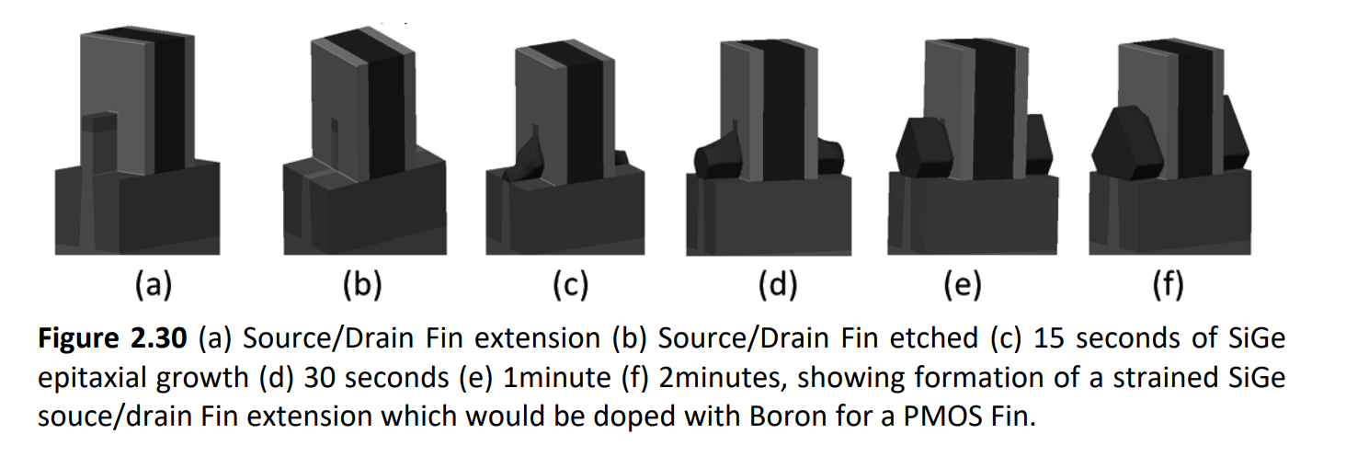
FinFET Fabrication
3D view of epitaxial S/D (Ref. Integrated Circuit Fabrication : Science and Technology)

Slide 24
FinFET Fabrication
22. Oxide Fill
Oxide
Oxide
Nitride
Nitride
Poly Si
Polysilicon
Si Fin
Si substrate
Si Substrate
Cross section along Fin
Cross section along Gate

Slide 25
FinFET Fabrication
23. Replacement Metal Gate : Dummy Dielectric Etching
Oxide
Nitride
Poly Si
Polysilicon
Si Fin
Si substrate
Si Substrate
Cross section along Fin
Cross section along Gate

Slide 26
FinFET Fabrication
24. Replacement Metal Gate : Gate Dielectric Deposition
Oxide
Nitride
Poly Si
Polysilicon
Gate dielectric
Gate Dielectric
Si Fin
Si substrate
Si Substrate
Cross section along Fin
Cross section along Gate

Slide 27
FinFET Fabrication
25. Replacement Metal Gate : Metal Gate Deposition
Metal Gate
Oxide
Nitride
Metal Gate
Polysilicon
Gate dielectric
Si Fin
Si substrate
Si Substrate
Cross section along Fin
Cross section along Gate

Slide 28
FinFET Fabrication
26. Contact Formation
W
Metal Gate
W
Oxide
Nitride
Metal Gate
Polysilicon
Gate dielectric
Si Fin
Si substrate
Si Substrate
Cross section along Fin
Cross section along Gate

Slide 29
FinFET Fabrication
ILD1
27. BEOL : ILD1 Deposition
W
Metal Gate
W
Oxide
ILD1
Nitride
Metal Gate
Polysilicon
Gate dielectric
Si Fin
Si substrate
Si Substrate
Cross section along Fin
Cross section along Gate

