Slide 1

Project Title – Seasonal Agriculture Performance Analysis
Student Name : ANIRUDRA GUPTA
College Name : MEDICAPS UNIVERSITY
AICTE Student ID : STU697329b8738781769155000

Slide 2

PROBLEM STATEMENT
Agricultural activities are influenced by seasonal variations in environmental conditions, farming practices, resource availability and market conditions.
As a result, agricultural performance may differ from one season to another. However, raw agricultural data does not clearly explain how agricultural performance changes across seasons or what patterns can be observed in different seasonal conditions.
The problem is to analyze the given agricultural dataset and investigate seasonal differences in agricultural performance by identifying meaningful patterns, trends, relationships and variations within the available data.

Slide 3
Project Description : Seasonal Agriculture Performance Analysis
Objective: Analysed how agricultural performance changes across Kharif, Rabi, and Zaid seasons.
Dataset: Worked with 4,000 farm records and 28 attributes covering crops, states, weather, soil, resources, production, and financial performance.
Technologies: Python, Pandas, NumPy, Matplotlib, and Seaborn.
Data Cleaning: Identified missing values and handled them using mean imputation. Checked the dataset for duplicates and found none.
Exploratory Analysis: Studied season, crop, and state distributions and calculated important statistics using Pandas.
Seasonal Analysis: Compared yield, profit, rainfall, and water usage across the three seasons.
Visualization: Created bar charts, boxplots, and correlation heatmaps to clearly understand patterns and relationships.
Crop Analysis: Found Sugarcane to have the highest average yield at approximately 46.67 tonnes/ha.
Profit Analysis: Kharif had the highest average profit (~₹1.79 lakh), while Zaid had the lowest average profit (~−₹24.8K).
Loss Analysis: Identified 1,966 loss-making farms and analyzed their distribution across seasons.
Correlation Analysis: Studied relationships between rainfall, temperature, yield, profit, and water usage.
Key Finding: Kharif showed the strongest overall performance, while Zaid required better irrigation and resource management.
Outcome: Generated data-driven insights and recommendations to support better crop planning, resource utilization, and agricultural profitability.

Slide 4

WHO ARE THE END USERS?
For your Seasonal Agriculture Performance Analysis project, the main end users can be:
👨‍🌾 Farmers – to understand which seasons and crops give better yield and profit.
🌾 Agricultural Planners – to compare seasonal performance and plan crop production.
🏛️ Government & Agriculture Departments – to support agricultural policies, subsidies, and resource planning.
💧 Irrigation & Resource Managers – to analyze water usage and improve irrigation efficiency.
📊 Agricultural Analysts / Data Scientists – to study relationships between rainfall, temperature, yield, profit, and resources.
🏢 Agri-businesses & Companies – to make decisions about crop planning, supply, and investment.

Slide 5

Technology Used
Technologies Used
Python – Core programming
Pandas – Data cleaning and analysis
NumPy – Numerical calculations
Matplotlib – Data visualization
Seaborn – Statistical charts and heatmaps
Excel – Dataset storage and input

Slide 6
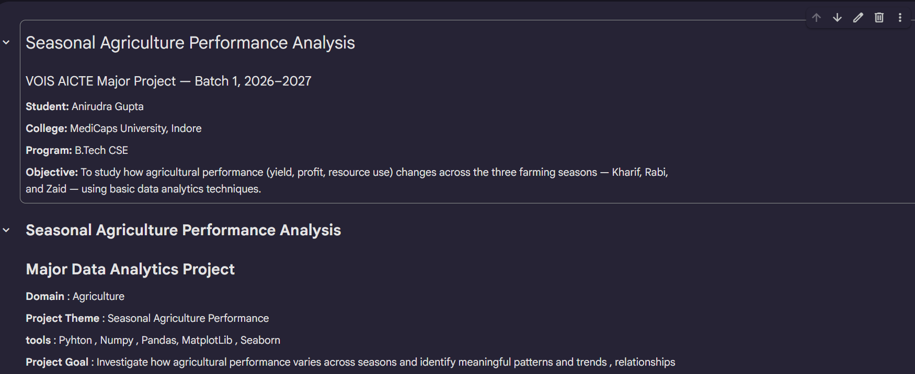
RESULTS

Slide 7
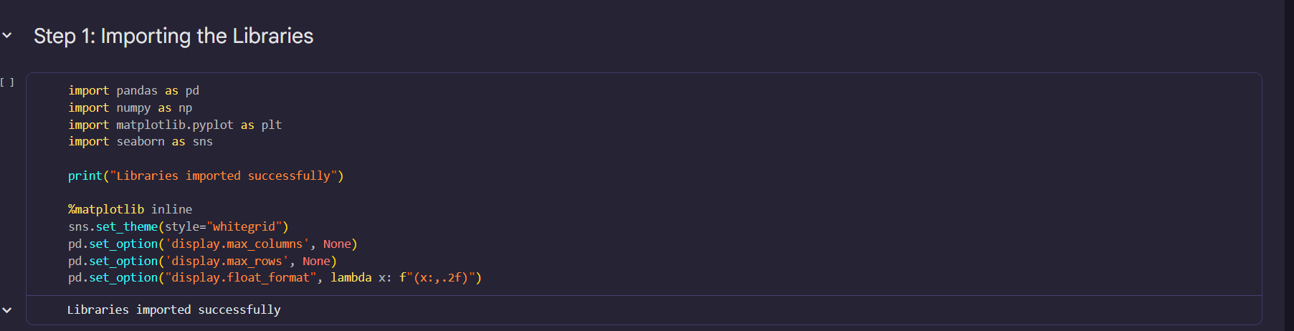
RESULTS

Slide 8
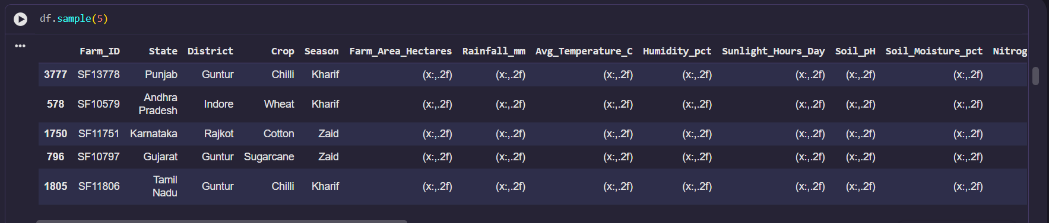
RESULTS

Slide 9
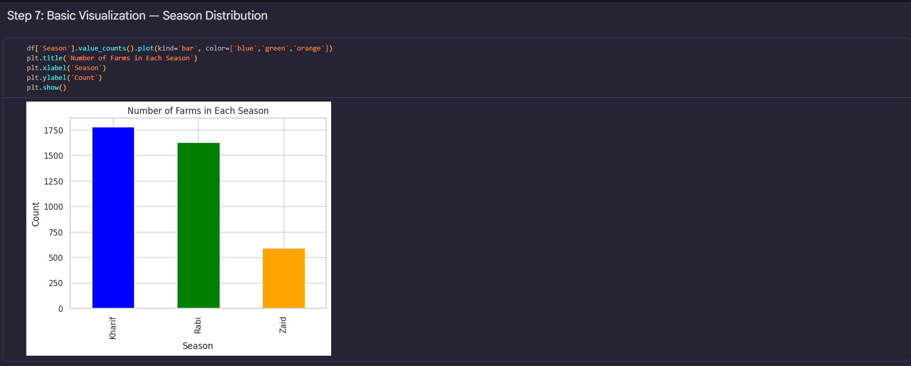
RESULTS

Slide 10
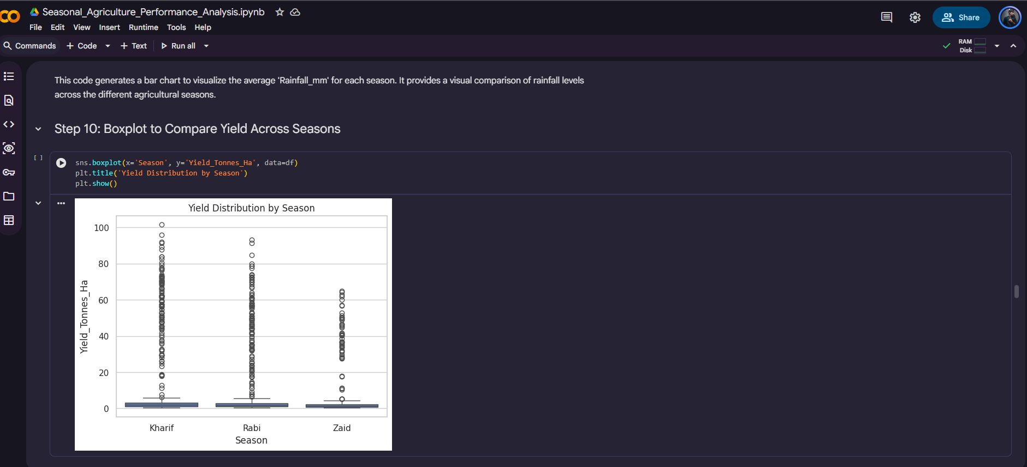
RESULTS

Slide 11
Future scope
In the future, the project can be enhanced with AI-based prediction models, real-time weather and soil data, and interactive dashboards to predict crop yield and profitability and provide better crop and irrigation recommendations.
Predictive Models – Predict crop yield and profit for future seasons.
Real-Time Data – Integrate live weather and soil data.
AI Recommendations – Suggest suitable crops and irrigation strategies.
Larger Datasets – Use multi-year data for more accurate insights.
Interactive Dashboard – Build a real-time dashboard for farmers and agricultural departments.

Slide 12
GitHub Link
https://github.com/ANIRUDRAGUPTA07/Seasonal-Agriculture-Performance-Analysis.git

Slide 13
VOIS Course completion certificate -
Course name- Data Visualization

Slide 14
Thank you
.
.

