Slide 1
MAKING OF 3D HOLOWGRAMS FROM YOUR PHONE
BY BATCH 11

Slide 2
CONCEPTS
INTRODUCTION
HISTORY
WHAT IS HOLOWGRAM
HOW TO MAKE HOLOWGRAM
WORKING PRINCIPLE
IMPORANCE AND NEED
APPLICATIONS
FUTURE SCOPE
CONCLUSION

Slide 3
INTRODUCTION
The word “holography” is made up of two Greek words: ‘HOLOS’ means ‘WHOLE’....and....’GRAPHY’ means ‘WRITING’.
Technical term for holography is wave front reconstruction.
At the begining stage the light scattered by an object is recorded and later reconstructed, so that a 3D impression is created as though the object is right in front of our eyes.
Here the image changes as the position and orientation of the viewing systems changes.

Slide 4
Records phase of the object.
Records our three dimensional world on a two dimensional recording medium.
Can be seen using naked eyes.
Demonstrates complete parallax and depth-of-field.
Image floats in free space.
Can also be used to optically store, retrieve, and process information.

Slide 5
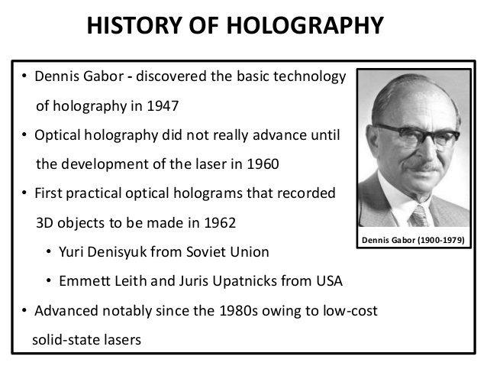

Slide 6
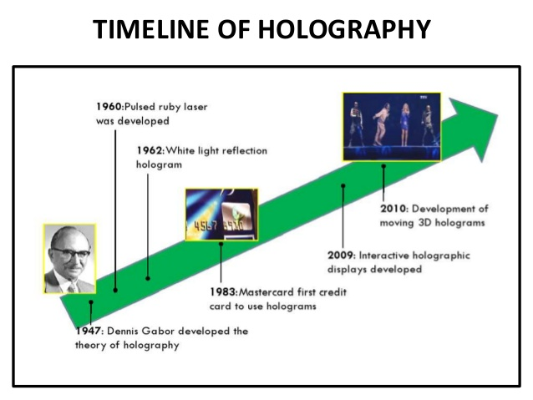

Slide 7
HOLOGRAPHY
Holography is the science and practice of making HOLOGRAM.
Typically a hologram is a photographic recording of light field, rather than an image formed by a lens, and it is used to display a fully THREE-DIMEMENTIONAL IMAGE of the holographed subject.
This 3D image is seen without any aid of special glasses or other intermediate optics.
The hologram itself is not an image and it is usually unintelligible when viewed under diffuse ambient light.

Slide 8
HOLOGRAPHY
It is an encoding light field as an interface pattern of seemingly random variations in the opacity, density, or surface profile of the photographic medium.
When suitable light, the interference pattern diffracts the light into a reproduction of the original light field and the objects that were in it appear to still be there, exhibiting visual depth cues such as parallax and perspective that change realistically with any change in the relative position of the observer.
Finally a hologram is a physical structure that diffracts light into an image

Slide 9
HOW TO MAKE HOLOGRAMS
Follow the simple steps to turn your smart phone into a 3D hologram projector.
APPARATUS:
Graph paper.
A CD case.
A pen.
A Pair of scissors.
Sellotape or superglue.
A Craft knife or glass cutter.
Your smartphone.

Slide 10
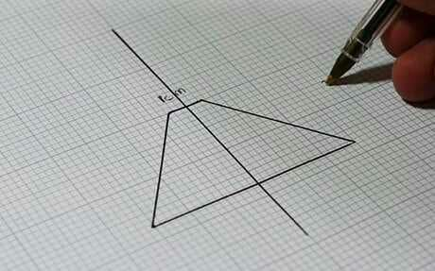
HOW TO MAKE HOLOGRAM
1) Sketch out a basic trapezoid shape on the graph paper using the dimensions 1cm,3.5cm,6cm.

Slide 11
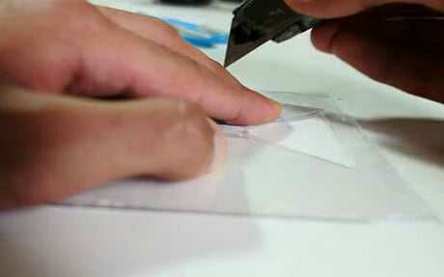
HOW TO MAKE HOLOGRAM
2) Snap off the shallow sides of the CD case and carefully trace around the paper template to cut the shape into the transparent plastic. Repeat four times.

Slide 12
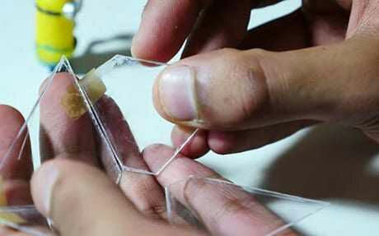
HOW TO MAKE HOLOGRAM
3) Tape the four shapes together, with the longest sides facing the top of the structure.

Slide 13
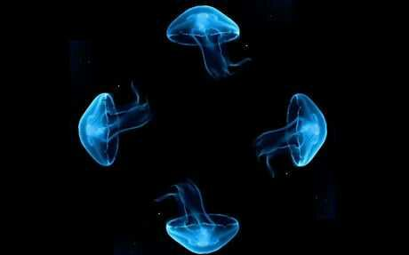
HOW TO MAKE HOLOGRAM
4) Select the holograph-specific video you’d like to project.
The following image is an best example.

Slide 14
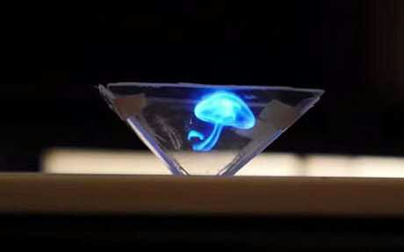
HOW TO MAKE HOLOGRAM
5) Place the shape over a video playing on your smart phone to create a mirrored, 3D hologram.

Slide 15
WORKING PRINCIPLE
The basic principle of holography is to create the image using two simultaneous beams of light, that interfere with each other to form a complex image on a suitable photographic film.
These two beams of light are created by splitting a light source in two with one source reflecting light from the object to be photographed on the film and the other falling directly on it from the source.
The image developed in this way is the hologram.

Slide 16
The light source used for holography is usually a laser light.
When light from any source falls on the film hologram, it changes this light to reconstruct the light pattern of original object, creating a three dimensional image.

Slide 17
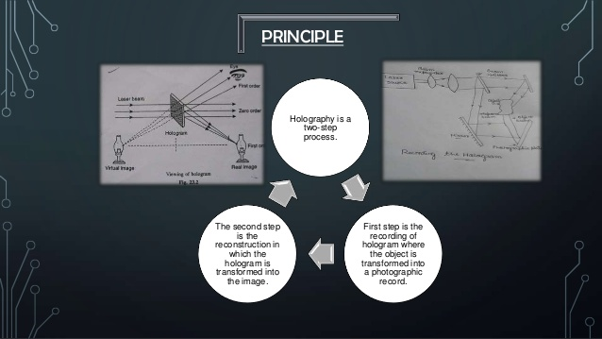

Slide 18
IMPORTANCE AND NEED
Rapidly growing technology.
Project large-scale, high-resolution images onto free space.
Accommodate multiple viewers independently and simultaneously.
Create tremendous effects on a all fields of life including business, education, science, art and healthcare.
Enabling viewing and manipulation of virtual 3D objects in 3D space without the need for special viewing goggles or headgear.

Slide 19
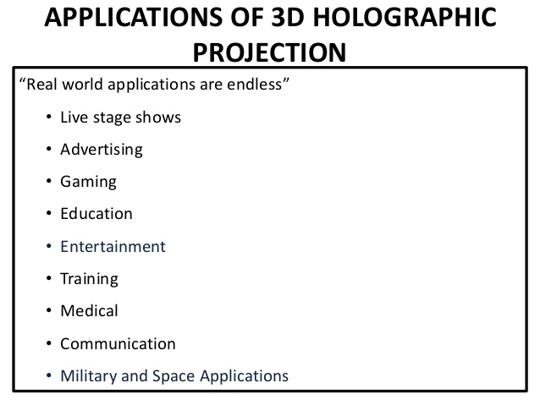

Slide 20
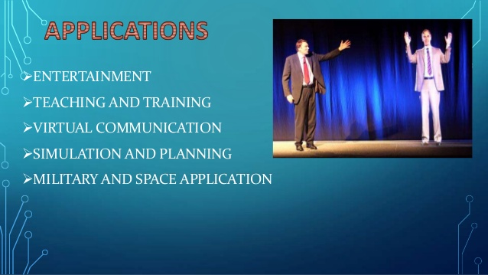

Slide 21
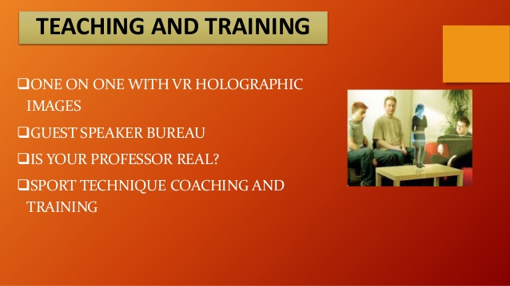

Slide 22
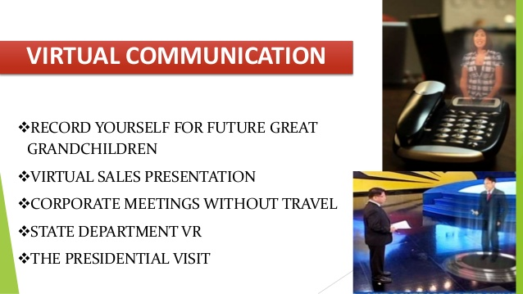

Slide 23
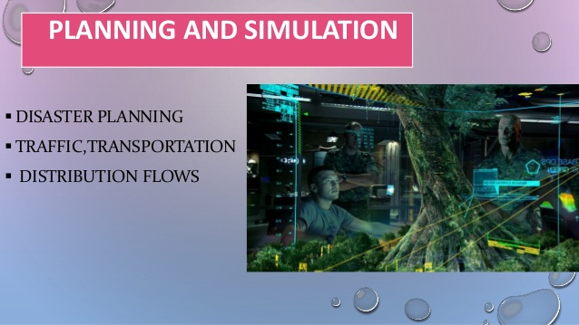

Slide 24
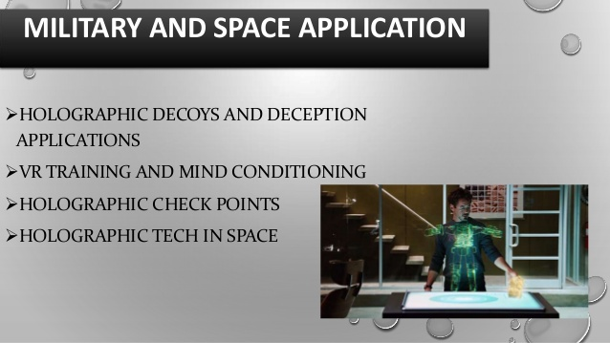

Slide 25
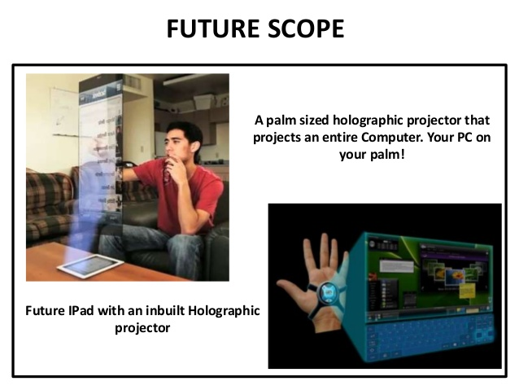

Slide 26
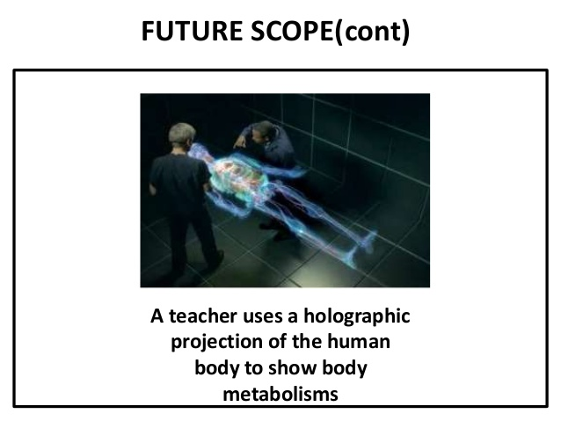

Slide 27
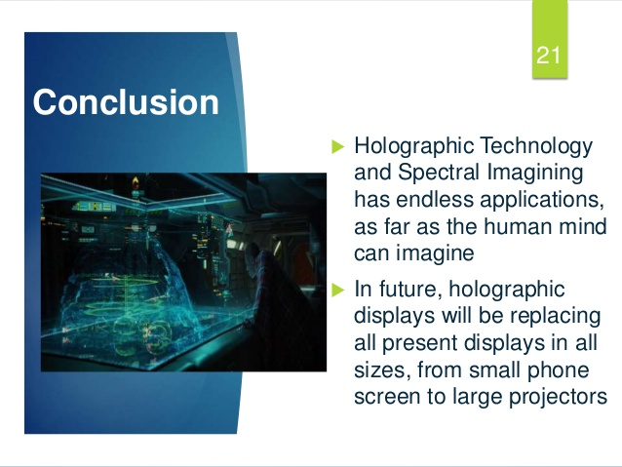

Slide 28
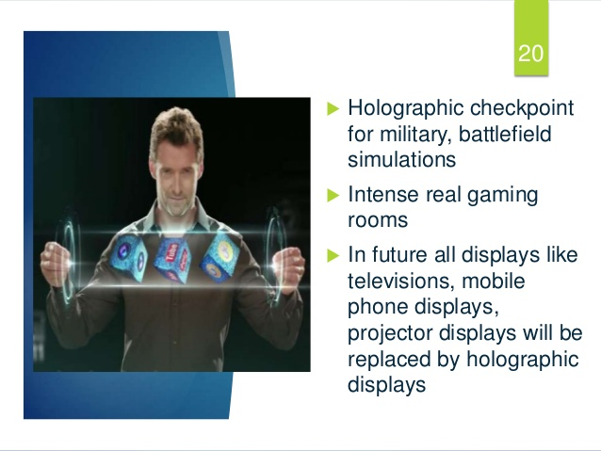

Slide 29


