Slide 1
Optimizer
Optimizing Weights and Learning Rate

Slide 2
Optimizers
Gradient Descend
Stochastic Gradient Descent (SGD)
Mini batch Gradient Descent (SGD)
Momentum based Gradient Descent (SGD)
Adagrad (short for adaptive gradient)
Adelta
Adam(Adaptive Gradient Descend)

Slide 3
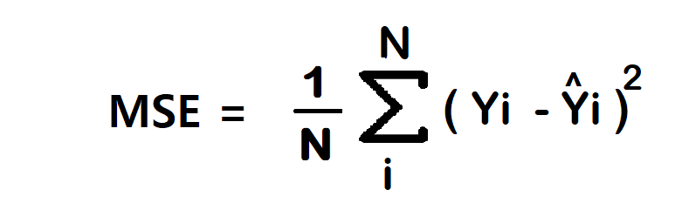
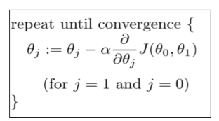
Generate some random data points with
500 rows and 2 columns (x and y)
and use them for training
data = np.random.randn(500, 2)
theta = np.zeros(2) ## Model Parameters(Weights)

Slide 4
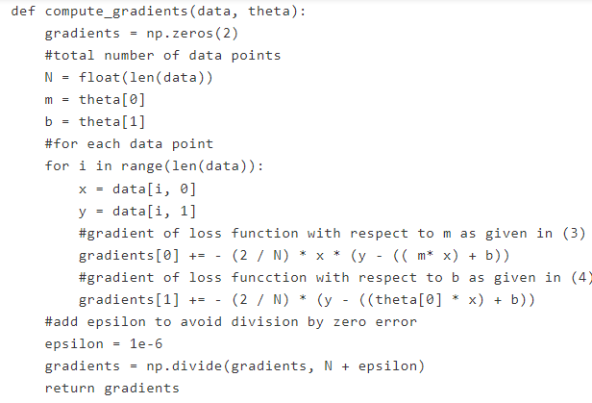
Calculate the Gradient of loss function for model parameters
Update our model parameter

Slide 5
Mini-batch Gradient Descent

Slide 6
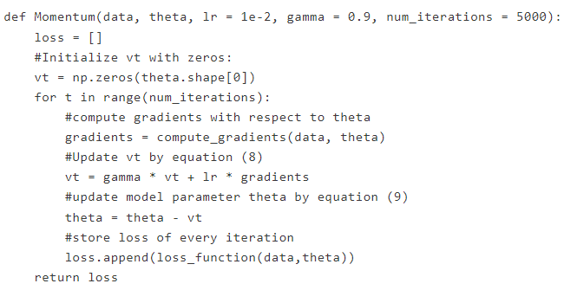
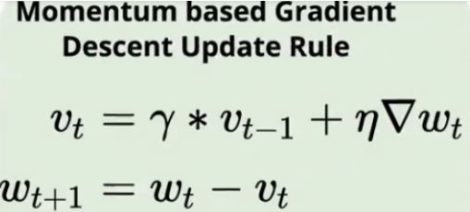
Momentum based Gradient Descent (SGD)

Slide 7

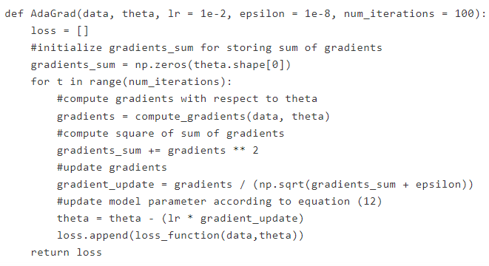
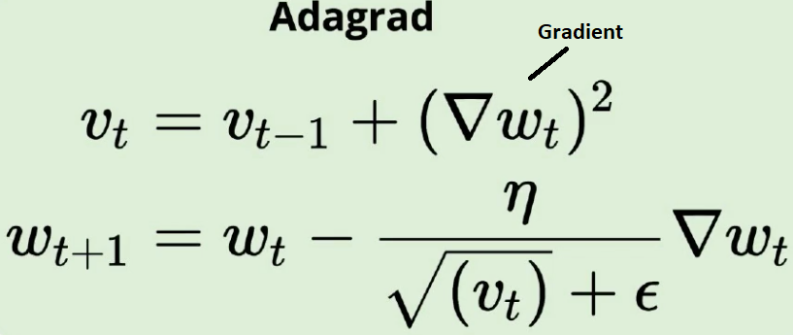
Adagrad

Slide 8
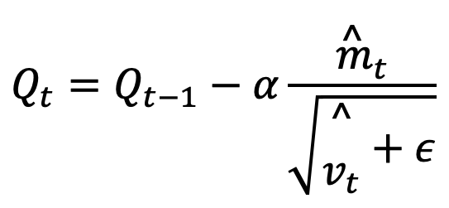
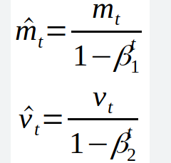

Slide 9

