Slide 1

Gated Recurrent Unit
GRU

Slide 2
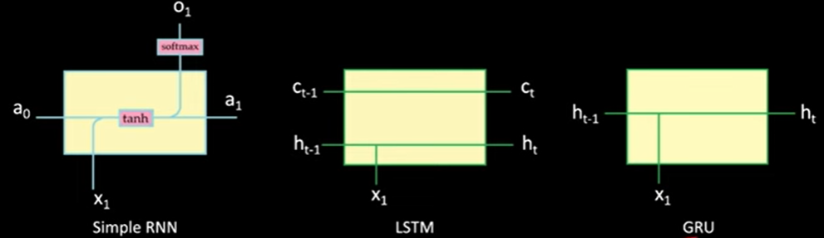

Slide 3
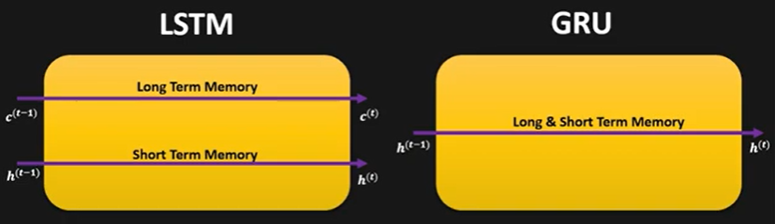

Slide 4
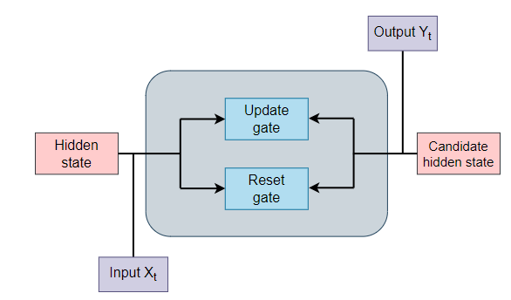

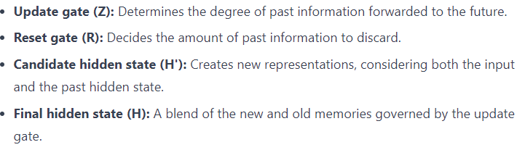

Slide 5
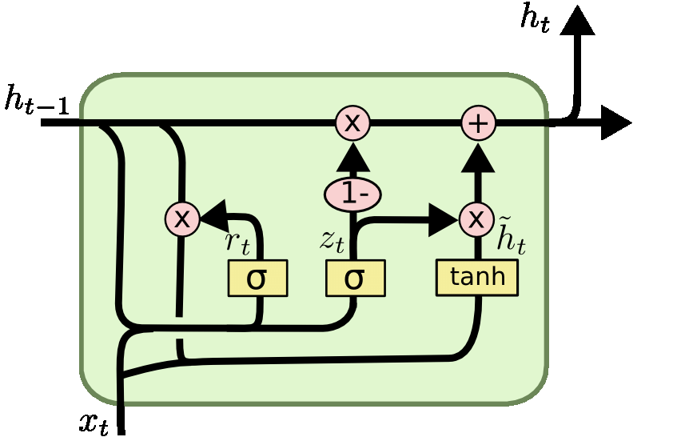




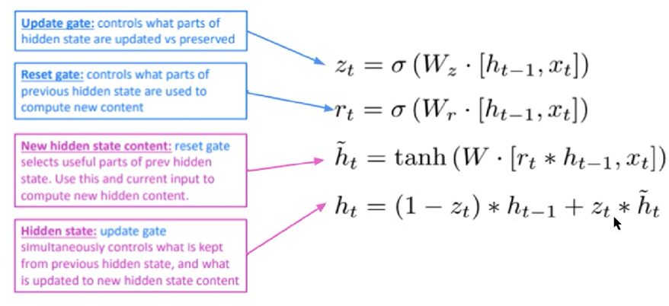

Slide 6
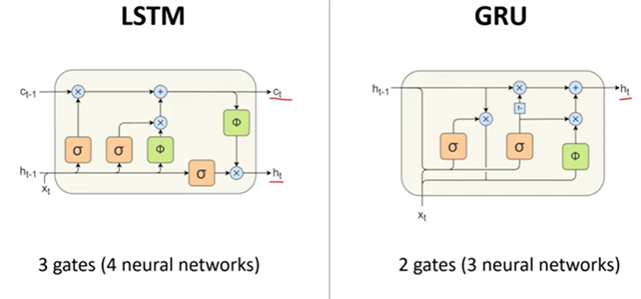

Slide 7
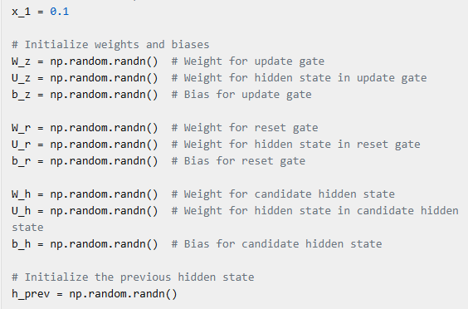

Slide 8
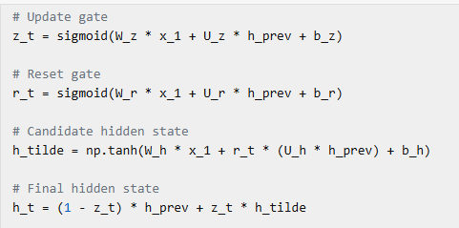

Slide 9
Let’s assume the following initial parameters for simplicity:
Input ( x_t = 1.0 )
Previous hidden state ( h_t-1 = 0.5 )
Weights and biases for the GRU unit:
( W_z = 0.1 ), ( U_z = 0.2 ), ( b_z = 0.3 )
( W_r = 0.4 ), ( U_r = 0.5 ), ( b_r = 0.6 )
( W_h = 0.7 ), ( U_h = 0.8 ), ( b_h = 0.9 )
2. Compute the Update Gate ( z_t )
The update gate is calculated as follows:
[ z_t = sigma(W_z x_t + U_z h_t_1 + b_z) ]
Substitute the values:
Use the sigmoid function
3. Compute the Reset Gate ( r_t )
The reset gate is calculated as follows:
Substitute the values:
Using the sigmoid function:
4. Compute the Candidate Hidden State h_tilde
The candidate hidden state is calculated as follows:
5. Compute the Final Hidden State ( h_t )
The final hidden state is calculated as follows:

