Slide 1
Oligopoly

Slide 2
Features of Oligopoly Markets
Oligopoly is a market structure characterized by a few large firms dominating the industry. These firms have significant market power and can influence the price and output levels in the market. Here are the key features of oligopoly markets:
1. Few Large Firms:
A small number of firms control the majority of the market share.
These firms are often multinational corporations with significant resources and market power.
2. Interdependence:
The actions of one firm significantly impact the other firms in the industry.
Firms are aware of each other's actions and strategies, leading to strategic behavior.
3. Barriers to Entry:
High barriers to entry prevent new firms from entering the market easily.
These barriers can include economies of scale, patents, government regulations, or control of essential resources.

Slide 3
4. Product Differentiation:
Firms may differentiate their products to create a unique selling proposition and reduce competition.
This can involve variations in features, branding, or marketing strategies.
5. Price Rigidity:
Prices in oligopolistic markets tend to be relatively stable.
Firms are reluctant to change prices due to the fear of retaliation from competitors.
6. Non-Price Competition:
Firms often compete on factors other than price, such as advertising, product quality, customer service, or innovation.
This can help to differentiate products and attract customers.

Slide 4
7. Collusion:
Firms may engage in collusion, either formally or informally, to coordinate their pricing and output decisions.
This can lead to higher prices and lower output levels.
8. Strategic Behavior:
Firms carefully consider the actions of their competitors when making decisions about pricing, output, and marketing.
This can lead to a game-theoretic approach to decision-making.
These features collectively contribute to the unique dynamics and challenges faced by firms operating in oligopolistic markets.

Slide 5
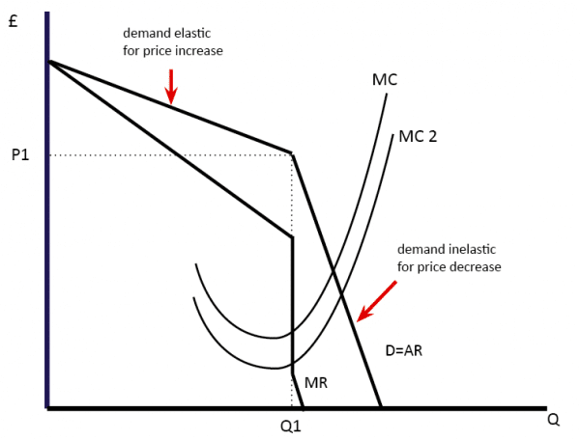
Kinked Demand Curve

