Slide 1
Applications of NLP
Prof. Saravanakumar K., SCOPE,
Vellore Institute of Technology, Vellore.

Slide 2
Most common tasks under NLP research
Syntax
Lemmatization
Morphological segmentation
Part-of-speech (POS) tagging
Parsing
Sentence breaking
Stemming
Word segmentation
Terminology extraction

Slide 3
Most common tasks under NLP research
Semantics
Lexical semantics
Distributional semantics
Machine translation
Named Entity Recognition (NER)
Natural language generation
Natural language understanding
Optical character recognition
Question answering
Relationship extraction
Sentiment analysis
Word sense disambiguation (WSD)

Slide 4
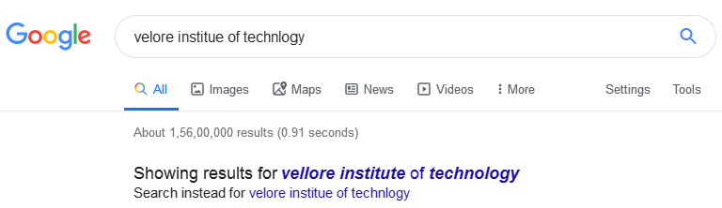
Spell and grammar checking
To check spelling and grammar
To suggest alternatives

Slide 5
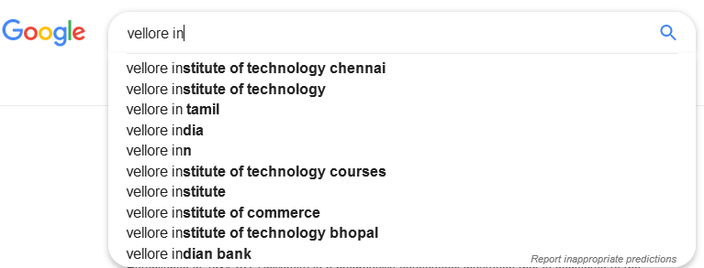
Word prediction
To predict (to suggest) the most probable word to be typed

Slide 6
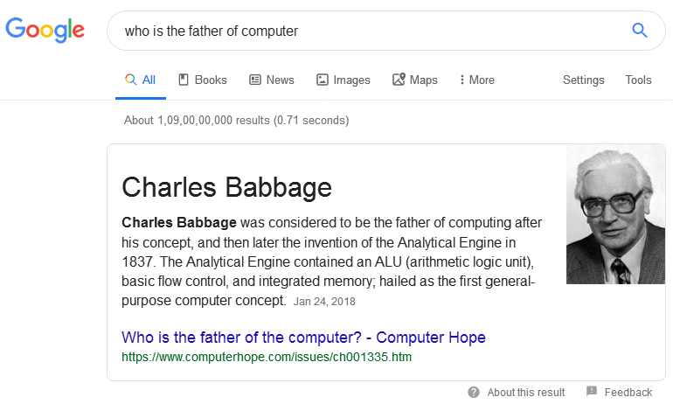
Information retrieval
To find the relevant information appropriate to the user’s query

Slide 7
Text categorization
“Text categorization is the task of automatically sorting a set of documents into categories (or classes, or topics) from a predefined set”
To assign predefined categories to a text
Also referred as text classification or topic spotting
Examples:
Web page categorization
Customer feedback classifier
Language detection

Slide 8
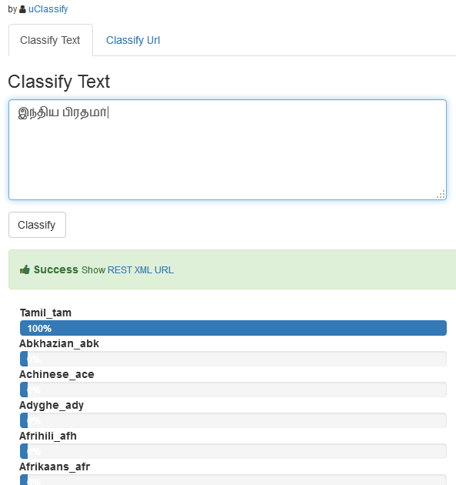
Text categorization contd…

Slide 9
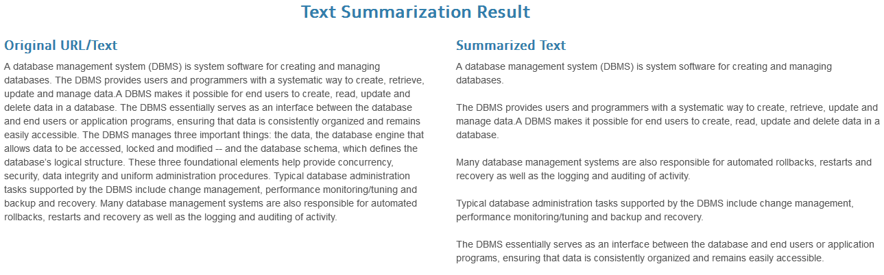
Summarization
To summarize text from one or more documents (based on requirement specification)

Slide 10
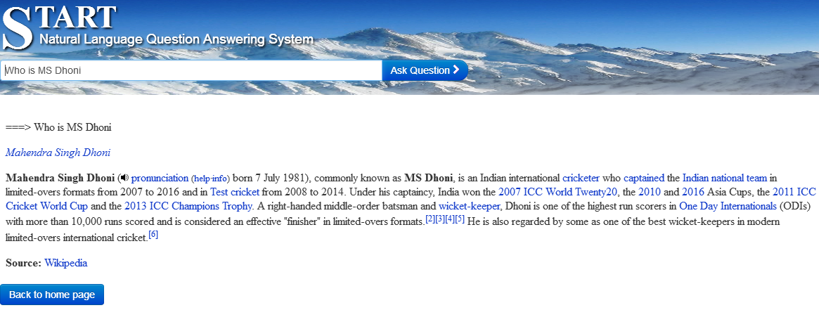
Question answering system
To answer in short text a question posed in natural language
Start.csail.mit.edu – Answers question using natural language annotation

Slide 11
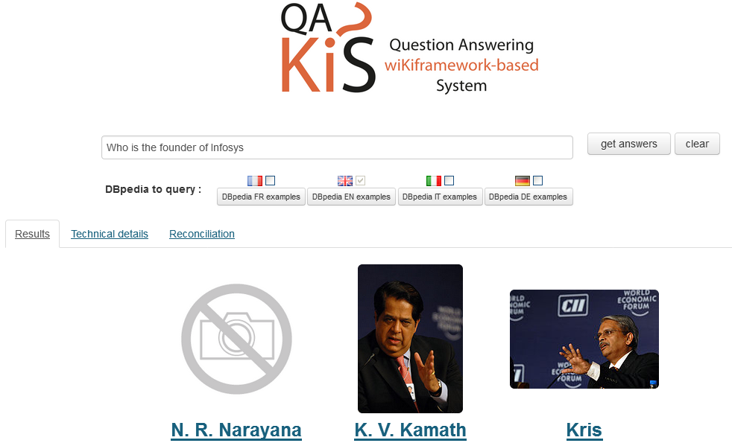
Question answering system
QAKiS.org – Answers question using structured knowledge bases (Eg. Dbpedia)

Slide 12
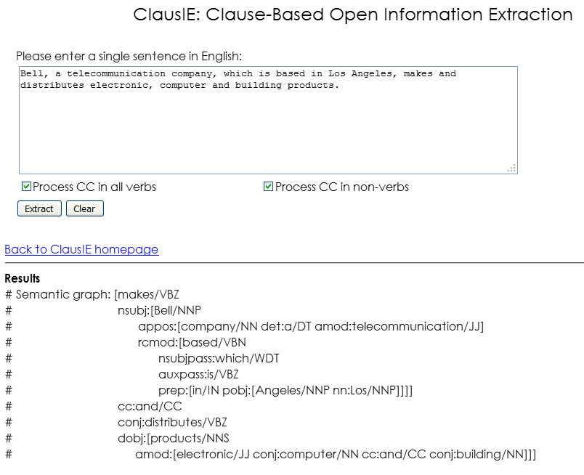
Information extraction
“Information extraction (IE) is the automated retrieval of specific information related to a selected topic from a body or bodies of text”.
To extract information from text.
It also includes Named Entity Recognition (NER).

Slide 13
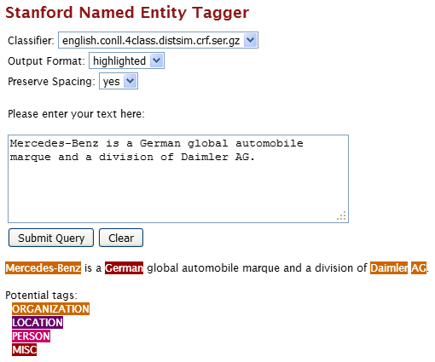
Information extraction contd…

Slide 14
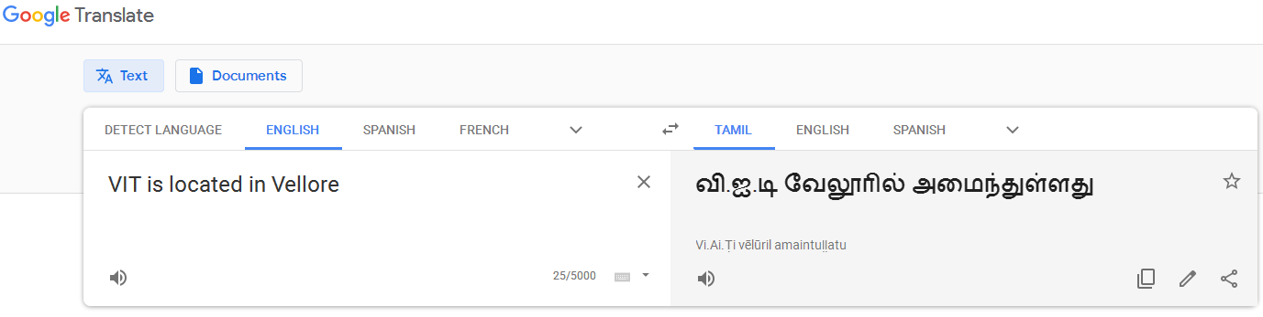
Machine translation
To translate text from one language to the other
Example: Google translate (statistical [2006] and neural [2016] MT)

Slide 15
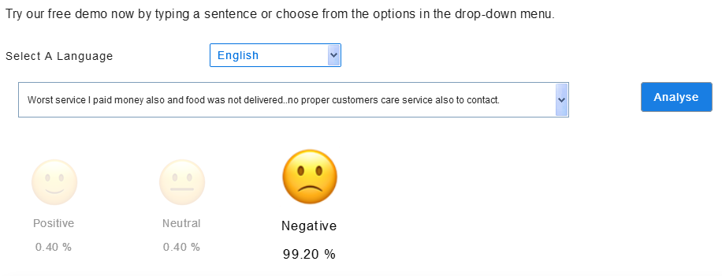
Sentiment analysis
To identify sentiments and opinions given in a text
ParallelDots - https://www.paralleldots.com/sentiment-analysis

Slide 16
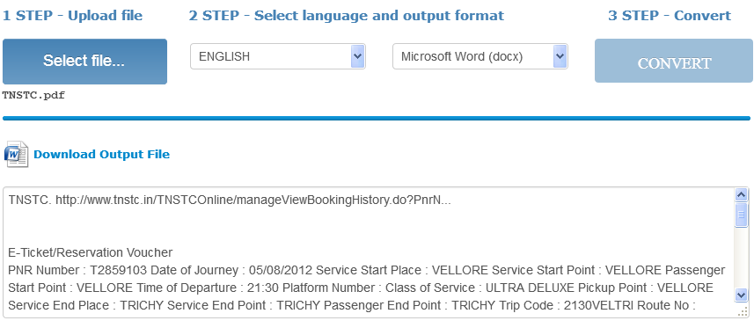
Optical character recognition
To recognize printed or handwritten texts and convert them to computer-readable texts
Free Online OCR - https://www.onlineocr.net/

Slide 17
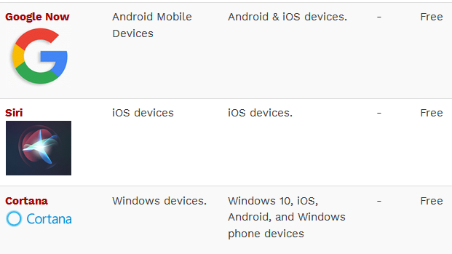
Speech recognition
To recognize a spoken language and transform to text

Slide 18
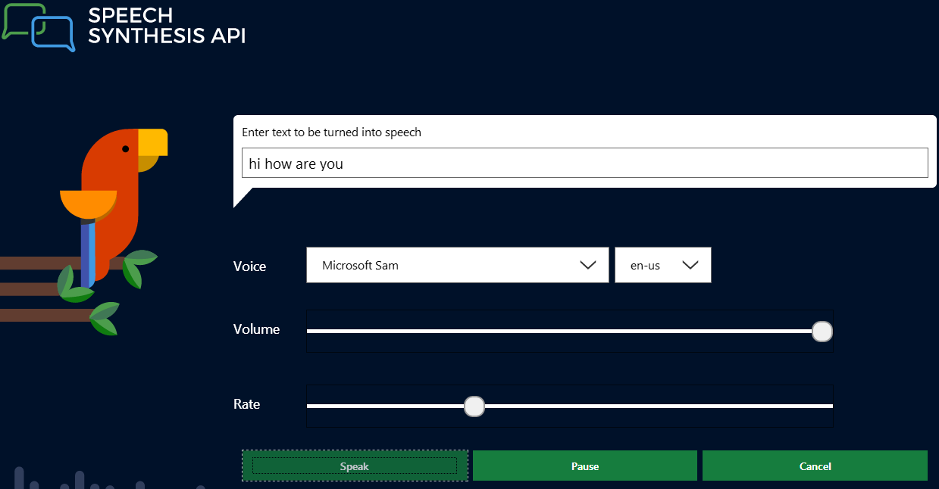
Speech synthesis
To generate speech from text
Microsoft - https://developer.microsoft.com/en-us/microsoft-edge/testdrive/demos/speechsynthesis/

Slide 19
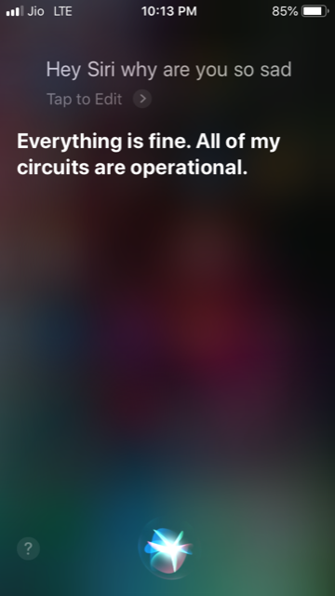
Spoken dialog systems
Dialog system that runs a dialog between user and the system
Any chatbots
Example: Siri

Slide 20
Difficulty levels for these applications
Easy
Spelling and grammar checking
Text categorization task
NER task
Medium
Information retrieval
Sentiment analysis
Machine translation
Information extraction
Difficult
Question answering
Summarization
Dialog systems

Slide 21
More applications
POS tagging
Paraphrase detection
Automotive virtual assistants
Computer assisted physician
Most of the automated customer services
And more…

