Slide 1
Introduction to NLP
Prof. Saravanakumar K., Associate Professor, SCOPE,
Vellore Institute of Technology, Vellore.

Slide 2
Language
Word – smallest element that can be uttered in isolation.
Vocabulary – consists of set of words
Text – composed of sequence of words from a vocabulary
Language – constructed of a set of all possible texts.

Slide 3
Natural Language Processing
“Natural language processing (NLP) is a subfield of computer science, information engineering, and artificial intelligence concerned with the interactions between computers and human (natural) languages, in particular how to program computers to process and analyze large amounts of natural language data” – Wikipedia.
“Natural language processing (NLP) is a branch of artificial intelligence that helps computers understand, interpret and manipulate human language”

Slide 4
NLP Goals
Science Goal
Understand the way language operates
Engineering Goal
Build systems that analyse and generate language; reduce the man machine gap
Design, implement, and test systems that process natural languages for practical applications.

Slide 5
Everyday NLP examples
Spam filtering
Voicemail
Web search suggestions
Virtual assistants

Slide 6
History
Turing test
Developed by Alan Turing in 1950 to test the ability of a machine on its intelligence
ELIZA
Early NLP computer program developed during 1964-66, developed at MIT AI lab by Joseph Weizenbaum.
PARRY
Developed at Stanford University in 1972 by psychiatrist Kenneth Colby.
BASEBALL
LUNAR

Slide 7
History – Chatbots today
A computer program that conducts conversation via auditory or text based methods.
Examples
Virtual assistants
Google assistant
Amazon alexa
Messaging apps
Facebook messenger
WeChat
Organizational apps
SBI – ILA (Interactive Live Assistant)
HDFC – EVA (Electronic Virtual Assistant)

Slide 8
Most common tasks under NLP research
Syntax
Lemmatization, Morphological segmentation, Part-of-speech (POS) tagging, Parsing, Sentence breaking, Stemming, Word segmentation, Terminology extraction
Semantics
Lexical semantics, Distributional semantics, Machine translation, Named Entity Recognition (NER), Natural language generation, Natural language understanding, Optical character recognition, Question answering, Relationship extraction, Sentiment analysis, Word sense disambiguation (WSD)

Slide 9
Why NLP is hard? - Ambiguity
Ambiguity
A state when the meaning of a word, phrase or sentence is uncertain.
This makes NLP challenging
Examples:
The astronomer loves the star.
I made her duck.
I read the book.
The bark was painful.

Slide 10
Ambiguity contd…
“I made her duck”. Possible understanding;
I cooked waterfowl for her.
I cooked waterfowl belonging to her.
I created the (plaster?) duck she owns.
I caused her to quickly lower her head or body.
I waved my magic wand and turned her into undifferentiated waterfowl.

Slide 11
Ambiguity contd…
Ways to resolve or disambiguate these ambiguities:
Deciding whether duck is a verb or a noun can be solved by part-of-speech tagging .
Deciding whether make means “create” or “cook” can be solved by word sense disambiguation.
Resolution of part-of-speech and word sense ambiguities are two important kinds of lexical disambiguation.
A wide variety of tasks can be framed as lexical disambiguation problems.
For example, a text-to-speech synthesis system reading the word lead needs to decide whether it should be pronounced as in lead pipe or as in lead me on.
Deciding whether her and duck are part of the same entity (as in (1) or (4)) or are different entity (as in (2)) is an example of syntactic disambiguation and can be addressed by probabilistic parsing.
Ambiguities that don’t arise in this particular example (like whether a given sentence is a statement or a question) will also be resolved, for example by speech act interpretation.

Slide 12
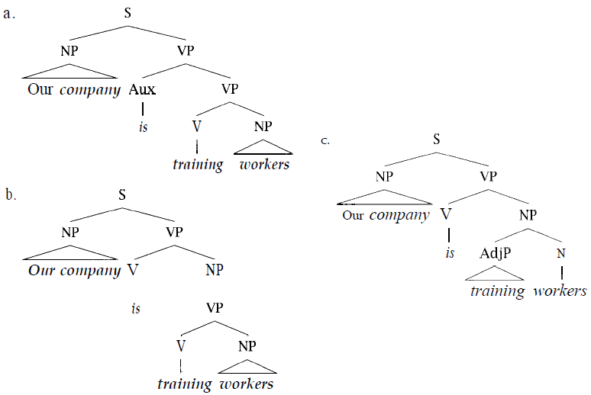
Ambiguity contd…
Syntactic analyses of “Our company is training workers”

Slide 13
Stages (levels) of language processing
What distinguishes language processing applications from other data processing systems is their use of knowledge of language
Linguistic knowledge required (linguistic essentials)
Phonetics and phonology – knowledge about linguistic sounds
Morphology – meaningful components
Lexical Analysis - tokenization
Syntactic Analysis – structural relationship between words
Semantic Analysis – meaning of words
Pragmatics – relationship of meaning with intention of the speaker
Discourse – about linguistic units larger than a single utterance

Slide 14
Phonetics
In linguistics, phonetics is the study of sounds and their relations to words.
How words are pronounced in terms of sequences of sounds and how each of these sounds is realized acoustically
Applications – Speech recognition, Speech synthesis
Challenges
Homophones (Homonyms) – carat (mass) vs carat (unit) vs carrot (vegetable)
Word boundary
Phrase boundary

Slide 15
Morphology
Word formation rules from root words
The study of internal structures of words and how they can be modified.
Morpheme – minimal unit of meaning
Prefix, stem, suffix
Unhappiness
un happy ness
(not being) (word) (a state of being)
BOUND MORPHEME FREE MORPHEME BOUND MORPHEME
Note: helps in increasing recall especially in IR

Slide 16
Morphology contd…
Morphological parsing - Parsing complex words into their component words.
Example:
Simple (noun boy – boys, verb identify – identified)
Complex (man – men)
Languages rich in morphology: e.g., Dravidian, Hungarian, Turkish
Languages poor in morphology: Chinese, English

Slide 17
Lexical analysis (tokenization)
Knowledge of the meanings of the component words
Example:
Lion
Lexical property - Noun
Morphological property – ends with ‘s’ in case of plural
Semantic property – Animal, 4-legged, etc.
Example tasks: POS disambiguation, WSD

Slide 18
Syntactic analysis
The knowledge needed to order and group words together.
To understand the roles played by different words in a body of text.
Human understanding is based on structural analysis.
Example: Innocent peacefully children sleep little vs Innocent little children sleep peacefully

Slide 19
Syntactic analysis contd…
In order to perform syntactic analysis, we need
a parser - i.e., a program that takes as input a sentence and produces the analysis.
a grammar - i.e., a set of rules that the parser can use.
a lexicon - i.e., a dictionary of legal words and their parts of speech

Slide 20
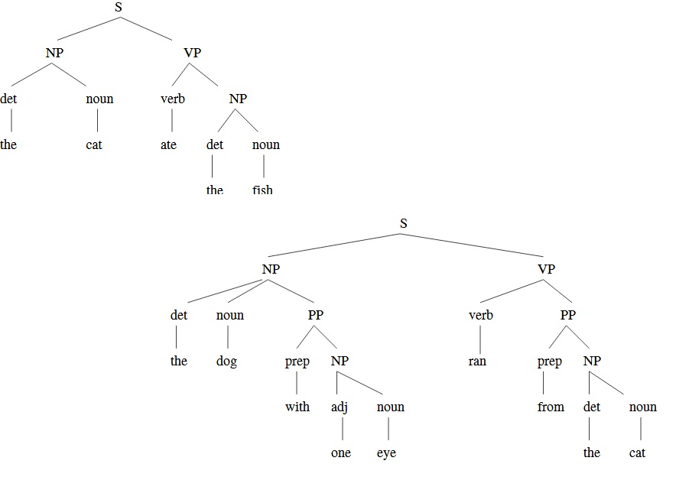
Syntactic analysis contd…

Slide 21
Semantic analysis
It is the process of relating syntactic structures, from the levels of phrases, clauses, sentences and paragraphs to the level of the writing as a whole, to their language-independent meanings
Lexical semantics and Compositional semantics
The study of the meaning of words, and how these combine to form the meanings of sentences
Synonymy: fall & autumn
Hypernymy & hyponymy (is a): animal & dog
Meronymy (part of): finger & hand
Homonymy: fall (verb & season)
Antonymy: big & small

Slide 22
Pragmatics
Pragmatics is a subfield of linguistics and semiotics that studies the ways in which context contributes to meaning.
Conversational implicature
What on earth has happened to the roast beef?
The dog is looking very happy.
Implicature? – The dog ate the roast beef.
Presupposition
Jane no longer writes fiction
Presupposition – Jane once wrote fiction

Slide 23
Semantics Vs Pragmatics
Semantics
What does it mean literally?
Pragmatics
What is the speaker really conveying?
Depends on the situation and world knowledge
Give me the book
Could you please give me the book?

Slide 24
Discourse analysis
The study of linguistic units larger than a single statement
Anaphora
He hits the car with a stone. It bounces back.
Understanding a text
Who/when/where/what … are involved in an event?
How to connect the semantic representations of different sentences?
What is the cause of an event and what is the consequence of an action?
…

Slide 25
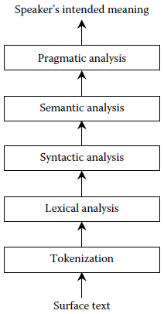
The stages of analysis in NLP

