Slide 1
NLP APPLICATIONS
Dr.A.Kannan,
Senior Professor

Slide 2
Text Mining

Slide 3
Text Mining
Text mining consists of extraction information from hidden patterns in large text-data collections.
The results can be important both:
for the analysis of the collection, and
for providing intelligent navigation and browsing methods.

Slide 4
Data Fusion and Text Data Mining
Extracted pieces of information from several sources are combined in one database.
Previously undetected relationships may be discovered.

Slide 5
Process
The text mining process can be organized roughly into five-major steps:
Data Selection
Term Extraction and Filtering
Data Clustering and Classification
Mapping or Visualization
Result Interpretation
Iterative and interactive process

Slide 6
Information Retrieval

Slide 7
What is Information Retrieval?
Find relationships between the information need of the user and documents in a repository.
Identify relevant documents in streams of information such as news feeds.
“IR is a field concerned with the structure, analysis, organization, storage, searching, and retrieval of information” (information includes database systems., Q/A systems).

Slide 8
Information Retrieval -Definition
Focus is on the user information need
– Information about a subject or topic
– Semantics is frequently loose
– Small errors are tolerated
Handles natural language text which is not always well structured and could be semantically ambiguous.

Slide 9
Text Indexing
As a precondition for document retrieval, texts are stored in an indexed database.
Usually a text is indexed for all word forms or – after lemmatization – for all lemmas.
Sometimes indexing is combined with categorization and summarization.

Slide 10
Text Retrieval
Texts are retrieved from a database that best match a given query or document.
The candidate documents are ordered with respect to their expected relevance.
Indexing, categorization, summarization and retrieval are often subsumed under the term information retrieval.

Slide 11
Steps in Basic Text Retrieval
Characterize each document in collection
Store characterizations
Characterize user’s (natural language) query
Compare characterization of query against document characterizations
Return rank-ordered list of documents

Slide 12
Some Possible Scenarios
Internet searches
Digital Libraries (ACM’s DL, IEEE’s DL)
Users searching for particular information in their local machines
Document retrieval in company’s networks (intranets).

Slide 13
Issues in IR
Relevance Feedback.
Concept Representation.
Multimedia Retrieval.
Multilingual Retrieval.
Query Expansion.

Slide 14
Web Search - challenges
Searching – exploits all evidences – web structure, meta-data and user context information
Captures & exploits user information & query context – to serve better for the users information need
What aspects of user context & history can we capture?
Language models to represent information need.
Formal modeling of interactive retrieval process.
Deals with variation in queries.
Identifies different types of queries & utilizes specific methods for specific query types
Representation of web document - annotate web pages – automatically /semi automatically.

Slide 15
Can NLP Techniques Help?
The extraction and use of semantic information can help to solve or alleviate some of the problems found in IR, like (Synonymy, Polysemy, Phrases, etc).
It seems natural to think that a representation of the “aboutness” of a document will help in the its classification.
Complete parsing and extraction of semantic information requires the use of domain specific lexicons.
Parsing and interpretation of a document is a computation intensive task.

Slide 16
Current Scenario -IR
Current IR systems – Text retrieval
Do not understand information need of user
Do not understand content of document
IR systems must:
Understand queries
Retrieve relevant information
Long document
Multiple documents of same topic
Most important material – clear and coherent manner
Present the results

Slide 17
Challenges in IR
Ability to leverage – advances in input processing and advances in content based access to multimedia artifacts.
Dealing with noisy large scale multimedia data.
Diverse sources – Radio, TV, Documents, web pages and human conversations.

Slide 18
Text Categorization

Slide 19
Text Categorization
This technology assigns texts to categories. Texts may belong to more than one category, categories may contain other categories.
Filtering is a special case of categorization with just two categories.

Slide 20
Observations
Broad indexing & speedy search alone are not enough.
Organizational view of data is critical for effective retrieval.
Categorized data are easy for user to browse.
Category taxonomies become most central in well-known web sites (Yahoo!, Lycos, ...).

Slide 21
Why Text Categorization?
Is it spam?
Is it Spanish?
Is it interesting to this user?
News filtering
Helpdesk routing
Is it interesting to this NLP program?
e.g., should my calendar system try to interpret this email as an appointment (using info. extraction)?
Where should it go in the directory?
Yahoo! / Open Directory / digital libraries
Which mail folder? (work, friends, junk, urgent ...)

Slide 22
Text Categorization Applications
Web pages organized into category hierarchies.
Journal articles indexed by subject categories (e.g., the Library of Congress, MEDLINE, etc.).
Patents archived using International Patent Classification.
Patient records coded using international insurance categories.
E-mail message filtering.
News events tracked and filtered by topics.

Slide 23
How to Categorize? (adaptive)
What if we gradually get more new data over time?
User feedback (active or passive) on our classifications
News / email systems that categorize, or judge relevance
Add new articles / messages to training data
If they’re unlabeled (no supervision), label them automatically
Add them only if we’re confident? Add them fractionally, like EM?
So model adjusts over time:
E.g., change the cluster centroids or n-gram parameters
May want to weight the more recent data more heavily, since the future is more like the present than the past
E.g., message from k days ago has weight 0.9^{k} (k=0,1,2, ...)
So today’s model = today’s data + 0.9 * yesterday’s model

Slide 24
Challenges –Text Categorization
Text Categorization - Perspective
User
Generic
Text categorization based on
General Ontology
Domain Ontology
Text Categorization
Specified Granularity

Slide 25
Topic Detection and Tracking

Slide 26
Topics and Events?
TDT’s perspective
Topic Detection and Tracking.
An event happens somewhere and sometime in the real world (a seminal event)
A particular earthquake.
Some events “inevitably” follow
Damage, rescues, …
The first event and all those that follow inevitably from it constitute a topic.

Slide 27
The Topic Tracking Task:
To detect stories that discuss the target topic, in multiple source streams.
Find all the stories that discuss a given target topic
Training: Given N_{t} sample stories that discuss a given target topic,
Test: Find all subsequent stories that discuss the target topic.

Slide 28
TDT task: new event detection
Monitor stream of news
Multimodal, only English here.
Flag stories that discuss a topic not seen earlier on the stream
Might be the first appearance of topic
Might be picked up in mid-topic.
Viewed as companion process to a filter for “interesting” topics.

Slide 29
Information Extraction

Slide 30
Information Extraction
Relevant information pieces of information are discovered and marked for extraction.
The extracted pieces can be: the topic, named entities such as company, place or person names, simple relations such as prices, destinations, functions etc. or complex relations describing accidents, company mergers or football matches.

Slide 31
Definition
Information Extraction (IE) systems analyze unrestricted text in order to extract specific types of information.
IE systems do not attempt to understand all of the text in all input documents, but they do analyze those portions of each document that contain relevant information
Relevance is determined by pre-defined domain guidelines which must specify, as accurately as possible, exactly what types of information the system is expected to find.
Wendy G. Lehnert

Slide 32
Issues - IE
The relative complexity of the extraction task
The quality of the knowledge bases available to the NLP system
The syntactic and semantic complexity of the documents to be processed
The regularity of the language in documents
The accuracy and robustness
The portability
Building an IE system in a new domain is difficult and time-consuming.
Knowledge acquisition
The empirical methods in NLP will address this problem!

Slide 33
The Stages of IE System
Tokenization and Tagging
Tag each word with respect to POS or semantic class
Sentence Analysis
Syntactic analysis or partial parsing
Extraction
Identification of domain-specific component
Merging
Coreference resolution or anaphora resolution
Template generation
Determines the number of distinct events in the text
Maps the individually extracted pieces of information onto each event
Produce output templates
Purely domain-specific inferences
Sometimes requires constraints or normalization

Slide 34
The Architecture of IE System and NLP
The spectrum of NLP system
A full syntactic analysis,
Semantic analysis,
Discourse-level analysis
IE system
Partial parsing
Keyword matching
technique

Slide 35
Applications
Financial
Email auto-response
e.g. "What is the balance of account N007623013?"
First categorize as balance-request
Then extract account number
Informational
For all seminar announcements in BB
extract time/title/speaker/location
From email messages about proposed meetings
extract time/participants/location
Corporate Intelligence
Extract key facts about competition web sites
New products offered
Any changes to prices, sales, etc.
Extract key facts about customers of competitors

Slide 36
Applications
Large-scale Web applications
Build DB of all job openings
Categorize web pages as job descriptions
Extract company/date/salary/level/...
fill in relational DB with extracted info
Whizbang! (a Pittsburgh eCompany) is doing just this via its flipdog.com site
Build DB of all web-posted resumes,
first categorizing pages as resumes,
then extracting key fields name/expertise/...

Slide 37
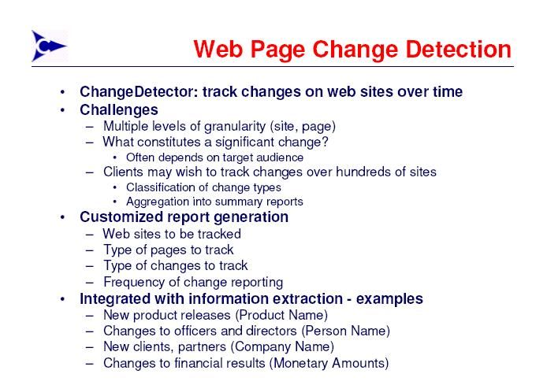

Slide 38
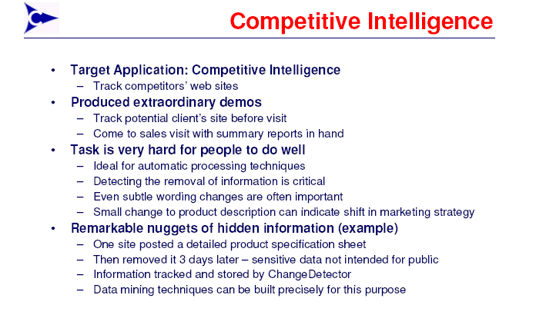

Slide 39
Question Answering

Slide 40
Question Answering
Question Answering Natural language queries are used to access information in a database.
The database may be a base of structured data or a repository of digital texts in which certain parts have been marked as potential answers.

Slide 41
IR vs QA
Type in keywords to Asking Questions in Natural Language
Response from documents to extracted or generated answer
Currently – “What” questions? Possible with IR
“Why” Questions only if
Answer in information database
Inferred afterwards by user

Slide 42
Issues –Q/A
Find answers to why questions from systems that make appropriate inferences
Automatic reasoning methods
Systematic extraction from text
Storage in proper representation
Draw conclusions
Types of questions
Simple factual questions – short phrase from single documents
General questions “What do we know about company X?
Retrieving multiple documents
Locating Portions of answers
Combining into single response
Complex Questions
Judgment Needed
Deep Knowledge of user’s Context

Slide 43
Scenario
Imagine someone is watching a television newscast – becomes interested in a person who is an advisor to the country’s Prime Minister
Who is This?
What is his background?
What is the political relationship between him and PM/opposition party/ruling party?
Must manage
Search in multiple sources in multiple languages/media
Fusion of information
Resolution of conflicting data
Multiple alternatives
Adding interpretation
Drawing conclusions

Slide 44
Challenges- Q/A
Research must deal with
Question analysis
Response delivery and generation from heterogeneous sources
structured and unstructured language data of all media types
Multiple languages, styles and formats
Image data – document images, photography and video
Language technology research deals with
Source selection
Source segmentation and extraction
Semantic integration and reasoning across heterogeneous sources of both structured and unstructured data

Slide 45
Report Generation
A report in natural language is produced that describes the essential contents or changes of a database.
The report can contain accumulated numbers, maxima,minima and the most drastic changes.

Slide 46
Dialogue Systems

Slide 47
QA vs Dialogue systems
Input – keyboard, voice, pointing device, combinations
Errors and incompleteness of spontaneous language
Mixed initiatives of speaker and system
Focus change
Interpretation based Dialog Context and Mutual Knowledge

Slide 48
Challenges and issues - Dialogue
Interactions
Ability to tailor flow and control of interactions
Facilitate interactions including error detection and correction tailored to individual, physical, perceptual and cognitive differences
Agent/User Modeling
Models of user beliefs, goals and plans
Models of users’ individual and collective skills by processing – documents and users interactions/conversations
Integration of semantics and pragmatics

Slide 49
Text Summarization

Slide 50
Text Summarization
The most relevant portions of a text are extracted as a summary.
The task depends on the needed lengths of the summaries.
Summarization is harder if the summary has to be specific to a certain query.

Slide 51
What is Text Summarization?
Enables knowledge workers access to large amounts of information – less reading
Process of distilling most important information from a source to produce an abridged version
Condensation
Selection
Selection of one or more salient or non-redundant information
Aggregation
From different parts of source or different linguistic descriptions
Generalization
Generalization of specific information with more general abstract information

Slide 52
Applications
Headlines (from around the world)
Outlines (notes for students)
Minutes (of a meeting)
Previews (of movies)
Digests (T.V. guide)
Abridgements (Shakespeare for children)
Bulletins (weather reports)
Sound bites (politicians comments on current issues)
Histories (chronologies of salient events)
Physicians’ aids (summarize and compare treatments)
Search Engine hits (summarize information in hit lists)
Intelligence Gathering (biography of Dr.Manmohan Singh)
Hand-held devices (create screen-sized summary of book)
Aids for Handicapped (compact text and read to blind person)

Slide 53
High-level Architecture
Documents
Compression
audience
function
fluency
Generic
User-focussed
Indicative
Informative
Evaluative
Fragments
Connected text
summary
analysis
transformation
synthesis

Slide 54
Issues- Summarization
What kinds of summaries do people want?
summarizing, abstracting, gisting,...?
How sophisticated must systems be?
Are statistical techniques sufficient?
Or do we need symbolic techniques and deep understanding as well?
What milestones would mark quantum leaps in summarization theory and practice?
How do we measure summarization quality?

Slide 55
‘Genere’s of Summary
Indicative vs. informative
...used for quick categorization vs. content processing.
Extract vs. abstract
...lists fragments of text vs. re-phrases content coherently.
Generic vs. query-oriented
...provides author’s view vs. reflects user’s interest.
Background vs. just-the-news
...assumes reader’s prior knowledge is poor vs. up-to-date.
Single-document vs. multi-document source
...based on one text vs. fuses together many texts.

Slide 56
Aspects that Describe Summaries
Input (Sparck Jones 97)
subject type: domain
genre: newspaper articles, editorials, letters, reports...
form: regular text structure; free-form
source size: single doc; multiple docs (few; many)
Purpose
situation: embedded in larger system (MT, IR) or not?
audience: focused or general
usage: IR, sorting, skimming...
Output
completeness: include all aspects, or focus on some?
format: paragraph, table, etc.
style: informative, indicative, aggregative, critical...

Slide 57
Characteristics
Compression rate
Fidelity of source
Relevance to user’s interest
Extracts
Avoid gaps
Dangling anaphora
Abstracts
Well-formedness –syntax and discourse levels
Plausible output

Slide 58
Approaches – level of processing
Surface-level approaches – terms of shallow features – selectively combined – salience function – extract information
Thematic features – statistically salient terms
Location – position in text
Background – presence of terms in title, headings
Cue words & phrases – in summary, important
Domain-specific – bonus & stigma terms
Entity-level approaches – internal representation for text – modeling text entities and their relationships

Slide 59
Approaches – level of processing
Entity level approaches – represent patterns /connectivity in text – relationships between entities include
Similarity (Vocabulary overlap)
Proximity (Distance between text units)
Co-occurrence (Words related based on their occuring in common contexts)
Thesaural relations (synonymy, hypernymy, part-of relations)
Coreference (referring expressions such as noun phrases)
Logical relations such as agreements, contradiction, entailment, and consistency
Syntactic relations (based on parse trees)
Meaning based relations (predicate argument relations)

Slide 60
Approaches – level of processing
Discourse level approaches – model global structure & its relation to communicative goals. This structure includes
Format of documents (hypertext markup, document outlines)
Threads of topics as revealed in text
Rhetorical structure such as argumentation or narrative structure
Hybrid approach

Slide 61
Paradigms: NLP/IE vs. IR/statistics
NLP/IE:
Approach: try to ‘understand’ text—re-represent content using ‘deeper’ notation; then manipulate that.
Need: rules for text analysis and manipulation, at all levels.
Strengths: higher quality; supports abstracting.
Weaknesses: speed; still needs to scale up to robust open-domain summarization.
IR/Statistics:
Approach: operate at lexical level—use word frequency, collocation counts, etc.
Need: large amounts of text.
Strengths: robust; good for query-oriented summaries.
Weaknesses: lower quality; inability to manipulate information at abstract levels.

Slide 62
Machine Translation

Slide 63
Translation Technologies
Technologies that translate texts or assist human translators.
Automatic translation is called machine translation.
Translation memories use large amounts of texts together with existing translations for efficient look-up of possible translations for words, phrases and sentences.

Slide 64
Translation Process
Source Text
Analysis
Meaning
Synthesis
Target Text

Slide 65
Issues in Machine Translations
Text to Text Machine Translations
Speech to Speech Machine Translations
Most of the work has addressed pairs of widely spread languages like English-French, English-Chinese

Slide 66
Issues in Machine Translations
How to translate text?
Learn from previously translated data
→ Need parallel corpora
French-English, Chinese-English have the Hansards
Reasonable translations
Chinese-Hindi – no such tools available today!

Slide 67
Issues in Machine Translations
How to obtain parallel texts?
From the Web! How?
From Web users! How?
Once we have the texts, how to get most out of them?
Word alignments
Obtain lexicons
Import knowledge from well studied languages

Slide 68
MT: User dreams
Language plug-ins for mobile phones (for transactions rather than full fledged interpretation)
Help with the hard part of foreign languages.
Large MT evaluation from user perspective.
Standard control menu language (for cross-language communication by means of small menu driven devices)
Cross-lingual sign-reading eyeglasses (foreign language signs or messages are read by a small camera, and the translation is projected in the user's glasses)
Learning from user feedback (via post-edition tools), and predicting user needs, constructing user models
Web search and translation with CLIR.
Automatic stenography (TV, conferences)

Slide 69
Speech Processing

Slide 70

Overview
to converse freely with a machine – ultimate challenge!!
Spoken language interfaces – a fast necessity
Sentence
Language
Generation
Speech
Synthesis
Speech
Database
System Manager
Graphs & Tables
Discourse
Context
Meaning
Representation
Speech
Recognition
Language
Understanding
Words
Speech
Speaker
Recognition
Language
Recognition

Slide 71
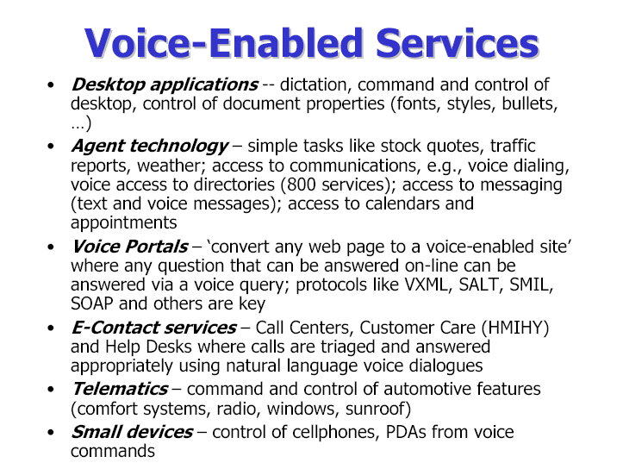

Slide 72
Speech recognition
Spoken language is recognized and transformed in into text as in dictation systems, into commands as in robot control systems, or into some other internal representation.

Slide 73
Speech Recognition
Key Focus of the Technology
Deriving a textual representation of a spoken utterance
Applications
Desktop command and control
Dictation
– Telephony-based transaction and information services

Slide 74
Speech Recognition – Issues
Isolated words vs. continuous speech
Vocabulary size
Speaker dependence vs. speaker independence

Slide 75
Speech Synthesis
(also Speech Generation)
Utterances in spoken language are produced from text (text-to-speech systems) or from internal representations of words or sentences (concept-to-speech systems)

Slide 76
Spoken Dialogue Systems
The system can carry out a dialogue with a human user in which the user can solicit information or conduct purchases, reservations or other transactions.

Slide 77
Spoken Language Dialog Systems
Key Focus of the Technology
Natural voice interactive dialogs with computer-based systems
Spoken dialogue systems communicate with users via automatic speech recognition and text-to-speech interfaces, and mediate the user's access to a back-end database
Applications
Information services: stock quotes, timetables
Transaction services: banking, betting, flight reservations

Slide 78
SLDSs – Issues
Telephony-based systems cannot afford a training period
Making a conversation too realistic falsely raises expectations
Error handling is a significant issue
Giving dialogue initiative to the user increases difficulty

Slide 79
Beyond Speech Recognition
Spoken Language Understanding
Interpret meaning of key words and phrases in the recognized speech and map to actions
Accurate understanding of every word not needed
Customer can speak naturally
Applications – Automation of complex operator based tasks – customer care, catalog ordering, form filling, help lines
Dialog Management
Combine meaning of current input with interaction history – decide what is next step in interaction
Complex services – multiple exchanges between system and customer
Handle user initiated topic switching (within domain)
Applications – customer care, travel planning, conference registration, scheduling, voiced access to unified messaging

Slide 80
User Interface Applications

Slide 82
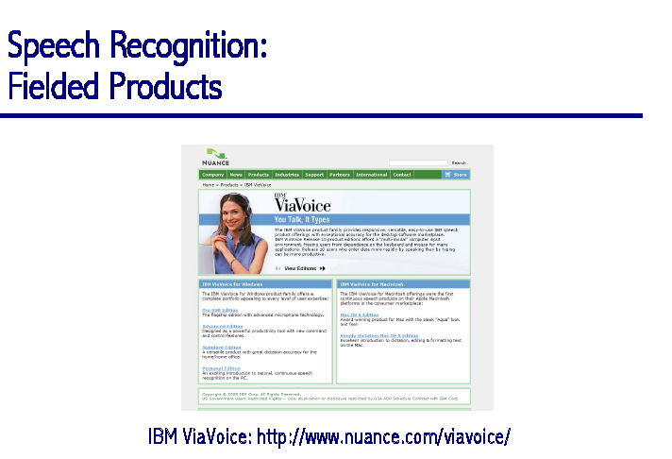

Slide 84
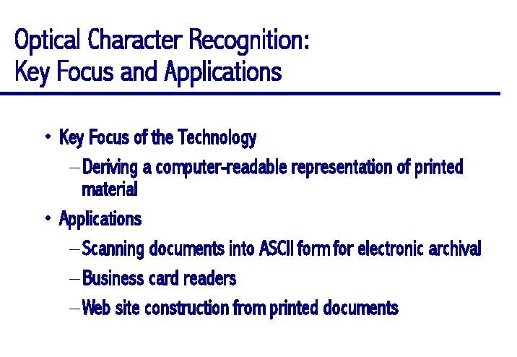

Slide 85
Ontology Development

Slide 86
Why an Ontology?
Structure to the meaningful content of Web pages – Semantic Web
Provide intelligent access to heterogeneous and distributed semantic information
Enable sofware agents to mediate and work together in rela scenarios
The Semantic Web is an extension of the current web in which information is given well defined meaning, better enabling computers and people to work in co-operation. [Berners-Lee et al., 2001]

Slide 87
Requirements
Required – creation of a machine understandable semantics for some or all information presented in the WWW
Developing languages for expressing machine understandable meta-information for documents
Developing terminologies (ontologies)
Integrating and translating different terminologies
Developing tools to support search, access, present and maintain information sources

Slide 88
MultiModality and MultiLinguality

Slide 89
MultiModality
Speech
handwriting
prosody
facial expressions
gestures
emotions
haptics
etc.
research
Multi-modal services
development
Scope
integration
use
Existing work on
Systems for design and presentation
People-aware rooms
Business and artistic communication enriched with understanding and expression of emotions and haptics
Delegates (avatars) - human like communication/interaction capabilities

Slide 90
Opportunities for...
Smart home appliances, eGames, Information appliances manufacturers
Mobile information appliances and terminal manufacturers
Telecom, eTailers, eCommerce and eService (CRM)
Video conference software and services
Car manufacturers, in-vehicle devices OEM suppliers
Human factor research and leading technology suppliers

Slide 92
Issues in Multi-Lingual Computing
Content Development
Human Computer Interaction
Machine Translation
Speech to Speech Translation
Localization

Slide 93
Multilinguality
Non-English Sites increasing
Challenges – Lexical Complexity
200 different languages
Multilingual dictionaries – mapping to independent knowledge organization structures – common systems of concepts linked by semantic relations
“Interlingua” – languages – make distinctions of different granularity

Slide 94
Aspects to Localization
Infrastructure aspects (telecom, Internet Protocol),
Input output aspects (keyboards, character sets, rendition, schemes, data formats, sorting),
Linguistic aspects (translation, writing styles),
Design & Content aspects (look & feel, content localization),
Commercial aspects (marketing, service, pricing),
Legal aspects (local law, consumer protection, privacy)

Slide 95
Current and Future Trends

Slide 96
Maturity of Text Technologies
Spell Checkers
Machine-Assisted Human Translation
Translation Memories
Indicative Machine Translation
Grammar Checkers
Information Extraction
Human Assisted Machine Translation
Report Generation
High Quality Text Translation
Text Generation Systems
Deployed. On the market
Mature or close to maturity
Research prototypes in R&D

Slide 97
Maturity of Speech Technologies
Voice Control Systems
Dictation Systems
Text-to-Speech Systems
Machine Initiative Spoken Dialogue Systems
Identification and Verification Systems
Spoken Information Access
Mixed Initiative Spoken Dialogue Systems
Speech Translation Systems
Deployed. On the market
Mature or close to maturity
Research prototypes in R&D

Slide 98
Maturity of IM Technologies
Word-Based Information Retrieval
Summarization by Simple Condensation
Simple Statistical Categorization
Simple Automatic Hyperlinking
Cross-Lingual Information Retrieval
Automatic Hyperlinking With Disambiguation
Simple Information Extraction (Unary, Binary Relations)
Complex Information Extraction (Ternary+ Relations)
Dense Associative Hyperlinking
Concept-Based Information Retrieval
Text Understanding
Deployed. On the market
Mature or close to maturity
Research prototypes in R&D

Slide 99
NLP “Rainbow”
Understanding
Knowledge base
Analysis
Generation
Discourse
Discourse
Logical Form
Transfer
Logical Form
Syntax
Syntax
Dictionary
Dictionary
Morphology
Morphology
Word Breaking
Grammar
Checking
Machine
Translation
Source Text
Target Text

Slide 100
Conclusions
So what is Language Technology about?
Formalize some insights
Study the formalism mathematically
Develop & implement algorithms
Test on real data
Big Questions?
What are the right formalisms to encode linguistic knowledge?
Discrete knowledge: what is possible?
Continuous knowledge: what is likely?
How can we compute efficiently with these formalisms?
Or find approximations that work pretty well?

Slide 101
Thank You

