Slide 1
BCSE409L Natural Language Processing
Prof. Saravanakumar K, M.Tech (IIT), PhD (VIT), Associate Professor,
School of Computer Science and Engineering, Vellore Institute of Technology, Vellore, India

Slide 2
Contact information
Office: SJT 310-A23
Contact: 9944752747
E-mail: ksaravanakumar@vit.ac.in
Alternate: ksaravanakumarvit@gmail.com
Website: https://www.exploredatabase.com
Open hours: Wednesday, 10:00 – 11:30 AM, Thursday, 02:00 – 03:00 PM

Slide 3
Areas of research/interest
Database and related areas
Information retrieval
Question answering system
Data science and Machine learning
Natural language processing

Slide 4
Classroom policies
Interactive sessions
Entry to the lectures – maximum 5 minutes late may be accepted (not on all lectures).
Wearing ID card inside the classroom is must.
Please avoid using mobile phone during lectures.

Slide 5
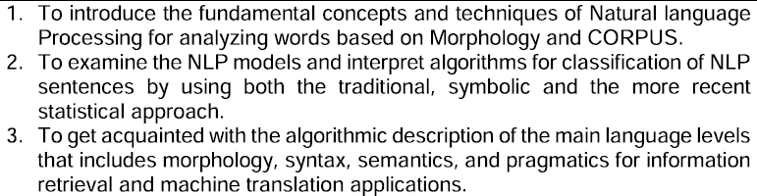
Course Objectives

Slide 6
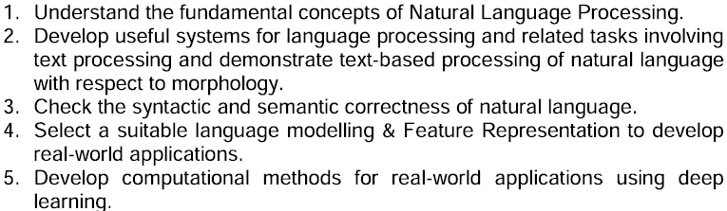
Expected Course Outcome

Slide 7
Assessment – Theory Component
2 Quizzes – no re-quiz will be conducted.
Continuous Assessment Test(s)
1 Digital Assignment

Slide 8
Assessment – Tentative Dates
Quiz 1 – between 09/09 and 15/09
Quiz II – between 20/10 and 25/10
Digital Assignment – will be announced during the lecture.
Exact time and mode for quizzes will be announced during the lecture hours in the class room.

Slide 9
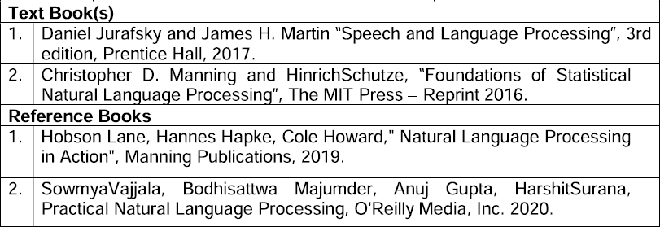
Books and References

Slide 10
Thanks Questions?

