Slide 1
Ambiguities in NLP

Slide 2
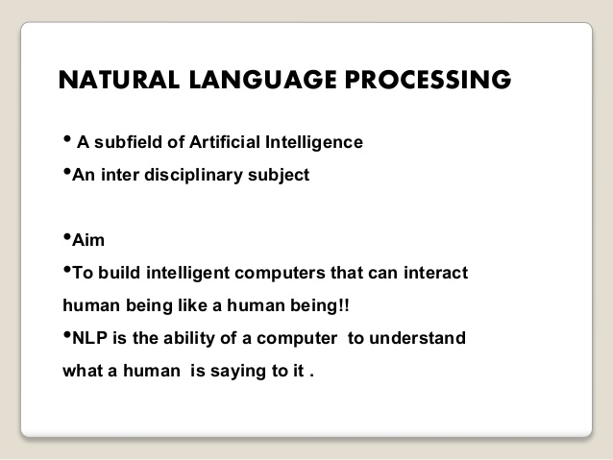

Slide 3
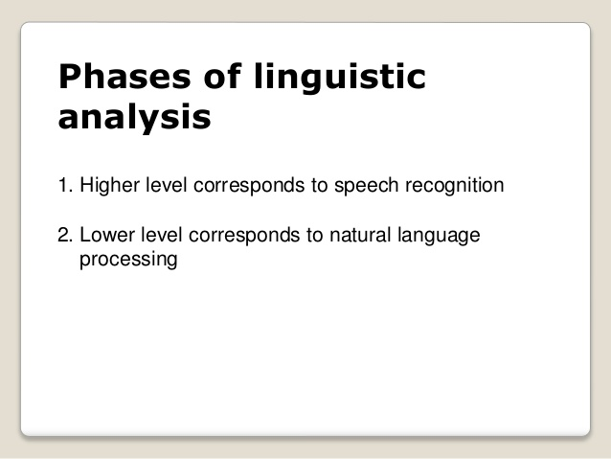

Slide 4
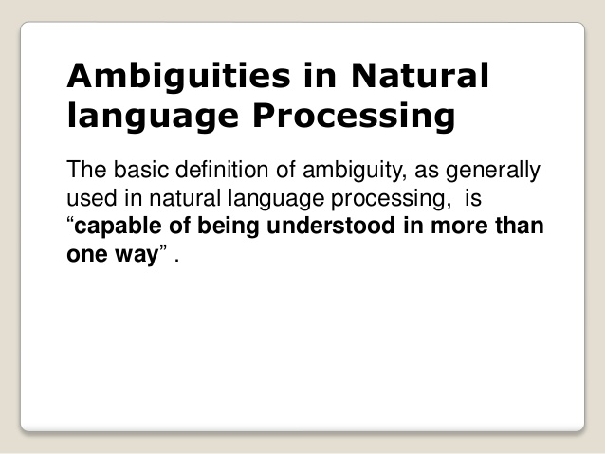

Slide 5
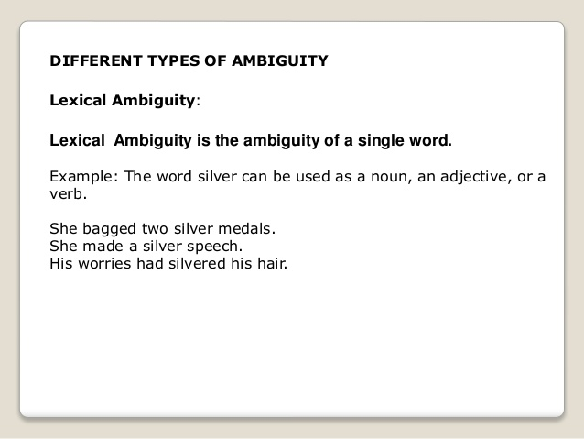

Slide 6
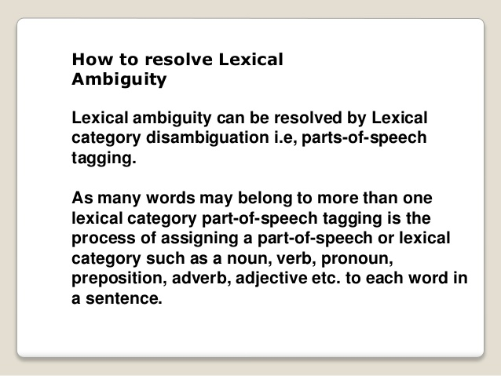

Slide 7
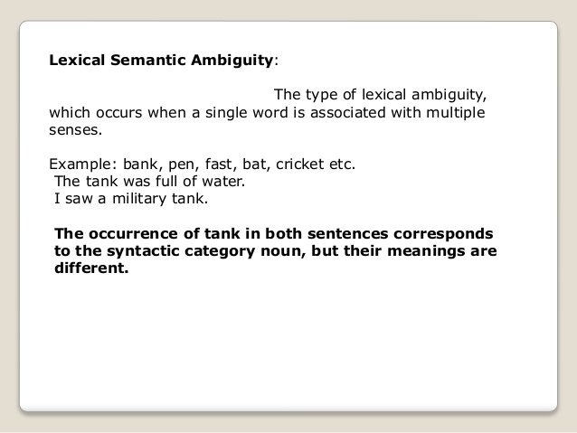

Slide 8
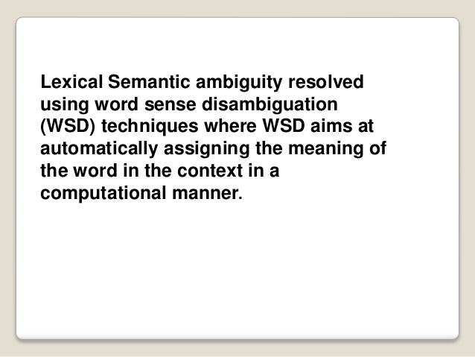

Slide 9
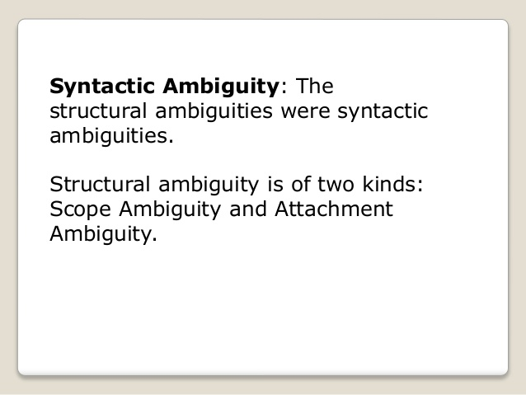

Slide 10
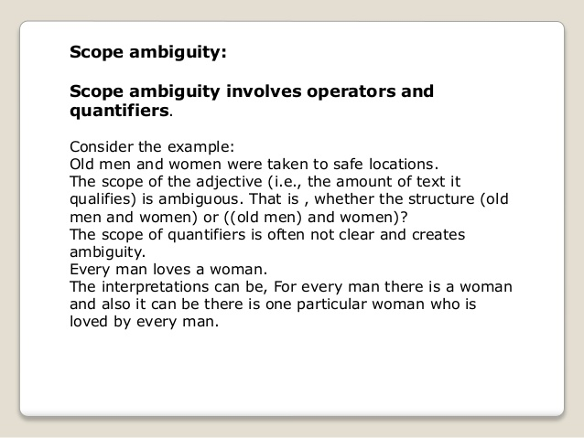

Slide 11
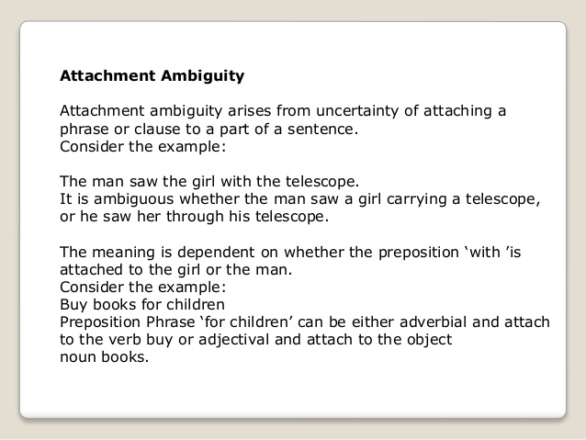

Slide 12
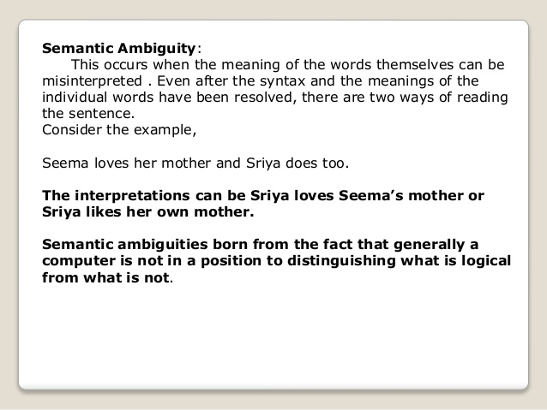

Slide 13
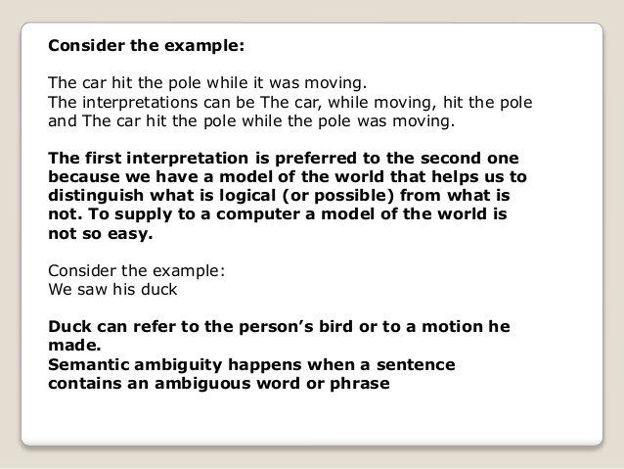

Slide 14
Resolve Ambiguities
We will introduce models and algorithms to resolve ambiguities at different levels.
part-of-speech tagging -- Deciding whether duck is verb or noun.
word-sense disambiguation -- Deciding whether make is create or cook. (Example)
lexical disambiguation -- Resolution of part-of-speech and word-sense ambiguities are two important kinds of lexical disambiguation.
syntactic ambiguity -- her duck is an example of syntactic ambiguity, and can be addressed by probabilistic parsing.

Slide 15
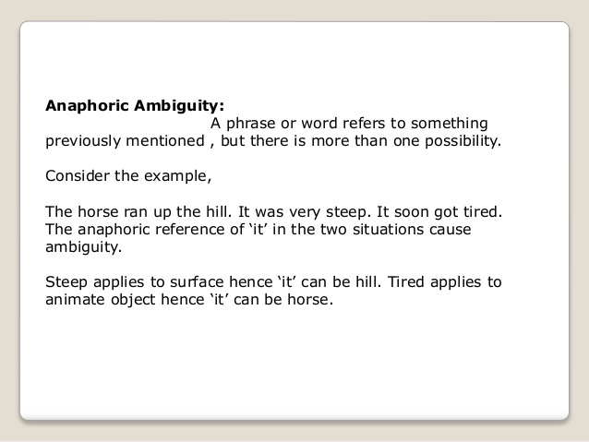
Pragmatic ambiguity

