Slide 1
NATURAL LANGUAGE PROCESSING
Dr.A.Kannan,
Professor

Slide 2
INTRODUCTION TO NLP
A natural language is a human spoken language, such as English.
One of the aims of AI is to build machines that can "understand" commands in natural language, written or spoken.
A computer that can do this requires very powerful hardware and sophisticated software.
At the present time, this is needed in web.

Slide 3
Introduction to NLP (cont)
It is not an easy task to teach a person or computer a natural language.
The main problems are syntax (the rules governing the way in which words are arranged), and understanding context to determine the meaning of a word.
To interpret even simple phrases requires a vast amount of knowledge.
The basic goal of Natural language Processing is to enable a person to communicate with a computer in a language that they use in their everyday life.

Slide 4
Natural Language and Computer
Natural language are those that we use for communicating with each other, eg. English, French, Japanese, etc.
Natural language are expressive and easy for us to use.
Computer languages are those that we use for controlling the operations of a computer, eg. Prolog, C, C++, Java, etc.
Computer languages are easy for a computer to understand, but they are not expressive.

Slide 5
Motivations for NLP
Traditional
➢ Intellectual challenge for AI
➢ Easier human-computer dialogue
Recent
➢ Information Revolution - Knowledge-Based Economy
➢ Information Highway, World Wide Web
➢ Globalization

Slide 6
NLP History
1950-60: Machine Translation
• Georgetown University MT Experiment (1952-54): Crude models of mainly
word-by-word translation with minimal syntactic analysis.
1960-70: Semantics-less
• String analysis models (1965) based on Chomsky's Transformational Grammar
• Natural Language Dialogue - ELIZA (Weizenbaum 1966): Keyword-based NL
conversation

Slide 7
NLP History (cont)
1970-80: AI takes the lead
• Development of NL-mediated “understanding systems”
• Augmented Transition Networks (Woods 1971) - A computationally feasible grammar
formalism with the power of transformational grammar. Used for LUNAR (Woods
197?): System able to answer NL questions about moon rock samples.
• SHRDLU (Winograd 1971): NL dialogue with a simulated robot operating in a simple
“blocks world". System able to act and plan as well as answer questions.
• MARGIE (Schank 1973): NL understanding by making inferences based on
conceptual knowledge.
1980-90: Grammar Formalisms
• Definite Clause Grammars (DCGs) - Parsing based on logic programming (Pereira
and Warren 1980).
• Unication and Constraint Based Grammar
• Dialogue Systems Use of planning models for both understanding (Perrault and
Cohen) and generation (Appelt 1985).

Slide 8

Major NLP Accomplishments
Chomsky (1957) Syntactic Structures
Weizenbaum (1966), ELIZA
Woods (1967), Procedural semantics
Thorne et al. and Woods (1968-70), ATNs
Winograd (1970), Shrdlu
Colby, Weber & Hilf, 1971; Colby, 1975, PARRY
Wilks (1972), Preference semantics
Woods et al. (1972), LSNLIS / Lunar
Charniak (1972), Frames and demons
Wilks (1973), Stanford machine translation project
Montague (1973) IL semantics (Montague Grammar) in PTQ
Grosz (1977), Focus in task-oriented dialogues
Marcus (1977), Deterministic parsing
Davey (1978)
Cohen, Phil (1979), Planning speech acts
Allen (1980), Understanding speech acts
McDonald (1980), MUMBLE
Heim/Kamp (1981) Discourse Representation Theory
McKeown (1982), TEXT
Appelt (1982), KAMP (Integration of Functional Grammar with Discourse Plans)
Shieber (1984) Noncontextfreeness of NL syntax proven
Pollack (1986), Plan inference
Mann & Thompson (1987), Rhetorical Structure Theory

Slide 9

Real World NLP Applications
Machine Translation
Information Retrieval / NL interface
Information Visualization
Autonomous interacting bots
Grammer Checking Systems
Speech Recognition Systems / Speech Synthesizers
Document Summary Systems

Slide 10

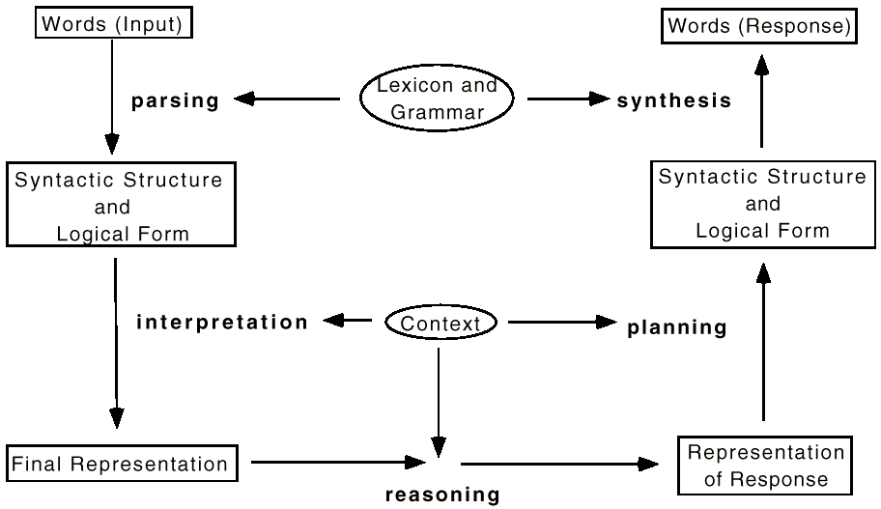
A Generic NL System Architecture

Slide 11
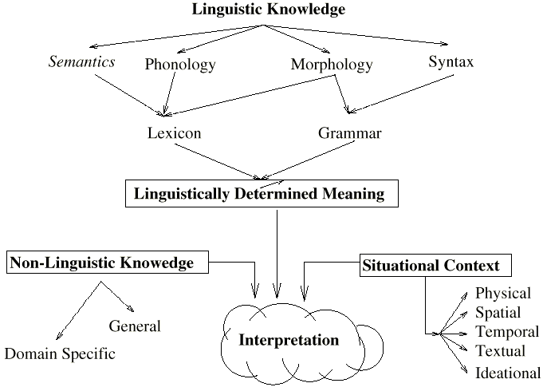
Language and Knowledge

Slide 12

Five Processing Stages in a NLP System
Phonological Analysis
Morphological Analysis
Syntactic Analysis
Semantic Analysis
Pragmatic Analysis

Slide 13

Five Processing Stages in a NLP System
(1) Phonological Analysis
Phonetics: deals with the physical building blocks of a language sound system.
eg. sounds of ‘k’, ‘t’ and ‘e’ in ‘kite’
Phonology: organisation of speech sounds within a language.
eg. (1) different ‘k’ sounds in ‘kite’ vs ‘coat’
(2) different ‘t’ and ‘p’ sounds in ‘top’ vs ‘pot’

Slide 14

Five Processing Stages in a NLP System
(2) Morphological Analysis
Morphology is the structure of words.
It is concerned with inflection¹.
It is also concerned with derivation of new words from existing ones, eg. lighthouse (formed from light & house).
In NLP, words are also known as lexicon items and a set of words form a lexicon.
¹ The various forms of the same basic word. eg. run-ran, dog-dogs, etc.

Slide 15
Five Processing Stages in a NLP System
(2) Morphological Analysis: Why is it important?
Any NL analysis system needs a lexicon {a module that tells what words there are and what properties they have.
Simplest model is a full form dictionary that lists every word explicitly.
Simply expanding the dictionary fails to take advantages of the regularities.
No dictionary contains all the words one is likely to encounter in real input.
- Languages with highly productive morphology (e.g.
Finnish, where a verb can have many thousands of forms.)
- Noun Compounding

Slide 16
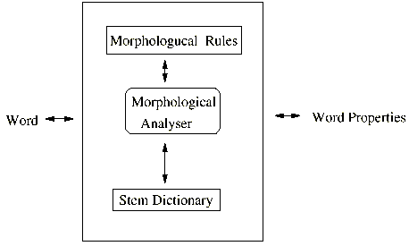
Five Processing Stages in a NLP System
(2) Morphological Analysis: The Lexicon
The black box behaviour of the lexicon is to relate words to different kinds of information, as shown by the outer square.
Full form lexicon.
Lexicon with morphological analysis.
The lexicon is a repository of all the exceptions in the language.
A lexicon is also as the dictionary

Slide 17

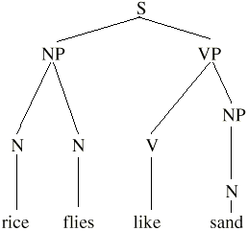
Five Processing Stages in a NLP System
(3) Syntactic Analysis
Syntactic analysis is concerned with the construction of sentences.
Syntactic structure indicates how the words are related to each other.
Syntax tree is assigned by a grammer and a lexicon.
Lexicon indicates syntactic category of words.
Grammar (typically Context Free Grammer) specifies legitimate concatenations of constituents.

Slide 18



Context Free Grammars
A context-free grammar (CFG) is a formal system that describes a language by specifying how any legal text can be derived from a distinguished symbol called the axiom, or sentence symbol.
It consists of a set of productions, each of which states that a given symbol can be replaced by a given sequence of symbols.
An alternative shorter explanation of CFG is that CFG specifies rewrite rules for how a symbol can be replaced by a series of symbols and words.
Parsing tries to determine how a sentence can be generated from a grammar.

Slide 19

Context Free Grammars
Components of a Natural Language: Types of Words
Content Words: Identifies a part
of the world
Nouns: person, place, or thing
(child, room, hammer)
Adjectives: properties of objects (tall, dark, pretty)
Verbs: actions, relationships
(edit, load, debug, link)
Adverbs: properties of verbs
(slowly, frequently, nally)
Function Words: Glues words,
phrases together
Determiners: indicate specific object (a, the, that)
Quantifiers: how many are identified (all, some, none)
Prepositions: relates phrases
(at, on, of, about)
Connectives: connect words, phrases (and, but, when)

Slide 20


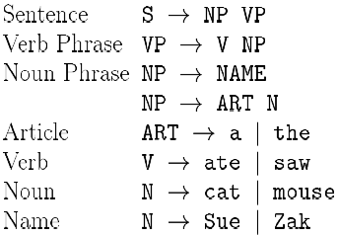
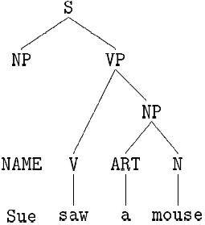
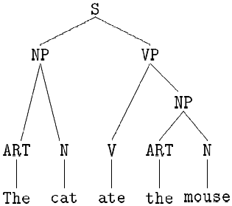
Context Free Grammars
SMC Example: Sue, mouse & the cat
Parse tree 1 (Parse tree is also known as derivation tree)
Parse tree 2

Slide 21

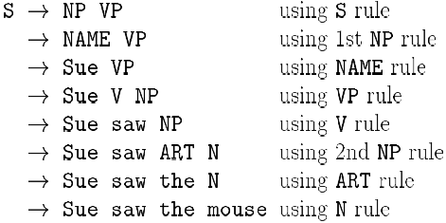
Context Free Grammars
SMC Example: Top-down parsing (A)
Top-down parsing starts with the S symbol and tries to rewrite it into the sentence.

Slide 22

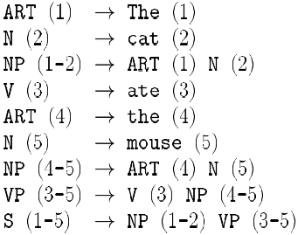
Context Free Grammars
SMC Example: Bottom-up parsing (A)
Bottom-up parsing starts with the words and tries to find symbols that generate them.

Slide 23
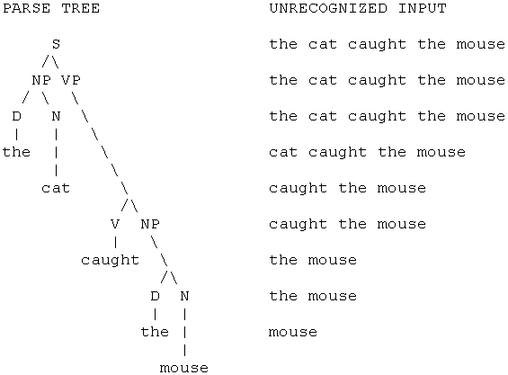
Context Free Grammars
SMC Example: Top-down parsing (B) - using parse tree

Slide 24
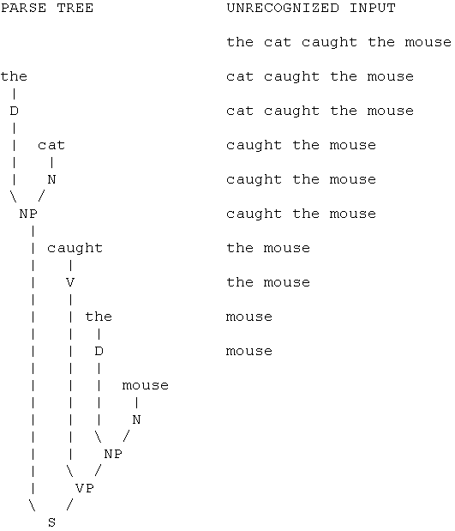
Context Free Grammars
SMC Example: Bottom-up parsing (B) - using parse tree

Slide 25

Five Processing Stages in a NLP System
(4) Semantic Analysis
Semantic analysis is concerned with the meaning of the language.
This stage uses the meanings of the word to extend and perhaps disambiguate the result returned by the syntactic parse.
The first step in any semantic processing system is to look up the individual words in a dictionary (or lexicon) and extract their meanings.
Unfortunately, many words have several meanings, for example, the word ‘diamond’ might have the following set of meanings:
(1) a geometrical shape with four equal sides.
(2) a baseball field
(3) an extremely hard and valuable gemstone
To select the correct meaning for the word ‘diamond’ in the sentence
Joan saw Susan’s diamond shimmering from across the room.
It is necessary to know that neither geometrical shapes nor baseball fields shimmer, whereas gemstones do (process of elimination).

Slide 26
Five Processing Stages in a NLP System
(4) Semantic Analysis (cont)
The process of determining the correct meaning of an individual word is call word sense disambiguation or lexical disambiguation.
It is done by associating, with each word in the lexicon, information about the contexts in which each of the word’s senses may appear.
Each of the words in a sentence can serve as part of the context in which the meanings of the other words must be determined.
eg. The baseball field interpretation of ‘diamond’ could be marked as a LOCATION. Then the meaning of ‘diamond’ in the sentences “I’ll meet you at the diamond” could easily be determined if the fact at requires a TIME or a LOCATION as its object were recorded as part of the lexical entry for at.

Slide 27
Five Processing Stages in a NLP System
(4) Semantic Analysis (cont)
Other useful semantic markers are
• PHYSICAL-OBJECT
• ANIMATE-OBJECT
• ABSTRACT-OBJECT
Using these markers, the correct meaning of ‘diamond’ in the sentence “I dropped my diamond” can be computed.
As part of the lexical entry, the verb ‘drop’ will specify that its object must be a PHYSICAL-OBJECT.
Unfortunately, to solve lexical disambiguation problem complete, it becomes necessary to introduce more and more finely grained semantic markers.

Slide 28
Five Processing Stages in a NLP System
(4) Semantic Analysis (cont)
Finally, we have to process the text at sentence level. There are four approaches to this.
First, semantic grammars which combine syntactic, semantic and pragmatic knowledge into a single set of rules in the form of a grammar.
Second, case grammar in which the structure that is built by the parser contains some semantic information, although further interpretation may also be necessary.
Third, conceptual parsing in which syntactic and semantic knowledge are combined into a single interpretation system that is driven by the semantic knowledge.
Lastly, approximately compositional semantic interpretation, in which semantic processing is applied to the result of performing a syntactic parse.
For details on each method, refer to Rich & Knight AI book, pg 400-414

Slide 29

Five Processing Stages in a NLP System
(5) Pragmatic Analysis
This is an additional stage of analysis concerned with the pragmatic use of the language.
This is important in the understanding of texts and dialogues.
There are many important relationships that may hold between phrases and parts of their discourse context, as outlined below.
Identical entities. Consider
- Bill had a red balloon.
- John wanted it.
The word ‘it’ should be identified as referring to the red balloon.
References such as this are call anaphoric or anaphora.

Slide 30
Five Processing Stages in a NLP System
(5) Pragmatic Analysis (cont)
Parts of entities. Consider the text
- Tracy opened the book she just bought.
- The title page was torn.
The phrase ‘the title page’ should be recognized as being part of the book tat was just bought.
Parts of action. Consider the text
- Lynn went on a business trip to New York.
- She left on an early morning flight.
Taking a flight should be recognized as part of going on a trip.
Entities involving in actions. Consider the text
- Hir house was broken into last week.
- They took the TV and the stereo.
The pronoun ‘they’ should be recognized as referring to the burglars who broke into the house.

Slide 31
Five Processing Stages in a NLP System
(5) Pragmatic Analysis (cont)
Elements of sets. Consider the text
- The stickers we have in stocks are stars, the moons, item and a flag.
- I’ll take two moons.
The moons in the 2nd sentences should be understood to be some of the moons mentioned in the 1st sentence.
Notice that to understand the 2nd sentence at all requires that we use the context of the first sentence to establish that the word ‘moons’ means moon stickers.
Names of individuals. Consider the text
- Dan went to the movies.
Dan should be understood to be some person named Dan. Although there are many, the speaker had one particular one in mind and the discourse context should tell us which.

Slide 32
Issues in Developing Natural Language Systems
Knowledge Representation (KR)
  Effective formalisms
  Rules
  Logic
  Semantic Nets
  Frames
  CD
  Scripts
Manipulation of Knowledge
  Retrieval, reasoning, and maintenance of Knowledge
  Powerful query / transaction languages
  Efficient query processing
  Powerful Query optimization
  Concurrency control, resiliency, etc.

Slide 33
Uncertainty: A Big Challenge
Future research in uncertainty is essential, as we learn not only to cope with data of limited reliability, but do so efficiently, with massive amounts of data
Intuitively, a piece of data is uncertain if its truth is not established definitely.
Logic database programming with its declarative and modular properties and its powerful Top-down and bottom-up query processing techniques recognized suitable for dealing with uncertainty.

Slide 34
Logics to Handle Uncertainty
Non monotonic Logic
Situational Logic
Modal Logic
Temporal Logic
Fuzzy Logic
Epistemic Logic

Slide 35
Logical Approach to Natural Language Queries
Predicate Logic to PROLOG
DATALOG
Lambda Calculus
LISP
DAPLEX

Slide 36
Natural Language DataBase Interfaces
Main components
Natural Language
Question
Answer
Meaning
Representation
Database
Query
DBMS
Analysis
Translation
Linguistic
Knowledge
Translation
Knowledge
Notes:
As all of you know, NLDBI is a system that allows users to access database data in NLs.
In this interface, a user’s NL question is analyzed into meaning representation using LK.
Then, it is translated into a formal database query based on TK, and finally this is sent to DBMS to produce an answer.
In this study, I will focus on this part, translation module and TK.
Generally, TK describes correspondences between NL constructions and target DB structures.

Slide 37
Research issues
Morphological Analysis
Syntax Analysis
Semantic Analysis
Previous Queries
Logical Form
Target Query Language

Slide 38
Sample Queries
What is the salary paid to the employee after 2000?
  WHAT – WH question type
  IS – Verb present tense
  THE - Determiner
  PAID – Second verb, past tense
  TO – Preposistion
  EACH - Quantifier
  AFTER – Temporal Operator
  2000 – Time.

Slide 39
Conversion of Natural Language Queries
What is the average marks of Baskaran from 2002 to 2003.
  SELECT AVG (MARKS)
  FROM STUDENT
  WHERE NAME = ‘BASKARAN’
  WHEN TIME DURING 1.1.2002 and 31.12.2003

Slide 40
Conversion of Natural Language Queries
How Many Elective subjects where taken by ANAND after 2001?
  SELECT COUNT (*)
  FROM STUDENT
  WHERE SUBJECT-TYPE = ‘E’
  AND NAME = ‘ANAND’
  WHEN VALID TIME AFTER 2001.

Slide 41
CONCLUSION
Natural Language Processing
  Lexical Analysis
  Syntax Analysis
  Logical Form generation
Database features
Query Language
Query Processing Techniques

Slide 42
THANK YOU

