Slide 1
Basic Text Processing
Regular Expressions

Slide 2
2.1 Regular Expressions
In computer science, RE is a language used for specifying text search string.
A regular expression is a formula in a special language that is used for specifying a simple class of string.
Formally, a regular expression is an algebraic notation for characterizing a set of strings.
RE search requires
a pattern that we want to search for, and
a corpus of texts to search through.

Slide 3
2.1 Regular Expressions
A RE search function will search through the corpus returning all texts that contain the pattern.
In a Web search engine, they might be the entire documents or Web pages.
In a word-processor, they might be individual words, or lines of a document. (We take this paradigm.)
E.g., the UNIX grep command

Slide 4
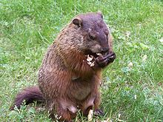
Regular expressions
A formal language for specifying text strings
How can we search for any of these?
woodchuck
woodchucks
Woodchuck
Woodchucks

Slide 5
Regular Expressions: Disjunctions
Letters inside square brackets []
Ranges [A-Z]
Pattern | Matches
[wW]oodchuck | Woodchuck, woodchuck
[1234567890] | Any digit
Pattern | Matches
[A-Z] | An upper case letter | Drenched Blossoms
[a-z] | A lower case letter | my beans were impatient
[0-9] | A single digit | Chapter 1: Down the Rabbit Hole

Slide 6
Regular Expressions: Negation in Disjunction
Negations [^Ss]
Carat means negation only when first in []
Pattern | Matches
[^A-Z] | Not an upper case letter | Oyfn pripetchik
[^Ss] | Neither ‘S’ nor ‘s’ | I have no exquisite reason”
[^e^] | Neither e nor ^ | Look here
a^b | The pattern a carat b | Look up a^b now

Slide 7
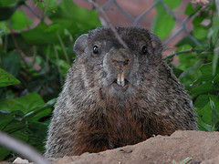
Regular Expressions: More Disjunction
Woodchucks is another name for groundhog!
The pipe | for disjunction
Pattern | Matches
groundhog|woodchuck
yours|mine | yours mine
a|b|c | = [abc]
[gG]roundhog|[Ww]oodchuck
Photo D. Fletcher

Slide 8
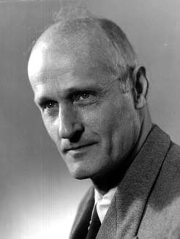
Regular Expressions: ? * + .
Pattern | Matches
colou?r | Optional previous char | color colour
oo*h! | 0 or more of previous char | oh! ooh! oooh! ooooh!
o+h! | 1 or more of previous char | oh! ooh! oooh! ooooh!
baa+ |  | baa baaa baaaa baaaaa
beg.n |  | begin begun begun beg3n
Stephen C Kleene
Kleene *, Kleene +

Slide 9
Regular Expressions: Anchors ^ $
Pattern | Matches
^[A-Z] | Palo Alto
^[^A-Za-z] | 1 “Hello”
\.$ | The end.
.$ | The end? The end!

Slide 10
Example
Find me all instances of the word “the” in a text.
the
Misses capitalized examples
[tT]he
Incorrectly returns other or theology
[^a-zA-Z][tT]he[^a-zA-Z]

Slide 11
2.1 Regular Expressions A Simple Example
To find the English article the
/the/
/[tT]he/
/\b[tT]he\b/
/[^a-zA-Z][tT]he[^a-zA-Z]/
/^|[^a-zA-Z][tT]he[^a-zA-Z]/

Slide 12
2.1 Regular Expressions A More Complex Example
“any PC with more than 500 MHz and 32 Gb of disk space for less than $1000”
/$[0-9]+/
/$[0-9]+\.[0-9][0-9]/
/\b$[0-9]+(\.[0-9][0-9])?\b/
/\b[0-9]+ *(MHz|[Mm]egahertz|GHz|[Gg]igahertz)\b/
/\b[0-9]+ *(Mb|[Mm]egabytes?)\b/
/\b[0-9](\.[0-9]+)? *(Gb|[Gg]igabytes?)\b/
/\b(Win95|Win98|WinNT|Windows *(NT|95|98|2000)?)\b/
/\b(Mac|Macintosh|Apple)\b/

Slide 13
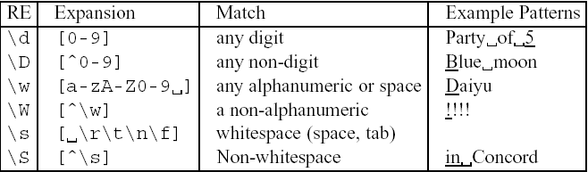
2.1 Regular Expressions Advanced Operators
Aliases for common sets of characters

Slide 14
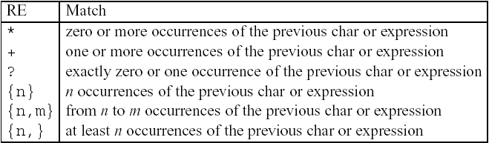
2.1 Regular Expressions Advanced Operators
Regular expression operators for counting

Slide 15
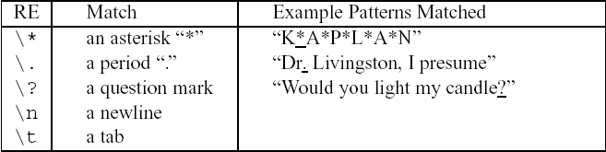
2.1 Regular Expressions Advanced Operators
Some characters that need to be backslashed

Slide 16
2.1 Regular Expressions Regular Expression Substitution, Memory, and ELIZA
s/regexp1/regexp2/
E.g. the 35 boxes → the <35> boxes
s/([0-9]+)/<\1>/
The following pattern matches “The bigger they were, the bigger they will be”, not “The bigger they were, the faster they will be”
/the (.*)er they were, the\1er they will be/
The following pattern matches “The bigger they were, the bigger they were”, not “The bigger they were, the bigger they will be”
/the (.*)er they (.*), the\1er they \2/
registers

Slide 17
2.1 Regular Expressions Regular Expressions Substitution, Memory, and ELIZA
Eliza worked by having a cascade of regular expression substitutions that each match some part of the input lines and changed them
my → YOUR, I’m → YOU ARE …
s/.* YOU ARE (depressed|sad) .*/I AM SORRY TO HEAR YOU ARE \1/
s/.* YOU ARE (depressed|sad) .*/WHY DO YOU THINK YOU ARE \1/
s/.* all .*/IN WHAT WAY/
s/.* always .*/CAN YOU THINK OF A SPECIFIC EXAMPLE/
User₁: Men are all alike.
ELIZA₁: IN WHAT WAY
User₂: They’re always bugging us about something or other.
ELIZA₂: CAN YOU THINK OF A SPECIFIC EXAMPLE
User₃: Well, my boyfriend made me come here.
ELIZA₃: YOUR BOYBRIEND MADE YOU COME HERE
User₄: He says I’m depressed much of the time.
ELIZA₄: I AM SORRY TO HEAR YOU ARE DEPRESSED

Slide 18
Errors
The process we just went through was based on fixing two kinds of errors
Matching strings that we should not have matched (there, then, other)
False positives (Type I)
Not matching things that we should have matched (The)
False negatives (Type II)

Slide 19
Errors cont.
In NLP we are always dealing with these kinds of errors.
Reducing the error rate for an application often involves two antagonistic efforts:
Increasing accuracy or precision (minimizing false positives)
Increasing coverage or recall (minimizing false negatives).

Slide 20
Summary
Regular expressions play a surprisingly large role
Sophisticated sequences of regular expressions are often the first model for any text processing text
For many hard tasks, we use machine learning classifiers
But regular expressions are used as features in the classifiers
Can be very useful in capturing generalizations

Slide 21
Basic Text Processing
Regular Expressions

Slide 22
Basic Text Processing
Word tokenization

Slide 23
Text Normalization
Every NLP task needs to do text normalization:
Segmenting/tokenizing words in running text
Normalizing word formats
Segmenting sentences in running text

Slide 24
How many words?
I do uh main- mainly business data processing
Fragments, filled pauses
Seuss’s cat in the hat is different from other cats!
Lemma: same stem, part of speech, rough word sense
cat and cats = same lemma
Wordform: the full inflected surface form
cat and cats = different wordforms

Slide 25
How many words?
they lay back on the San Francisco grass and looked at the stars and their
Type: an element of the vocabulary.
Token: an instance of that type in running text.
How many?
15 tokens (or 14)
13 types (or 12) (or 11?)

Slide 26
How many words?
N = number of tokens
V = vocabulary = set of types
|V| is the size of the vocabulary
Church and Gale (1990): |V| > O(N^{½})
 | Tokens = N | Types = |V|
Switchboard phone conversations | 2.4 million | 20 thousand
Shakespeare | 884,000 | 31 thousand
Google N-grams | 1 trillion | 13 million

Slide 27
Simple Tokenization in UNIX
(Inspired by Ken Church’s UNIX for Poets.)
Given a text file, output the word tokens and their frequencies
tr -sc ’A-Za-z’ ’\n’ < shakes.txt
| sort
| uniq –c
1945 A
72 AARON
19 ABBESS
5 ABBOT
... ...
Change all non-alpha to newlines
Sort in alphabetical order
Merge and count each type
25 Aaron
6 Abate
1 Abates
5 Abbess
6 Abbey
3 Abbot
.... …

Slide 28
The first step: tokenizing
tr -sc ’A-Za-z’ ’\n’ < shakes.txt | head
THE
SONNETS
by
William
Shakespeare
From
fairest
creatures
We
...

Slide 29
The second step: sorting
tr -sc ’A-Za-z’ ’\n’ < shakes.txt | sort | head
A
A
A
A
A
A
A
A
A
...

Slide 30
More counting
Merging upper and lower case
tr ‘A-Z’ ‘a-z’ < shakes.txt | tr –sc ‘A-Za-z’ ‘\n’ | sort | uniq –c
Sorting the counts
tr ‘A-Z’ ‘a-z’ < shakes.txt | tr –sc ‘A-Za-z’ ‘\n’ | sort | uniq –c | sort –n –r
23243 the
22225 i
18618 and
16339 to
15687 of
12780 a
12163 you
10839 my
10005 in
8954 d
What happened here?

Slide 31
Issues in Tokenization
Finland’s capital → Finland Finlands Finland’s ?
what’re, I’m, isn’t → What are, I am, is not
Hewlett-Packard → Hewlett Packard ?
state-of-the-art → state of the art ?
Lowercase → lower-case lowercase lower case ?
San Francisco → one token or two?
m.p.h., PhD. → ??

Slide 32
Tokenization: language issues
French
L'ensemble → one token or two?
L ? L’ ? Le ?
Want l’ensemble to match with un ensemble
German noun compounds are not segmented
Lebensversicherungsgesellschaftsangestellter
‘life insurance company employee’
German information retrieval needs compound splitter

Slide 33
Tokenization: language issues
Chinese and Japanese no spaces between words:
莎拉波娃现在居住在美国东南部的佛罗里达。
莎拉波娃 现在 居住 在 美国 东南部 的 佛罗里达
Sharapova now lives in US southeastern Florida
Further complicated in Japanese, with multiple alphabets intermingled
Dates/amounts in multiple formats
フォーチュン500社は情報不足のため時間あた$500K(約6,000万円)
Katakana
Hiragana
Kanji
Romaji
End-user can express query entirely in hiragana!

Slide 34
Word Tokenization in Chinese
Also called Word Segmentation
Chinese words are composed of characters
Characters are generally 1 syllable and 1 morpheme.
Average word is 2.4 characters long.
Standard baseline segmentation algorithm:
Maximum Matching (also called Greedy)

Slide 35
Maximum Matching Word Segmentation Algorithm
Given a wordlist of Chinese, and a string.
Start a pointer at the beginning of the string
Find the longest word in dictionary that matches the string starting at pointer
Move the pointer over the word in string
Go to 2

Slide 36
Max-match segmentation illustration
Thecatinthehat
Thetabledownthere
Doesn’t generally work in English!
But works astonishingly well in Chinese
莎拉波娃现在居住在美国东南部的佛罗里达。
莎拉波娃 现在 居住 在 美国 东南部 的 佛罗里达
Modern probabilistic segmentation algorithms even better
the cat in the hat
the table down there
theta bled own there

Slide 37
Basic Text Processing
Word tokenization

Slide 38
Basic Text Processing
Word Normalization and Stemming

Slide 39
Normalization
Need to “normalize” terms
Information Retrieval: indexed text & query terms must have same form.
We want to match U.S.A. and USA
We implicitly define equivalence classes of terms
e.g., deleting periods in a term
Alternative: asymmetric expansion:
Enter: window Search: window, windows
Enter: windows Search: Windows, windows, window
Enter: Windows Search: Windows
Potentially more powerful, but less efficient

Slide 40
Case folding
Applications like IR: reduce all letters to lower case
Since users tend to use lower case
Possible exception: upper case in mid-sentence?
e.g., General Motors
Fed vs. fed
SAIL vs. sail
For sentiment analysis, MT, Information extraction
Case is helpful (US versus us is important)

Slide 41
Lemmatization
Reduce inflections or variant forms to base form
am, are, is → be
car, cars, car's, cars' → car
the boy's cars are different colors → the boy car be different color
Lemmatization: have to find correct dictionary headword form
Machine translation
Spanish quiero (‘I want’), quieres (‘you want’) same lemma as querer ‘want’

Slide 42
Morphology
Morphemes:
The small meaningful units that make up words
Stems: The core meaning-bearing units
Affixes: Bits and pieces that adhere to stems
Often with grammatical functions

Slide 43
Stemming
Reduce terms to their stems in information retrieval
Stemming is crude chopping of affixes
language dependent
e.g., automate(s), automatic, automation all reduced to automat.
for example compressed
and compression are both
accepted as equivalent to
compress.
for exampl compress and
compress ar both accept
as equival to compress

Slide 44
Porter’s algorithm The most common English stemmer
Step 1a
sses → ss caresses → caress
ies → i ponies → poni
ss → ss caress → caress
s → ø cats → cat
Step 1b
(*v*)ing → ø walking → walk
sing → sing
(*v*)ed → ø plastered → plaster
…
Step 2 (for long stems)
ational→ ate relational→ relate
izer→ ize digitizer → digitize
ator→ ate operator → operate
…
Step 3 (for longer stems)
al → ø revival → reviv
able → ø adjustable → adjust
ate → ø activate → activ
…

Slide 45
Viewing morphology in a corpus Why only strip –ing if there is a vowel?
(*v*)ing → ø walking → walk
sing → sing

Slide 46
Viewing morphology in a corpus Why only strip –ing if there is a vowel?
(*v*)ing → ø walking → walk
sing → sing
tr -sc 'A-Za-z' '\n' < shakes.txt | grep ’ing$' | sort | uniq -c | sort –nr
tr -sc 'A-Za-z' '\n' < shakes.txt | grep '[aeiou].*ing$' | sort | uniq -c | sort –nr
1312 King
548 being
541 nothing
388 king
375 bring
358 thing
307 ring
152 something
145 coming
130 morning
548 being
541 nothing
152 something
145 coming
130 morning
122 having
120 living
117 loving
116 Being
102 going

Slide 47
Dealing with complex morphology is sometimes necessary
Some languages requires complex morpheme segmentation
Turkish
Uygarlastiramadiklarimizdanmissinizcasina
`(behaving) as if you are among those whom we could not civilize’
Uygar `civilized’ + las `become’
+ tir `cause’ + ama `not able’
+ dik `past’ + lar ‘plural’
+ imiz ‘p1pl’ + dan ‘abl’
+ mis ‘past’ + siniz ‘2pl’ + casina ‘as if’

Slide 48
Basic Text Processing
Word Normalization and Stemming

Slide 49
Basic Text Processing
Sentence Segmentation and Decision Trees

Slide 50
Sentence Segmentation
!, ? are relatively unambiguous
Period “.” is quite ambiguous
Sentence boundary
Abbreviations like Inc. or Dr.
Numbers like .02% or 4.3
Build a binary classifier
Looks at a “.”
Decides EndOfSentence/NotEndOfSentence
Classifiers: hand-written rules, regular expressions, or machine-learning

Slide 51
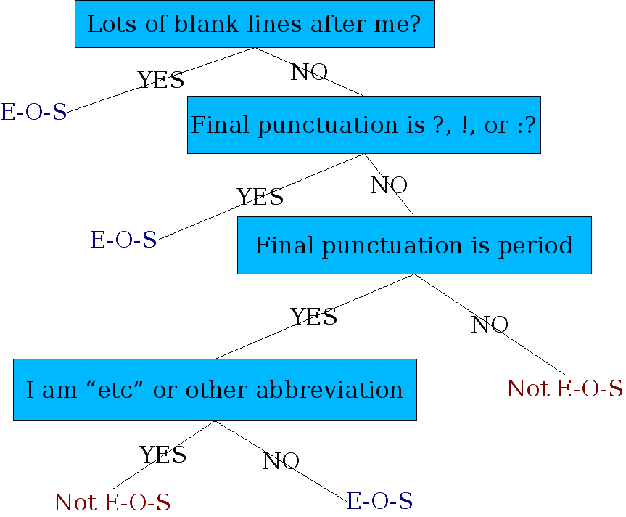
Determining if a word is end-of-sentence: a Decision Tree

Slide 52
More sophisticated decision tree features
Case of word with “.”: Upper, Lower, Cap, Number
Case of word after “.”: Upper, Lower, Cap, Number
Numeric features
Length of word with “.”
Probability(word with “.” occurs at end-of-s)
Probability(word after “.” occurs at beginning-of-s)

Slide 53
Implementing Decision Trees
A decision tree is just an if-then-else statement
The interesting research is choosing the features
Setting up the structure is often too hard to do by hand
Hand-building only possible for very simple features, domains
For numeric features, it’s too hard to pick each threshold
Instead, structure usually learned by machine learning from a training corpus

Slide 54
Decision Trees and other classifiers
We can think of the questions in a decision tree
As features that could be exploited by any kind of classifier
Logistic regression
SVM
Neural Nets
etc.

Slide 55
Basic Text Processing
Sentence Segmentation and Decision Trees

