Slide 1
Tokenization and Sentence Segmentation
Prof. Saravanakumar K

Slide 2
Tokenization
Tokenization in artificial languages – well studied one
Why? No structural and lexical ambiguities
Space delimited languages
Unsegmented languages

Slide 3
Tokenization in space delimited languages
Eg. European languages
Words are separated by whitespace
Yet we have tokenization ambiguity in use of punctuation marks.
Eg. periods, commas, quotation marks, apostrophes, and hyphens

Slide 4
Tokenization in space delimited languages
Example – Extracted from Wall Street Journal (1988)
Clairson International Corp. said it expects to report a net loss for its second quarter ended March 26 and doesn’t expect to meet analysts’ profit estimates of $3.9 to $4 million, or 76 cents a share to 79 cents a share, for its year ending Sept. 24.
Observation 1 – uses period in three different ways
within numbers as a decimal point ($3.9),
to mark abbreviations (Corp. and Sept.), and
to mark the end of the sentence
Knowledge required - The tokenizer must be aware of the uses of punctuation marks.

Slide 5
Tokenization in space delimited languages
Example – Extracted from Wall Street Journal (1988)
Clairson International Corp. said it expects to report a net loss for its second quarter ended March 26 and doesn’t expect to meet analysts’ profit estimates of $3.9 to $4 million, or 76 cents a share to 79 cents a share, for its year ending Sept. 24.
Observation 2 – uses apostrophes in two different ways
to denote the possession (analysts’), and
to show contractions (doesn’t)
Knowledge required - The tokenizer must be aware of the uses of punctuation marks.

Slide 6
Tokenization in space delimited languages
Other observations
76 cents a share
Has four tokens
Semantically equal to 76-cents-a-share (hyphenated – orthographically different)
Other Semantic equivalents:
$3.9 to $4 million is same as 3.9 to 4 million dollars same as $3,900,000 to $4,000,000

Slide 7
1.1 Tokenizing Punctuation
Punctuation characters are treated as separate tokens – usually
Sometimes they must be attached to another token
Varies from language to language

Slide 8
1.1 Tokenizing Punctuation in English Period
Abbreviations
Single period marks for both abbreviation and Sentence Boundary
An abbreviation can stand for different words – St. for Saint, Street, State…
(1) The contemporary viewer may simply wonder at the vast wooded vistas rising up from the Saguenay River and Lac St. Jean, standing in for the St. Lawrence River.
(2)The ﬁrm said it plans to sublease its current headquarters at 55 Water St. A spokesman declined to elaborate.

Slide 9
1.1 Tokenizing Punctuation in English QUOTATION MARKS & APOSTROPHES
A major source of tokenization ambiguity
Indicate quoted passage (Ambiguity: Open or Close)
Sometimes, Single Quote and Apostrophe are same!!
Ambiguities of Apostrophe
Genetive case of noun – Eg. Peters Kopf or Peter’s Kopf; Peter’s home or Peters home
Contractions (Soln: Expand the word – but, language knowledge is reqd.) - he‘s, she’s, it’s
Plural forms :
1980’s, ID’s
In these cases tokenization is context dependent and closely tied to syntactic analysis

Slide 10
1.2 Tokenising Multi-Part Words
Compound words are hyphenated (as in English or not as in German)
Nachkriegszeit (postwar period); Nichtraucher (nonsmoker)
Single token words - end-of-line
Multi-token words – Delhi-based
Hyphen usage varies greatly
French - va-t-il (will it?); c’est-à-dire (that is to say)
-contractions should be expanded
End of line hyphens to mark continuity

Slide 11
1.3 Tokenising Multi-Word Expressions
In spite of => Despite (One Word meaning)
Loaned words – au pair, de facto => one word
Dates : November 18, 1989 same as Nov. 18, 1989, 18 November 1989, 11/18/89 or 18/11/89.
Numbers are ubiquitous but representations are different!!
March 26
$3.9 to $4 million
Sept. 24
SINGLE TOKENS
Tokenising requires the knowledge of number representations

Slide 12
2 Tokenisation in Unsegmented Languages
CJK
Thai
No spaces between words
Common Approaches:
Extensive Word List
But no widely accepted guideline to DEFINE A WORD!!

Slide 13
2 Common Word Segmentation Algorithm
Each character is a distinct word
But does not help in parsing; POS tagging; text-to-speech system
Thus hurts performance!!
Greedy Approach – Maximum Matching Algorithm
Starts with first character
Searches for the longest word in list starting with this character
If match is found,
boundary is marked
Else
Character is treated as word

Slide 14
2 Common Word Segmentation Algorithm -2
Try applying in English ☺
thetabledownthere – remove space from the table down there
Greedy algorithm will first find ‘theta’ longest word starting at t in the given sequence
Continuing in this manner, we will get:
theta bled own there
☹ !!!

Slide 15
2 Common Word Segmentation Algorithm -3
Variant of Greedy Algorithm:
Matching proceeds from the end of the string of characters
With this we will get the table down there correctly!!! ☺
Forward-Backward Matching
Results are compared
Optimised Segmentation occurs
Language-specific heuristics are used later

Slide 16
2.1 Chinese Segmentation
Hanzi – Several Thousands of Characters
Approaches:
Statistical – use mutual information between characters from a corpus
Lexical rule-based – syntax; semantics; morphological rules
Hybrid - combination; weighted Finite State Transducer to identify dictionary entries

Slide 17
2.2 Japanese Segmentation
Alphabetic – Syllabic – Logographic
Kanji
Hiragana
Katakana
Romanji
Challenges:
Identifying the base
Mix of writing systems may be used
Approaches:
Statistical techniques of Chinese apply

Slide 18
2.3 Unsegmented Alphabetic - Syllabic Languages
Thai
Balinese
Javanese
Khmer
Approaches:
Maximum matching
Broken to syllables – trained syllable collocation is used
Features:
Fewer characters
Longer words

Slide 19
3 Sentence Segmentation
Different Punctuation Marks
Disambiguating all instances of punctuations may help
Thai – no use of period; but a space ; which can be mixed with carriage return
Spaces are used in place of commas to mark clauses
. ! ? Are used to mark sentence boundaries, but they can occur with in a sentence and should be disambiguated…

Slide 20
Sentence Segmentation
Sentences in most written languages are delimited by punctuation marks, yet the specific usage rules for punctuation are not always coherently defined.

Slide 21
Sentence Segmentation
Sentence delimiters are (!, ?) are relatively unambiguous
Period “.” is quite ambiguous
Sentence boundary
In most NLP applications, the only sentence boundary punctuation marks considered are the period, question mark, and exclamation point, and the definition of sentence is limited to the text sentence which begins with a capital letter and ends in a full stop.
Abbreviations like Inc. or Dr.
Numbers like .02% or 4.3

Slide 22
Sentence segmentation
Consider Examples, two English sentences that convey exactly the same meaning; yet, by the traditional definitions,
the first would be classified as two sentences, the second as just one. The semicolon in Example could likewise be replaced by a comma or a dash, retain the same meaning, but still be considered a single sentence.
Here is a sentence. Here is another.
Here is a sentence; here is another.

Slide 23
Sentence segmentation
A sentence from Lewis Carroll’s Alice in Wonderland
There was nothing so VERY remarkable in that; nor did Alice think it so VERY much out of the way to hear the Rabbit say to itself, ‘Oh dear! Oh dear! I shall be late!’ (when she thought it over afterwards, it occurred to her that she ought to have wondered at this, but at the time it all seemed quite natural); but when the Rabbit actually TOOK AWATCHOUT OF ITS WAISTCOATPOCKET, and looked at it, and then hurried on, Alice started to her feet, for it flashed across her mind that she had never before seen a rabbit with either a waistcoat-pocket, or a watch to take out of it, and burning with curiosity, she ran across the field after it, and fortunately was just in time to see it pop down a large rabbit-hole under the hedge.
Parsers consistently have difficulty with sentences longer than 15–25 words

Slide 24
Sentence segmentation
Finding from the previous example sentence
True sentence segmentation can be achieved by integrating the segmentation process with parsing.
Still open for research

Slide 25
Sentence segmentation – contribution of context
Contextual factors that are helping in disambiguating punctuations;
Case distinctions
Part of speech
Wordlength
Lexical endings
Prefixes and suffixes
Abbreviation classes
Internal punctuation
Proper nouns

Slide 26
Sentence Segmentation
Build a binary classifier
Looks at a “.”
Decides EndOfSentence/NotEndOfSentence
Classifiers: hand-written rules, regular expressions, or machine-learning

Slide 27
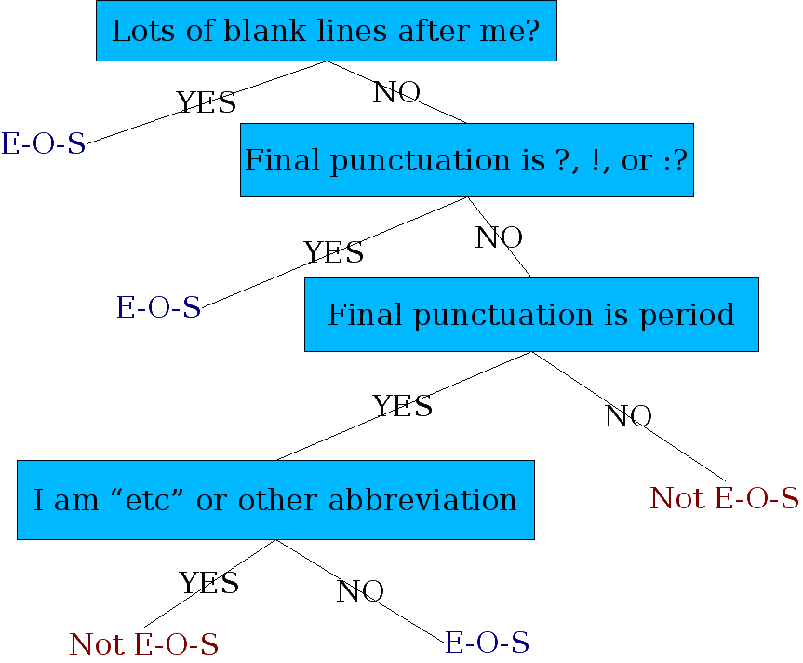
Determining if a word is end-of-sentence: a Decision Tree

