Slide 1
Morphology
Morphology is the study of the way words are built from smaller meaningful units called morphemes.
We can divide morphemes into two broad classes.
  Stems – the core meaningful units, the root of the word.
  Affixes – add additional meanings and grammatical functions to words.
Affixes are further divided into:
  Prefixes – precede the stem: do / undo
  Suffixes – follow the stem: eat / eats
  Infixes – are inserted inside the stem
  Circumfixes – precede and follow the stem
English doesn’t stack more affixes.
But Turkish can have words with a lot of suffixes.
Languages, such as Turkish, tend to string affixes together are called agglutinative languages.
BİL711 Natural Language Processing

Slide 2
Surface and Lexical Forms
The surface level of a word represents the actual spelling
of that word.
  geliyorum eats cats kitabım
The lexical level of a word represents a simple concatenation
of morphemes making up that word.
  gel +PROG +1SG
  eat +AOR
  cat +PLU
  kitap +P1SG
Morphological processors try to find correspondences between lexical and surface forms of words.
  Morphological recognition – surface to lexical
  Morphological generation – lexical to surface
BİL711 Natural Language Processing

Slide 3
Inflectional and Derivational Morphology
There are two broad classes of morphology:
  Inflectional morphology
  Derivational morphology
After a combination with an inflectional morpheme,
the meaning and class of the actual stem usually do not change.
  eat / eats pencil / pencils
  gel / geliyorum masa / masam
After a combination with an derivational morpheme, the meaning and the class of the actual stem usually change.
  compute / computer do / undo friend / friendly
  Uygar / uygarlaş kapı / kapıcı
The irregular changes may happen with derivational affixes.
BİL711 Natural Language Processing

Slide 4
English Inflectional Morphology
Nouns have simple inflectional morphology.
  plural -- cat / cats
  possessive -- John / John’s
Verbs have slightly more complex inflectional, but still relatively simple inflectional morphology.
  past form -- walk / walked
  past participle form -- walk / walked
  gerund -- walk / walking
  singular third person -- walk / walks
Verbs can be categorized as:
  main verbs
  modal verbs -- can, will, should
  primary verbs -- be, have, do
Regular and irregular verbs: walk / walked -- go / went
BİL711 Natural Language Processing

Slide 5
English Derivational Morphology
Some English derivational affixes
  -ation : transport / transportation
  -er : kill / killer
  -ness : fuzzy / fuzziness
  -al : computation / computational
  -able : break / breakable
  -less : help / helpless
  un : do / undo
  re : try / retry
BİL711 Natural Language Processing

Slide 6
Turkish Inflectional Morphology
Some of inflectional suffixes that Turkish nouns can have:
  singular/plural : masa / masalar
  possessive markers : masam / masan / masası / masamız / masanız / masaları
  case markers :
    ablative : masadan
    accusative : masayı
    dative : masaya
Some of inflectional suffixes that Turkish verbs can have:
  tense : gel / geldi / geliyor / gelmiş / gelecek
  second tense : geliyordu / gelmişti / gelecekti
  agreement marker : geldim / geldin / geldi / geldik / geldiniz / geldiler
There are order among inflectional suffixes (morphotactics )
  masalarımdan -- masa +PLU +P1SG +ABL
  geliyordum -- gel +PROG +PAST +1SG
BİL711 Natural Language Processing

Slide 7
Turkish Derivational Morphology
Turkish derivational morphology is very rich. Some of derivational suffixes in Turkish:
  -cı : kapı / kapıcı
  -laş : uygar / uygarlaş
  -mek : gel / gelmek
  -cik : mini / minicik
  -li : Ankara / Ankaralı
BİL711 Natural Language Processing

Slide 8
Morphological Parsing
Morphological parsing is to find the lexical form of a word
from its surface form.
  cats -- cat +N +PLU
  cat -- cat +N +SG
  goose -- goose +N +SG or goose +V
  geese -- goose +N +PLU
  gooses -- goose +V +3SG
  catch -- catch +V
  caught -- catch +V +PAST or catch +V +PP
  geliyorum -- gel +V +PROG +1SG
  masalardan -- masa +N +PLU +ABL
There can be more than one lexical level representation
for a given word. (ambiguity)
BİL711 Natural Language Processing

Slide 9
Parts of A Morphological Processor
For a morphological processor, we need at least followings:
Lexicon : The list of stems and affixes together with basic information about them such as their main categories (noun, verb, adjective, …) and their sub-categories (regular noun, irregular noun, …).
Morphotactics : The model of morpheme ordering that explains which classes of morphemes can follow other classes of morphemes inside a word.
Orthographic Rules (Spelling Rules) : These spelling rules are used to model changes that occur in a word (normally when two morphemes combine).
BİL711 Natural Language Processing

Slide 10
Lexicon
A lexicon is a repository for words (stems).
They are grouped according to their main categories.
  noun, verb, adjective, adverb, …
They may be also divided into sub-categories.
  regular-nouns, irregular-singular nouns, irregular-plural nouns, …
The simplest way to create a morphological parser, put all possible words (together with its inflections) into a lexicon.
  We do not this because their numbers are huge (theoratically for Turkish,
  it is infinite)
BİL711 Natural Language Processing

Slide 11
Morphotactics
Which morphemes can follow which morphemes.
Lexicon:
regular-noun irregular-pl-noun irreg-sg-noun plural
fox geese goose -s
cat sheep sheep
dog mice mouse
Simple English Nominal Inflection (Morphotactic Rules)
1
plural (-s)
reg-noun
0
irreg-sg-noun
2
irreg-pl-noun
BİL711 Natural Language Processing

Slide 12
Combine Lexicon and Morphotactics
o
f
x
c
a
t
s
d
o
g
s
p
h
e
e
g
e
o
s
o
e
e
e
m
o
u
s
i
c
This only says yes or no. Does not give lexical representation.
It accepts a wrong word (foxs).
BİL711 Natural Language Processing

Slide 13
Two-Level Morphology
Two-level morphology represents the correspondence between lexical and surface levels.
We use a finite-state transducer to find mapping between these two levels.
A FST is a two-tape automaton:
  Reads from one tape, and writes to other one.
For morphological processing, one tape holds lexical representation, the second one holds the surface form of a word.
Lexical Tape
 | d | o | g | +N | +PL
(upper tape)
Surface Tape
 | d | o | g | s
(lower tape)
BİL711 Natural Language Processing

Slide 14
Formal Definition of FST (Mealey Machine)
FST is Q x Σ x q₀ x F x δ
Q : a finite set of N states q₀, q₁, … q_{N}
Σ : a finite input alphabet of complex symbols.
  Each complex symbol is a pair of an input and an output symbol i:o
  where i is a member of I (an input alphabet),
  and o is a member of O (an output alphabet).
  I and O may contain empty string.
  So, Σ is a subset of IxO.
q₀ : the start state
F : the set of final states -- F is a subset of Q
δ(q,i:o) : transition function
BİL711 Natural Language Processing

Slide 15
FST (cont.)
Σ may not contain all possible pairs from IxO.
For example:
  I = {a, b, c} O={a,b,c, є}
  Σ = {a:a, b:b, c:c, a:є, b: є, c: є}
feasible pairs – In two-level morphology terminology, the pairs in Σ are called as feasible pairs.
default pair – Instead of a:a we can use a single character for this default pair.
FSAs are isomorphic to regular languages, and FSTs are isomorphic to regular relations (pair of strings of regular languages).
BİL711 Natural Language Processing

Slide 16
FST Properties
FSTs are closed under: union, inversion, and composition.
union : The union of two regular relations is also a regular relation.
inversion : The inversion of a FST simply switches the input and output labels.
  This means that the same FST can be used for both directions of a morphological processor.
composition : If T₁ is a FST from I₁ to O₁ and T₂ is a FST from O₁ to O₂, then composition of T₁ and T₂ (T₁oT₂) maps from I₁ to O₂.
We use these properties of FSTs in the creation of the FST for a morphological processor.
BİL711 Natural Language Processing

Slide 17
A FST for Simple English Nominals
+N: є
+S:#
+PL:^s#
reg-noun
+N: є
irreg-sg-noun
+SG:#
irreg-pl-noun
+PL:#
+N: є
BİL711 Natural Language Processing

Slide 18
FST for stems
A FST for stems which maps roots to their root-class
reg-noun irreg-pl-noun irreg-sg-noun
fox g o:e o:e se goose
cat sheep sheep
dog m o:i u:є s:c e mouse
fox stands for f:f o:o x:x
When these two transducers are composed, we have a FST which maps lexical forms to intermediate forms of words for simple English noun inflections.
Next thing that we should handle is to design the FSTs for orthographic rules, and combine all these transducers.
BİL711 Natural Language Processing

Slide 19
Multi-Level Multi-Tape Machines
A frequently use FST idiom, called cascade, is to have the output of one FST read in as the input to a subsequent machine.
So, to handle spelling we use three tapes:
  lexical, intermediate and surface
We need one transducer to work between the lexical and intermediate levels, and a second (a bunch of FSTs) to work between intermediate and surface levels to patch up the spelling.
lexical
d
o
g
+N
+PL
intermediate
d
o
g
^
s #
surface
d
o
g
s
BİL711 Natural Language Processing

Slide 20
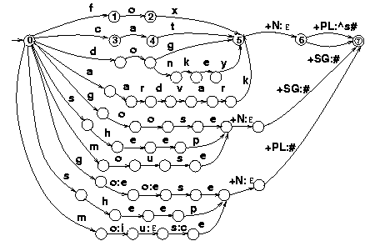
Lexical to Intermediate FST
BİL711 Natural Language Processing

Slide 21
Orthographic Rules
We need FSTs to map intermediate level to surface level.
For each spelling rule we will have a FST, and these FSTs run parallel.
Some of English Spelling Rules:
  consonant doubling -- 1-letter consonant doubled before ing/ed -- beg/begging
  E deletion - Silent e dropped before ing and ed -- make/making
  E insertion -- e added after s, z, x, ch, sh before s -- watch/watches
  Y replacement -- y changes to ie before s, and to i before ed -- try/tries
  K insertion -- verbs ending with vowel+c we add k -- panic/panicked
We represent these rules using two-level morphology rules:
  a => b / c __ d rewrite a as b when it occurs between c and d.
BİL711 Natural Language Processing

Slide 22
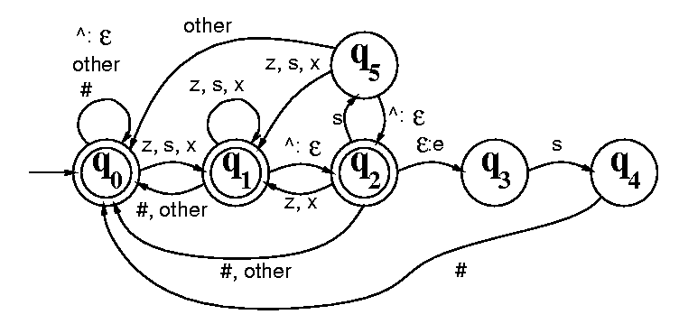
FST for E-Insertion Rule
E-insertion rule: є => e / {x,s,z}^ __ s#
^ (morpheme boundary) means ^: є
BİL711 Natural Language Processing

Slide 23
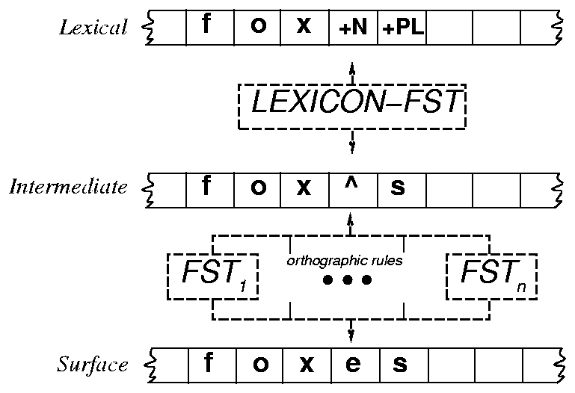
Generating or Parsing with FST Lexicon and Rules
BİL711 Natural Language Processing

Slide 24
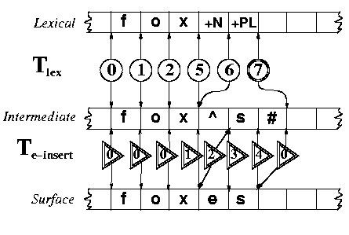
Accepting Foxes
BİL711 Natural Language Processing

Slide 25
Intersection
We can intersect all rule FSTs to create a single FST.
Intersection algorithm just takes the Cartesian product of states.
  For each state q_{i} of the first machine and q_{j} of the second machine, we create a new state q_{ij}
  For input symbol a, if the first machine would transition to state q_{n} and the second machine would transition to q_{m} the new machine would transition to q_{nm}.
BİL711 Natural Language Processing

Slide 26

Composition
Cascade can turn out to be somewhat pain.
  it is hard to manage all tapes
  it fails to take advantage of restricting power of the machines
So, it is better to compile the cascade into a single large machine.
Create a new state (x,y) for every pair of states x є Q₁ and y є Q₂. The transition function of composition will be defined as follows:
δ((x,y),i:o) = (v,z) if
there exists c such that δ₁(x,i:c) = v and δ₂(y,c:o) = z
BİL711 Natural Language Processing

Slide 27
Intersect Rule FSTs
lexical tape
LEXICON-FST
intermediate tape
FST₁ … FST_{n}
=> FST_{R} = FST₁ ^ … ^ FST_{n}
surface tape
BİL711 Natural Language Processing

Slide 28
Compose Lexicon and Rule FSTs
lexical tape
lexical tape
LEXICON-FST
=> LEXICON-FST o FST_{R}
intermediate tape
FST_{R} = FST₁ ^ … ^ FST_{n}
surface level
surface tape
BİL711 Natural Language Processing

Slide 29
Porter Stemming
Some applications (some informational retrieval applications) do not need the whole morphological processor.
They only need the stem of the word.
A stemming algorithm (Port Stemming algorithm) is a lexicon-free FST.
It is just a cascaded rewrite rules.
Stemming algorithms are efficient but they may introduce errors because they do not use a lexicon.
BİL711 Natural Language Processing

