Slide 1
Dependency Parsing

Slide 2
Dependency Parsing
Dependency parsing is a broader term for analysing a sentence's grammatical structure by establishing relationships between words. In a dependency parse, each word in the sentence is linked to other words, indicating how they relate to each other in terms of syntax and grammar.
Purpose: To determine the syntactic structure of a sentence by identifying dependencies between words.
Output: A dependency tree or graph where nodes represent words and edges represent grammatical relations (e.g., subject, object, modifier).
Types: There are various methods for dependency parsing, including rule-based, statistical, and neural network approaches.

Slide 3
Why dependency parsing is essential
1. Understanding Sentence Structure
  Grammatical Relationships: Dependency parsing helps in understanding the grammatical relationships between words in a sentence. It identifies which words govern or modify other words, providing insights into how different parts of a sentence fit together.
2. Improving Text Analysis Tasks
  Named Entity Recognition (NER): Dependency parsing can enhance NER by providing context about the relationships between entities in a sentence, leading to more accurate identification and classification of named entities.
  Sentiment Analysis: By understanding the syntactic structure, dependency parsing can improve sentiment analysis by helping to determine how different parts of a sentence contribute to the overall sentiment.

Slide 4
Why dependency parsing is essential
3. Enhancing Machine Translation
  Contextual Understanding: In machine translation, understanding the syntactic structure helps in translating sentences more accurately by preserving grammatical relationships between words in different languages.
4. Information Extraction
  Relationship Extraction: Dependency parsing is used to extract relationships between entities in a text. For example, it can identify relationships between people, places, and organizations in news articles.
5. Question Answering Systems
  Understanding Queries: Dependency parsing helps in understanding the syntactic structure of questions and queries, improving the accuracy of answers provided by question-answering systems.

Slide 5
Why dependency parsing is essential
6. Text Generation
  Grammar Consistency: For text generation tasks, dependency parsing ensures that the generated text maintains grammatical consistency and adheres to the correct syntactic structure.
7. Syntax-Based Text Summarization
  Effective Summarization: Dependency parsing helps in generating summaries by identifying the core components of a text and their relationships, leading to more coherent and meaningful summaries.
8. Speech Recognition
  Contextual Understanding: In speech recognition systems, understanding the grammatical relationships between words can help improve the accuracy of transcriptions by providing context.

Slide 6
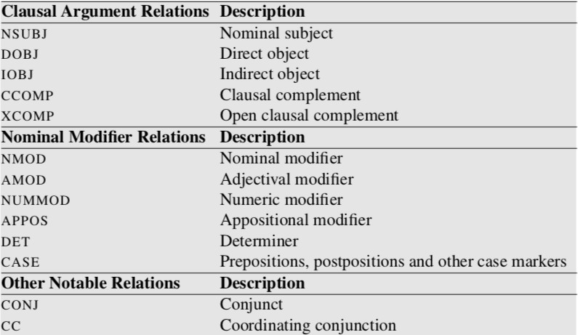
Dependency relations
Each dependency relationship is labelled with a specific tag that describes the nature of the relationship. These labels are essential for understanding the syntactic structure of sentences and can be accessed through the token.dep attribute in spaCy.

Slide 7
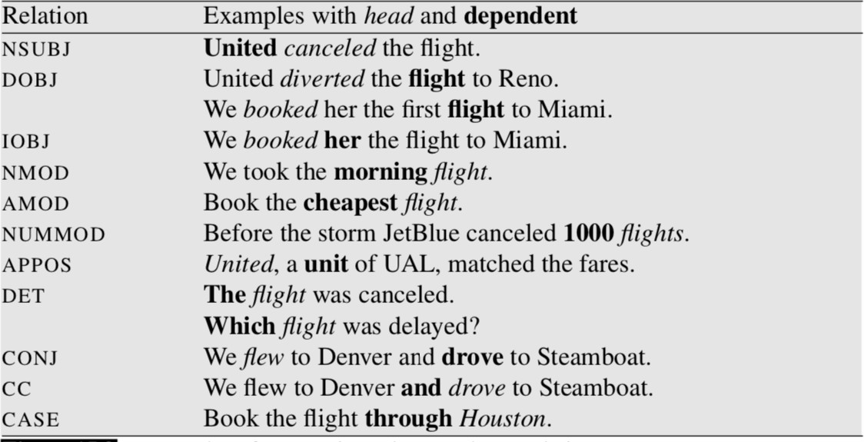
Dependency relations – Universal Dependency Relation

Slide 8
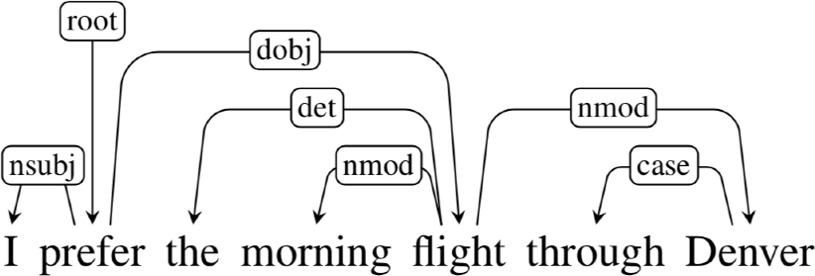
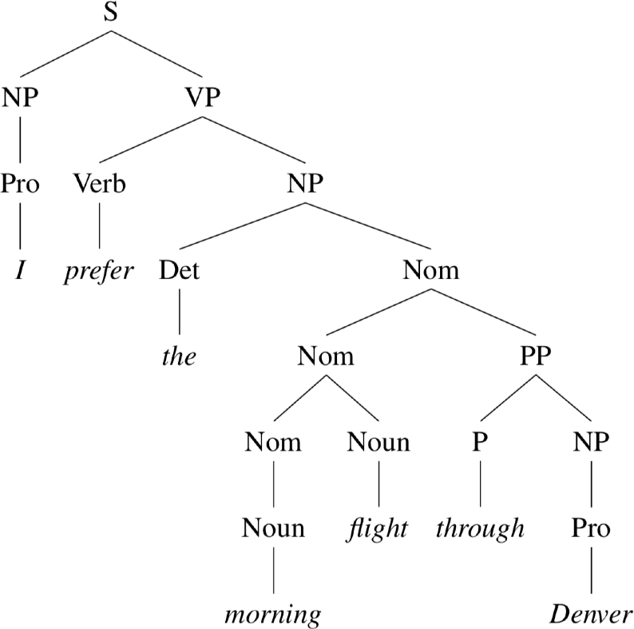
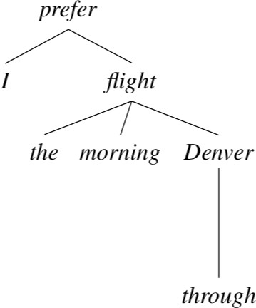
Constituency vs Dependency structure
Constituency Parsing provides a hierarchical view of sentence structure, focusing on phrases and their internal structure.
Dependency Parsing provides a relational view of sentence structure, focusing on the direct dependencies between individual words.

Slide 9

Dependency structure
•
•
Consists of relations between lexical items, normally binary, asymmetric
relations (“arrows”) called dependencies
The arrows are commonly typed with the name of grammatical relations (subject, prepositional object, apposition, etc)
•
•
The arrow connects a head (governor) and a dependent (modifier) Usually, dependencies form a tree (single-head, connected, acyclic)

Slide 10
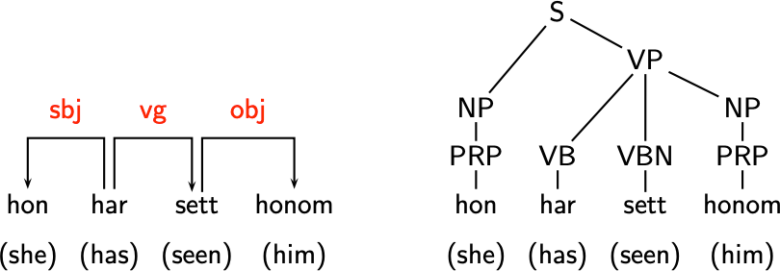
Advantages of dependency structure
•
More suitable for free word order languages

Slide 11

Dependency parsing
Input:
Output:
I prefer the morning flight through Denver
A sentence is parsed by choosing for each word what other word is it a dependent of (and also the relation type)
Usually some constraints:
•
•
Only one word is a dependent of ROOT No cycles: A —> B, B —> C, C —> A
Learning from data: treebanks!

Slide 12
Dependency Parsing
1. Understanding Dependency Parsing
  Dependencies: In dependency parsing, dependencies represent the relationships between words in a sentence.
  For example, in the sentence "She eats an apple," "eats" is the main verb and "She" is the subject, while "apple" is the object of the verb "eats."
  Dependency Tree: A dependency tree visualizes these relationships. Each word is a node, and directed edges indicate dependencies between words.
2. Steps to Find Dependencies
  Tokenization : Tokenize the Sentence: Break down the sentence into individual words or tokens. For example, "She eats an apple" becomes ["She", "eats", "an", "apple"].
  POS Tagging: Part-of-Speech Tagging: Assign POS tags to each token. For "She eats an apple," the tags might be ["PRP", "VBZ", "DT", "NN"].

Slide 13
Dependency Parsing
3. Parsing: Parse the Sentence: Use a dependency parser to analyze the syntactic structure.
There are several tools available for dependency parsing, such as:
  spaCy: A popular library in Python for NLP that includes pre-trained models for dependency parsing.
  Stanford NLP: Provides models and tools for dependency parsing.
  NLTK: Offers some functionality for parsing and analyzing syntactic structure.
4. Extract Dependencies
  Identify Dependencies: After parsing, each word will have a head (the word it depends on) and a dependency relation (the type of relationship). For example, in the sentence "She eats an apple," the word "eats" might have:
  Head: "eats"
  Dependency Relations:
  "She" (subject of "eats")
  "apple" (object of "eats")

Slide 14
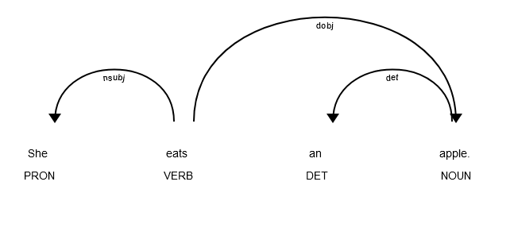
Dependency Parsing
5. Analyze the Output
Dependency Relations: Review the output from the parser to understand how words relate to each other. The result is often represented as a tree or graph.

Slide 15
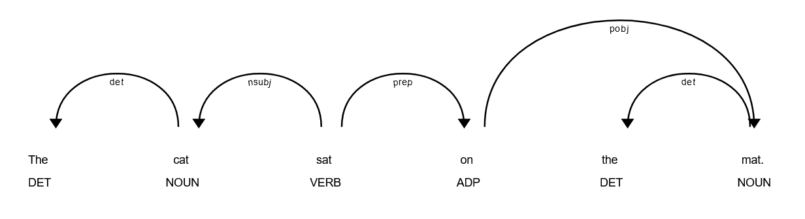
Dependency Parsing
ADP – Adposition - Preposition

Slide 16
Dependency Parsing
The dependency relations might look like this:
| Token | Dependency Relation | Head | Head POS |
| The | det | cat | NOUN |
| cat | nsubj | sat | VERB |
| sat | ROOT | sat | VERB |
| on | prep | sat | VERB |
| the | det | mat | NOUN |
| mat | pobj | on | ADP |

Slide 17
Dependency Parsing
Explanation of Dependencies
The (DT) -> cat (NN): "The" is a determiner (det) for "cat".
cat (NN) -> sat (VBD): "cat" is the subject (nsubj) of "sat".
sat (VBD) -> sat (VBD): "sat" is the root of the sentence (ROOT).
on (IN) -> sat (VBD): "on" is a preposition (prep) modifying "sat".
the (DT) -> mat (NN): "The" is a determiner (det) for "mat".
mat (NN) -> on (IN): "mat" is the object of the preposition "on" (pobj).

Slide 18
Dependency Parsing
In dependency parsing, the verb is often the root of a sentence because it serves as the central element that anchors the sentence's structure. Here’s why the verb typically plays this central role:
1. Central to Sentence Structure
  Core Predicate: The verb functions as the core predicate of the sentence. It describes the main action or state that the sentence is about. The other elements in the sentence—such as subjects, objects, and complements—are organized around the verb, making it the focal point of the sentence's meaning.
2. Syntactic Dependency
  Head of Clauses In traditional syntactic theory, sentences are structured around a head, and the verb is usually this head. All other elements in the sentence (like the subject or object) depend on the verb. This makes the verb the "root" because it is the central element upon which the grammatical structure of the sentence hinges.

Slide 19
Dependency Parsing
3. Grammatical Relationships
Subject-Verb Agreement: The verb often determines the agreement in number and person with the subject. This relationship is crucial for understanding who is performing the action and who is affected by it.
Object and Complement Relationships: The verb also governs how objects and complements are connected to the main action or state described by the sentence.
4. Dependency Tree Construction
Root Node: In a dependency tree, the root node is the head of the main clause. For simple sentences, this is usually the main verb. For example, in the sentence "She eats an apple," "eats" is the verb and the root because it connects the subject ("She") and the object ("an apple") through its dependencies.

Slide 20
Dependency Parsing
Consider the sentence "She writes a letter":
1. Sentence Analysis:
"She": Subject (nsubj) of the verb.
"writes": Main verb (ROOT) of the sentence.
"a letter": Direct object (dobj) of the verb.
2. Dependency Parsing:
"writes" is the ROOT because it is the central action or state around which the sentence is built.
"She" (subject) depends on "writes" because it describes who is performing the action.
"a letter" (object) depends on "writes" because it describes what is being written.

Slide 21
Dependency Parsing
Visual Representation
In a dependency tree, the verb "writes" would be the root node with branches extending to the subject "She" and the object "a letter":
writes
/ \
She letter
/
a
This tree structure illustrates that "writes" is central, and all other elements are related to it.

Slide 22
Special Cases -
Complex Sentences: In complex sentences with multiple clauses, each clause might have its own root verb. For instance, in "She writes a letter because she wants to inform him," "writes" is the root of the main clause, while "wants" is the root of the subordinate clause.
Imperative Sentences: For imperative sentences (e.g., "Close the door"), the verb is still the root even though the subject may be implied (often "you").
In summary, the verb is typically the root in dependency parsing because it is the main action or state around which the sentence is organized. It serves as the focal point of the sentence’s structure, and all other elements are linked to it through various grammatical dependencies.

Slide 23
Transition-based parsing
Transition-based dependency parsing is a popular approach for dependency parsing that uses a sequence of transitions to build a dependency parse tree incrementally. It is particularly known for its efficiency and effectiveness in parsing sentences.
Transition-based parsing involves processing a sentence word-by-word and applying a sequence of actions (transitions) to construct the dependency tree. The key idea is to transform a data structure (usually a stack and a buffer) step-by-step until the entire sentence is parsed.

Slide 24
Key Components
Data Structures:
  Stack: Holds partially parsed words or constituents.
  Buffer: Contains the remaining words yet to be processed.
  Parse Tree: The final structure that will be built by applying transitions.
Transitions: Transition-based parsers use a predefined set of actions to modify the stack, buffer, and dependency structure. Common transitions include:
  Shift: Move the next word from the buffer to the stack.
  Left Arc (or Left Attachment): Create a dependency from the top word on the stack to the word below it, then remove the top word from the stack.
  Right Arc (or Right Attachment): Create a dependency from the word below the top word on the stack to the top word, then remove the top word from the stack.
Transition Sequence: The goal is to find a sequence of transitions that correctly builds the dependency structure for the entire sentence. This is typically formulated as a search problem, where the parser explores possible sequences of transitions to achieve the desired structure.

Slide 25
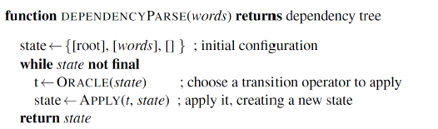
Transition-based parsing algorithm - Steps
Initialization:
The stack is initialized as empty.
The buffer contains all the words of the sentence in their original order.
Processing:
At each step, a transition is applied based on the current configuration of the stack and buffer.
The transition modifies the stack, buffer, or dependency structure, and the parser proceeds to the next step.
Termination:
The parsing process continues until the buffer is empty and the stack contains only the root node of the parse tree.

Slide 26
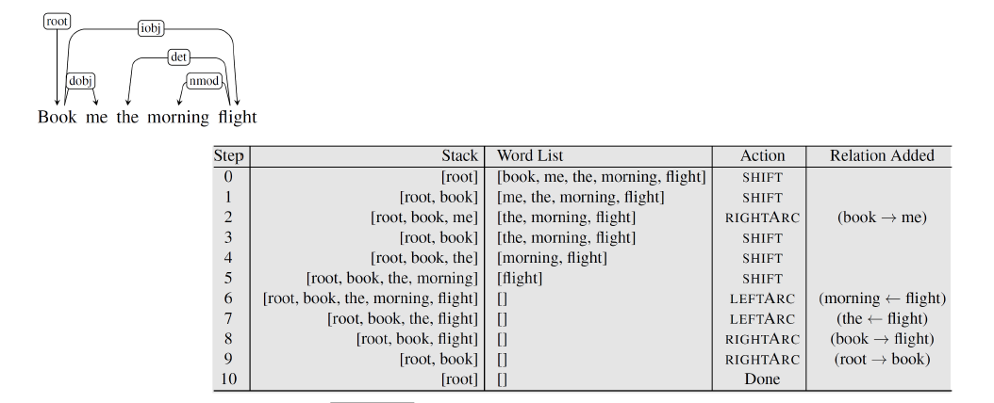
Example:1 Transition-based dependency parsing

Slide 27
Example:2 Transition-based dependency parsing
Consider the sentence: “John eats an apple.”
The transition-based parser might process it as follows:
1. Initial State:
  Stack: []
  Buffer: [John, eats, an, apple]
2. Shift: Move “John” to the stack.
  Stack: [John]
  Buffer: [eats, an, apple]

Slide 28
3. Shift: Move “eats” to the stack.
  Stack: [John, eats]
  Buffer: [an, apple]
4. Right Arc: Create a dependency from “eats” to “John” (John is the subject of eats).
  Stack: [eats]
  Buffer: [an, apple]
  Dependencies: {eats → John}

Slide 29
5. Shift: Move “an” to the stack.
  Stack: [eats, an]
  Buffer: [apple]
6. Shift: Move “apple” to the stack.
  Stack: [eats, an, apple]
  Buffer: []
7. Right Arc: Create a dependency from “an” to “apple” (apple is the object of an).
  Stack: [eats, an]
  Dependencies: {eats → John, an → apple}

Slide 30
8.Left Arc: Create a dependency from “eats” to “an” (an is the object of eats).
  Stack: [eats]
  Dependencies: {eats → John, an → apple, eats → an}
9.Left Arc: Create a dependency from the root to “eats”.
  Stack: []
  Dependencies: {eats → John, an → apple, eats → an, root → eats}

Slide 31
Projectivity
Arc from head to dependent is projective
  If there is a path from head to every word between head and dependent
Dependency tree is projective
  If all arcs are projective
  Or equivalently, if it can be drawn with no crossing edges
Projective trees make computation easier
But most theoretical frameworks do not assume projectivity
Need to capture long-distance dependencies, free word order

Slide 32
Advantages
Efficiency: Transition-based parsers are typically efficient and can handle large datasets due to their linear time complexity in practice.
Simplicity: The transition-based approach is conceptually simple and easy to implement.
Flexibility: Can be adapted to different types of dependency grammars and can be enhanced with various features (e.g., part-of-speech tags, word embeddings) to improve performance.

