Slide 1
Module - 2
Introduction to Problem Solving by searching Methods-State Space search

Slide 2
What is a problem??
A matter or situation regarded as unwelcome or harmful and needing to be dealt with and overcome.
How the problems are solved ?
Defining the problem.
Generating alternatives.
Evaluating and selecting alternatives.
Implementing solutions.

Slide 3
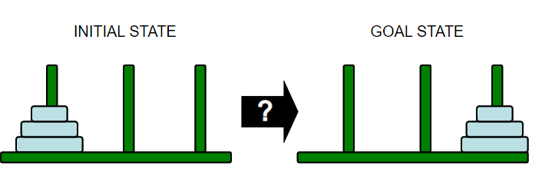
Definition
According to psychology, “a problem-solving refers to a state where we wish to reach to a definite goal from a present state or condition.”
According to computer science, a problem-solving is a part of artificial intelligence which encompasses a number of techniques such as algorithms, heuristics to solve a problem.

Slide 4
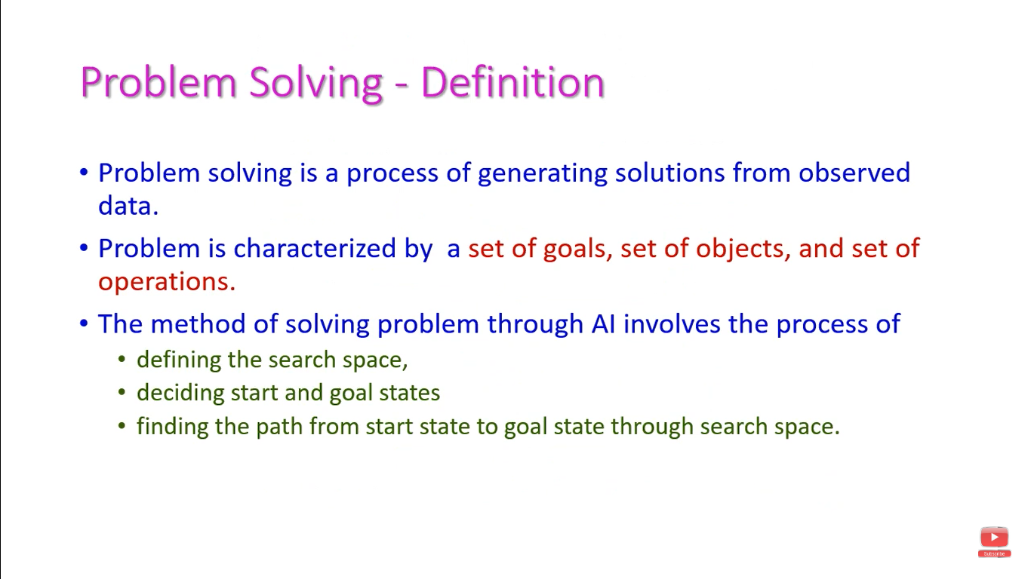
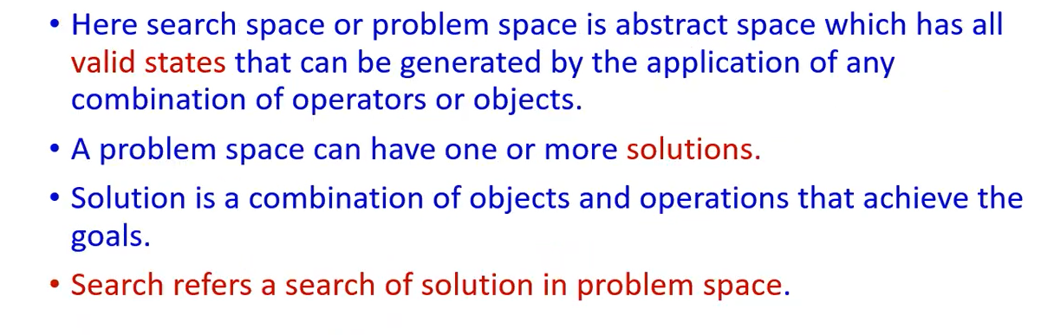

Slide 5
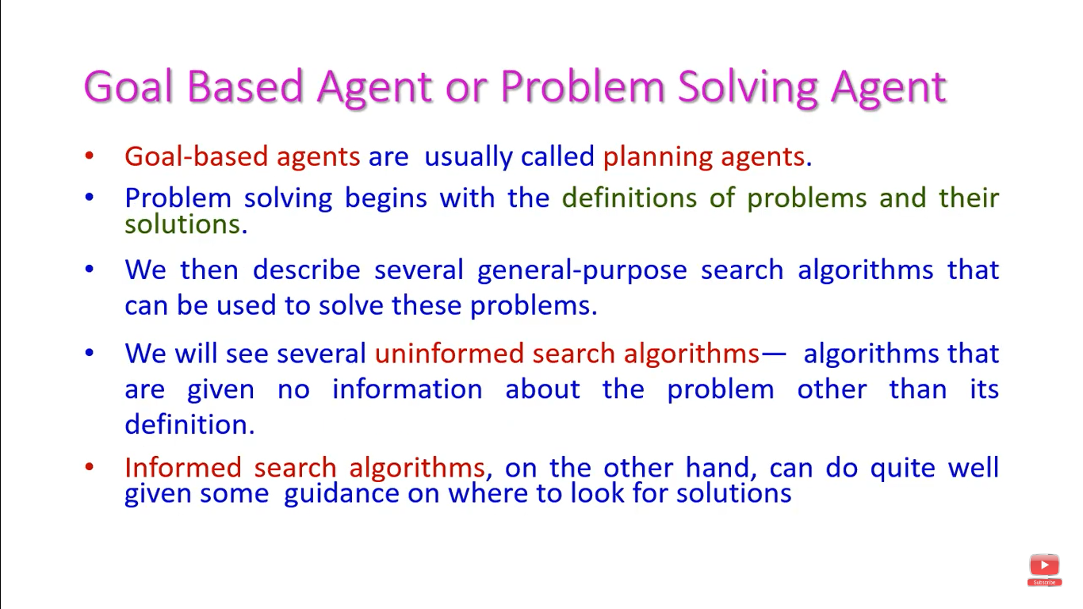

Slide 6
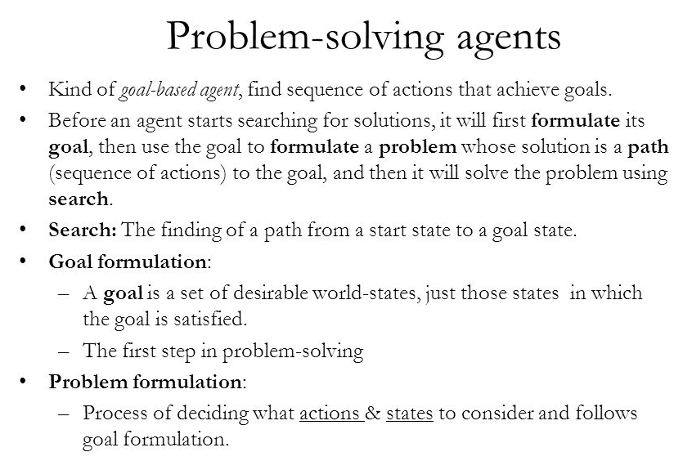

Slide 7
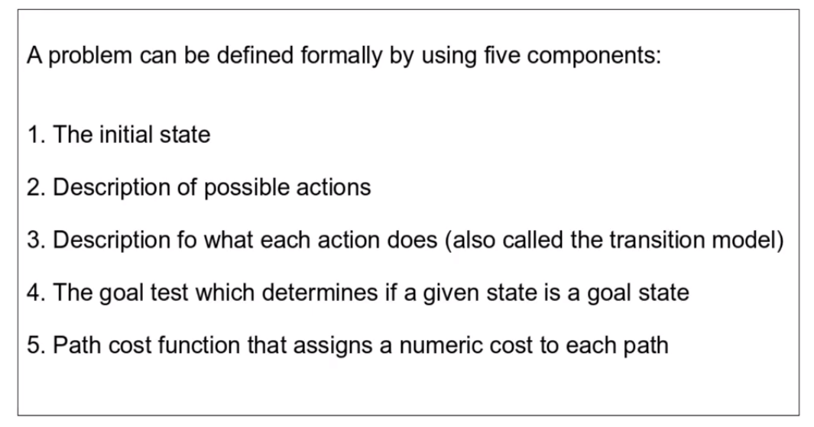
Components of a problem
After formulating a goal and problem to solve the agent calls a search procedure to solve it.

Slide 8
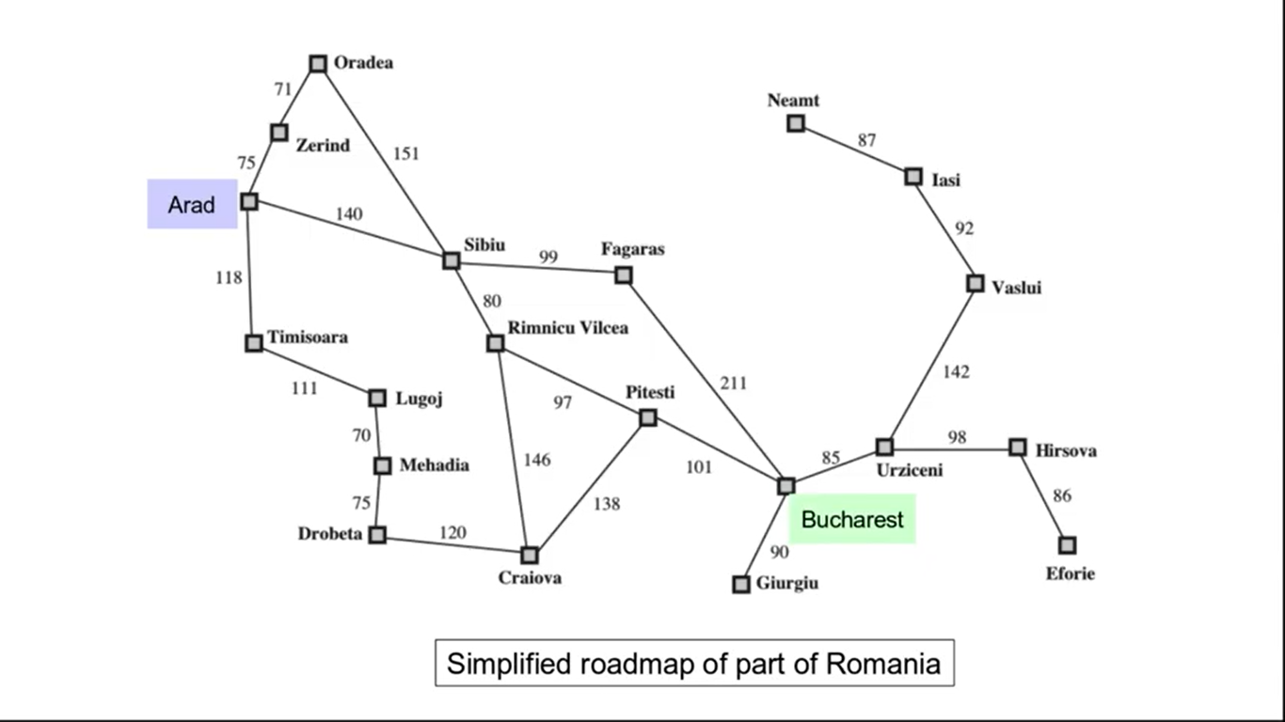

Slide 9
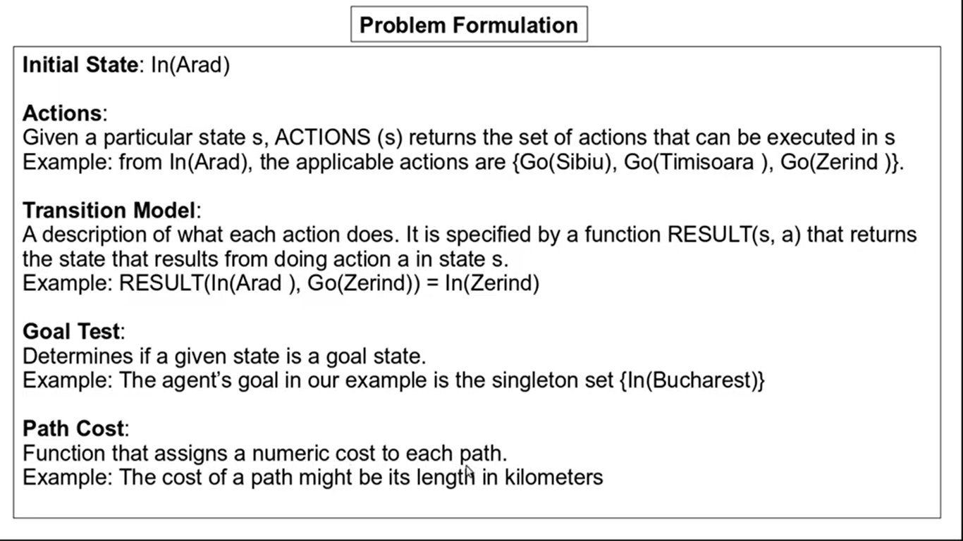

Slide 10
A problem can be defined formally by five components
The initial state that the agent starts in. For eg: the initial state for our agent in Romania might be described as In(Arad).
A description of the possible actions available to the agent. Given a particular state s, ACTIONS(s) returns the set of actions that can be executed in s. Each of these action is applicable in s.
For eg: from the state In(Arad), the applicable actions are
{Go(Sibiu), Go(Timisoara), Go(Zerind)}

Slide 11
A description of what each action does; the formal name for this is the transition model, specified by a function RESULT(s,a), that returns the state that results from doing action a in state s.
Successor: refer to any state reachable from a given state by a single action.
For eg: RESULT(In(Arad), Go(Zerind))= In(Zerind)
Together, the initial state, actions, and transition model implicitly define the state space of the problem- the set of all states reachable from the initial state by any sequence of actions.
The state space forms a directed network or graph in which the nodes are state and the links between nodes are actions.
A path in the state space is a sequence of states connected by a sequence of actions.

Slide 12
The goal test, which determines whether a given state is a goal state. For eg, in chess, the goal is to reach a state called “checkmate” where the opponent’s king is under attack and can’t escape.
A path cost function that assigns a numeric cost to each path (here, the cost path might be its length in kilometers)
The step cost of taking action a in state s to reach state s’ is denoted by c(s,a,s’)
A solution to a problem is an action sequence that leads from the initial state to a goal state.
An optimal solution has the lowest path cost among all solutions.

Slide 13
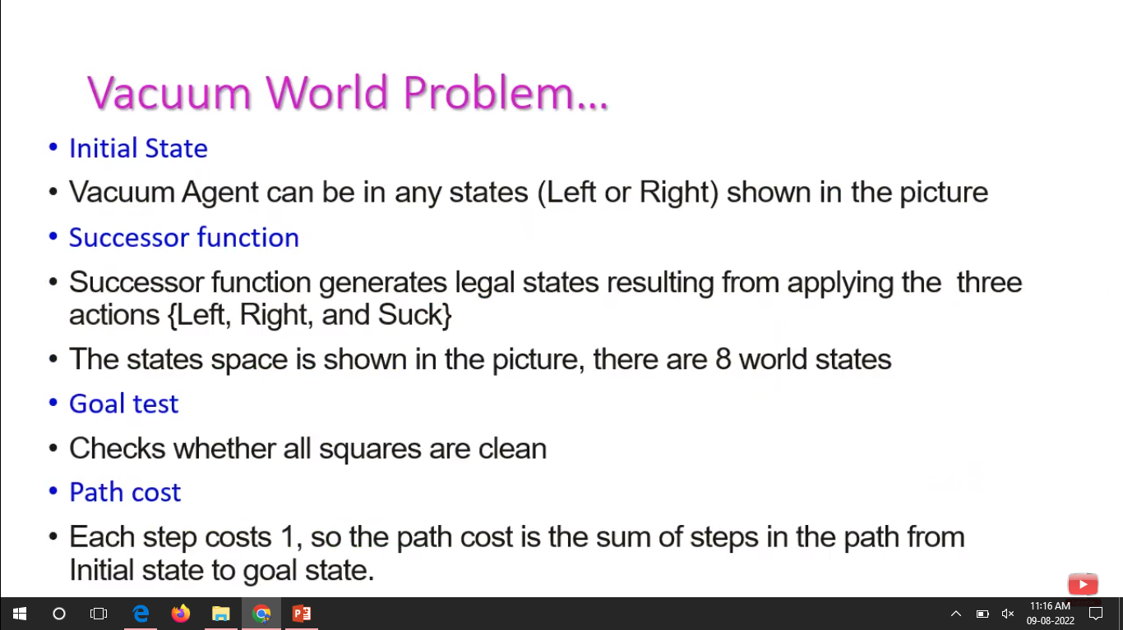
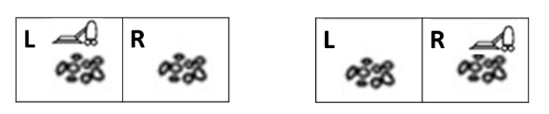

Slide 14
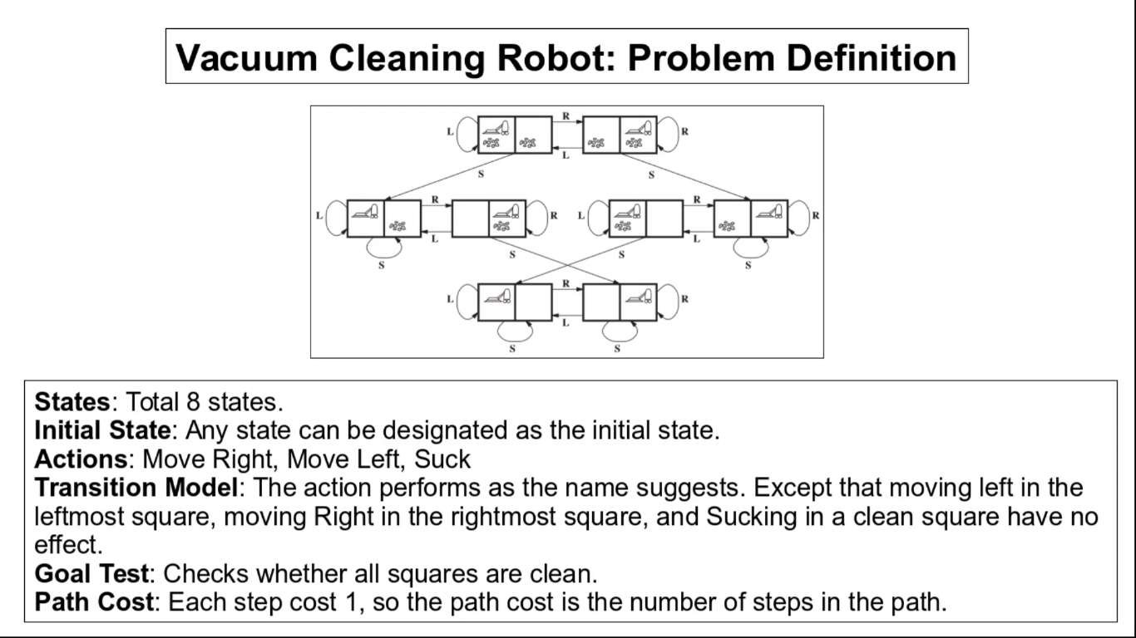

Slide 15
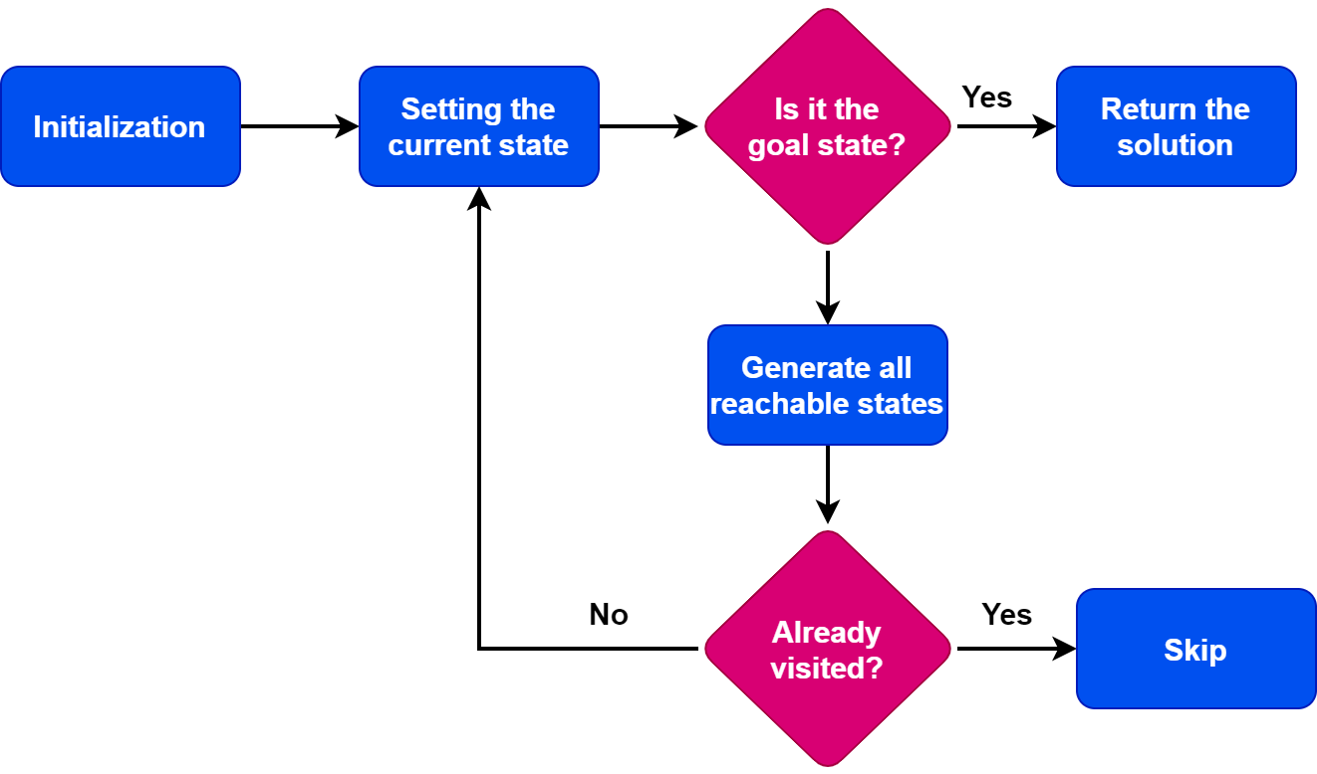
state space search

Slide 16
Example: Eight Puzzle
States:
Description of the eight tiles and location of the blank tile
Successor Function:
Generates the legal states from trying the four actions {Left, Right, Up, Down}
Goal Test:
Checks whether the state matches the goal configuration
Path Cost:
Each step costs 1
7 | 2 | 4
5 |  | 6
8 | 3 | 1
1 | 2 | 3
4 | 5 | 6
7 | 8

Slide 17
State Space
Initial state, actions, and transition model together define the state-space of the problem implicitly.
State-space of a problem is a set of all states which can be reached from the initial state followed by any sequence of actions.
The state-space forms a directed map or graph where nodes are the states, links between the nodes are actions, and the path is a sequence of states connected by the sequence of actions.

Slide 18
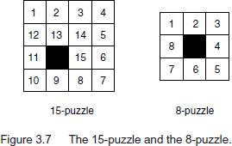

THE 8-PUZZLE
The legal moves are:

Slide 19
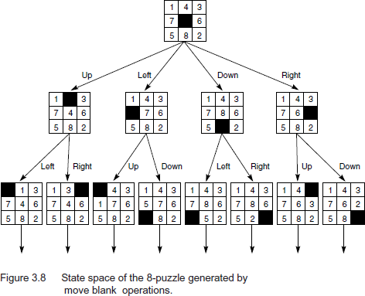

Slide 20
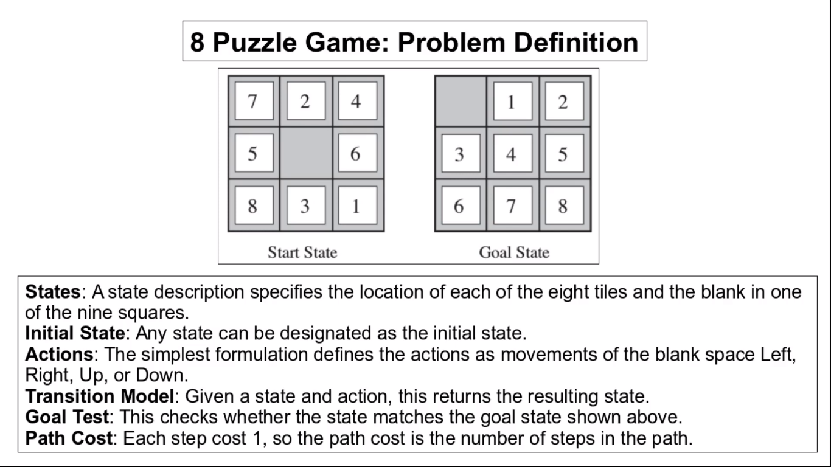

Slide 21
Search Algorithm Terminologies
Search: Searching is a step by step procedure to solve a search-problem in a
given search space.
A search problem can have three main factors:
1. Search Space: Search space represents a set of possible solutions, which a system may have.
2. Start State: It is a state from where agent begins the search.
3. Goal test: It is a function which observe the current state and returns whether the goal state is achieved or not.

Slide 22
Search Algorithm Terminologies
Search tree: A tree representation of search problem is called Search tree. The root of the
search tree is the root node which is corresponding to the initial state.
Actions: It gives the description of all the available actions to the agent.
Transition model: A description of what each action do, can be represented as a
transition model.
Path Cost: It is a function which assigns a numeric cost to each path.
Solution: It is an action sequence which leads from the start node to the goal node.
Optimal Solution: If a solution has the lowest cost among all solutions.

