Slide 1
Informed Search

Slide 2
Informed Search
The uninformed search algorithms which looked through search space for all possible solutions of the problem without having any additional knowledge about search space.
But informed search algorithm contains an array of knowledge such as how far we are from the goal, path cost, how to reach to goal node, etc.
This knowledge help agents to explore less to the search space and find more efficiently the goal node.
The informed search algorithm is more useful for large search space.
Informed search algorithm uses the idea of heuristic, so it is also called Heuristic search.

Slide 3
Informed Search Strategies
Add domain-specific information to select what is the best path to continue searching along. Using this info it will choose the most promising node at each stage.
Terminology:
Define a heuristic function, h(n), that estimates the "goodness" of a node n with respect to reaching a goal. i.e., cheapest estimated path from current state (n) to a goal state.
g(n) – cheapest known path from start state to current state(n)
f(n) = g(n) + h(n) = estimated total cost of path through n
h(n) is an estimate (rule of thumb), based on domain-specific information that is computable from the current state description.
Heuristics do not guarantee feasible solutions and are often without theoretical basis.

Slide 4
Heuristics function
Heuristic is a function which is used in Informed Search, and it finds the most promising path.
It takes the current state of the agent as its input and produces the estimation of how close agent is from the goal.
The heuristic method, however, might not always give the best solution, but it guaranteed to find a good solution in reasonable time.
Heuristic function estimates how close a state is to the goal. It is represented by h(n), and it calculates the cost of an optimal path between the pair of states.
The value of the heuristic function is always positive.
In general:
h(n) >= 0 for all nodes n
h(n) = 0 implies that n is a goal node
h(n) = infinity implies that n is a dead end from which a goal cannot be reached

Slide 5
Pure Heuristic Search
Pure heuristic search is the simplest form of heuristic search algorithms.
It expands nodes based on their heuristic value h(n).
It maintains two lists, OPEN and CLOSED list.
In the CLOSED list, it places those nodes which have already expanded and in the OPEN list, it places nodes which have yet not been expanded.
On each iteration, each node n with the lowest heuristic value is expanded and generates all its successors and n is placed to the closed list.
The algorithm continues until a goal state is found.

Slide 6
Best-first search
The general approach we consider is called best first search.
Best-first search is an instance of the general Tree-Search or Graph-Search algorithm in which a node is selected for expansion based on an evaluation function, f(n).
The evaluation function is construed as a cost-estimate, so the node with the lowest evaluation is expanded first.
The implementation of best first graph search is identical to that for Uniform-Cost Search, except for the use of f instead of g to order the priority queue.

Slide 7
Best First Search
A search method of selecting the best local choice at each step in hopes of finding an optimal solution.
Does not consider how optimal the current solution is.
At each step, uses a heuristic to estimate the distance (cost) of each local choice from the goal.
Steps:
1. Define a heuristic function h(x) to estimate the distance to the goal from any state.
2. From the current state, determine the search space (actions) for one step ahead.
3. Select the action from the search space that minimizes the heuristic function.

Slide 8
Best first search algorithm
Step 1: Place the starting node into the OPEN list.
Step 2: If the OPEN list is empty, Stop and return failure.
Step 3: Remove the node n, from the OPEN list which has the lowest value of h(n), and places it in the CLOSED list.
Step 4: Expand the node n, and generate the successors of node n.
Step 5: Check each successor of node n, and find whether any node is a goal node or not. If any successor node is goal node, then return success and terminate the search, else proceed to Step 6.
Step 6: For each successor node, algorithm checks for evaluation function f(n), and then check if the node has been in either OPEN or CLOSED list. If the node has not been in both list, then add it to the OPEN list.
Step 7: Return to Step 2.

Slide 9
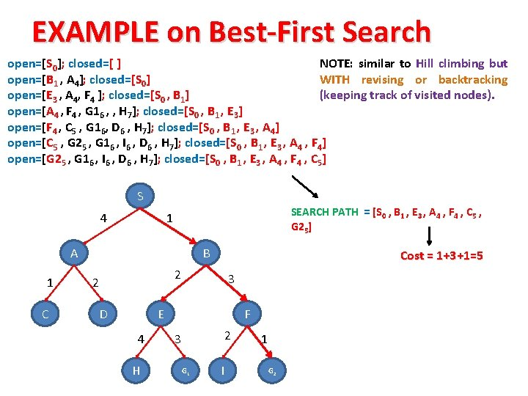

Slide 10
Advantages:
Best first search can switch between BFS and DFS by gaining the advantages of both the algorithms.
This algorithm is more efficient than BFS and DFS algorithms.
Disadvantages:
It can behave as an unguided depth-first search in the worst case scenario.
It can get stuck in a loop as DFS.
This algorithm is not optimal.

Slide 11
Greedy best-first search
Evaluation function f(n) = h(n) (heuristic)
= estimate of cost from n to goal
e.g., h_{SLD}(n) = straight-line distance from n to goal state/place
Greedy best-first search expands the node that appears to be closest to goal

Slide 12
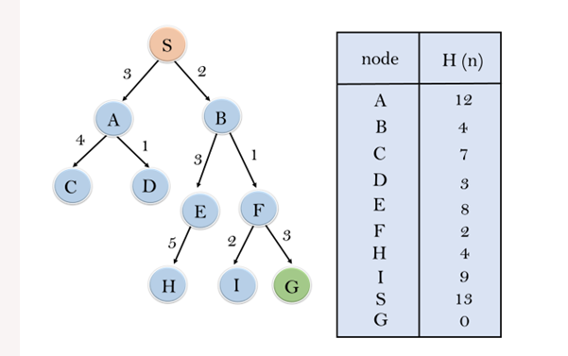
Example: Consider the below search problem, and we will traverse it using greedy best-first search. At each iteration, each node is expanded using evaluation function f(n)=h(n) , which is given in the below table.

Slide 13
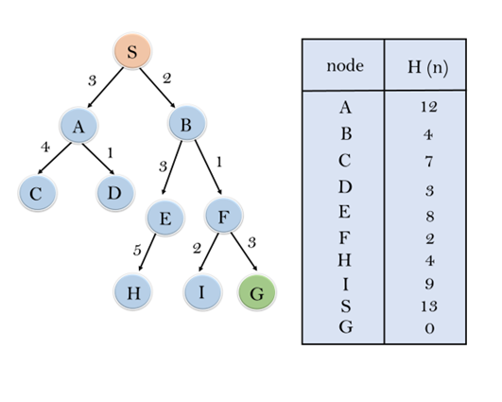
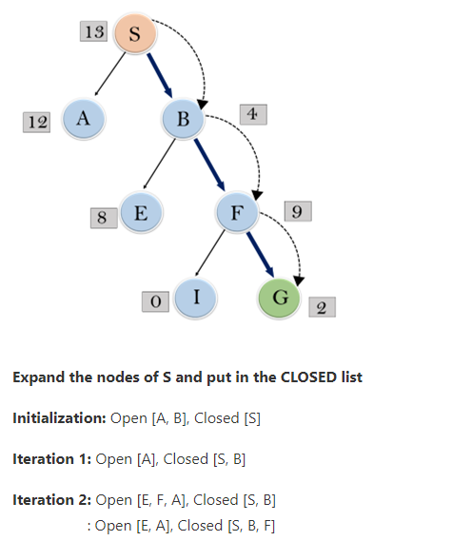
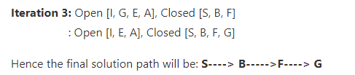

Slide 14
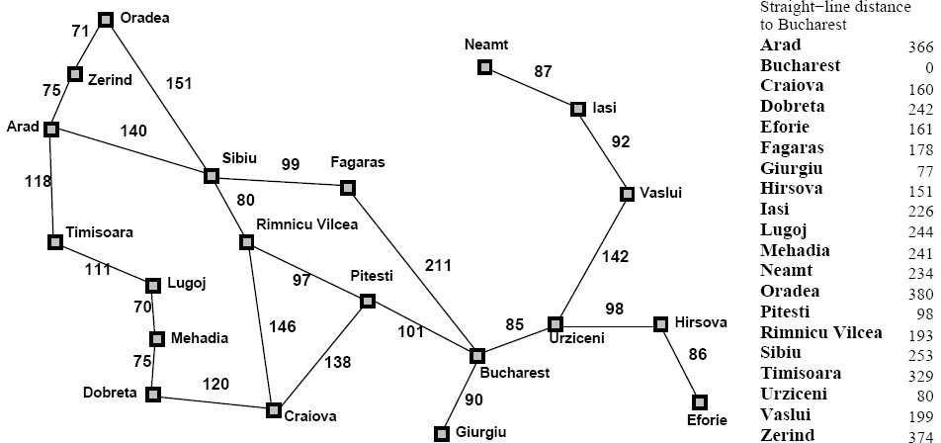
Greedy Best-First Search

Slide 15


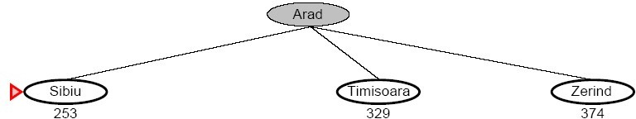
Greedy Best-First Search

Slide 16
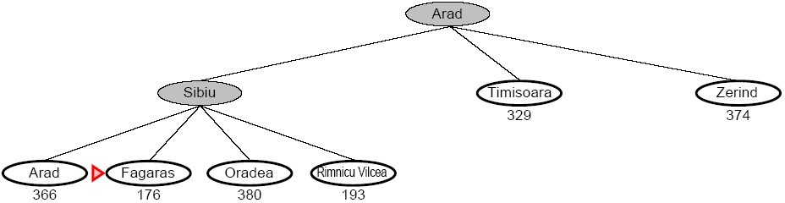
Greedy Best-First Search

Slide 17
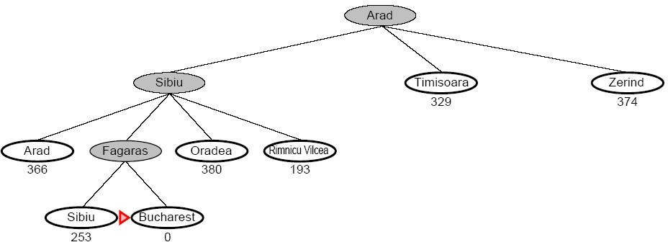
Greedy Best-First Search

Slide 18
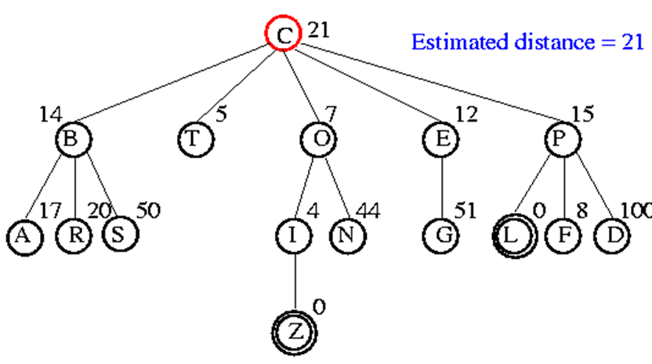
Example: Consider the below search problem, and we will traverse it using greedy best-first search. At each iteration, each node is expanded using evaluation function f(n)=h(n) , which is given in the below table.

Slide 19
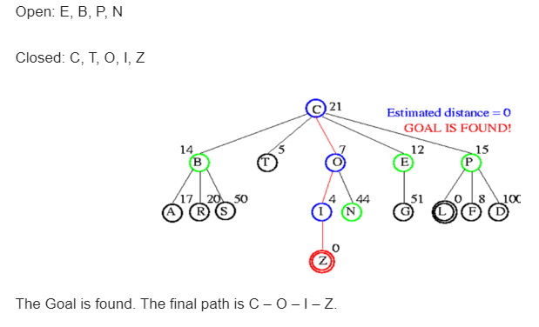

Slide 26
Performance
Time Complexity: The worst case time complexity of Greedy best first search is O(b^{m}).
Space Complexity: The worst case space complexity of Greedy best first search is O(b^{m}). Where, m is the maximum depth of the search space.
Complete: Greedy best-first search is also incomplete, even if the given state space is finite.
Optimal: Greedy best first search algorithm is not optimal.

Slide 27
A* Algorithm
A* Algorithm is one of the best and popular techniques used for path finding and graph traversals.
A lot of games and web-based maps use this algorithm for finding the shortest path efficiently.
It is essentially a best first search algorithm.

Slide 28
Cont…
A* Algorithm extends the path that minimizes the following function-
f(n) = g(n) + h(n)
Here,
‘n’ is the last node on the path
Idea: avoid expanding paths that are already expensive
Evaluation function f(n) = g(n) + h(n)
g(n) = cost so far to reach n
h(n) = estimated cost from n to goal
f(n) = estimated total cost of path through n to goal

Slide 29
Working of A*
The algorithm maintains two sets
OPEN list: The OPEN list keeps track of those nodes that need to be examined.
CLOSED list: The CLOSED list keeps track of nodes that have already been examined.
Initially, the OPEN list contains just the initial node, and the CLOSED list is empty
g(n) = the cost of getting from the initial node to n
h(n) = the estimate, according to the heuristic function, of the cost from n to goal node
f(n) = g(n)+h(n); intuitively, this is the estimate of the best solution that goes through n

Slide 30
Working of A*
Each node also maintains a pointer to its parent, so that the best solution if found can be retrieved.
It has main loop that repeatedly gets the node, call it n with lowest f(n) value from OPEN list.
If n is goal node then stop (done) otherwise, n is removed from OPEN list & added to the CLOSED list.
Next all the possible successor nodes of n are generated.
For each successor node n, if it is already in the CLOSED list and the copy there has an equal or lower f estimate, and then we can safely discard the newly generated n and move on.
Similarly, if n is already in the OPEN list & the copy there has an equal or lower f estimate, we can discard the newly generated n and move on.

Slide 31
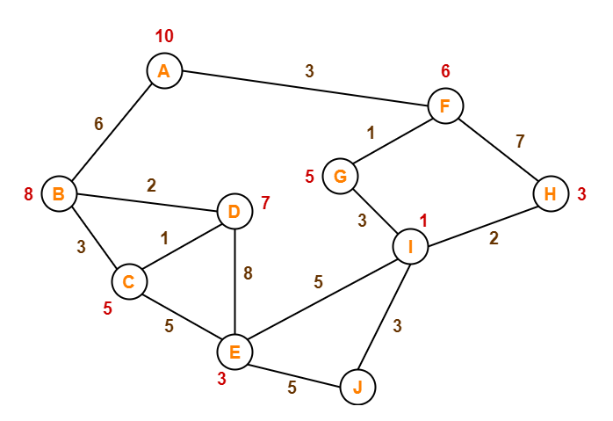
Example
The numbers written on edges represent the distance between the nodes.
The numbers written on nodes represent the heuristic value.
Find the most cost-effective path to reach from start state A to final state J using A* Algorithm.

Slide 32
A* Search

Slide 33
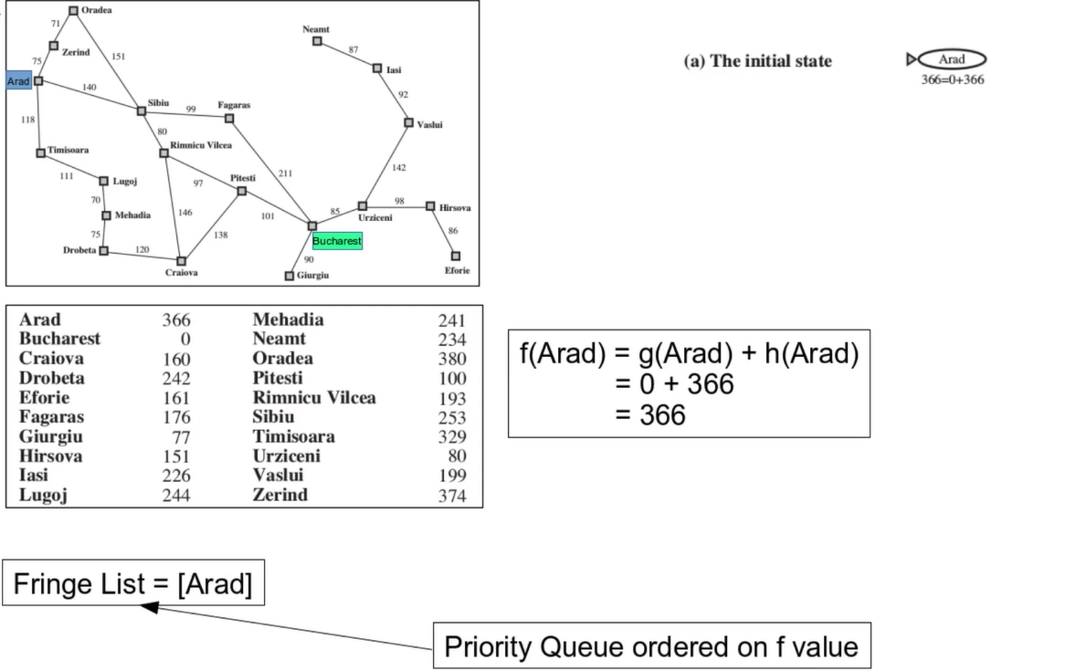

Slide 34
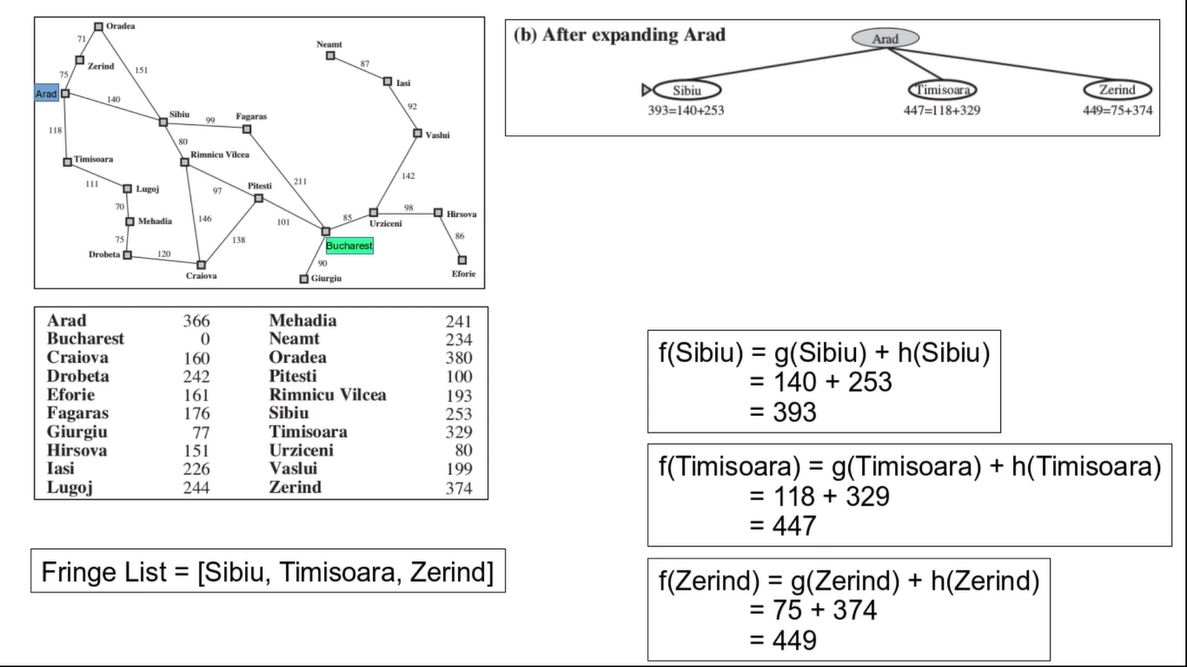

Slide 35
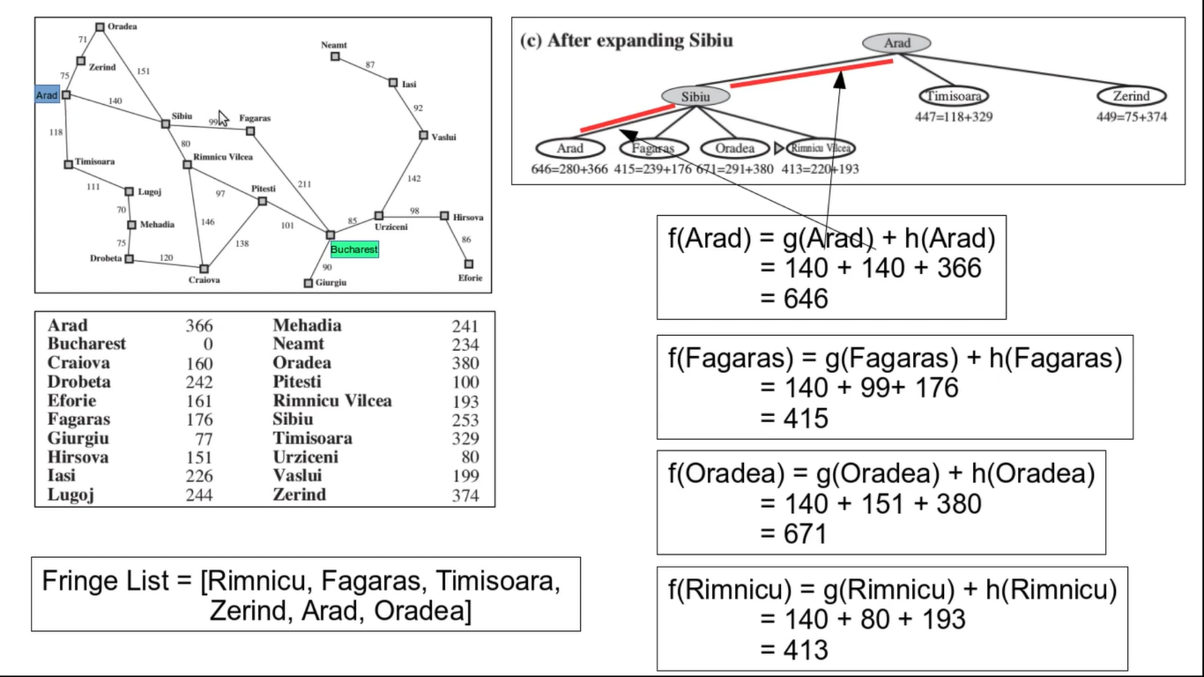

Slide 36
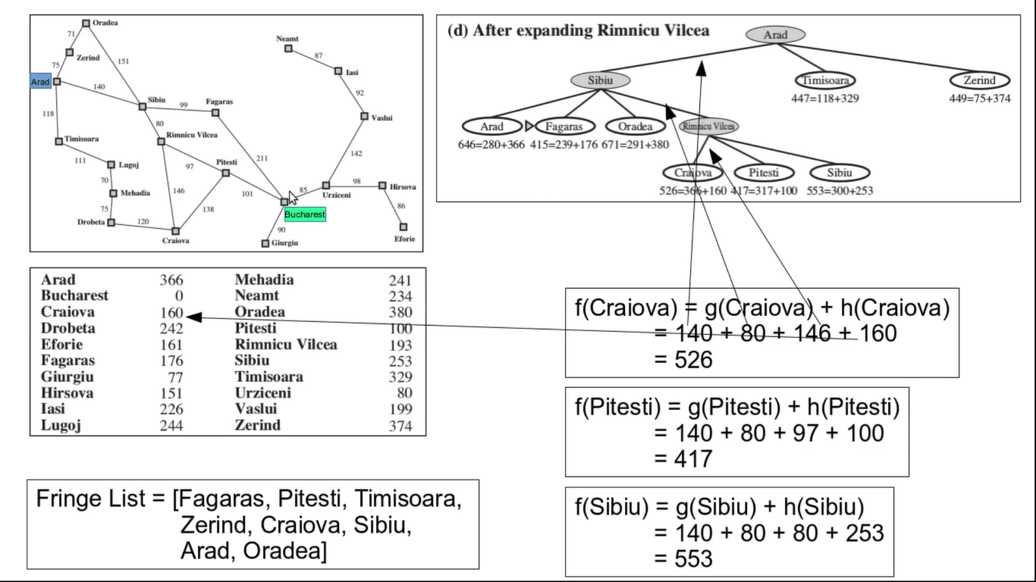

Slide 37
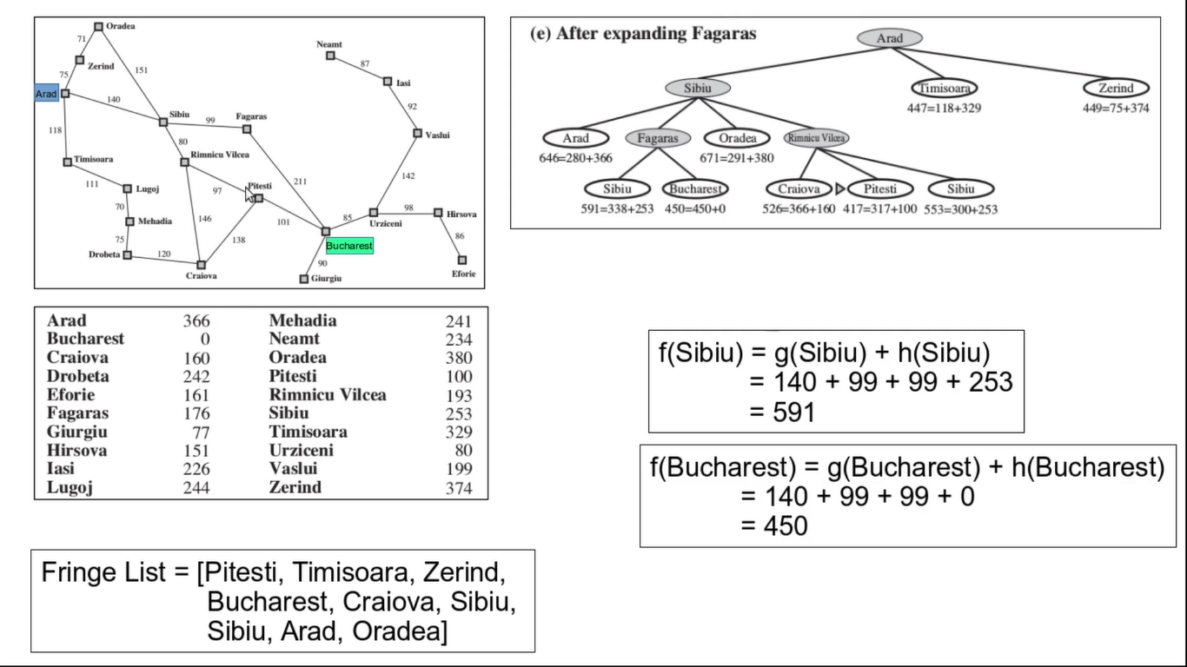

Slide 38
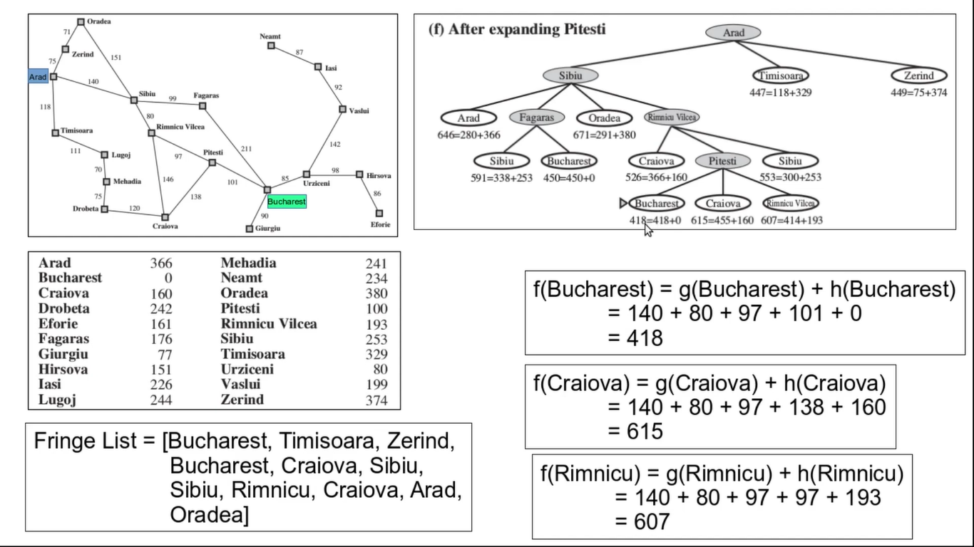

Slide 39
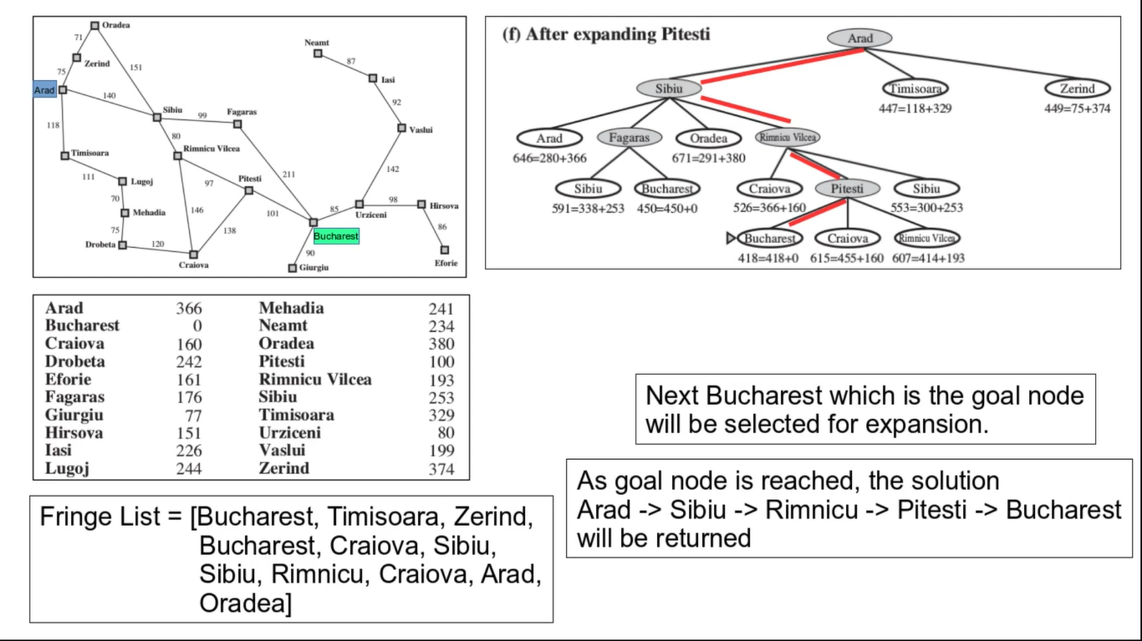

Slide 40
Cont…
Advantages
A* search algorithm is the best algorithm than other search algorithms.
A* search algorithm is optimal and complete.
This algorithm can solve very complex problems.
Disadvantages
It does not always produce the shortest path as it mostly based on heuristics and approximation.
A* search algorithm has some complexity issues.
The main drawback of A* is memory requirement as it keeps all generated nodes in the memory, so it is not practical for various large-scale problems.

