Slide 1
Local Search algorithms

Slide 2

Local Search
The uninformed and informed search algorithms that we have seen are designed to explore search spaces systematically.
They keep one or more paths in memory and by record which alternatives have been explored at each point along the path.
When a goal is found, the path to that goal also constitutes a solution to the problem. In many problems, however, the path to the goal is irrelevant.
If the path to the goal does not matter, we might consider a different class of algorithms that do not worry about paths at all.
local search algorithms

Slide 3
Local Search
Local search algorithms operate using a single current node and generally move only to neighbors of that node.
Local search algorithms ease up on completeness and optimality in the interest of improving time and space complexity?
Although local search algorithms are not systematic, they have two key advantages:
They use very little memory (usually a constant amount), and
They can often find reasonable solutions in large or infinite (continuous) state spaces.
In addition to finding goals, local search algorithms are useful for solving pure optimization problems, in which the aim is to find the best state according to an objective function.
In optimization problems, the path to goal is irrelevant and the goal state itself is the solution.
In some optimization problems, the goal is not known and the aim is to find the best state.

Slide 4
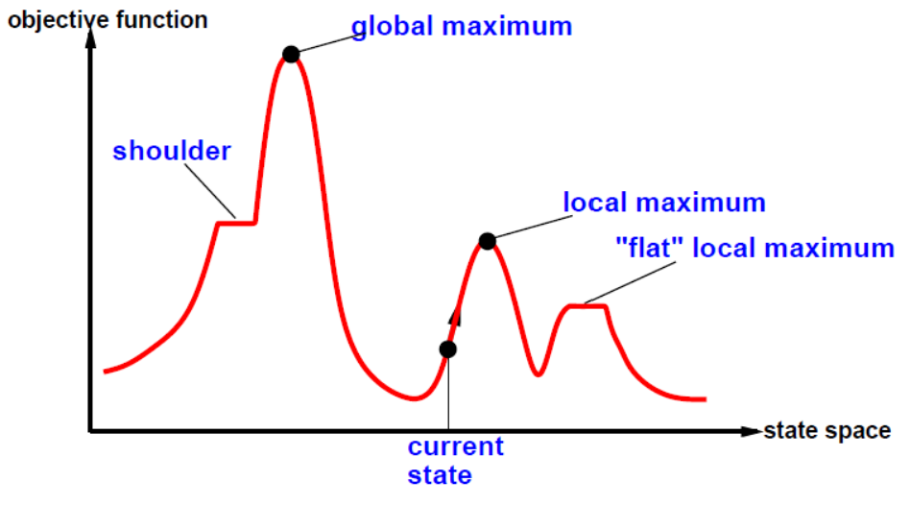
A one-dimensional state- space landscape
To understand local search, it is useful to consider the state-space landscape.
The aim is to find the highest peak - a global maximum.
Hill-climbing search modifies the current state to try to improve it.

Slide 5
Hill Climbing Search
(Steepest Ascent/Descent)
At each iteration, the hill-climbing search algorithm moves to the best successor of the current node according to an objective function.
Best successor is the successor with best value (highest or lowest) according to an objective function. If no successors have better value than the current value, it returns.
It moves in direction of uphill (hill climbing). It terminates
The algorithm does not maintain a search tree, so the data structure for the current node need only record the state and the value of the objective function.
Hill climbing does not look ahead beyond the immediate neighbors of the current state.
Hill climbing is sometimes called greedy local search because it grabs a good neighbor state without thinking ahead about where to go next.
Greedy algorithms often perform quite well and
Hill climbing often makes rapid progress toward a solution.

Slide 6
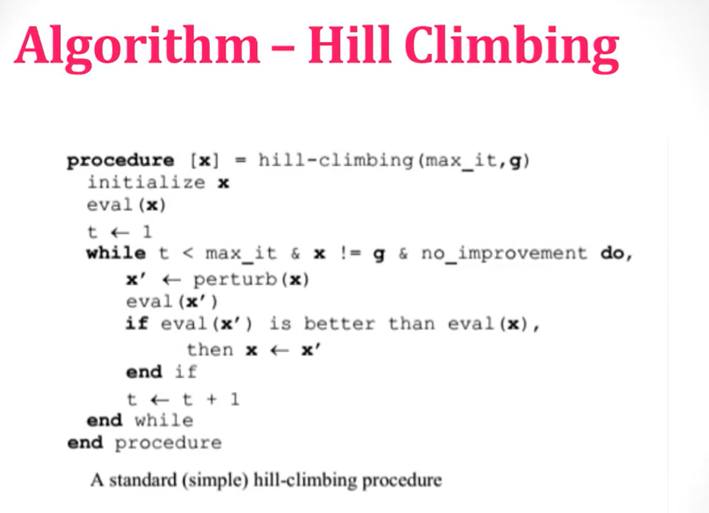

Slide 7
Variants of Hill Climbing Search
Simple Hill climbing : It examines the neighboring nodes one by one and selects the first neighboring node which optimizes the current cost as next node.
Steepest-Ascent Hill climbing : It first examines all the neighboring nodes and then selects the node closest to the solution state as of next node.
Stochastic hill climbing : It does not examine all the neighboring nodes before deciding which node to select. It just selects a neighboring node at random and decides (based on the amount of improvement in that neighbor) whether to move to that neighbor or to examine another.
Random-restart hill climbing: It adopts the well-known adage, “If at ﬁrst you don’t succeed, try, try again.”

Slide 8
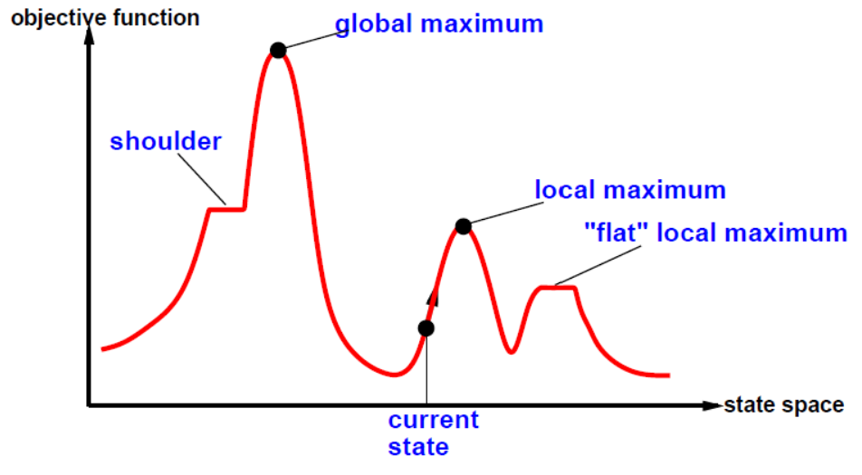
Hill Climbing Search
A local maximum is a peak that is higher than each of its neighboring states but lower than the
global maximum.
Hill-climbing algorithms that reach the vicinity of a local maximum will be drawn upward toward the peak but will then be stuck with nowhere else to go.
A plateau is a flat area of the state-space landscape. It can be a flat local maximum, from which no uphill exit exists, or a shoulder, from which progress is possible.
A hill-climbing search might get lost on the plateau.
Random sideways moves can escape from shoulders but they loop forever on flat maxima.

Slide 9
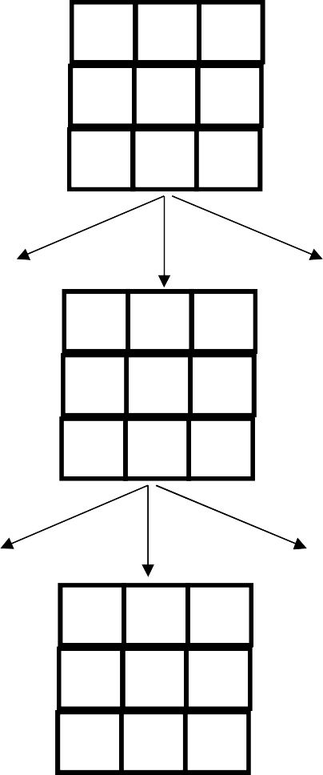
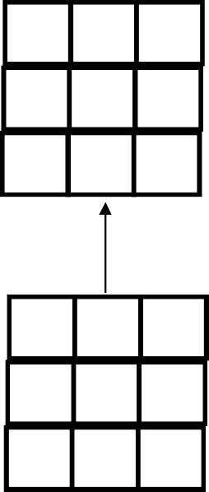
Hill climbing example
2 8 3
start 1 6 4
7 5
2
1 3
8 4 h = 0
7 6 5
h = 4
goal
5
 |  |  | 5
2 | 8 | 3
1 |  | 4 | h = 3
7 | 6 | 5
2 |  | 3 | 4
1 | 8 | 4
7 | 6 | 5 | 4
2
1 | 2 | 3
 | 8 | 4 | h = 1
7 | 6 | 5
 | 2 | 3
1 | 8 | 4 | h = 2
7 | 6 | 5
3
h = 3
f(n) = (number of tiles out of place)

Slide 10
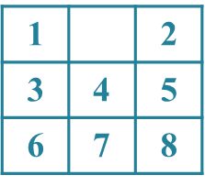
Hill Climbing Example
8-puzzle
Heuristic function is Manhattan Distance
-the sum of the distances of the tiles from their goal positions
1 | 4 | 2
 | 3 | 5
6 | 7 | 8
h = 3

Slide 11
Hill Climbing Example
8-puzzle
 | 4 | 2
1 | 3 | 5
6 | 7 | 8
Heuristic function is Manhattan Distance
h = 4
-the sum of the distances of the tiles from their goal positions
1 | 4 | 2
 | 3 | 5
6 | 7 | 8
1 | 4 | 2
3 |  | 5
6 | 7 | 8
h = 3
h = 2
1 | 4 | 2
6 | 3 | 5
 | 7 | 8
h = 4

Slide 12
Hill Climbing Example
8-puzzle
 | 4 | 2
1 | 3 | 5
6 | 7 | 8
1 | 4 | 2
 | 3 | 5
6 | 7 | 8
Heuristic function is Manhattan Distance
h = 4
h = 3
-the sum of the distances of the tiles from their goal positions
1 |  | 2
3 | 4 | 5
6 | 7 | 8
1 | 4 | 2
 | 3 | 5
6 | 7 | 8
1 | 4 | 2
3 |  | 5
6 | 7 | 8
h = 1
h = 3
h = 2
1 | 4 | 2
3 | 5
6 | 7 | 8
1 | 4 | 2
6 | 3 | 5
 | 7 | 8
h = 3
1 | 4 | 2
3 | 7 | 5
6 |  | 8
h = 4
h = 3

Slide 13

Hill Climbing Example
8-puzzle: a solution case
 | 4 | 2
1 | 3 | 5
6 | 7 | 8
1 | 4 | 2
 | 3 | 5
6 | 7 | 8
Heuristic function is Manhattan Distance
h = 4
h = 3
-the sum of the distances of the tiles from their goal positions
1 |  | 2
3 | 4 | 5
6 | 7 | 8
1 |  | 2
3 | 4 | 5
6 | 7 | 8
1 | 4 | 2
 | 3 | 5
6 | 7 | 8
1 | 4 | 2
3 |  | 5
6 | 7 | 8
h = 1
h = 0
h = 3
h = 2
1 | 4 | 2
3 | 5
6 | 7 | 8
1 | 4 | 2
6 | 3 | 5
 | 7 | 8
h = 3
1 | 4 | 2
3 | 7 | 5
6 |  | 8
h = 4
h = 3

Slide 14
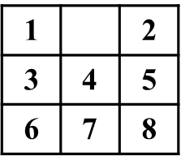
Hill Climbing Example
8-puzzle: stuck at local maximum
2 |  | 3
1 | 8 | 4
7 | 6 | 5
1 | 2 | 3
7 | 8 | 4
 | 6 | 5
Heuristic function is Manhattan Distance
h = 13
h = 12
 | 2 | 3
1 | 8 | 4
7 | 6 | 5
1 | 2 | 3
 | 8 | 4
7 | 6 | 5
 | 2 | 3
1 | 8 | 4
7 | 6 | 5
We are stuck with a local maximum.
h = 12
h = 11
h = 12
1 | 2 | 3
8 |  | 4
7 | 6 | 5
h = 12

Slide 15
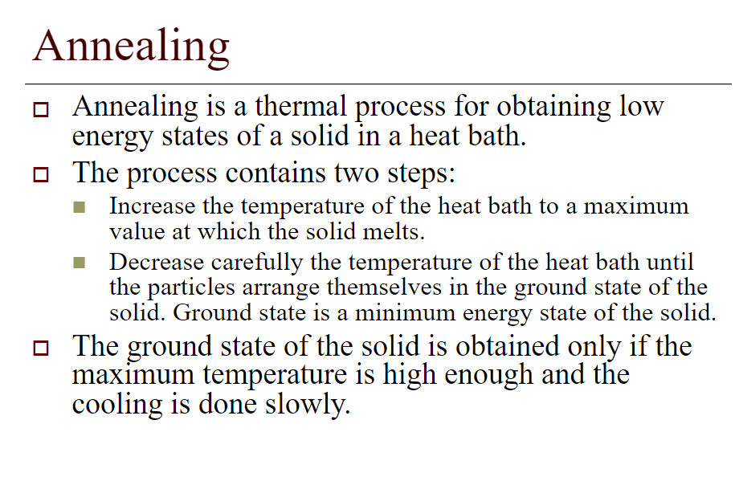

Slide 16
Simulated Annealing
A hill-climbing algorithm which never makes a move towards a lower value guaranteed to be incomplete because it can get stuck on a local maximum. And if algorithm applies a random walk, by moving a successor, then it may complete but not efficient. Simulated Annealing is an algorithm which yields both efficiency and completeness.
In mechanical term Annealing is a process of hardening a metal or glass to a high temperature then cooling gradually, so this allows the metal to reach a low-energy crystalline state. The same process is used in simulated annealing in which the algorithm picks a random move, instead of picking the best move. If the random move improves the state, then it follows the same path. Otherwise, the algorithm follows the path which has a probability of less than 1 or it moves downhill and chooses another path.

Slide 17
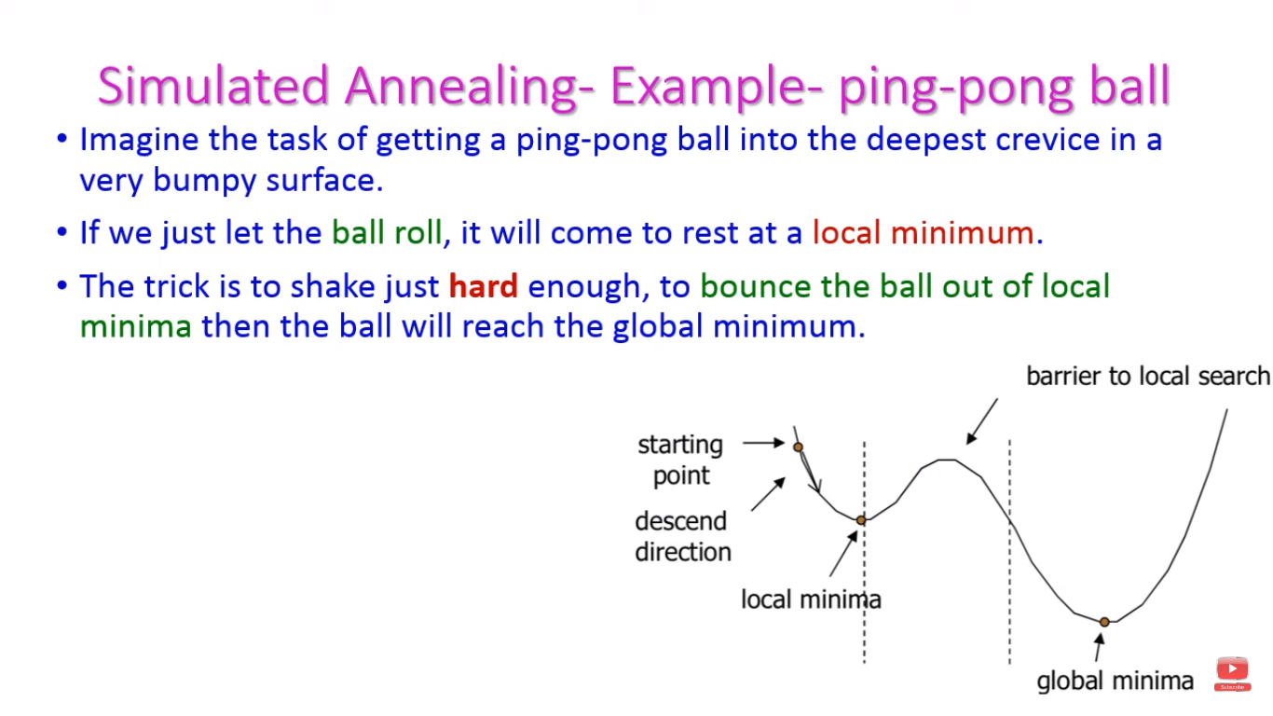

Slide 18
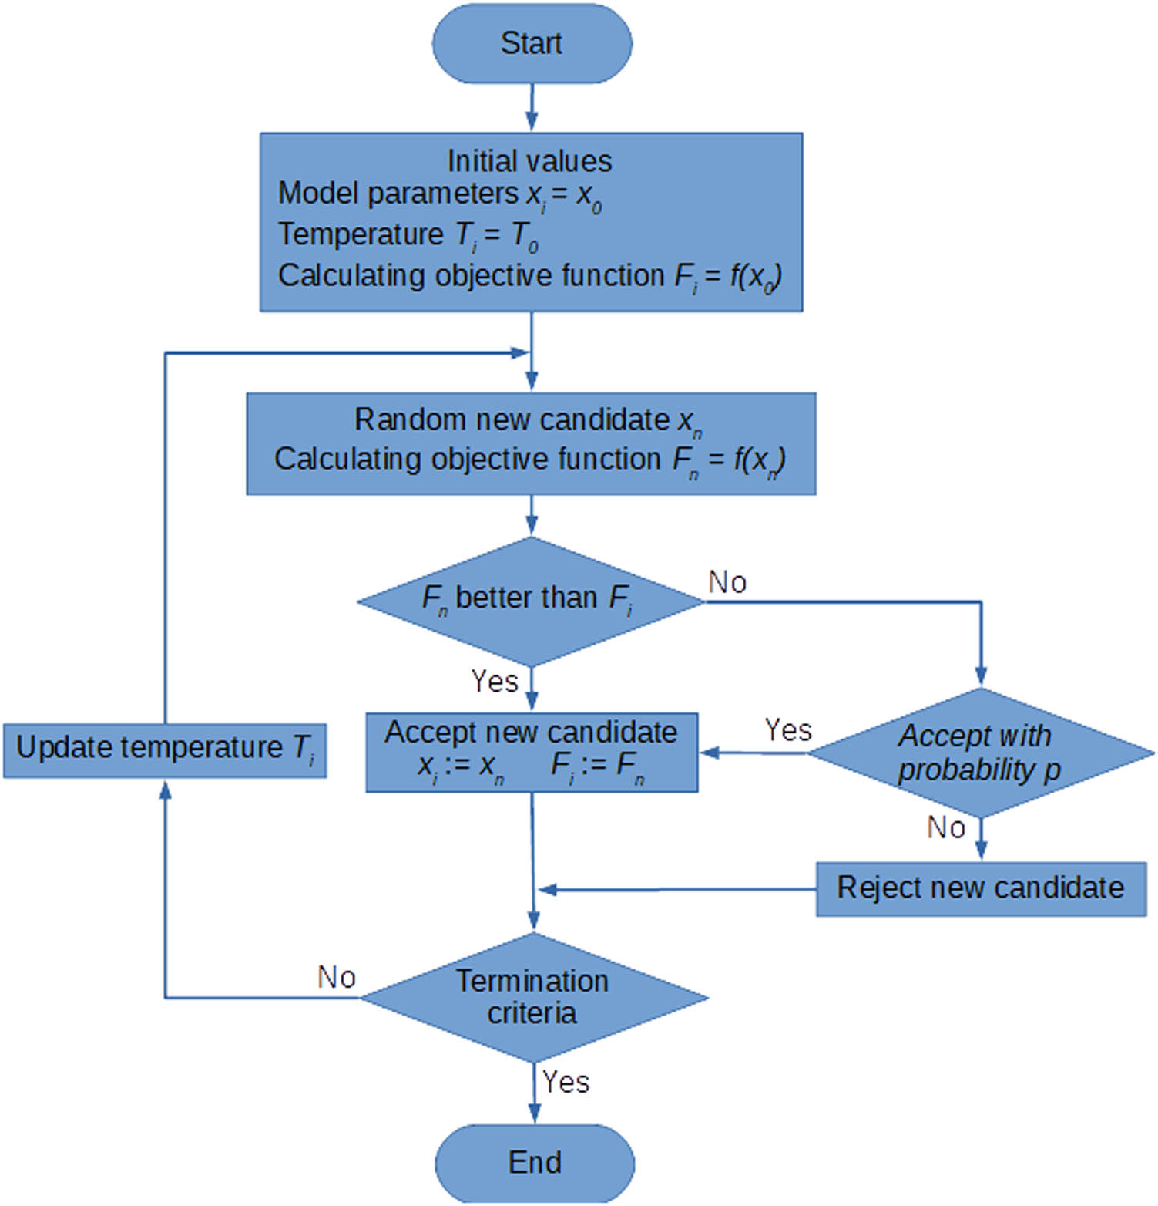

Slide 19
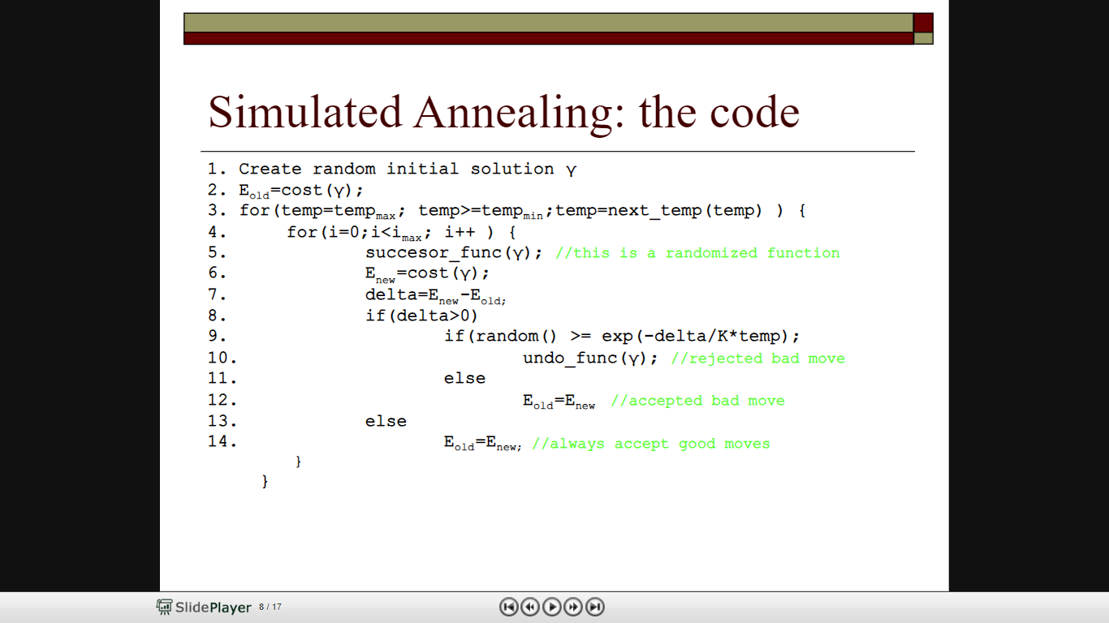

Slide 20
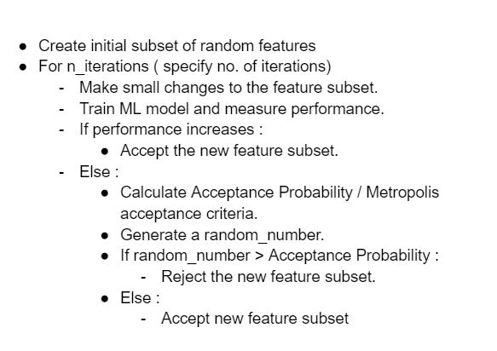
Use case of SA

Slide 21
